Slide 1
IMS Portable infrasound array in Côte d’Ivoire:
opportunity to study local and regional infrasound sources
K. Benjamin KOUASSI^{1,2*}, Fidele YOROBA^{1,2}, Adama DIAWARA^{1,2}
¹LAboratoire des Sciences de la Matière, de l'Environnement et de l'Energie Solaire (LASMES), UFR-SSMT, University FHB, 22 BP 582 Abidjan 22, Côte d’Ivoire.
²Station Geophysique de Lamto, BP 31 N’Douci, Cote d’Ivoire
P2.3-432
1- Introduction
In West Africa, we note a lack of infrasound stations that could allow improvement of events localization with I17CI (Côte d’Ivoire).
I17CI detection seems to be dominated by regional infrasound sources, while the IDC bulletins contain a limited number of events for the region.
The portable array (I68CI) helps to distinguish local and regional infrasound sources in the I17CI detection bulletins. Infrasound emission sources over West Africa are multiple (gravity waves, microbaroms, mines, thunderstorms, etc…)
In this work, we propose to analyze the origin of some local and regional infrasound sources detected by I17CI and the portable array I68CI located in the North-East of Cote d’Ivoire over twelve (12) months deployment in 2018.
2- Data and methods
The data used for this work come from CTBTO I17CI and portable array (168CI) from January to June 2018. The data processing is divided in three frequency bands : [0.1Hz - 1Hz] for the distant detections, [0.5Hz - 2.5Hz] for the regional detections and [2Hz - 4Hz] for the local detections
The PMCC method is to analyze the frequency content of infrasound signals. It is an automatic processing that measures geophysical parameters of an isolated signal and determines the characteristics and location of infrasound events

Slide 2
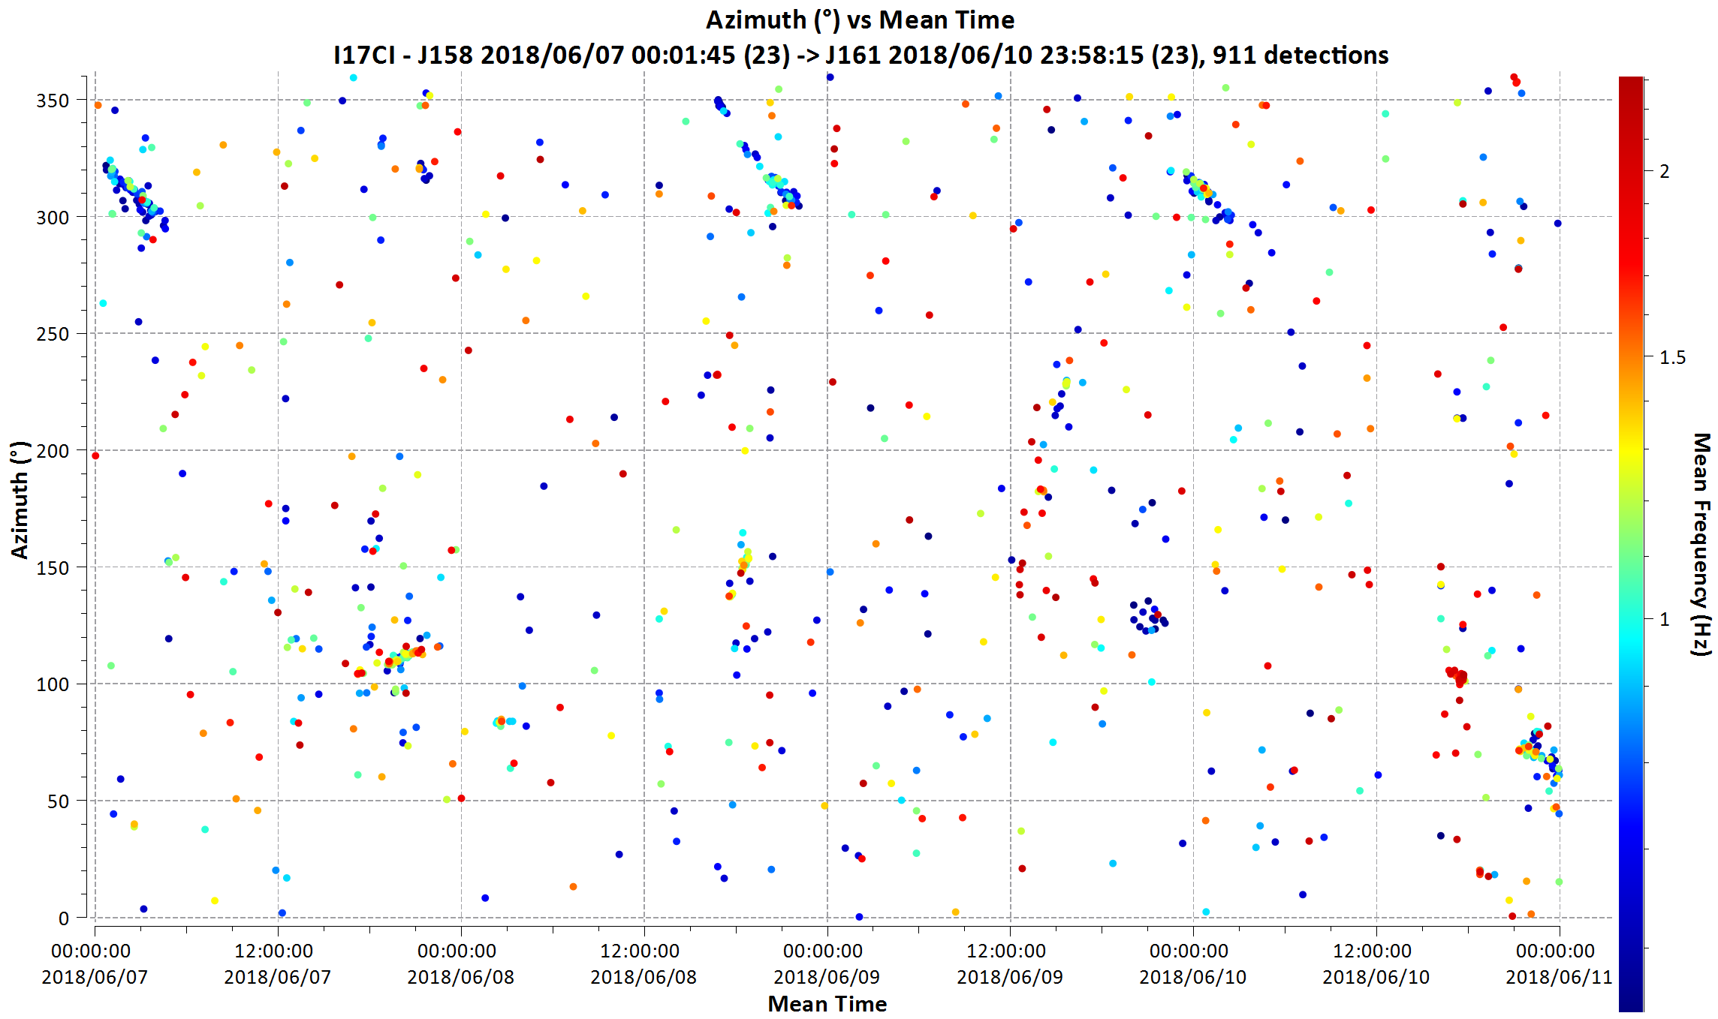
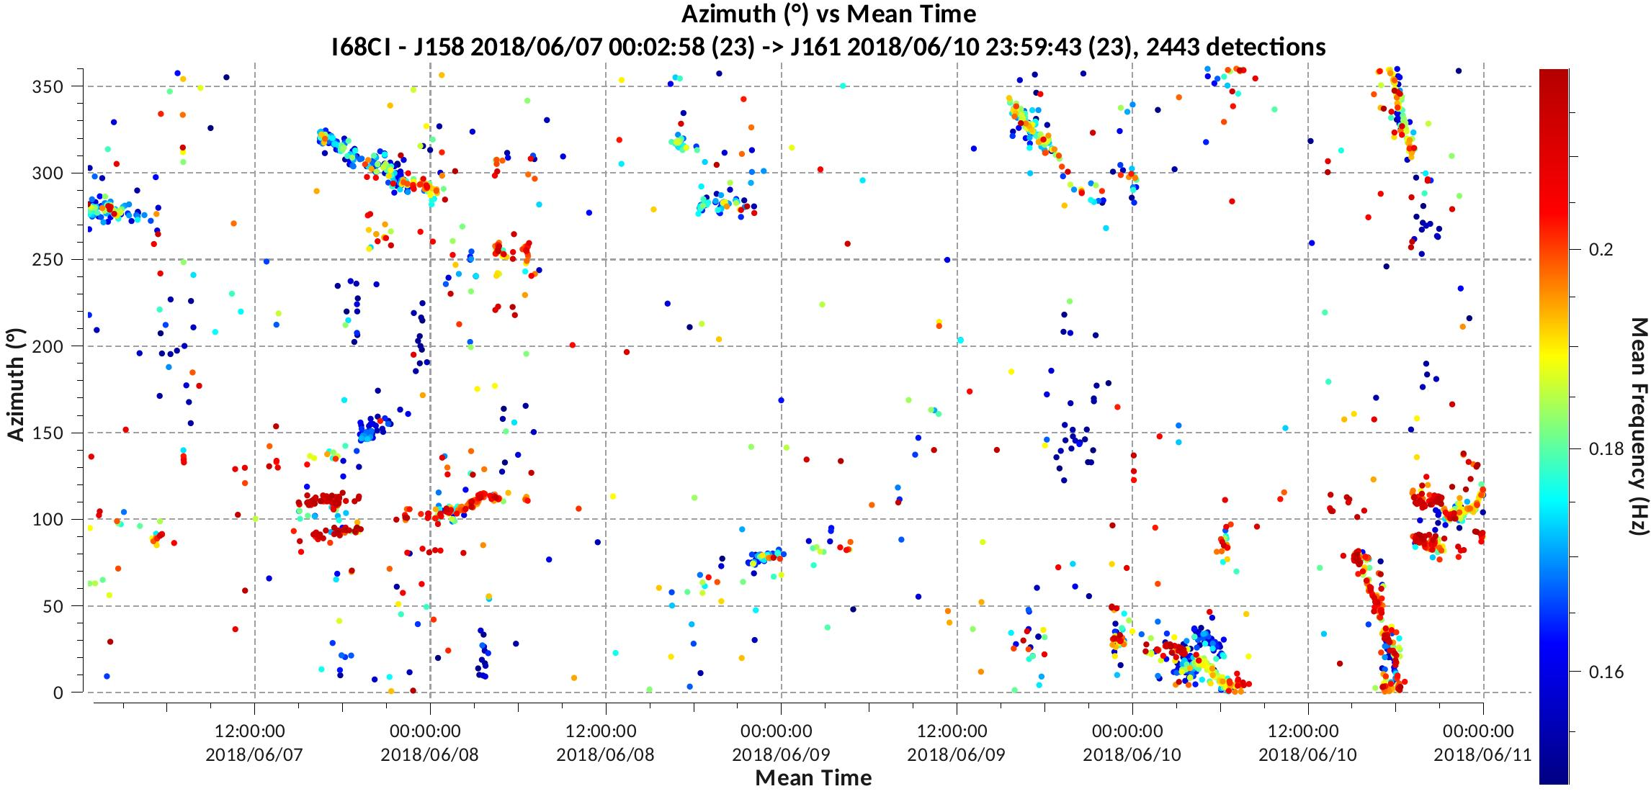
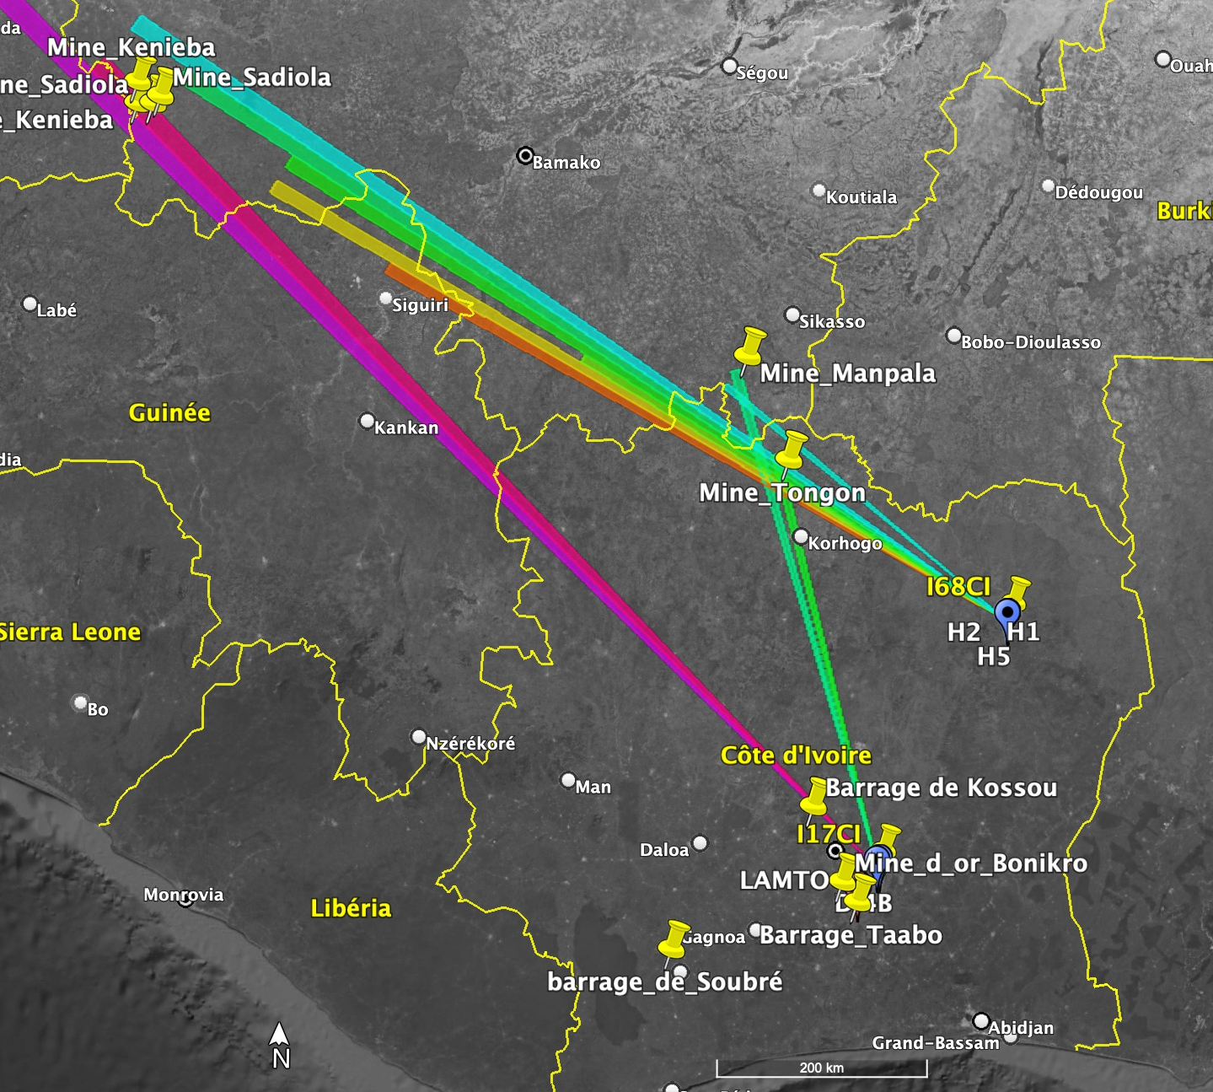
3- Results: Regional detections [0.5Hz – 2.5Hz] form I17CI and I68CI
I17CI
Figure 1: Detections from 7 to 11 June 2018 by I17CI (top) and the portable array I68CI (bottom).
I68CI
Figure 2: Azimuth projection of detections on Google Earth in the directions of a number of mines in West Africa, such as the Tongon mine (Côte d'Ivoire), Kenieba, Sadiola (west of Mali) and Manpala (south of Mali), Sabodala (Senegal).

Slide 3
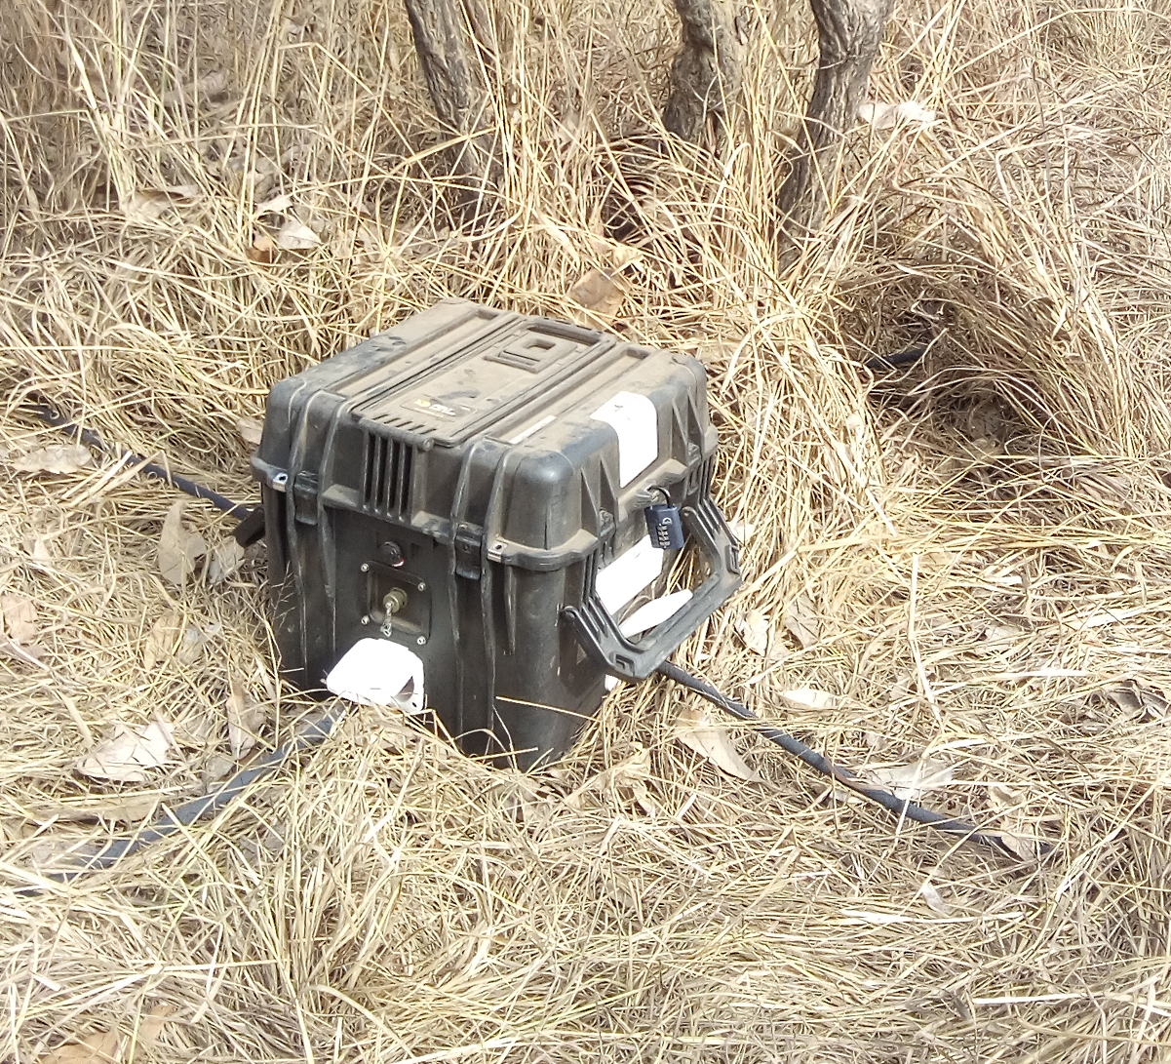
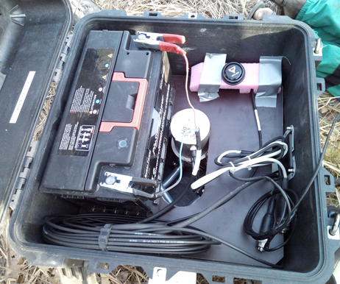
5- Conclusion
The portable array (I68CI) infrasound bulletins treatments allow us to find infrasound emission sources: Distant, Regional and Local sources of high and low frequencies. These sources are mines, hydroelectric dam, thunderstorms, microbaroms, etc…
The analysis of infrasound emission sources must consider the wind profiles that allow, depending on the wind direction, to have an idea of the station detectability areas. Indeed, the wind high altitude organization in a given direction is a waveguide for infrasound propagation. This analysis will be made later.
Portable Infrasound Array (I68CI)
Science and Technology 2023
19-23 June 2023
Vienna, Austria
1- Kouassi, K.B.; Yoroba, U.; Madu, F.O.; Diawara, A.; Kouadio, K.; Yao, P.A. Understanding the Split Characteristics of the Tropical Mesoscale Convective System (MCS) of April 9, 2018, in Northern Ghana Using Infrasound Data. Atmos. Clim. Sci.2021,11,104577. [CrossRef]

