Slide 1
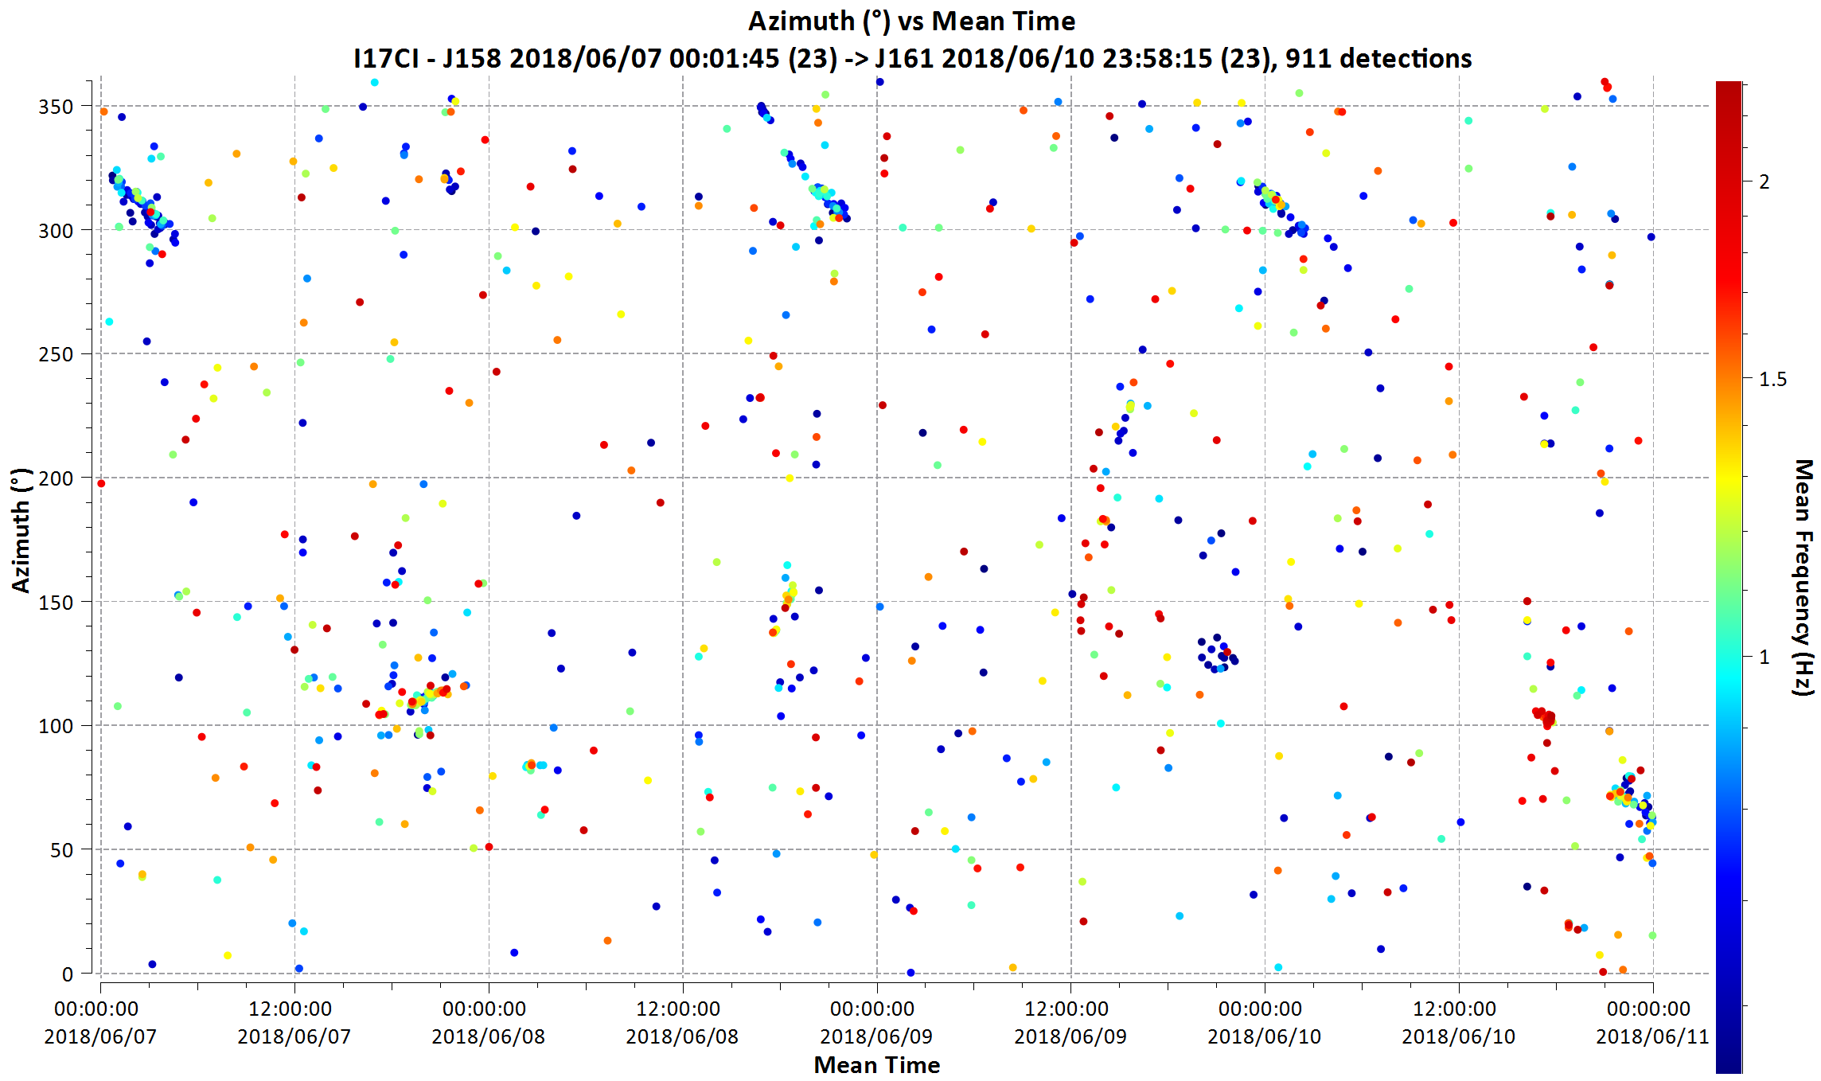
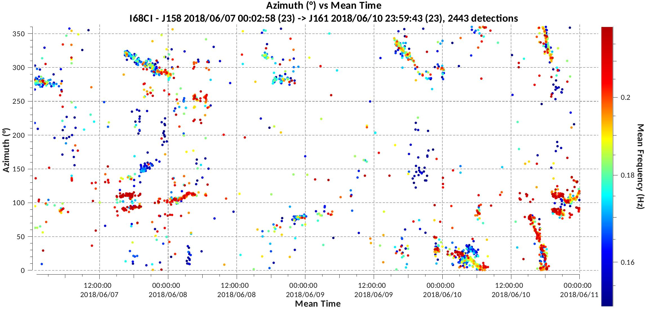
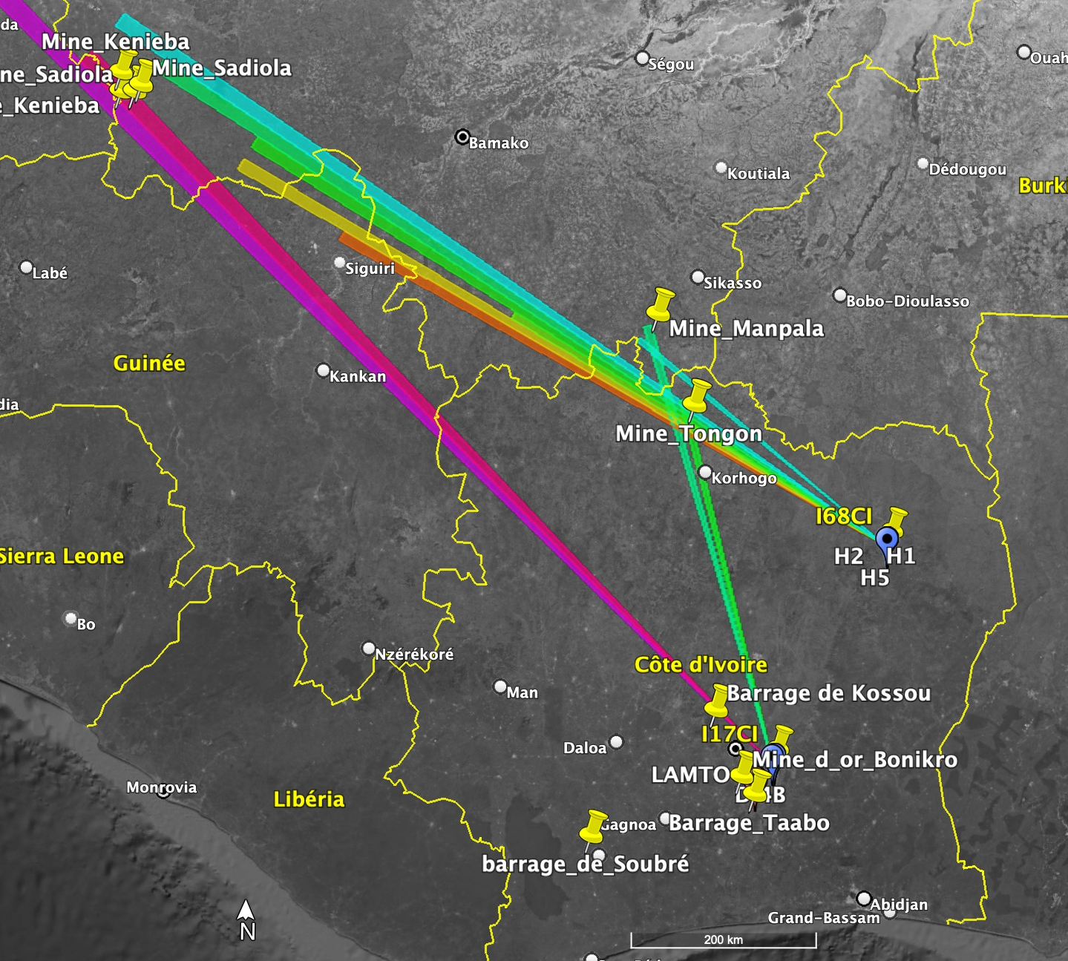
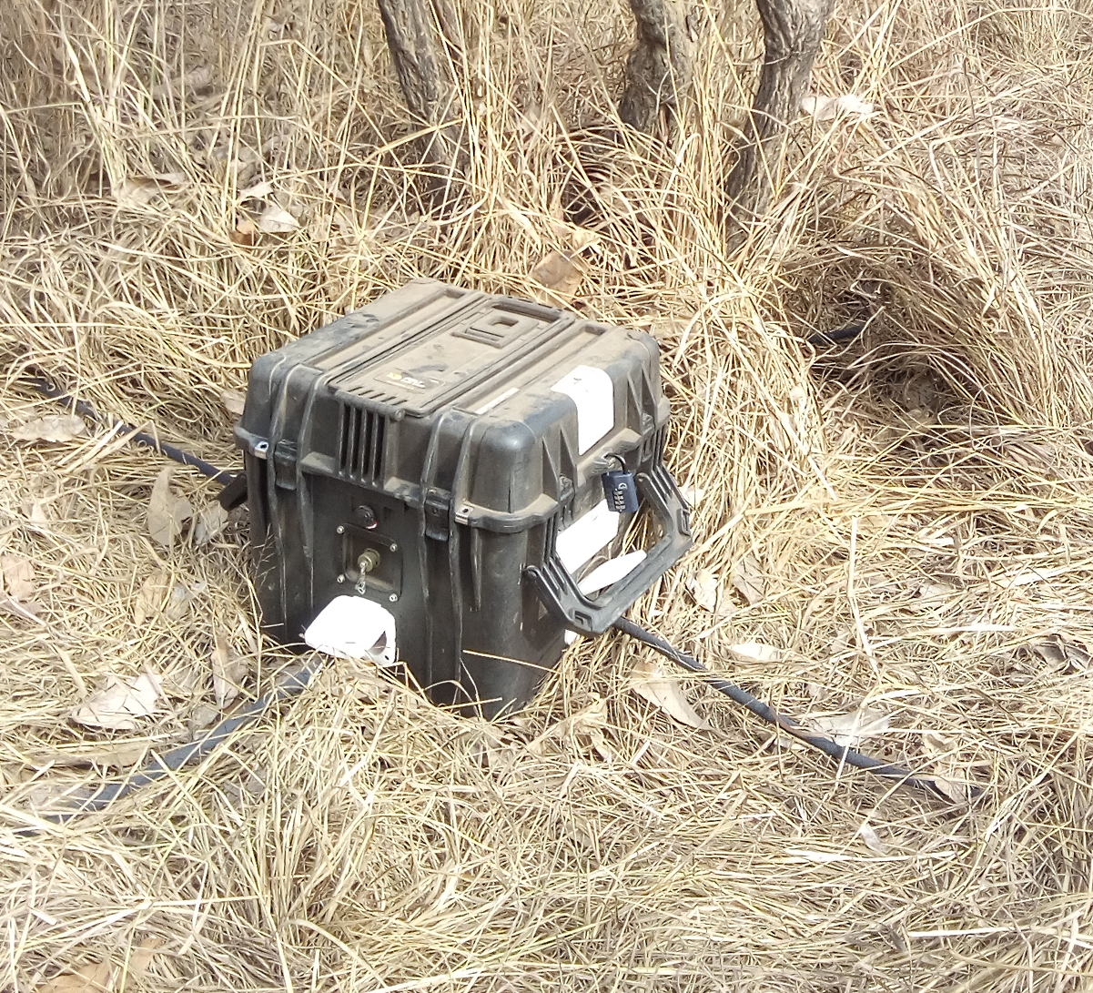
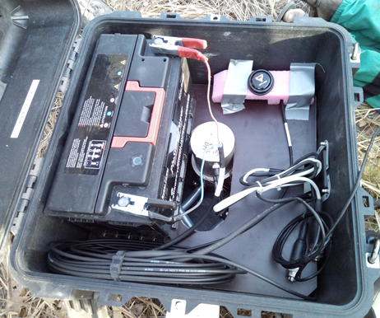
IMS Portable infrasound array in Côte d’Ivoire:
opportunity to study local and regional infrasound sources
Geophysical Station of LAMTO
K. Benjamin KOUASSI^{1,2*}, Fidele YOROBA^{1,2}, Adama DIAWARA^{1,2}
¹LAboratoire des Sciences de la Matière, de l'Environnement et de l'Energie Solaire (LASMES), UFR-SSMT, University FHB, 22 BP 582 Abidjan 22, Côte d’Ivoire.
²Station Geophysique de Lamto, BP 31 N’Douci, Cote d’Ivoire
Abstract : Côte d’Ivoire NDC and PTS have installed a portable infrasound network (I68CI) from mid-January to December 2018 in the Comoé National Park located Northeast Côte d’Ivoire. This mobile station includes 4 sensors and use MB3d microbarometers with 50 Hz sampling frequency. The main objective of this one-year deployment is to better understand and characterize regional infrasound sources.
Some regional and local infrasound sources are detected with combination of both the mobile array (I68CI) et fixed array (I17CI). Among these sources, we note Mbembele (Mali) and Tongon (Cote d’Ivoire) mines activities. Hydroelectric power dams (Buyo, Soubré and Taabo) activities are also detected in Cote d’Ivoire.
The split characteristics of the tropical Mesoscale Convective System (MCS) of April 9, 2018 in northern Ghana is also investigated using the mobile array (I68CI) measured data.
Abstract : Côte d’Ivoire NDC and PTS have installed a portable infrasound network (I68CI) from mid-January to December 2018 in the Comoé National Park located Northeast Côte d’Ivoire. This mobile station includes 4 sensors and use MB3d microbarometers with 50 Hz sampling frequency. The main objective of this one-year deployment is to better understand and characterize regional infrasound sources.
Some regional and local infrasound sources are detected with combination of both the mobile array (I68CI) et fixed array (I17CI). Among these sources, we note Mbembele (Mali) and Tongon (Cote d’Ivoire) mines activities. Hydroelectric power dams (Buyo, Soubré and Taabo) activities are also detected in Cote d’Ivoire.
The split characteristics of the tropical Mesoscale Convective System (MCS) of April 9, 2018 in northern Ghana is also investigated using the mobile array (I68CI) measured data.
1- Introduction
4- Results
In West Africa, we note a lack of infrasound stations that could allow improvement of events localization with I17CI (Côte d’Ivoire).
I17CI detection seems to be dominated by regional infrasound sources, while the IDC bulletins contain a limited number of events for the region.
The portable array (I68CI) helps to distinguish local and regional infrasound sources in the I17CI detection bulletins. Infrasound emission sources over West Africa are multiple (gravity waves, microbaroms, mines, thunderstorms, etc…)
In this work, we propose to analyze the origin of some local and regional infrasound sources detected by I17CI and the portable array I68CI located in the North-East of Cote d’Ivoire over twelve (12) months deployment in 2018.
4- Results
Regional detections [0.5Hz – 2.5Hz] form I17CI and I68CI
I17CI
I68CI
2- Data and methods
The data used for this work come from CTBTO I17CI and portable array (168CI) from January to June 2018. The data processing is divided in three frequency bands : [0.1Hz - 1Hz] for the distant detections, [0.5Hz - 2.5Hz] for the regional detections and [2Hz - 4Hz] for the local detections
The PMCC method is to analyze the frequency content of infrasound signals. It is an automatic processing that measures geophysical parameters of an isolated signal and determines the characteristics and location of infrasound events
Figure 1: Detections from 7 to 11 June 2018 by I17CI (top) and the portable array I68CI (bottom).
3- DTK-GPMCC and DTK-DIVA software
The software used for data processing are DTK-GPMCC and DTK-DIVA made available by the CTBTO.
GPMCC is an interactive graphic software that visualizes and analyzes data. It processes signals in multiple formats (wfdisc, Fonyx, miniSEED and ASCII) and generates a bulletin at the end of treatment.
DTK-DIVA is a visualization tool and processing Infrasound bulletins longer period.
Portable Infrasound Array (I68CI)
Figure 2: Azimuth projection of detections on Google Earth in the directions of a number of mines in West Africa, such as the Tongon mine (Côte d'Ivoire), Kenieba, Sadiola (west of Mali) and Manpala (south of Mali), Sabodala (Senegal).
5- Conclusion
The portable array (I68CI) infrasound bulletins treatments allow us to find infrasound emission sources: Distant, Regional and Local sources of high and low frequencies. These sources are mines, hydroelectric dam, thunderstorms, microbaroms, etc…
The analysis of infrasound emission sources must consider the wind profiles that allow, depending on the wind direction, to have an idea of the station detectability areas. Indeed, the wind high altitude organization in a given direction is a waveguide for infrasound propagation. This analysis will be made later.
Science and Technology 2023
19-23 June 2023
Vienna, Austria
1- Kouassi, K.B.; Yoroba, U.; Madu, F.O.; Diawara, A.; Kouadio, K.; Yao, P.A. Understanding the Split Characteristics of the Tropical
Mesoscale Convective System (MCS) of April 9, 2018, in Northern Ghana Using Infrasound Data. Atmos. Clim. Sci.2021,11,104577. [CrossRef]

