Slide 1
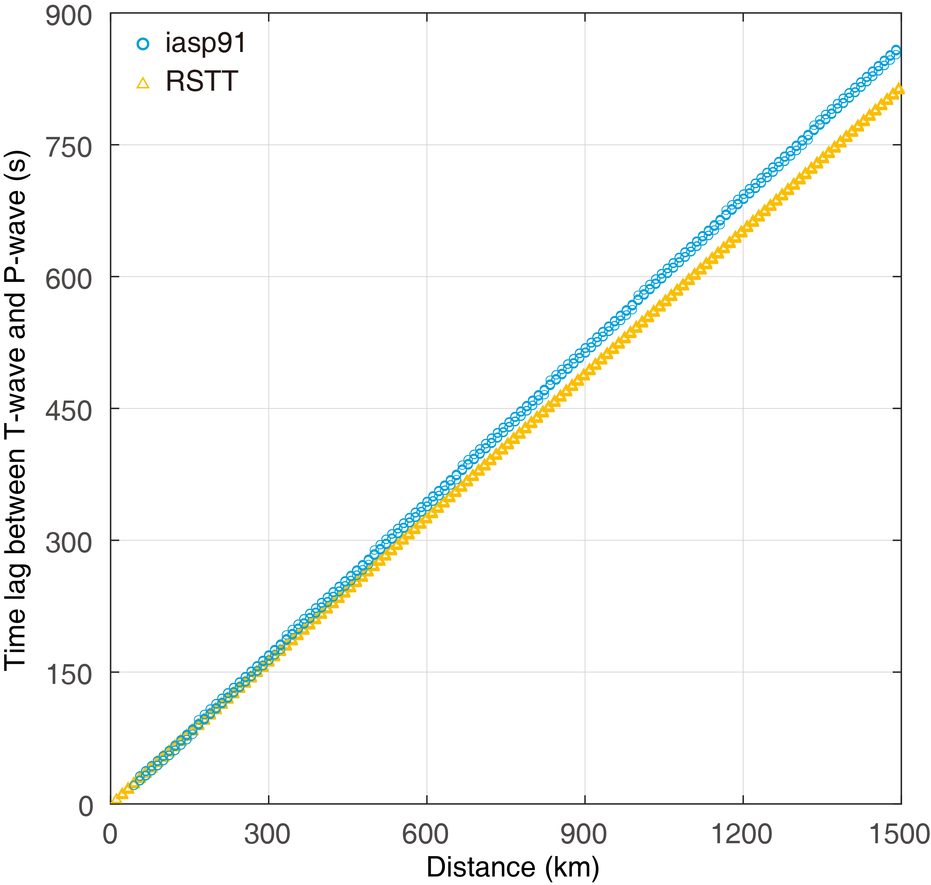
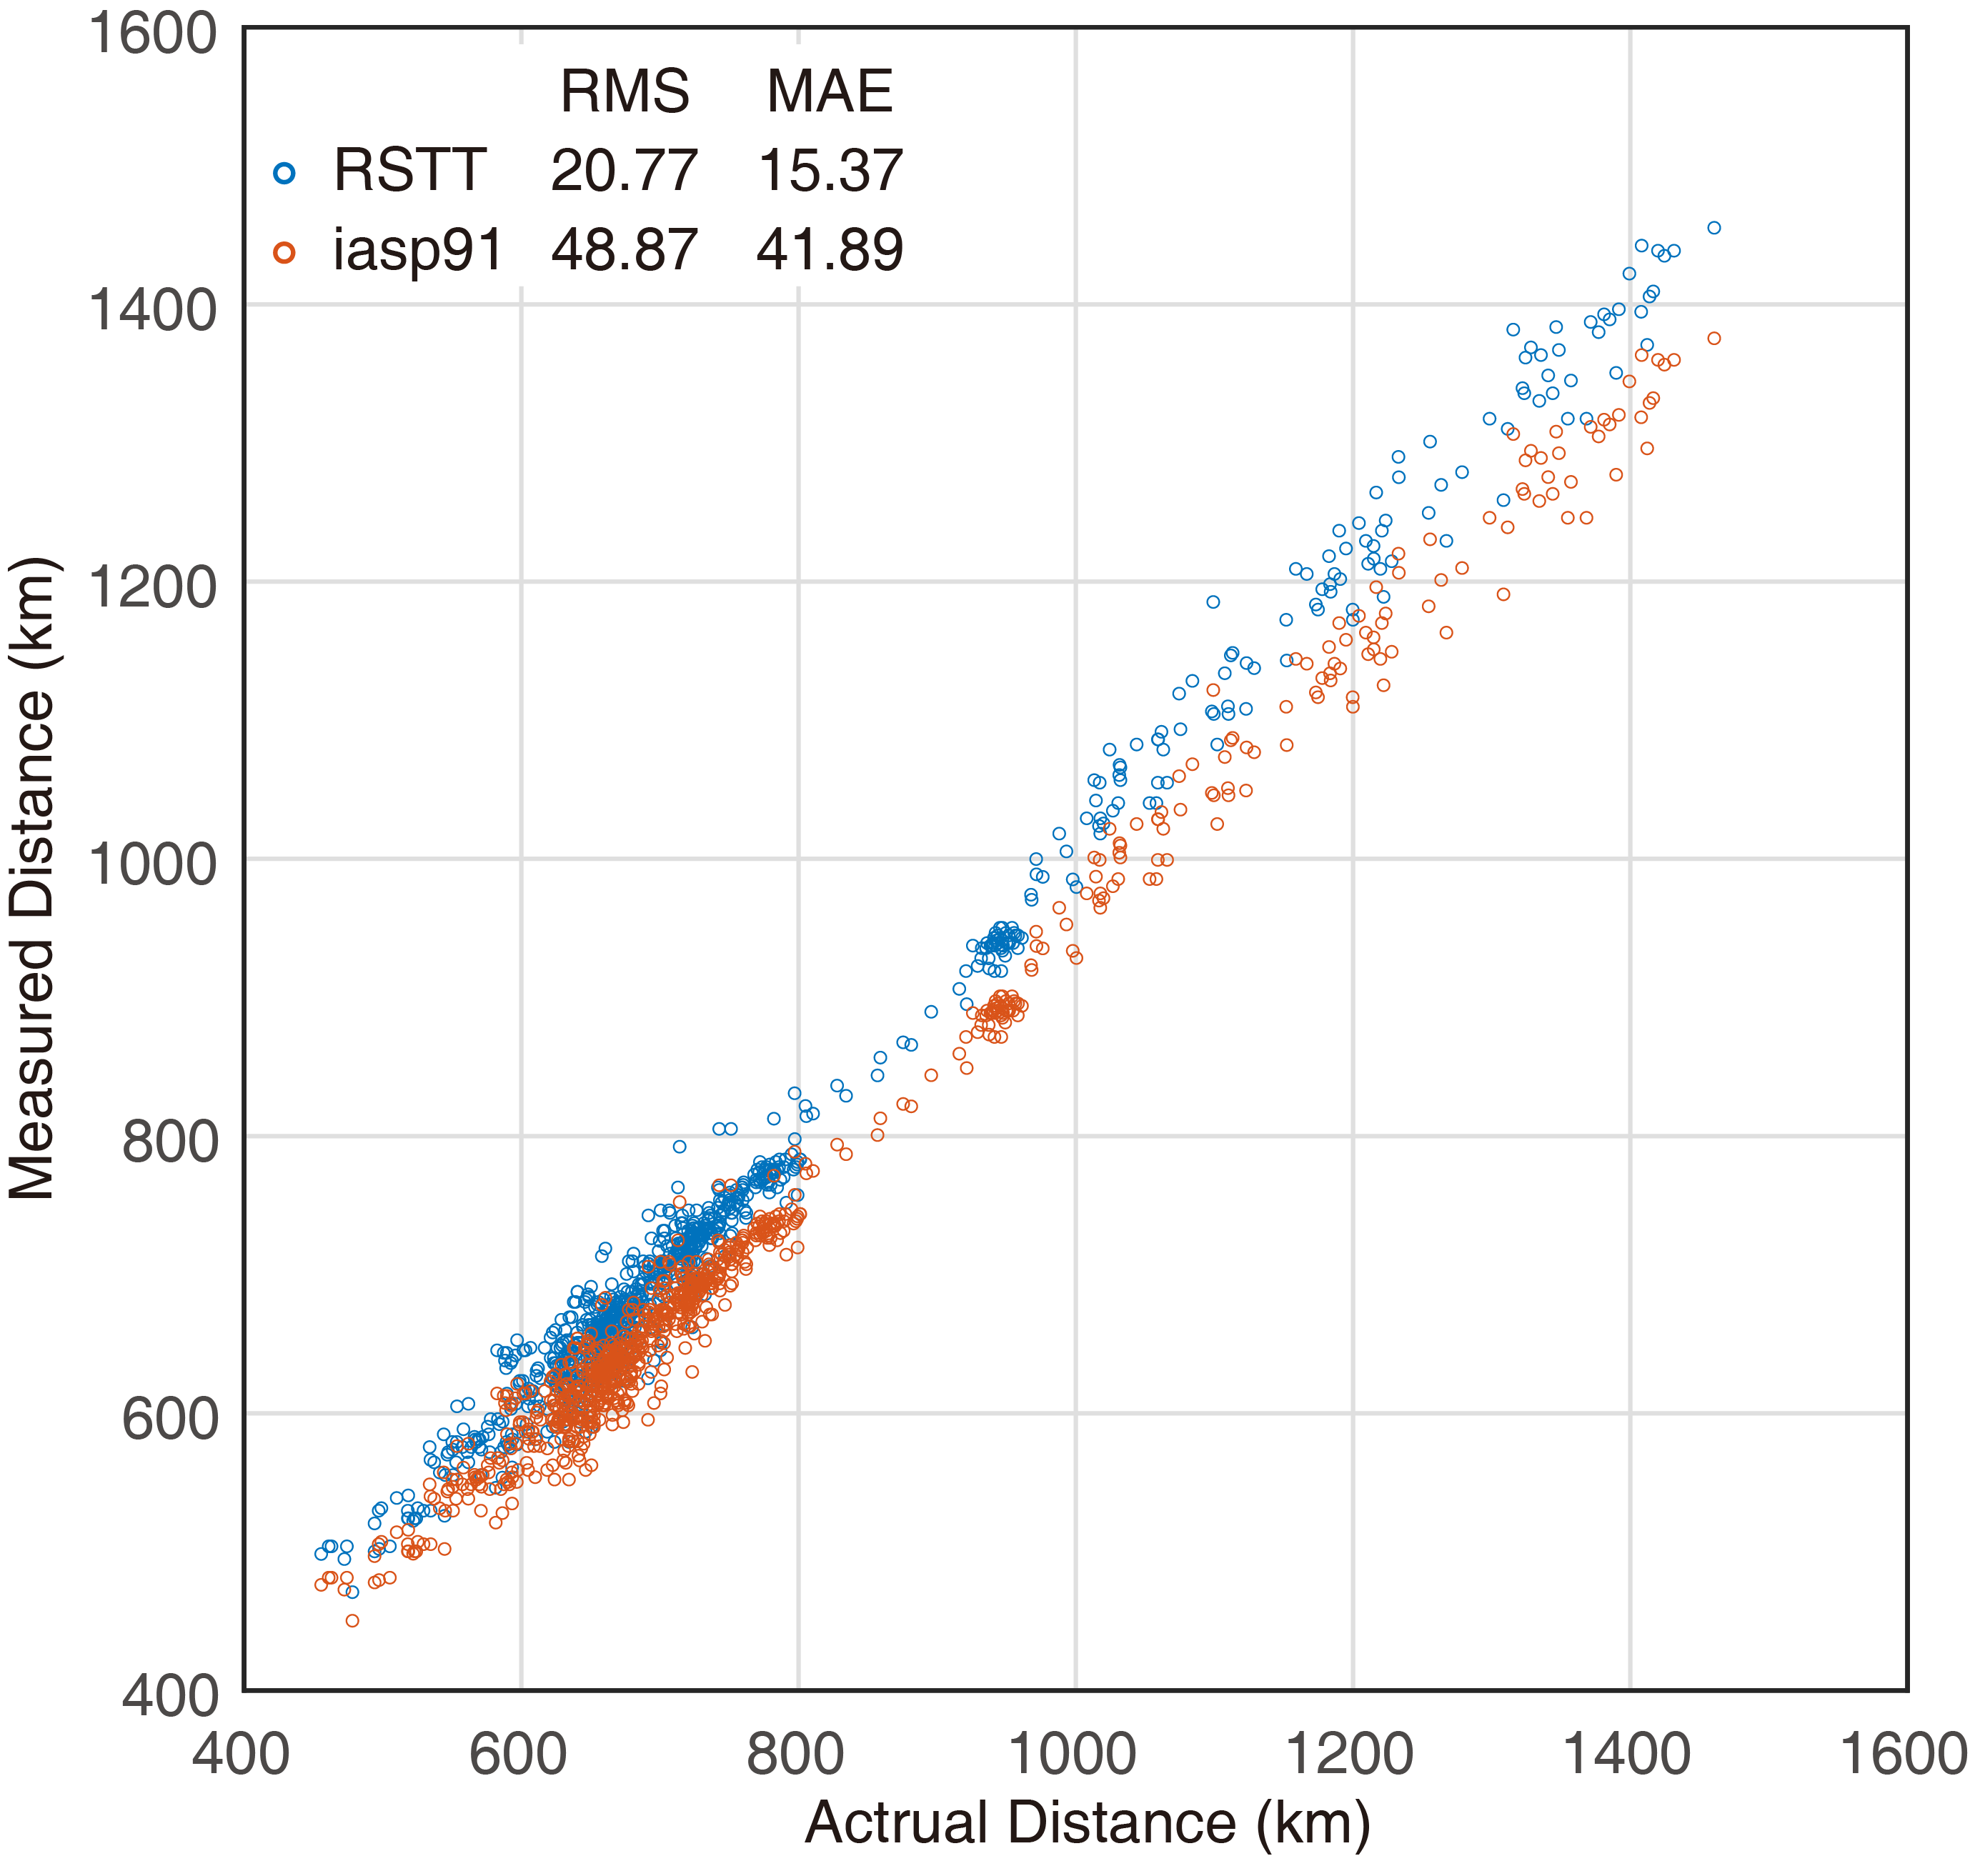
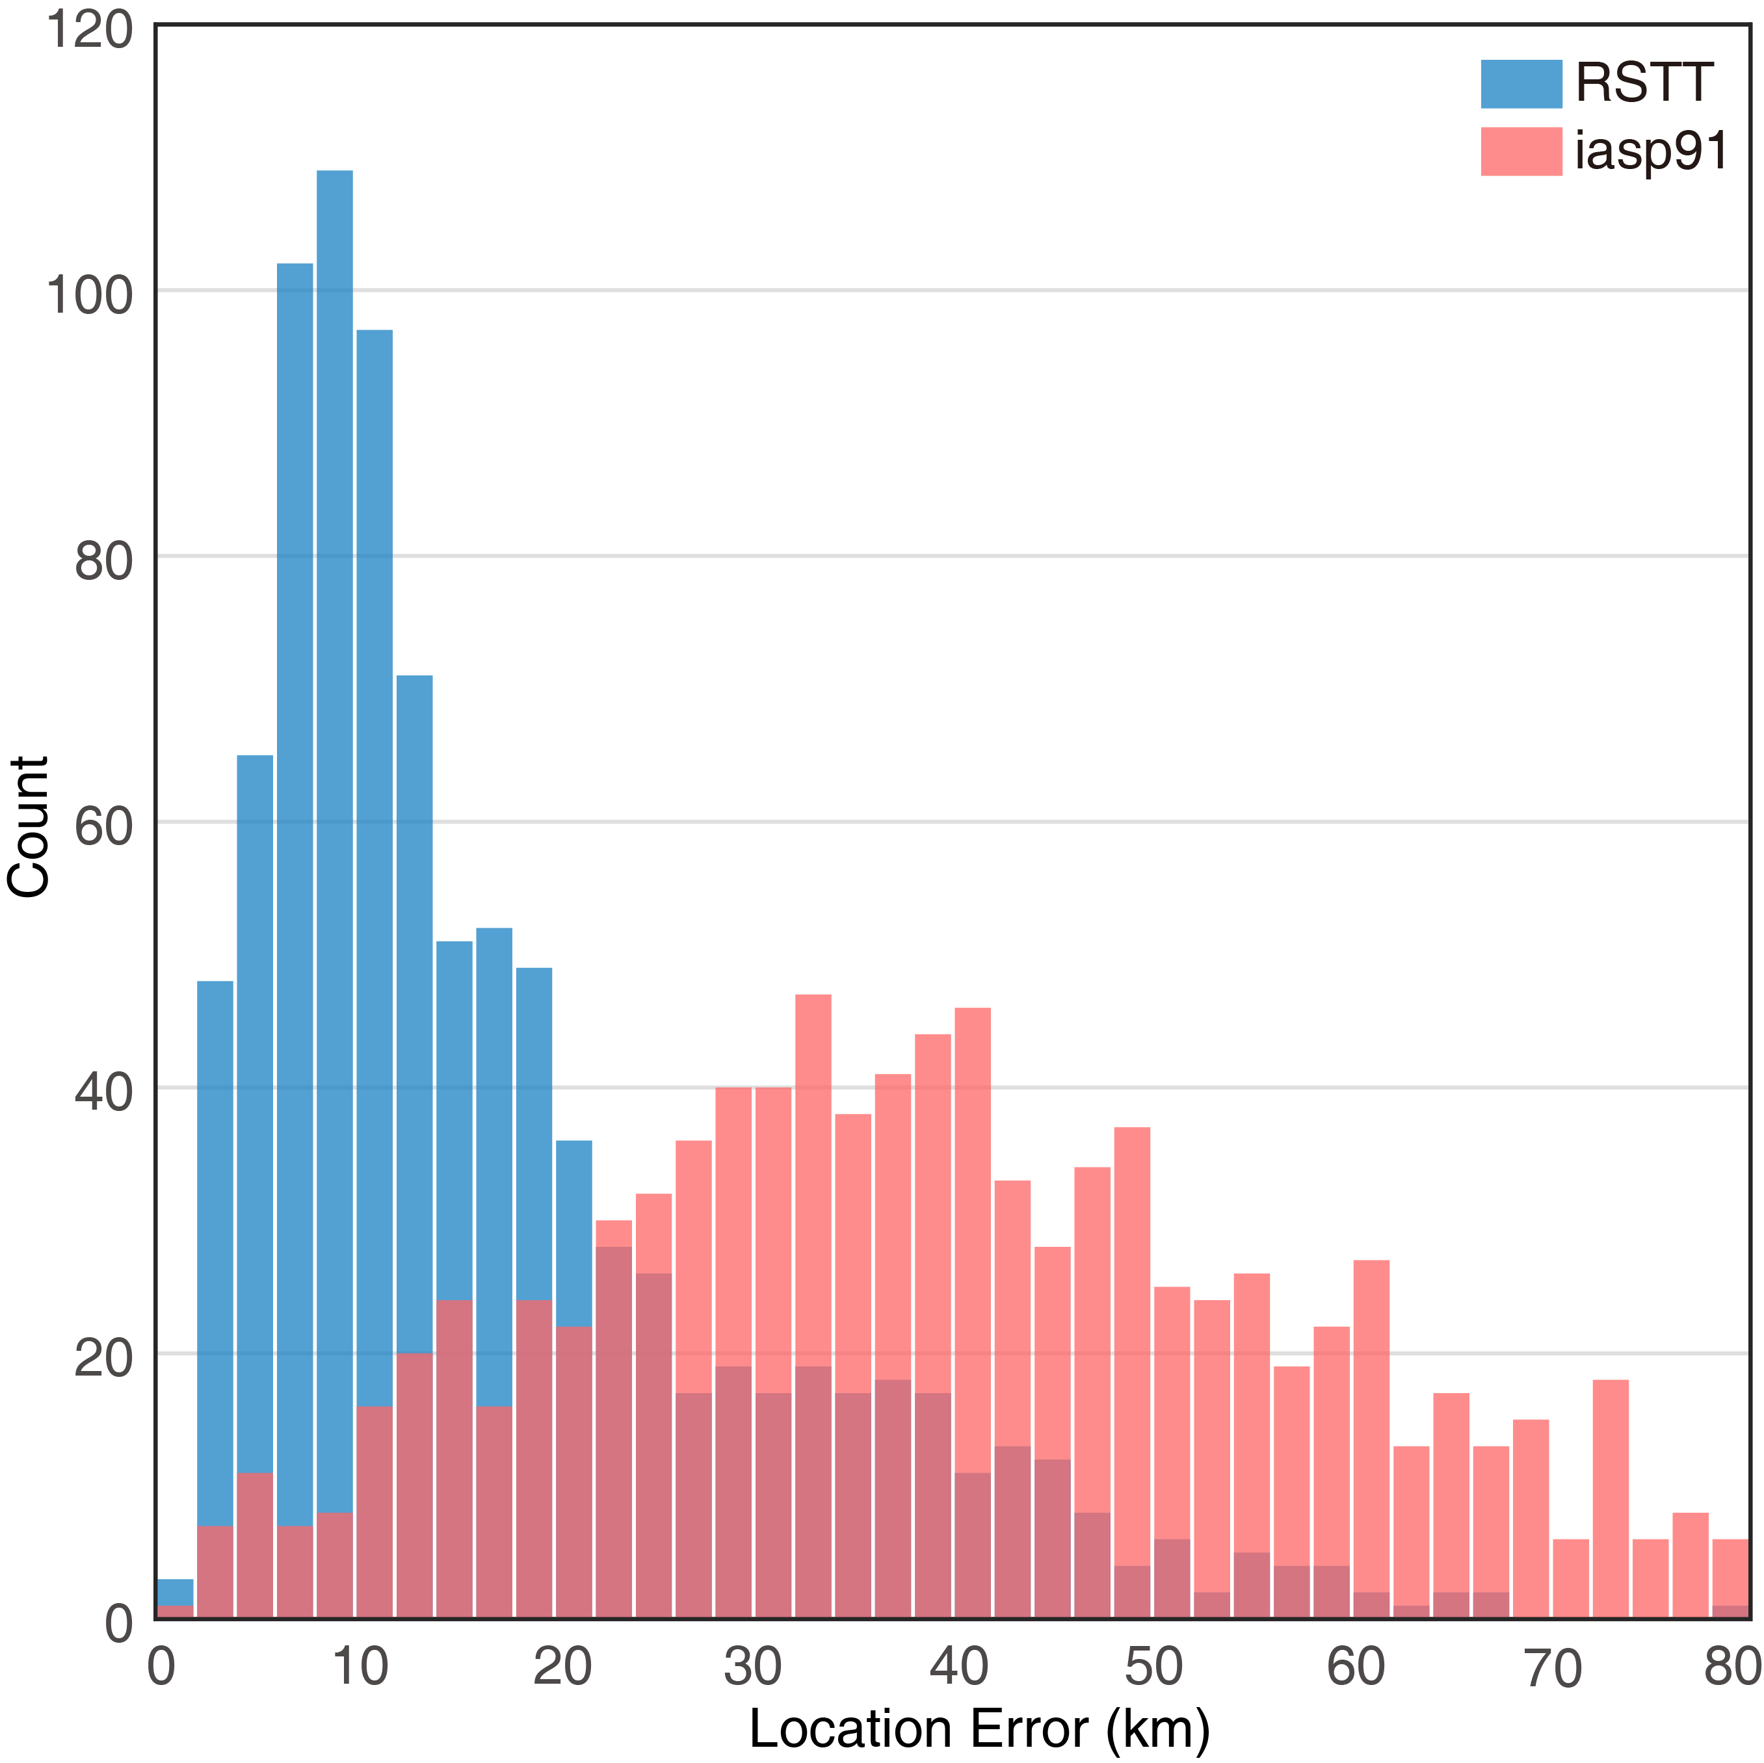
Localization of submarine earthquake with a single hydrophone triplet using multipath time delays in the deep ocean
Wei Shiyan, Yang Yanming, Ran Hailin
Third Institute of Oceanography, Ministry of Natural Resources, Xiamen, China
P2.3-377
This paper proposes a model between the time difference of P-waves and T-waves and the distance from the earthquake source to the hydrophone. The model coefficients are fitted by using existing seismic wave propagation time models, iasp91 and RSTT. The distance from the source to the hydrophone is set to 0 km ~1500 km with a step size of 10 km. Two hydrophone arrays H03N and H03S of the CTBTO-IMS at San Juan Island, South Pacific, were used to monitor 939 submarine earthquakes (M≥ 4) during 2014-2020. The results of the RSTT-based model are better than those of the iasp91-based model. The root mean square and mean absolute error are 20.77, 15.37 (RSTT) and 48.87, 41.89 (iasp91). Combined with the azimuth results, the earthquake has been located. The comparison of the position errors shows that the model based on RSTT is much better than the model based on iasp91. The average position error is better than 20 km.

