Slide 1
Localization of submarine earthquake with a single hydrophone triplet using multipath time delays in the deep ocean
Wei Shiyan, Yang Yanming, Ran Hailin
Third Institute of Oceanography, Ministry of Natural Resources, Xiamen, China
IMS H-phase stations have great potential for submarine earthquake monitoring in the Southern Hemisphere. The hydrophones would be able to record low frequency sounds from large areas. However, some seismic signals from different areas would have similar characteristics in a short time interval. It is difficult to locate the epicenter using only the azimuth and arrival time of the hydrophone triplet.
A submarine seismic location model was built based on the time delay of the P-wave and T-wave at a hydrophone to obtain the sound propagation distance. Hydrophone data recorded from 2014 to 2020 by two hydrophone triplets of the IMS hydroacoustic station HA03 located in the Juan Fernandez Islands were used.
The results of the RSTT based model are better than the iasp91 based model. The average position error of the RSTT model is better than 20 km.
A novel approach to submarine earthquake localization using only a single hydrophone triplet is presented in this paper. This method, especially when seismic network monitoring is ineffective, is applicable to the localization of submarine earthquakes in the Southern Hemisphere.
Please do not use this space, a QR code will be automatically overlayed
P2.3-377

Slide 2
Introduction
T-waves generated by earthquakes can be used to study large-scale ocean thermometry. OBH, hydroacoustic stations of the International Monitoring System (IMS) of the Comprehensive Nuclear-Test-Ban Treaty Organization (CTBTO), SIRENA arrays, etc. are typically used as T-wave observing systems. Based on the position of the observation systems, the arrival time and azimuth of the T-wave are estimated. The signals recorded by the hydrophones correspond to the seismic bulletin provided by the global seismic network. Seismic signals are mainly in the low frequency range and can propagate long distances along the deep ocean SOFAR channel. It is inevitable that the recorded hydrophone data will contain similar seismic signals. Wave velocity measurements are imprecise. It is unreliable to use only bearing and arrival time information to match seismic and hydrophone signals. Therefore, based on the seismic wave propagation time model, we propose a method to estimate the distance between the earthquake and the hydrophone using a single hydrophone. Two hydrophone arrays of the CTBTO-IMS on San Juan Island are used as hydroacoustic observing systems. Submarine earthquakes in the South Pacific are used to validate the method.
Please do not use this space, a QR code will be automatically overlayed
P2.3-377

Slide 3
Objectives
The hydroacoustic observatory system has been successfully used to monitor submarine earthquakes in the Southern Hemisphere.
Seismic signals propagate along different paths to the hydrophone. Because of medium sound speed are different, the wave propagation times are also different. In this paper, we proposed a distance estimation method with a single hydrophone based on the difference of the propagation times.
The arrival times of P-waves and T-waves were accurately detected. The submarine earthquakes were located by using the IMS hydrophone triplet.
Based on the seismic information from the global seismic network, we established corresponding relationships between the hydrophone signals and the seismic bulletin.
Please do not use this space, a QR code will be automatically overlayed
P2.3-377

Slide 4
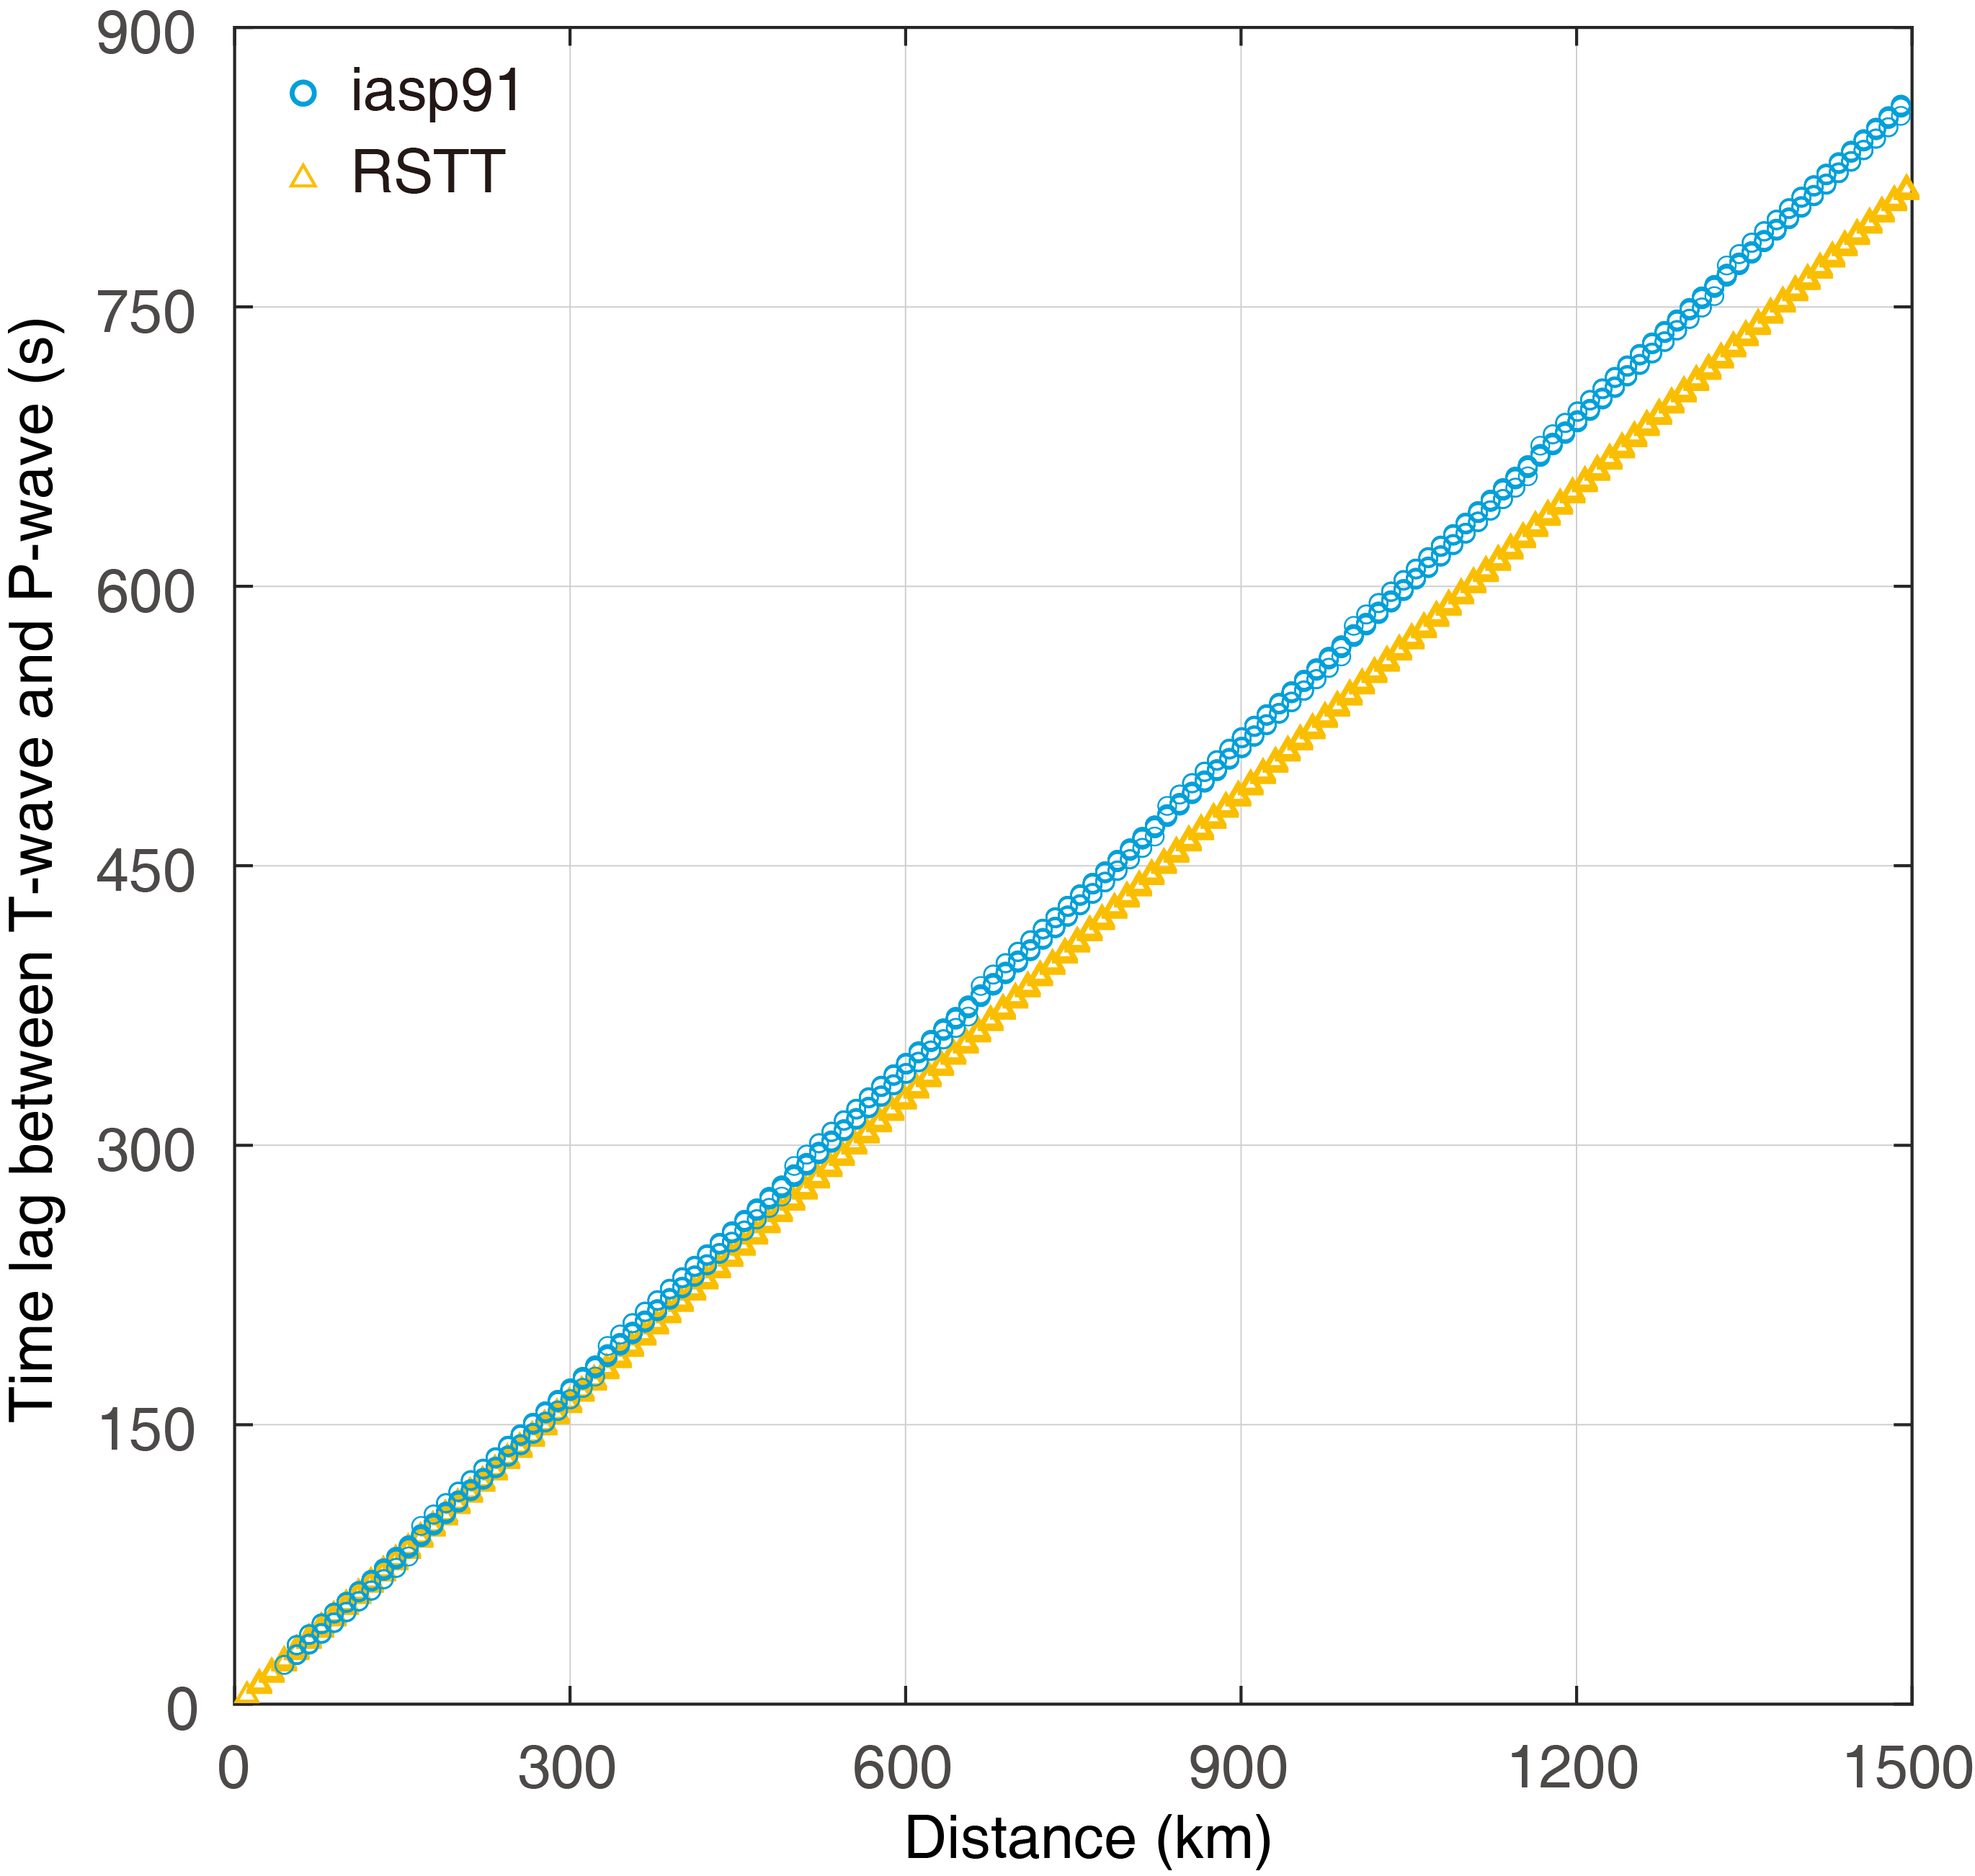
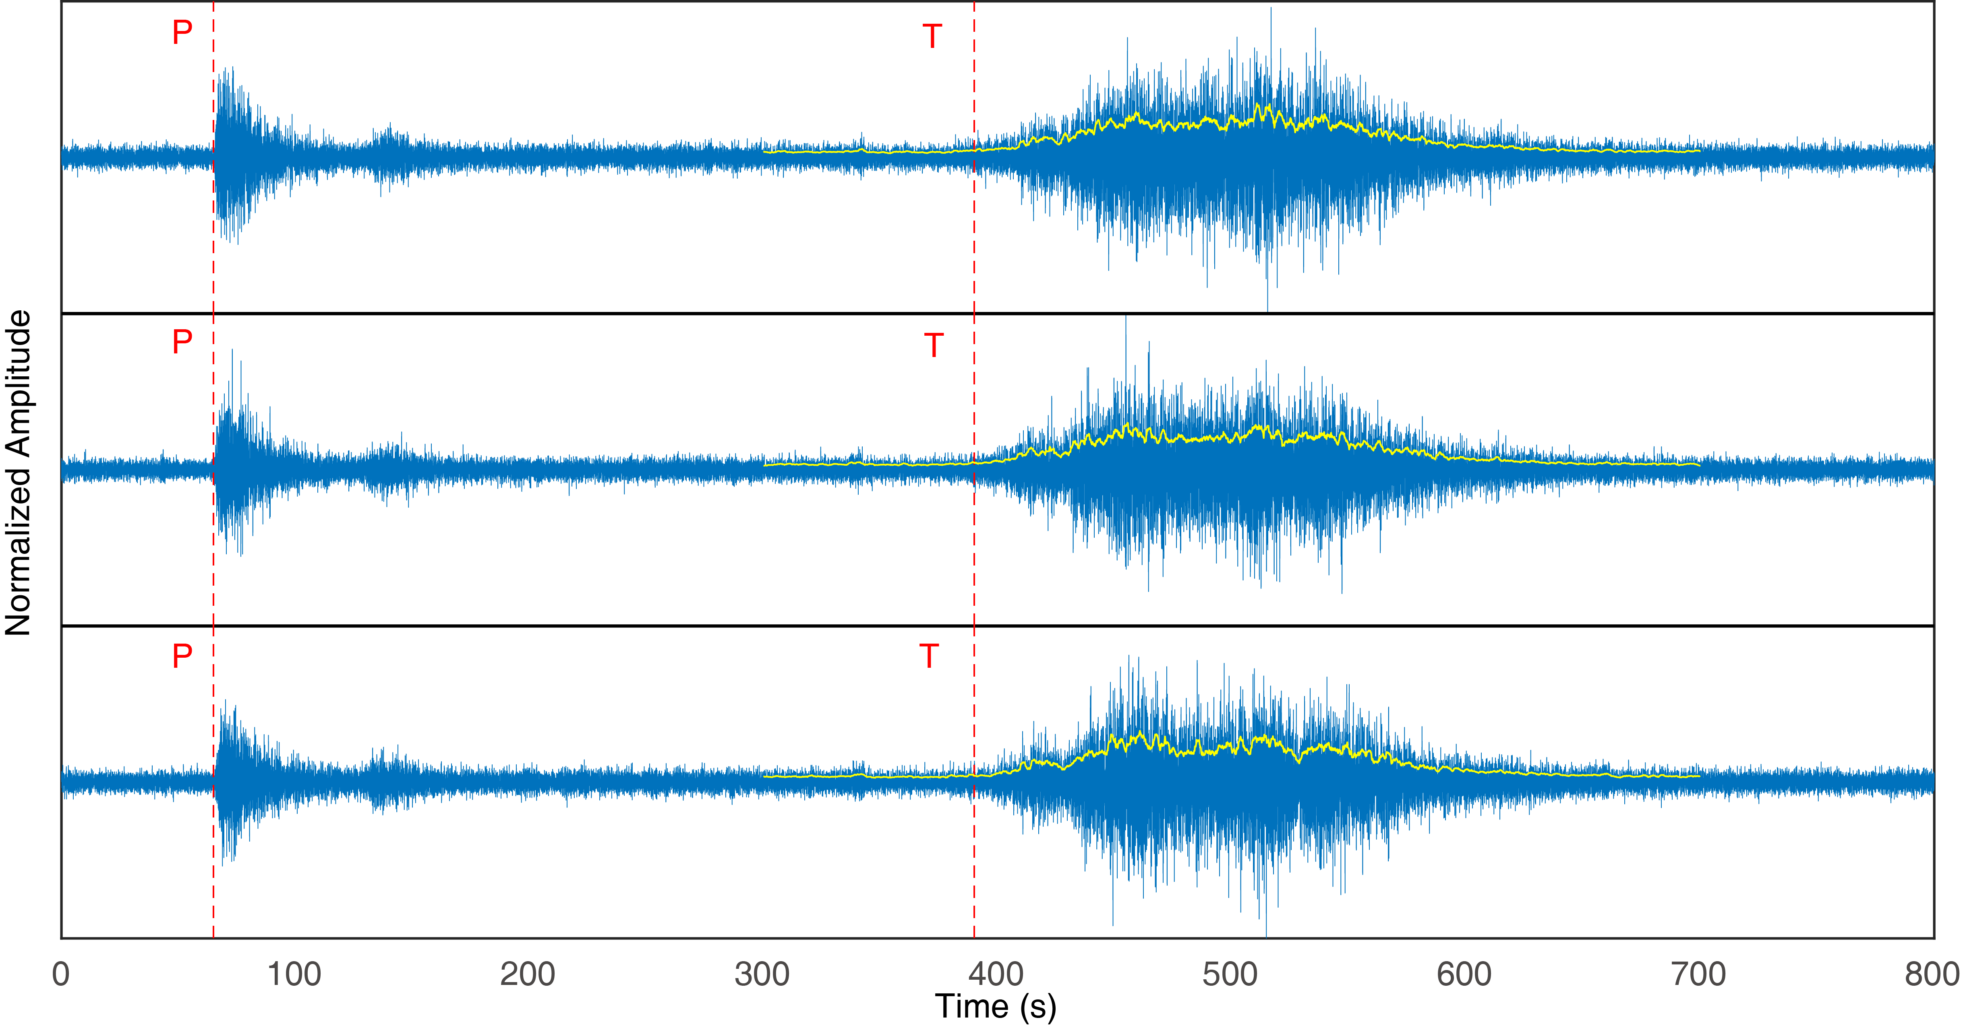
Methods/data
A linear model is established between the time difference of the P-waves and T-waves and the distance between the source and the hydrophone. The model coefficients are fitted using existing seismic wave propagation time models, iasp91 and RSTT. The AIC method is used to extract the arrival times of P-waves and T-waves. The distance from the source to the hydrophone is set to 0 km ~1500 km with a step size of 10 km. The difference in propagation times between T-waves and P-waves and the distance is modeled. The source depth is set from 5 km to 20 km with a step size of 1 km, since the source depth of submarine earthquakes is usually shallow.
Please do not use this space, a QR code will be automatically overlayed
P2.3-377

Slide 5
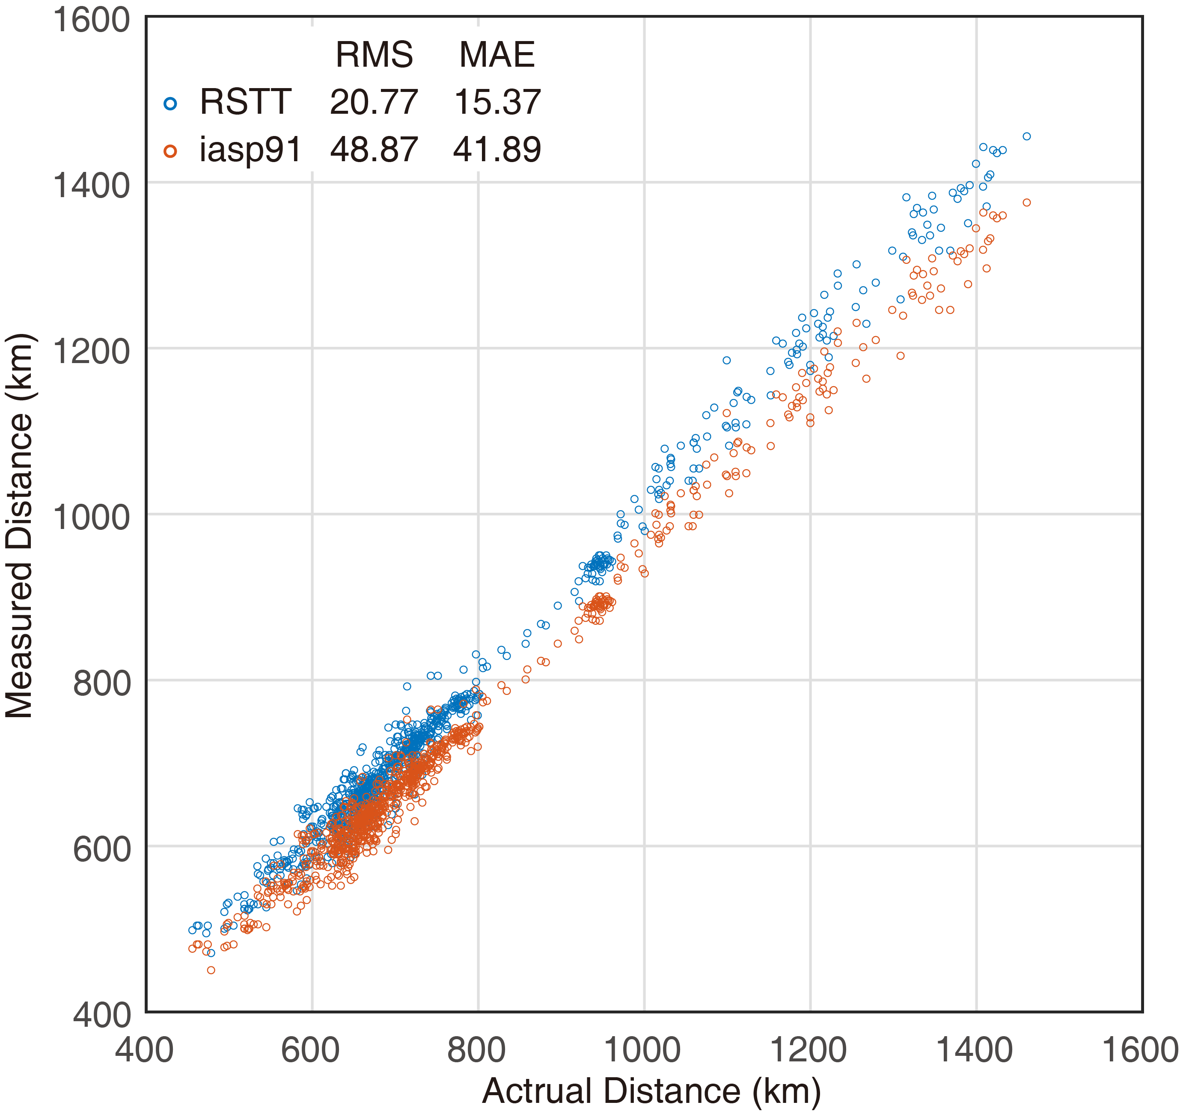
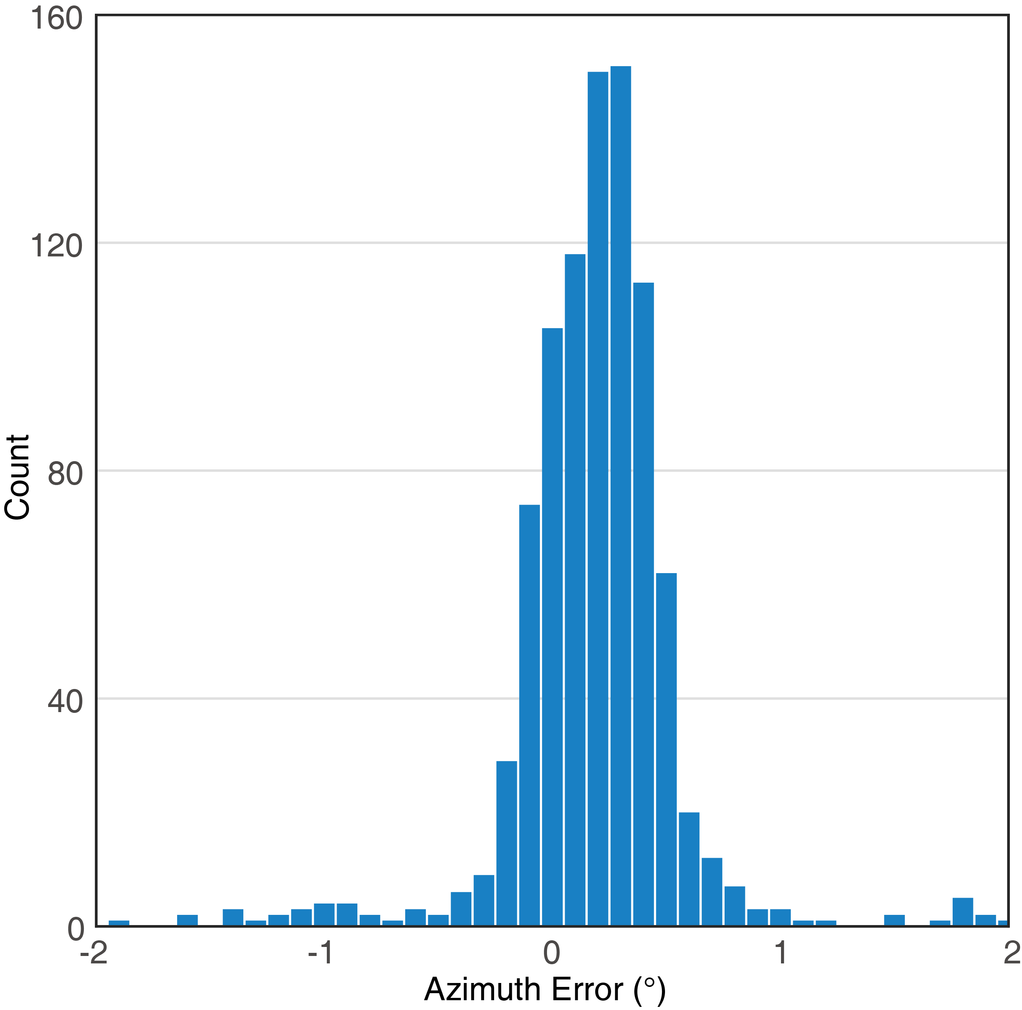
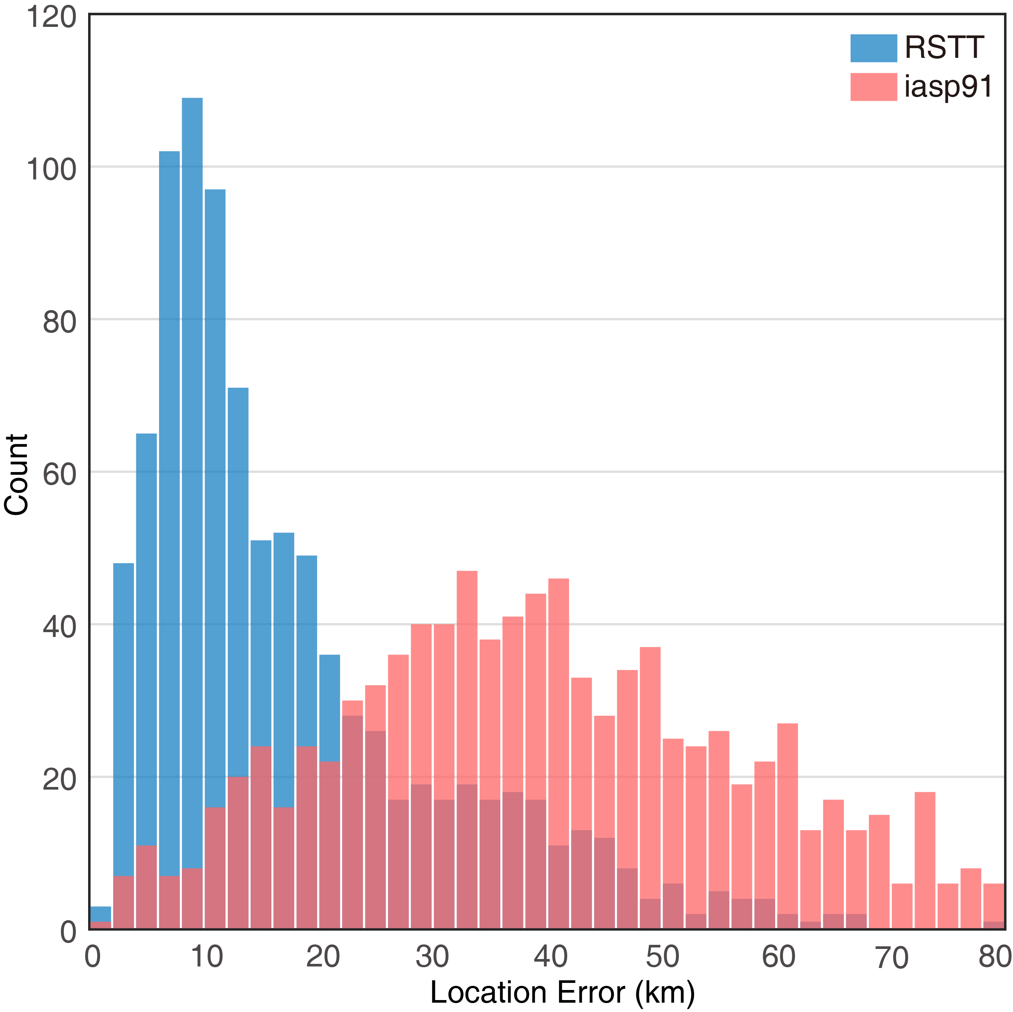
Results
Two hydrophone arrays H03N and H03S of the CTBTO-IMS at San Juan Island, South Pacific, were used to monitor 939 submarine earthquakes (M≥ 4) during 2014-2020. The distance between the earthquake and the hydrophone was estimated. The results of the RSTT-based model are better than those of the iasp91-based model. The root mean square and mean absolute error are 20.77, 15.37 (RSTT) and 48.87, 41.89 (iasp91). Combined with the azimuth results, the earthquake was located. Comparison of the position errors shows that the RSTT-based model is much better than the iasp91-based model. The average position error is less than 20km.
Please do not use this space, a QR code will be automatically overlayed
P2.3-377

Slide 6
Conclusion
A novel approach to submarine earthquake localization using only a single hydrophone triplet is presented in this paper. This method is applicable to the localization of marine seismic in the southern hemisphere, especially when the seismic network monitoring is ineffective.
When the distance from the epicenter to the hydrophone is in the range of 400 km ~ 1500 km, the average position errors are better than 20 km.The RSTT-based model is better than the iasp91-based model when the distance from the epicenter to the hydrophone is less than 16°.
A large amount of hydrophone data is recorded daily at the IMS H-phase stations. The detection of the seismic signal is a great challenge. The proposed method could be used to construct hydro-acoustic signal datasets for the seismic detection algorithms.
This paper focused on hydroacoustic signal processing and submarine seismic data analysis.
The model presented in this paper is applicable to underwater acoustic monitoring of the submarine earthquake with a hydrophone (such as OBH, Oceanic Float) or hydrophone arrays.
Please do not use this space, a QR code will be automatically overlayed
P2.3-377

Slide 7
References
Balanche, A., C. Guennou, J. Goslin, and C. Mazoyer (2009), Generation of hydroacoustic signals by oceanic subseafloor earthquakes: a mechanical model, Geophys. J. Int., 177(2), 476-480.
Dziak, R. P., S. R. Hammond, and C. G. Fox (2011), A 20-YEAR HYDROACOUSTIC TIME SERIES OF SEISMIC AND VOLCANIC EVENTS IN THE NORTHEAST PACIFIC OCEAN, Oceanography, 24(3), 280-293.
Dziak, R. P., D. R. Bohnenstiehl, and D. K. Smith (2012), HYDROACOUSTIC MONITORING OF OCEANIC SPREADING CENTERS Past, Present, and Future, Oceanography, 25(1), 116-127.
Freeman, S. E., G. L. D'Spain, S. D. Lynch, R. A. Stephen, K. D. Heaney, J. J. Murray, A. B. Baggeroer, P. F. Worcester, M. A. Dzieciuch, and J. A. Mercer (2013), Estimating the horizontal and vertical direction-of-arrival of water-borne seismic signals in the northern Philippine Sea, J. Acoust. Soc. Am., 134(4), 3282-3298.
Gomez, B., and U. Kadri (2021), Earthquake source characterization by machine learning algorithms applied to acoustic signals, Sci Rep, 11(1), 15.
Goslin, J., et al. (2012), Spatiotemporal distribution of the seismicity along the Mid-Atlantic Ridge north of the Azores from hydroacoustic data: Insights into seismogenic processes in a ridge-hot spot context, Geochem. Geophys. Geosyst., 13, 15.
Royer, J. Y., R. Chateau, R. P. Dziak, and D. R. Bohnenstiehl (2015), Seafloor seismicity, Antarctic ice-sounds, cetacean vocalizations and long-term ambient sound in the Indian Ocean basin, Geophys. J. Int., 202(2), 748-762.
Simon, J. D., F. J. Simons, and G. Nolet (2020), Multiscale Estimation of Event Arrival Times and Their Uncertainties in Hydroacoustic Records from Autonomous Oceanic Floats, Bull. Seismol. Soc. Amer., 110(3), 970-997.
Simon, J. D., F. J. Simons, and J. C. E. Irving (2021), A MERMAID Miscellany: Seismoacoustic Signals beyond the P Wave, Seismol. Res. Lett., 92(6), 3657-3667.
Sukhovich, A., S. Bonnieux, Y. Hello, J. O. Irisson, F. J. Simons, and G. Nolet (2015), Seismic monitoring in the oceans by autonomous floats, Nat. Commun., 6, 6.
Wu, W. B., Z. W. Zhan, S. R. Peng, S. D. Ni, and J. Callies (2020), Seismic ocean thermometry, Science, 369(6510), 1510.
Please do not use this space, a QR code will be automatically overlayed
P2.3-377

