Slide 1
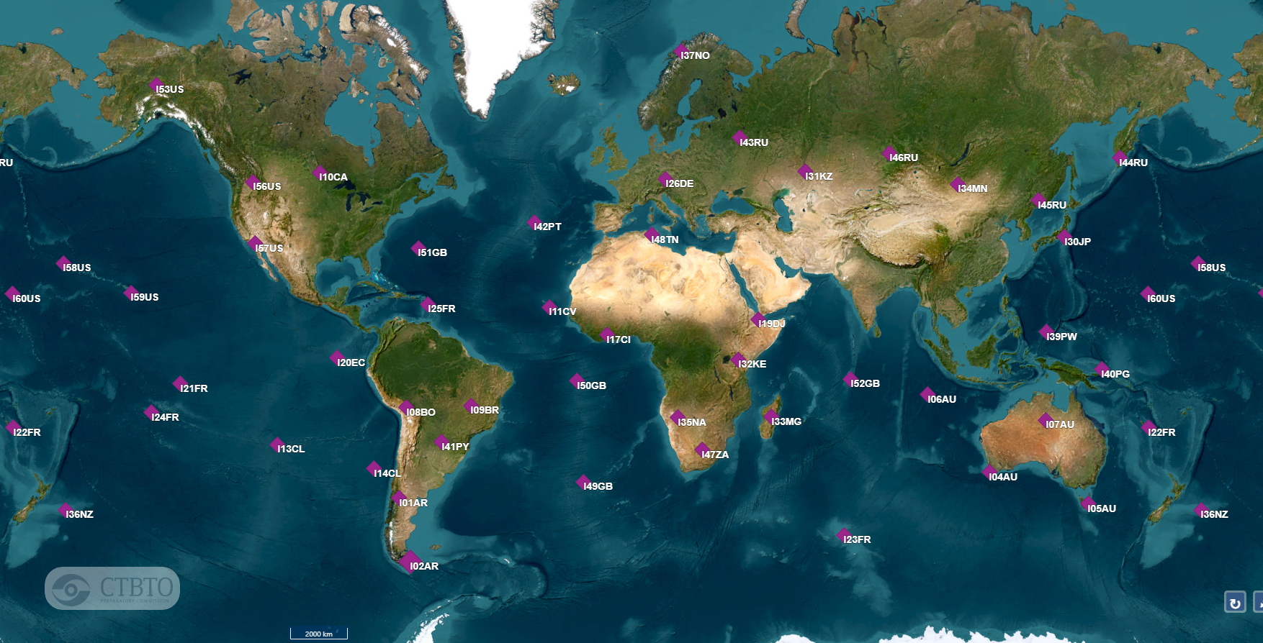
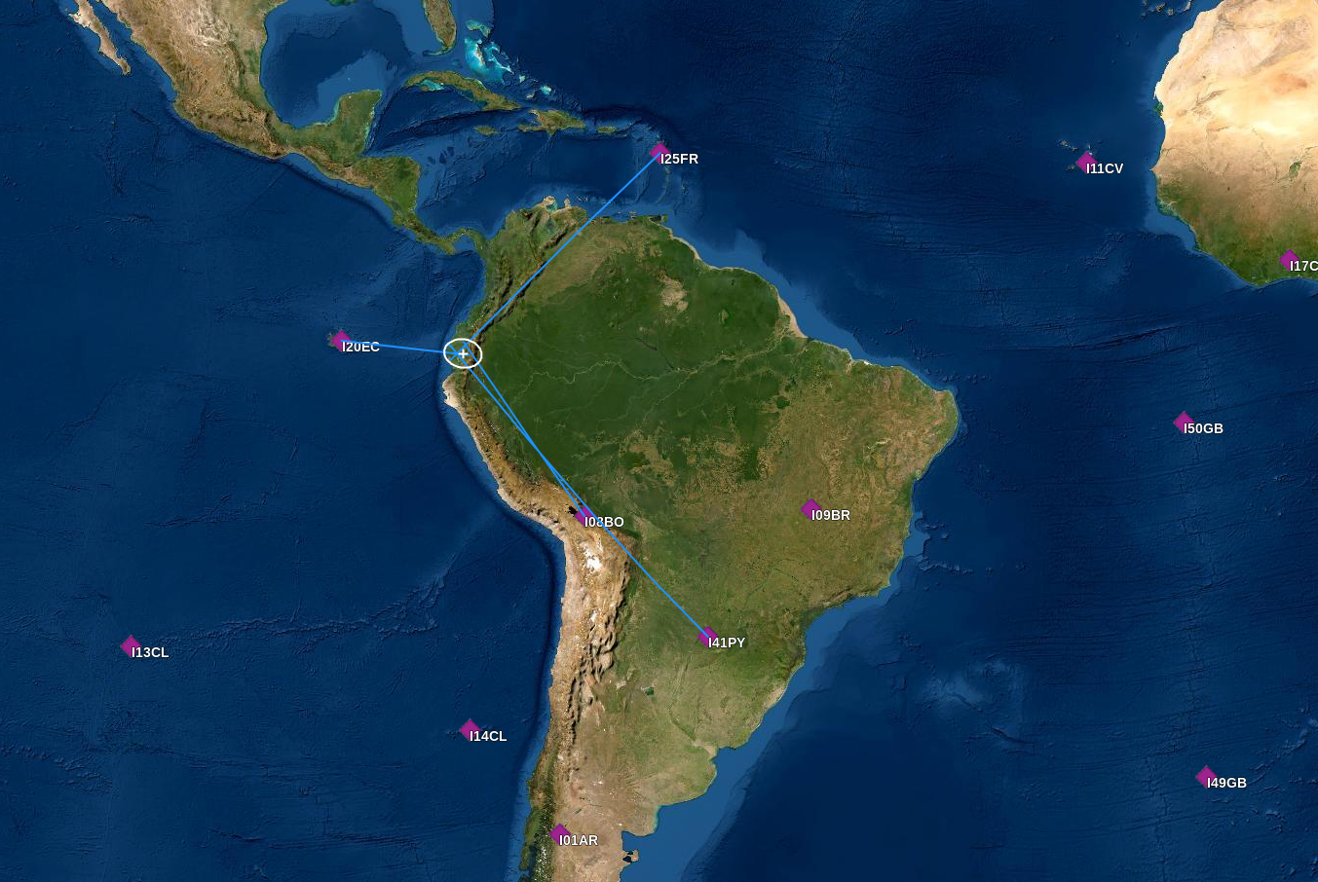
Recent Trends in International Data Centre Infrasound Analysis
D. Applbaum, G. Rambolamanana, P. Bittner, T. Mumladze, E. Qorbani, P. Tun, M. Villaroel and the Monitoring and Data Analysis Team
International Data Centre/Monitoring and Data Analysis section, CTBTO Preparatory Commission, Vienna, Austria
P2.3-544
As new stations are integrated, more events can be built and with better accuracy
Important to integrate new software without affecting bulletin production

