Slide 1
Recent Trends in International Data Centre Infrasound Analysis
D. Applbaum, G. Rambolamanana, P. Bittner, T. Mumladze, E. Qorbani, P. Tun, M. Villaroel and the Monitoring and Data Analysis Team
International Data Centre/Monitoring and Data Analysis section, CTBTO Preparatory Commission, Vienna, Austria
Infrasound analysis in the IDC has incorporated 2 new stations and a new analysis software package in recent years
Stations and software tested, then incorporated into operational analysis and LEB/REB Production
New stations used to build more events and more complete events for better location accuracy
New software successfully integrated without any negative affects
As the IMS infrasound network comes closer to completion, more and better events can be built. New analysis software can be integrated successfully without significantly affecting bulletin production
Please do not use this space, a QR code will be automatically overlayed
P2.3-544

Slide 2
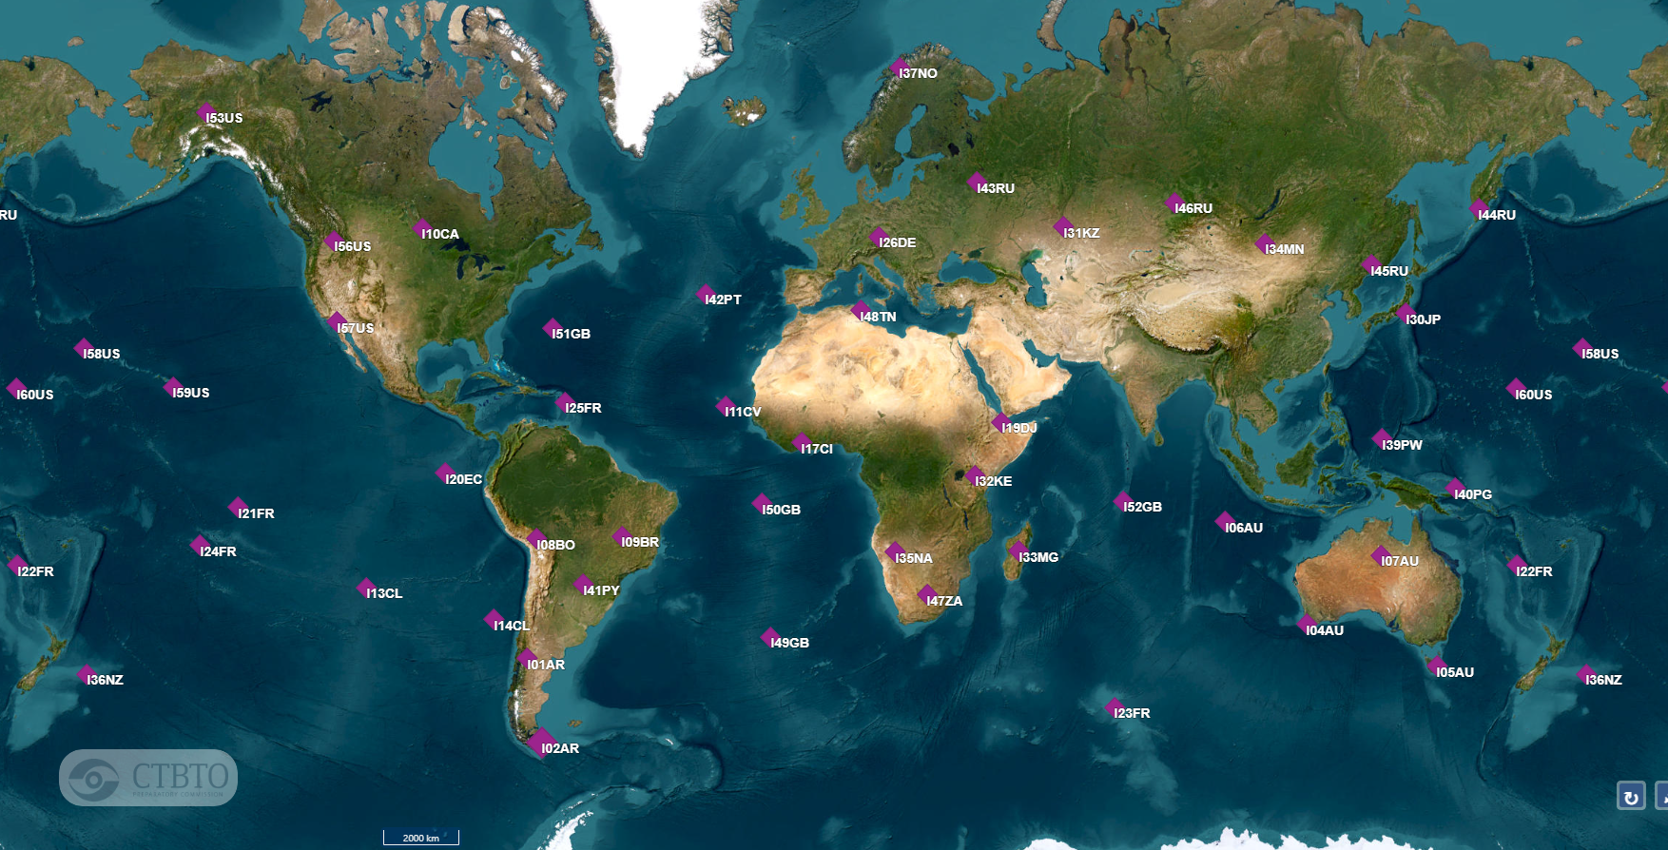
IMS Infrasound Network*
P2.3-544
Please do not use this space, a QR code will be automatically overlayed
most recent operational stations
*Excluding Antarctic stations

Slide 3
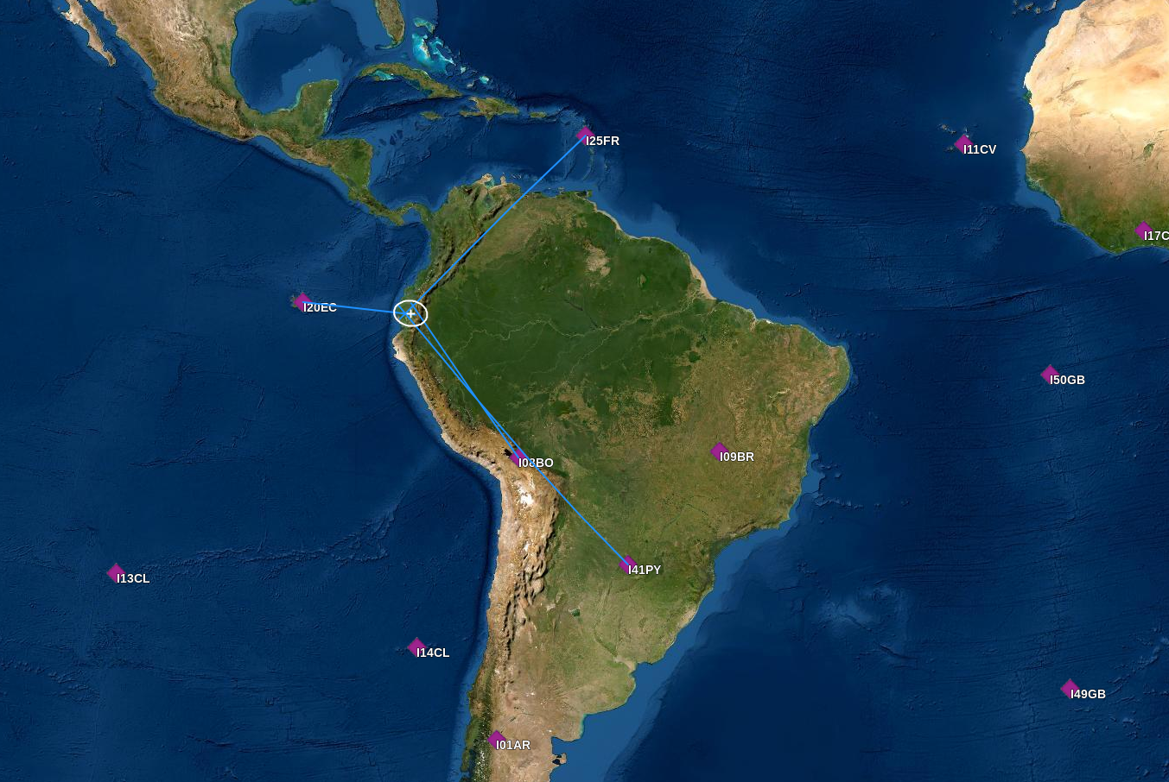
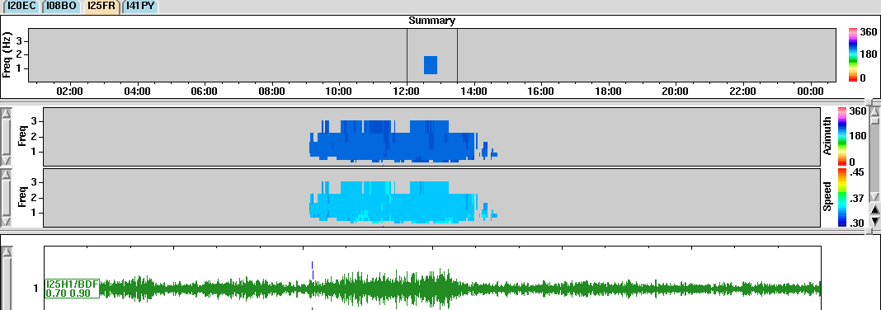
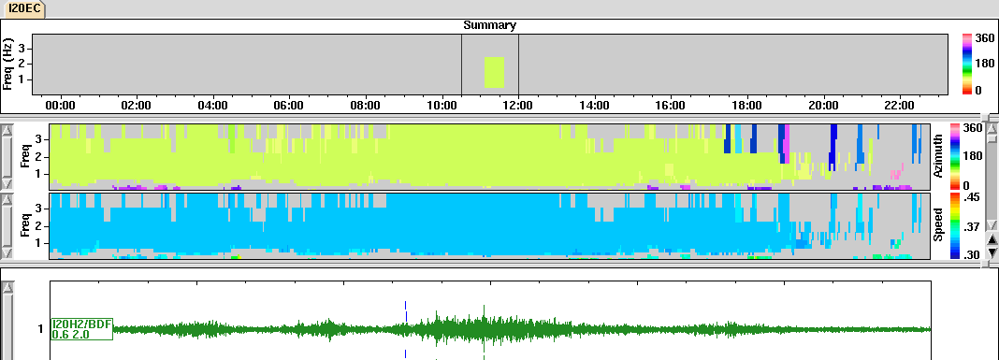
Sangay Volcano
Location made much more accurate by presence of stations from different azimuths
P2.3-544
Please do not use this space, a QR code will be automatically overlayed

Slide 4
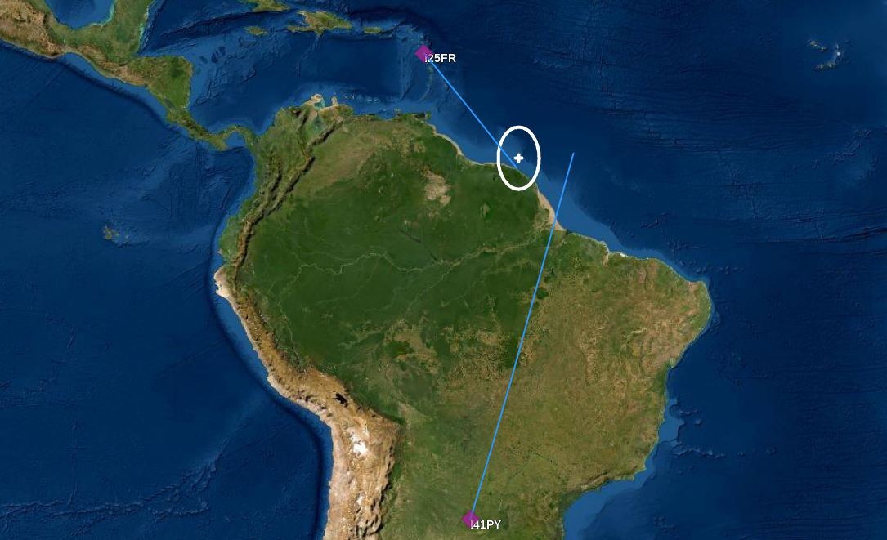
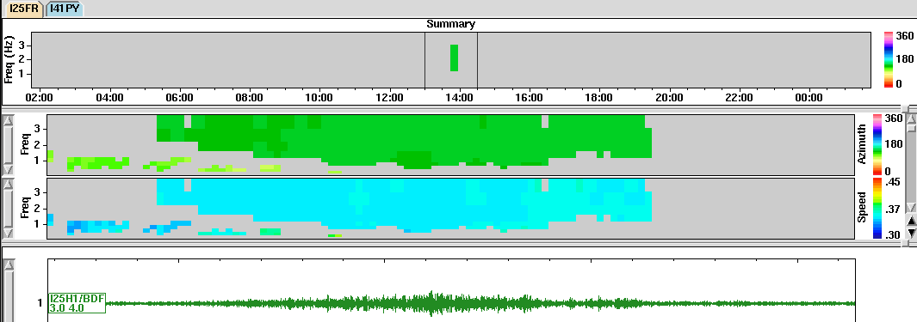
James Webb Space Telescope Launch
2-station event that would not make the LEB without I25 added to the network
P2.3-544
Please do not use this space, a QR code will be automatically overlayed

Slide 5
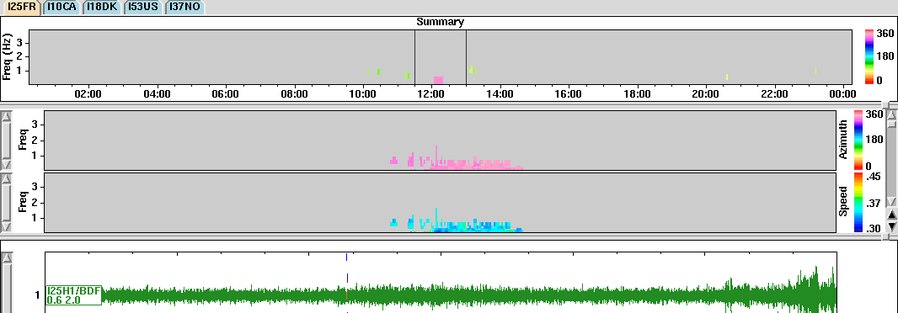
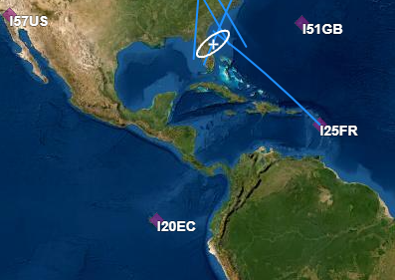
SpaceX Crew 4 Launch
I25 only station from the south side of launch, greatly improving location accuracy
P2.3-544
Please do not use this space, a QR code will be automatically overlayed

Slide 6
Generally, more infrasound LEB events built as the IMS infrasound network gets more and more complete
Approx. 930 LEB events from Ukraine region in 2022
Possible dip in human activity during Covid lockdowns
P2.3-544
Please do not use this space, a QR code will be automatically overlayed

Slide 7
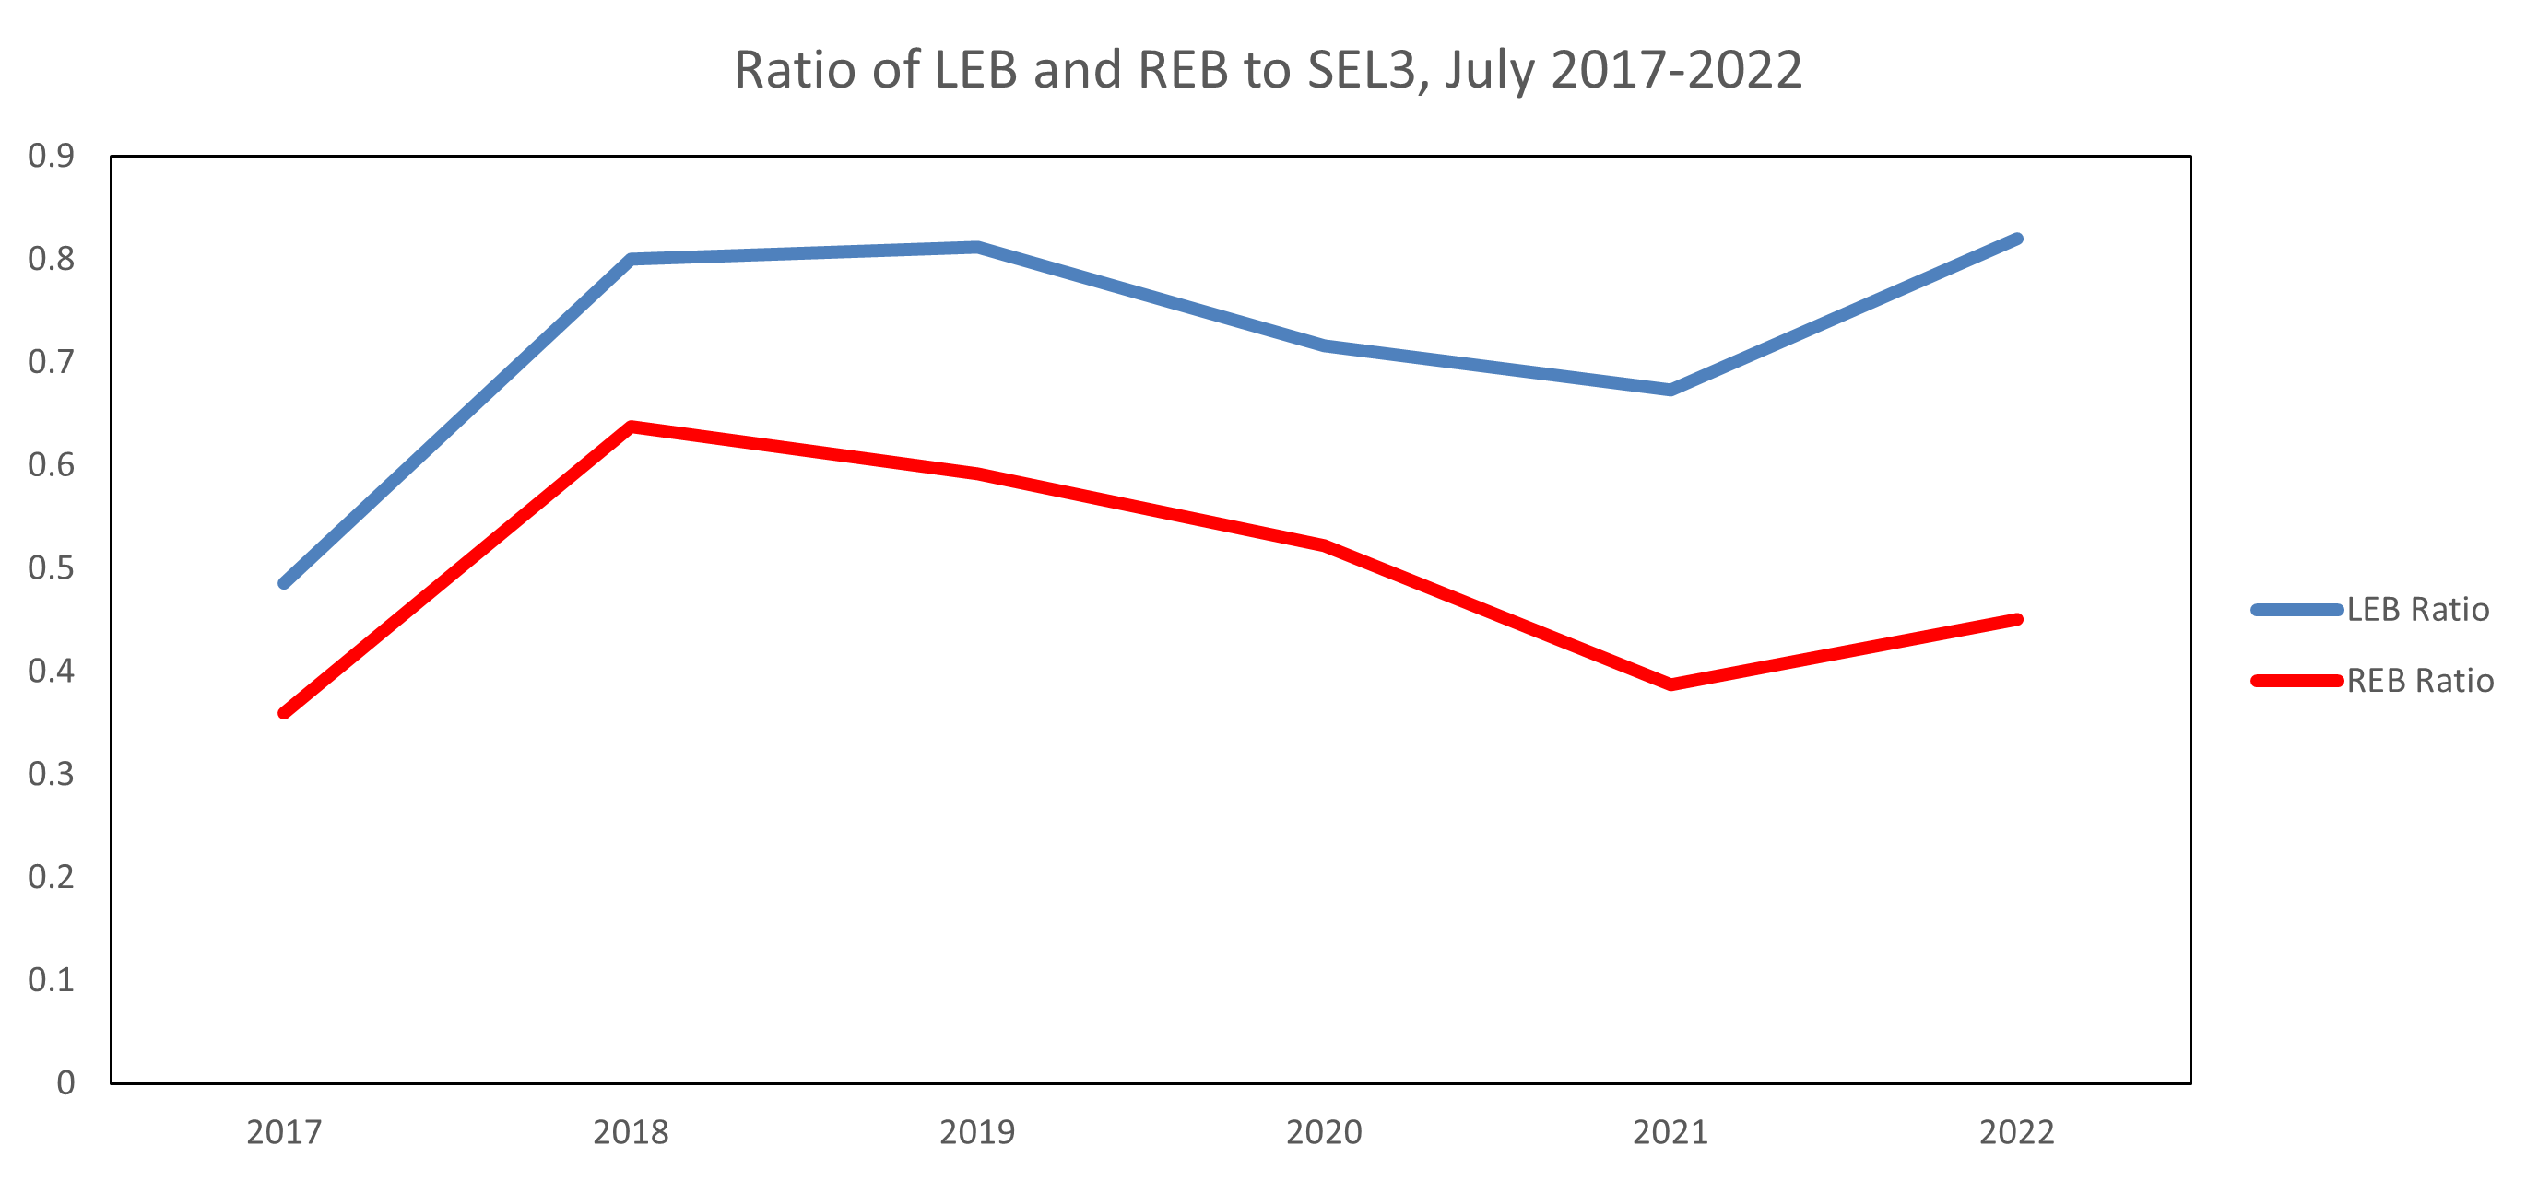
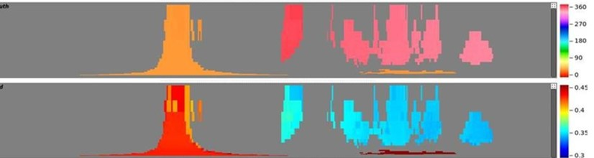
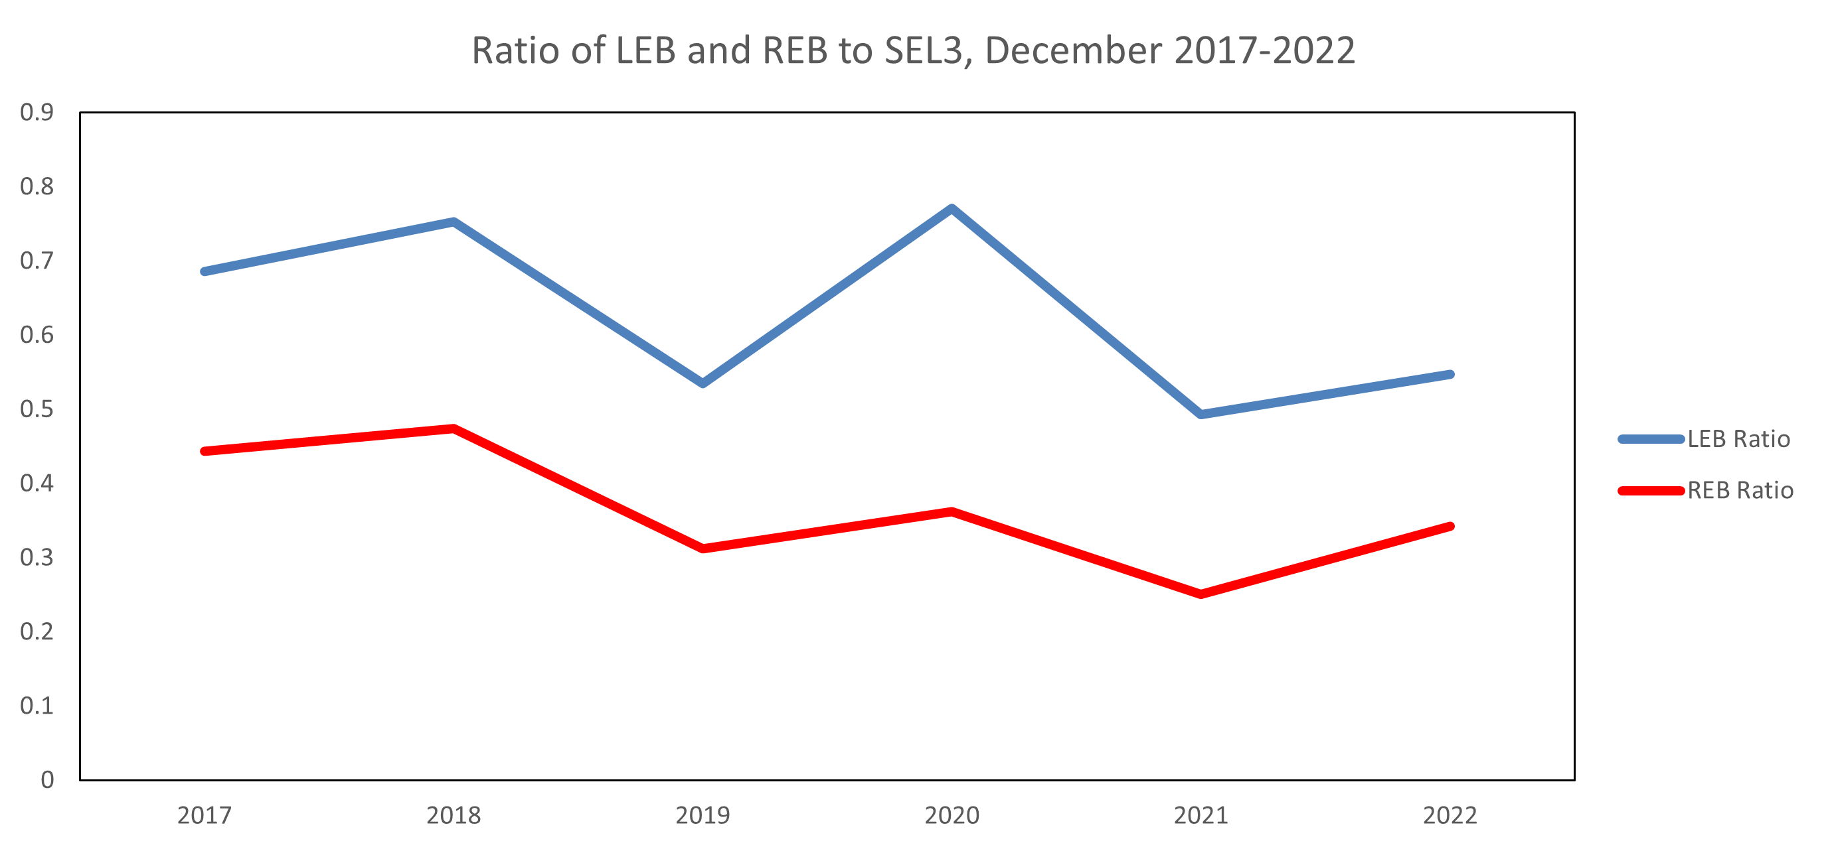
Fall 2022: Integration of DTKGPMCC
New analysis software with increased functionalities
BUT slightly different azimuth color scheme
Different steps for completing common tasks like adding arrivals and selecting pixels
Extensive testing by infrasound analysis team prior to entry into operations ensured a smooth transition
P2.3-544
Please do not use this space, a QR code will be automatically overlayed
Could have had an effect on bulletin production, but does not seem to have*
*Ukraine activity excluded from study

