Slide 1

P2.3-825
Possible GT5 Events in Costa Rica
Ronnie Quintero¹
¹/OVSICORI/Universidad Nacional de Costa Rica
ronnieq@gmail.com
OVISCORI-UNA seismic network began monitoring seismic and volcanic activity in Costa Rica in April 1984. Since 2004, analog stations have been replaced by broadband sensor equipment, it can record local earthquakes. In this work we use the catalog to select possible GT5 events.
We selected possible candidates to GT5.0 seismic events from the OVSICORI-UNA seismic catalog starting 2010. The events were located with the GENLOC program within ANTELOPE, and the selection criteria were: 1) Minimum number of stations > 10, 2) Gap < 110°, 3) number minimum of stations within 10 km >= 1. Then we transformed it to SeiSan and restricted the selection to earthquakes with depths < 25 km, rms < 0.5 sec, more than 30 stations and at least 10 of them with distance less than 150 km from the epicenter.
A total of 707 events, identified using GENLOC and filtered based on the previously mentioned parameters, were initially found. However, after applying additional selection criteria within Seisan, the number of events was reduced to 178. These selected events predominantly occurred in the central region of Costa Rica and had magnitudes ranging from 1.9 to 5.1 Ml.
Seismic catalogs like the one from OVSICORI-UNA, which have a good distribution of digital seismic stations, are important for proposing GT5 events, as shown here. These events serve as calibration earthquakes.
Please do not use this space, a QR code will be automatically overlayed

Slide 2
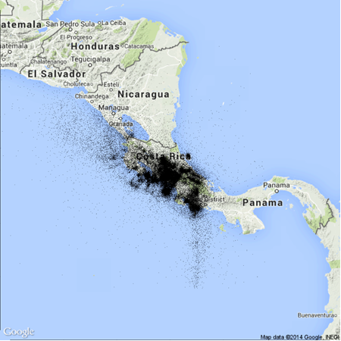
Introduction
OVISCORI-UNA seismic network began monitoring seismic and volcanic activity in Costa Rica in April 1984 (see Fig.1 for epicenters). Since 2004, analog stations have been replaced by broadband sensor equipment and digital data transmission. To date, there are more than 70 stations that record local, regional and global seismic activity. The seismic network is optimal for monitoring seismic activity within Costa Rican territory; however, it is capable of recording earthquakes considered moderate to large outside Costa Rican territory. Another thing that the seismic catalog of OVISCORI-UNA can contribute to the international community is to select candidates for possible GT5 events. During the initial years of OVSICORI-UNA network operation, earthquakes were located using a limited number of seismic stations (refer to Fig. 2 for the variation in picks used). However, starting from 1984, there was a gradual increase in the utilization of phases, with a substantial surge observed from 1990 to early 1993, attributed to heightened seismic activity. Another significant change occurred around 2010, coinciding with the network's shift to digital technology and the implementation of the ANTELOPE system.
Fig. 2. The smoothed trend of the number of phases used in the earthquake location of the OVSICORI-UNA catalog from 1984 to 2014.
Fig. 1. The epicentral map displays the earthquakes recorded by OVSICORI-UNA from 1984 onward. The earthquakes are represented by black points on the map.
Please do not use this space, a QR code will be automatically overlayed
P2.3-825

Slide 3
Objectives/Methods/data
Objective
Selected potential candidates for GT5.0 seismic events from the OVSICORI-UNA seismic catalog in Costa Rica.
Methods/data
We make a selection of possible candidates to GT5.0 seismic events from the OVSICORI-UNA seismic catalog from 2010 until the present. The events had been located into ANTELOPE using GENLOC program. The selection criteria was: Minimum number of stations 10, Gap less than 110°. In total 707 events were selected. Selected events are mostly in the center part of the OVSICORI-UNA network, with magnitude between 1.9 and 6.0 Ml and 0 to 200 km depth. Then we transform to SeiSan and choose earthquakes with depths less than 25 km, rms less than 0.5 sec, more than 30 stations and at least 10 of them with distance less than 150 km from the epicenter.
Please do not use this space, a QR code will be automatically overlayed
P2.3-825

Slide 4

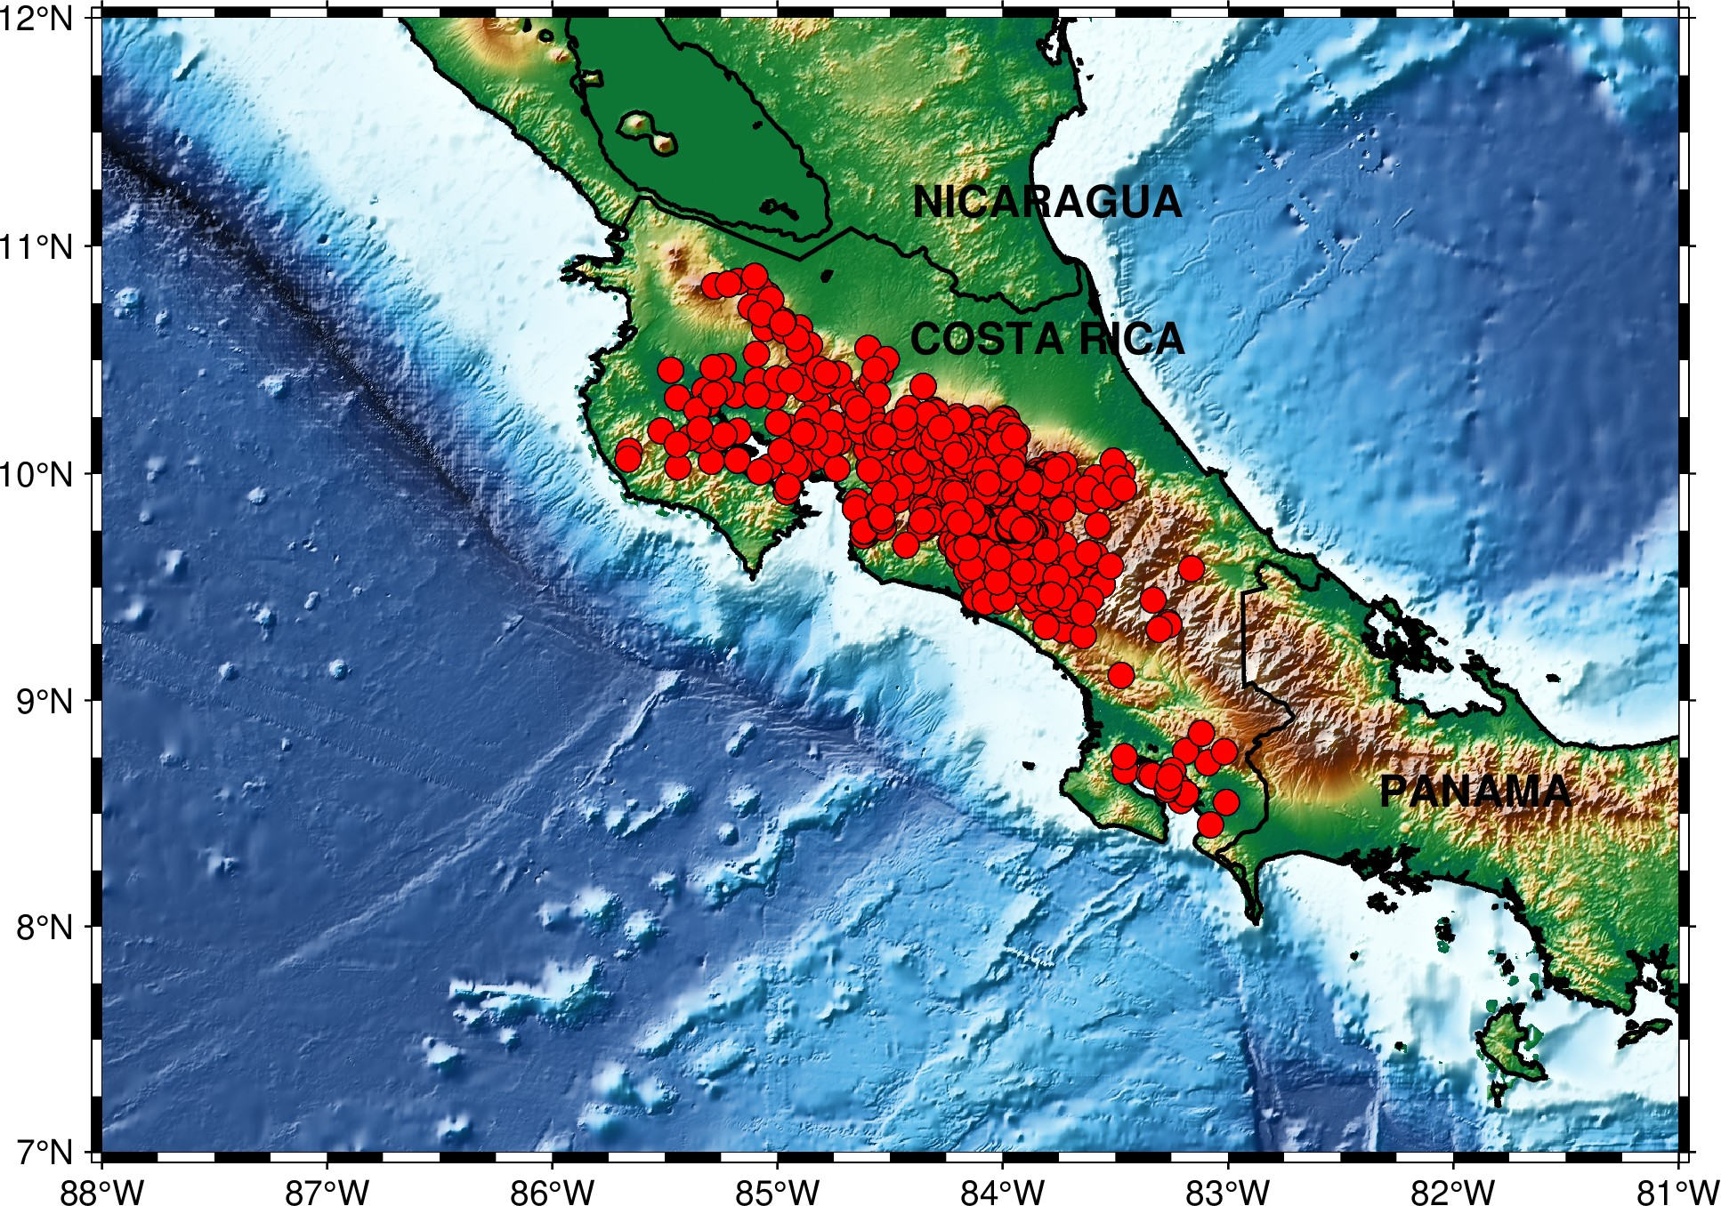
Results
A total of 707 events were obtained when a direct selection was made from the seismic catalog, where GenLoc and the Quintero and Kissling velocity model are used for location purposes (see Fig. 3).
Please do not use this space, a QR code will be automatically overlayed
Fig. 3. Selected event from UNA database
P2.3-825

Slide 5
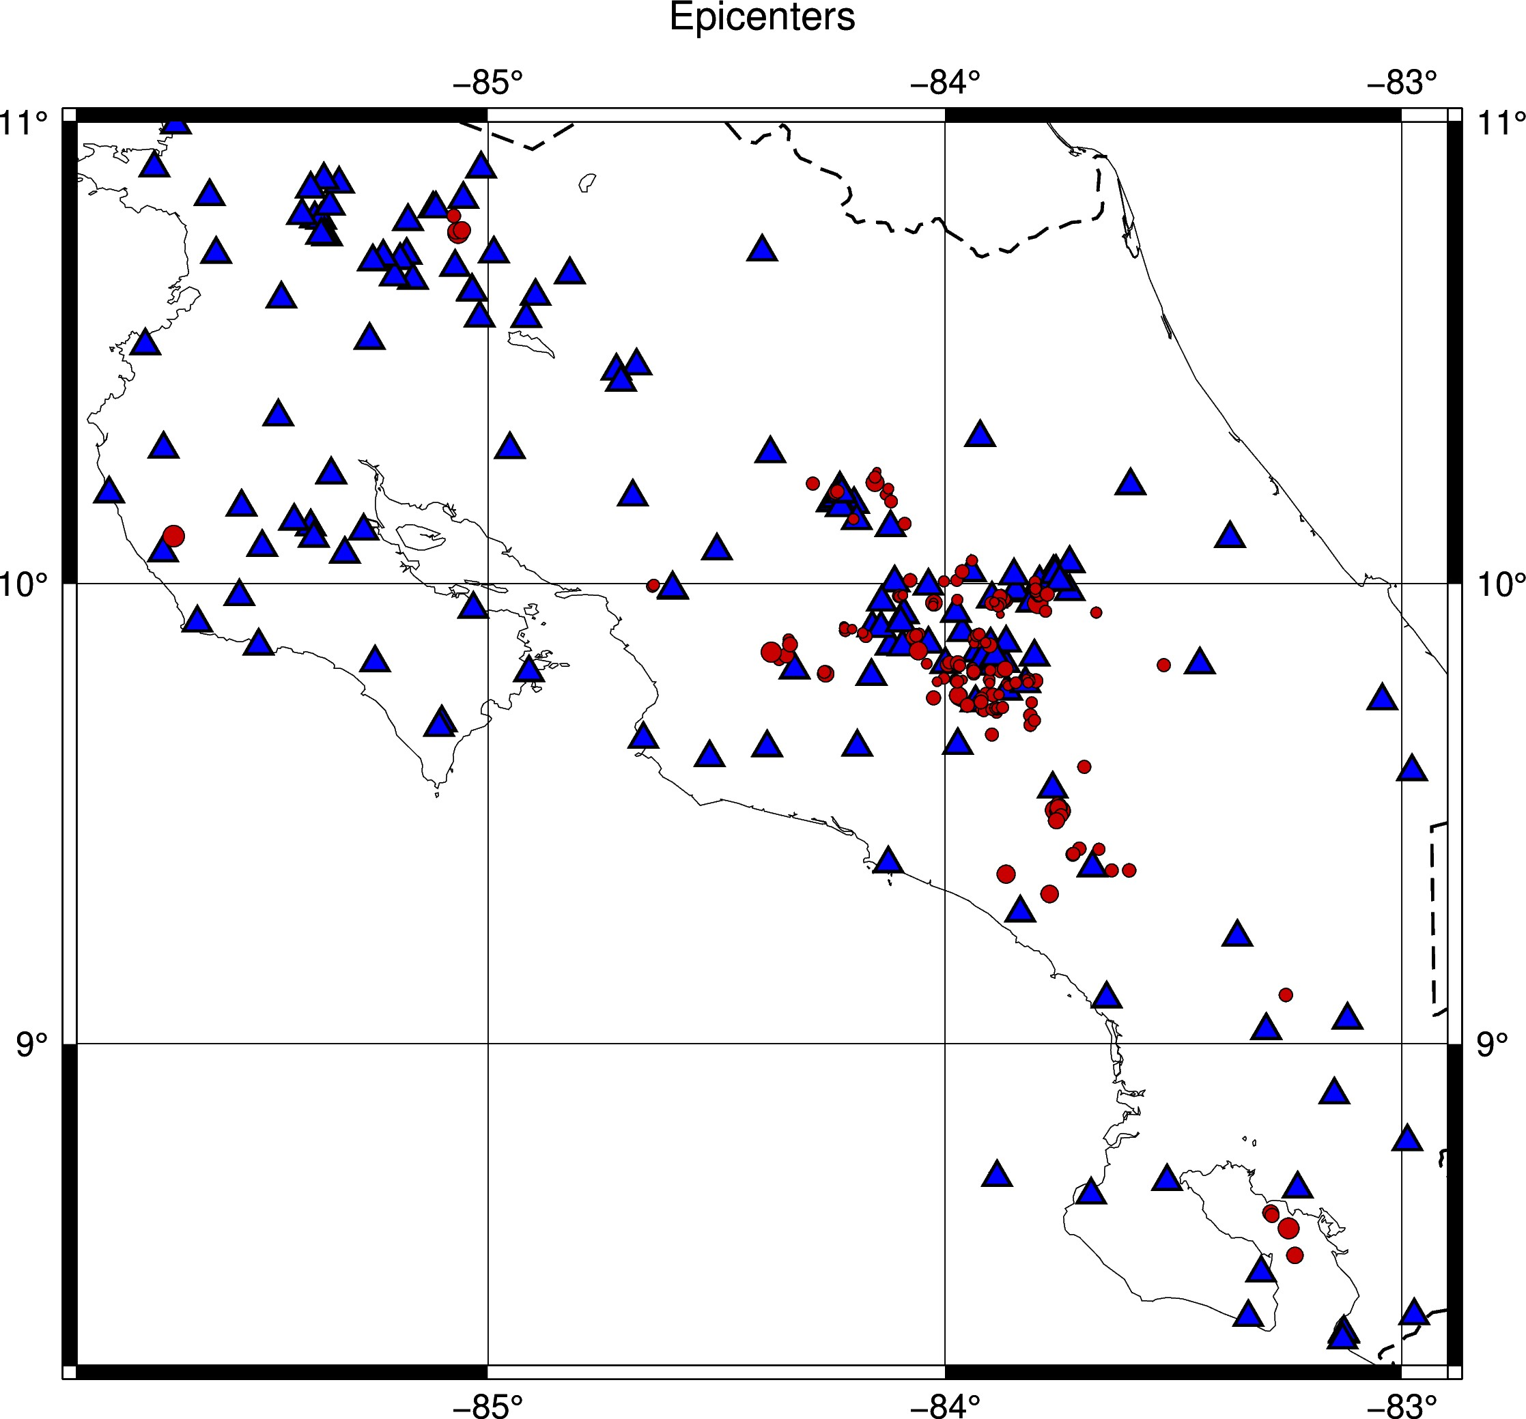
Results/Conclusions
After transforming the data to SeiSan and relocating the events using HYPOCENTER with restricted selection criteria, a total of 178 events were obtained. These events are primarily concentrated in the central part of Costa Rica, where there is a higher density of seismic stations. Their magnitudes range between 1.9 and 5.1 Ml (see Fig 4.).
Conclusions
This is a first attempt to identify possible GT5 events directly from the OVSICORI-UNA seismic catalog. The selection criteria are similar to those of Bondar et al (2004). Other studies need to be carried out to classify them as such. The region located in the center of the American continent, such as Costa Rica, is important for validating travel-time predictions from 3D velocity models and new association and location algorithms, as indicated by Bondar (2015).
Fig. 4. The figure shows GT5 candidates represented by red circles and seismic stations that recorded them represented by blue triangles
Please do not use this space, a QR code will be automatically overlayed
P2.3-825

Slide 6
REFERENCES
Lienert, B. R., and J. Haskov, 1995. A computer program for locating earthquakes both locally and globally, Seism. Res. Lett. 66, 26–36.
Pavlis G.L., Vernon F., Harvey D., Quinlan D. (2004). The generalized earthquake-location (GENLOC) package: An earthquake-location library Computers and Geosciences, 30 (9-10) , pp. 1079-1091
Quintero, R., and E. Kissling (2001=. An improved P-wave velocity reference model for Costa Rica, Geofís. Int., 40, 3 –19.
Bondár, István (2015). IASPEI Reference Event List. NDC Capacity Building and Regional Seismic Travel Time Workshop and Training, Heredia, Costa Rica, 7-11 September 2015.
Please do not use this space, a QR code will be automatically overlayed
P2.3-825

