Slide 1
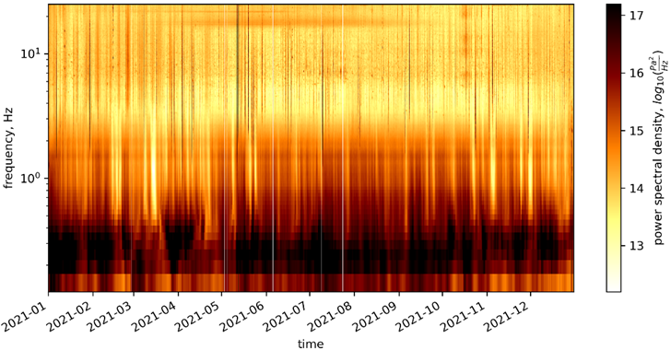
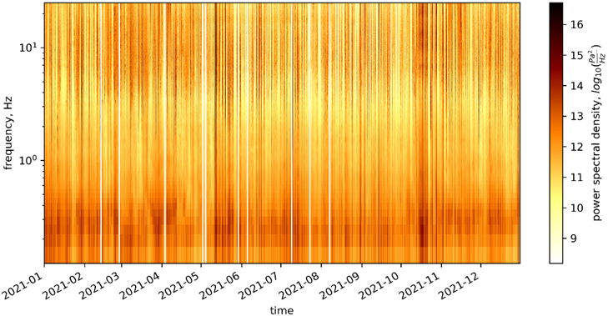
Systematic event analysis of IMS hydrophones
to identify and categorize hydroacoustic sources
We apply a machine learning based denoising approach on IMS hydrophone waveform data to reduce continuous noise sources and highlight transient features (DPRK’s 6th nuclear test and earthquake P-waves)
Proof of concept: large improvement of signal-to-noise-ratio, good transferability and generalization
Main conclusion: more specialized training could selectively remove noise sources and highlight events of CTBT interest, thus supporting waveform analysis and improving source identification and classification
Example: one year of IMS
hydroacoustic data (H08S)
Machine Learning based Denoising
Christoph Pilger, Peter Gaebler, Andreas Steinberg, Johanna Lehr
Federal Institute for Geosciences and Natural Resources (BGR)
P2.3-398

