Slide 1
SEISMOACOUSTIC LISTENING OF BALTIC SEA GAS EXPLOSION
U.O. Madu¹; A. Sani¹ and E.Oberafo¹
¹Nigeria Atomic Energy Commission, Abuja, Nigeria
The International Monitoring System (IMS) in addition to serving as a treaty verification tool also provides data for civil use by monitoring man-made activities and natural phenomena. The two Baltic Sea gas pipelines Nord Stream 1 and 2 eruptions (Fig1) on 26 September, 2022 which are man-made events are examples of civil use of data from the IMS..
Two infrasound arrays (I26DE and I43RU) coupled with seven seismic stations of the IMS recorded the events. The IMS data analysed were obtained from IDC. Data processing was performed using Geotool and GMPCC software provided by the CTBTO. The parameters studied were phase, spectrogram, magnitude, azimuth and slowness
The Baltic Sea explosion provides the opportunity for a detailed seism-acoustic study. The combined interpretation of seismic and infrasound signals was used to obtain the location of the event. The not too strong S-waves associated with the events are indications of man-made events.
At local and regional distances the IMS network is operational ready in a timely manner to contribute data towards a safer environment.
Please do not use this space, a QR code will be automatically overlayed
P2.3-804

Slide 2
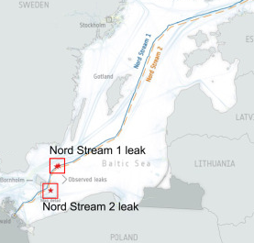
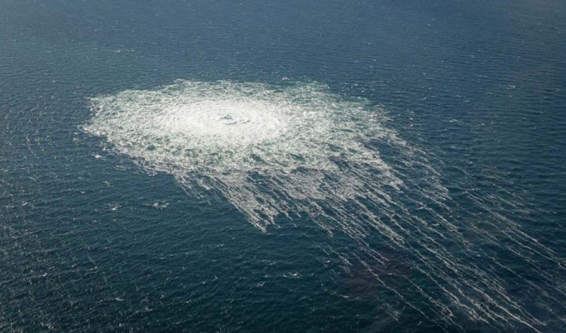
Introduction Slide Title goes here [Font: Arial Regular Size 20]
The International Monitoring System (IMS) was established to implement the verification of and compliance with the Comprehensive Nuclear-Test-Ban Treaty (CTBT) by State Parties. The IMS is supposed to be used for detecting and locating nuclear explosions and is spread globally as a network of radionuclide, hydroacoustic, seismic and infrasound stations. IMS in addition to serving as a treaty verification tool it also provides data for civil use by monitoring man-made activities and natural phenomena.
Two Baltic Sea gas pipelines Nord Stream 1 and 2 eruptions (Fig1) on 26 September, 2022 which are man-made events are examples of the civil use of data from the IMS. Two infrasound arrays (I26DE and I43RU) coupled with seven seismic stations of the IMS recorded the event.
Methane gas was released underwater during the eruption. Underwater eruptions generate air waves and pressure waves that caused fluctuations in the different layers of the atmosphere. Aerial pictures of the event showed a large turbulence with a diameter of about 1 km that is visible at the sea surface (Fig. 2)
Fig 1: Locations of leaks in the Nord Stream 1 and 2 pipelines (Source: Jiang et al 2022)
Please do not use this space, a QR code will be automatically overlayed
Fig 2: Aerial view of the gas release (source: Danish Defense)
P2.3-804

Slide 3
OBJECTIVES
The Objectives of this study are to test:
the data availability of IMS stations
performance of the IMS Network
for detection, location, and characterization of an event in the likelihood of a clandestine nuclear explosion
Please do not use this space, a QR code will be automatically overlayed
P2.3-804

Slide 4
METHODS
The event was reported in REB (Fig. 3 and 4 ). Seismic and infrasound stations at local, regional and teleseismic distances from the epicentre recorded the event. The IMS data was obtained using AutoDRM and analysed using software tools developed by Provisional Technical Secretariat of the Comprehensive Nuclear-TestBan Treaty Organization (PTS-CTBTO) and released as NDC-in-a-Box: Geotool for seismic data analysis; and DTK-GPMCC for infrasound data analysis. GPMCC was used for the analysis because of its ability to detect low-amplitude acoustic waves hidden in incoherent noise. The software was used to study and determine the wave parameters of:
azimuth,
phase
frequency,
amplitude, and
velocity
Fig 3: REB Event 22840617
Please do not use this space, a QR code will be automatically overlayed
Fig 4: REB Event 22846222
P2.3-804

Slide 5
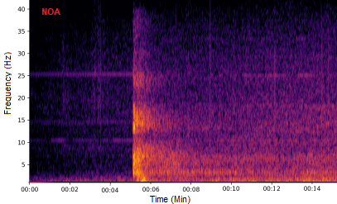
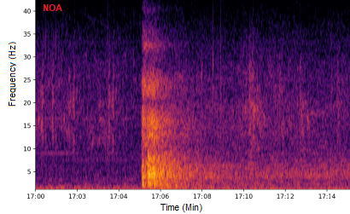
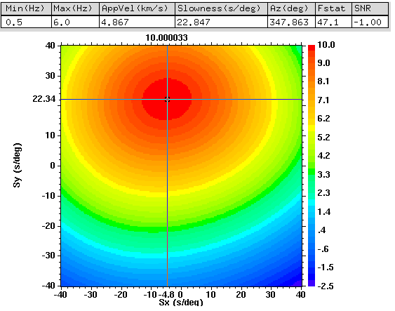
RESULTS AND DISCUSSION
The Baltic Sea explosion provides the opportunity for a detailed seism-acoustic study. Low-frequency acoustic waves (infrasound) not audible to humans are generated by bolides, volcanic eruptions and strong explosions (Brachet et al 2009). IMS stations which can be hundreds of kilometres from the source are calibrated to detect such acoustic waves. (Assink et al. 2018)
The infrasound signals were processed using array processing techniques to obtain wave field parameters like azimuth and speed (Koch and Pilger, 2020).which confirms the source direction, and observed arrivals’ propagation modes (Fig 8)
The two explosions occurred at 00:03 UTC and 17:03 UTC respectively and were recorded by seismic (Fig 5A and B) and infrasound stations. The second explosion consist of multiple blasts that released gas clouds which produced significant enough acoustic energy to be detected at IS26DE and I43RU (Fig 6).
A
Fig 6: Spectral analysis of I22FR
F–K analysis was carried out on the seismic data of the co-located GERES array, which yielded an azimuth, slowness and trace velocity values consistent with those of IDC (Fig 7)
Fig 5(A) and (B): Spectral analysis of NOA for the two events
B
Please do not use this space, a QR code will be automatically overlayed
Fig 7: FK analysis of GERES
Fig : GPMCC analysis of I22FR
P2.3-804

Slide 6
CONCLUSION
The combined interpretation of seismic and infrasound signals was used to obtain the location of the event. The Spectrogram analysis of the infrasound and seismic stations showed that the S-waves are not strong which is a characteristics of an explosion. Explosions are mostly are man-made events. The study concludes that at local and regional distances the IMS network is operational ready in a timely manner to contribute data towards a safer environment.
Please do not use this space, a QR code will be automatically overlayed
P2.3-804

Slide 7
REFERENCES
Assink, J., Averbuch, G., Shani-Kadmiel, S., Smets, P., & Evers, L. (2018). A seismo-acoustic analysis of the 2017 North Korean nuclear test. Seismological Research Letters, 89, pp 2025–2033.
Brachet, N., Brown, D., Le Bras, R., Cansi, Y., Mialle, P., and Coyne, J., (2009). Monitoring the Earth’s Atmosphere with the Global IMS Infrasound Network. In: Le Pichon A., Blanc E., Hauchecorne A. Infrasound Monitoring for Atmospheric Studies. Part I - History, Instrumentation, Network. Springer, Dordrecht. pp. 77-118.
Jiang, F. Jia M., Li, F., Zhang, Y., Wu, M., Li, Y., Feng, S., Wang, H., Chen, H., Ju, M., Lin, J., Cai J., Zhang, Y., (2022). The Nord Stream pipeline gas leaks released approximately 220,000 tonnes of methane into the atmosphere. Environmental Science and Ecotechnology, Vol 12, 100210 https://doi.org/10.1016/j.ese.2022.100210
Koch, K., and Pilger, C., (2020). Comprehensive Study of Infrasound Signals Detected from the Ingolstadt, Germany, Explosion of 1 September 2018. Pure Appl. Geophys. 177, 4229–4245
Please do not use this space, a QR code will be automatically overlayed
P2.3-804

