Slide 1
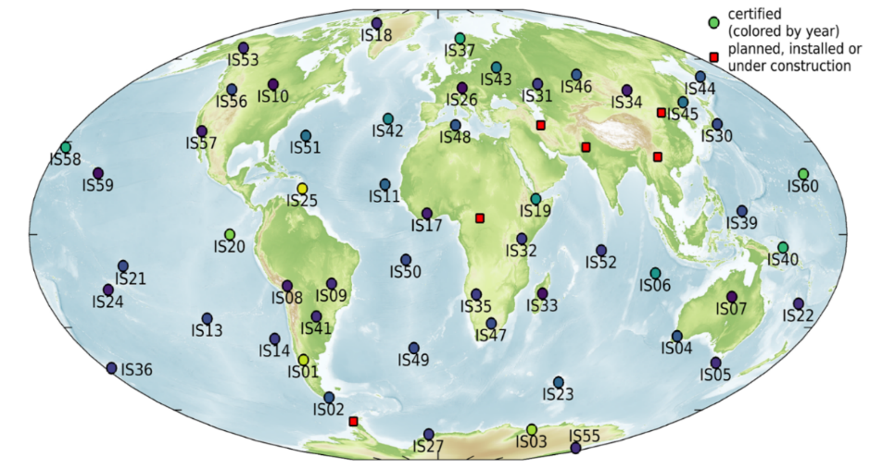
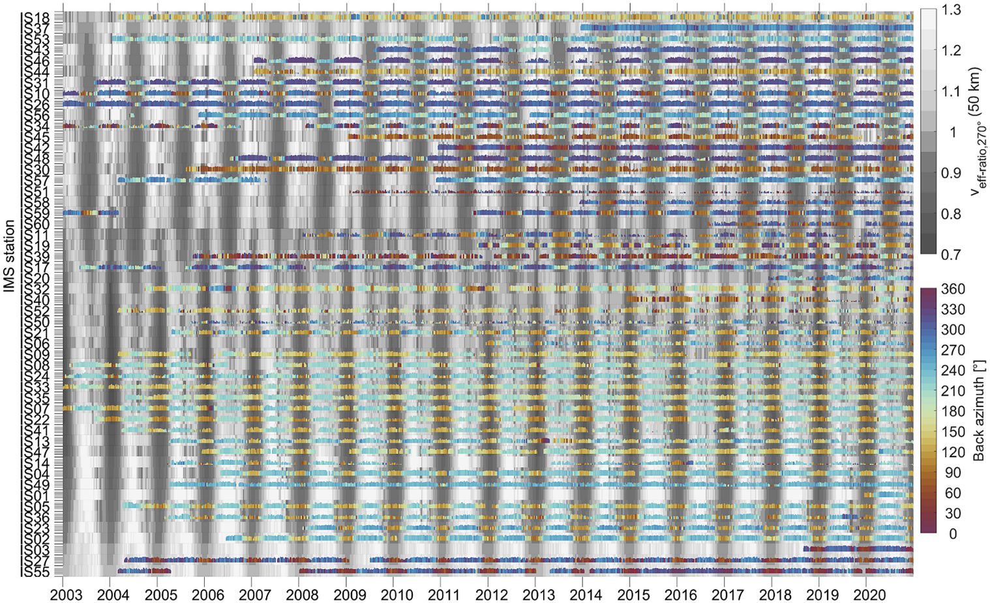
Open-access products from IMS infrasound bulletins for atmospheric science applications
Effective sound speed ratio
IMS infrasound data useful for atmospheric studies (e.g., Le Pichon et al., 2019)
But access to IMS infrasound waveform data restricted (e.g., vDEC contract)
Four open-access products
Microbarom product:
well correlated with middle atmosphere dynamics
E-poster highlights:
2021 and 2022 updates – what‘s new?
Data examples of recent events
Guide: How to download the products?
Patrick Hupe¹, Lars Ceranna¹, Alexis Le Pichon², Robin S. Matoza³, Pierrick Mialle⁴
¹ Federal Institute for Geosciences and Natural Resources (BGR)
² CEA / DAM / DIF, ³ UCSB / Earth Science / ERI, ⁴ CTBTO / IDC
P2.3-322

