Slide 1
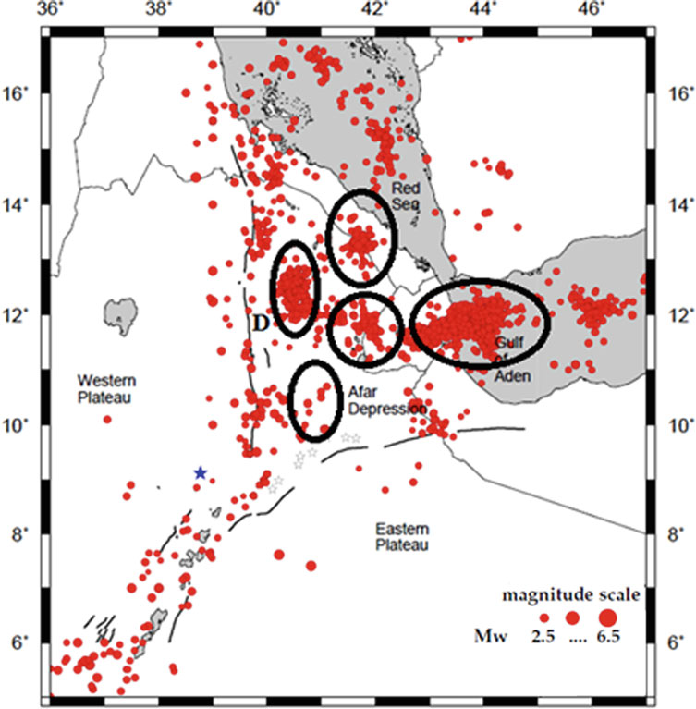
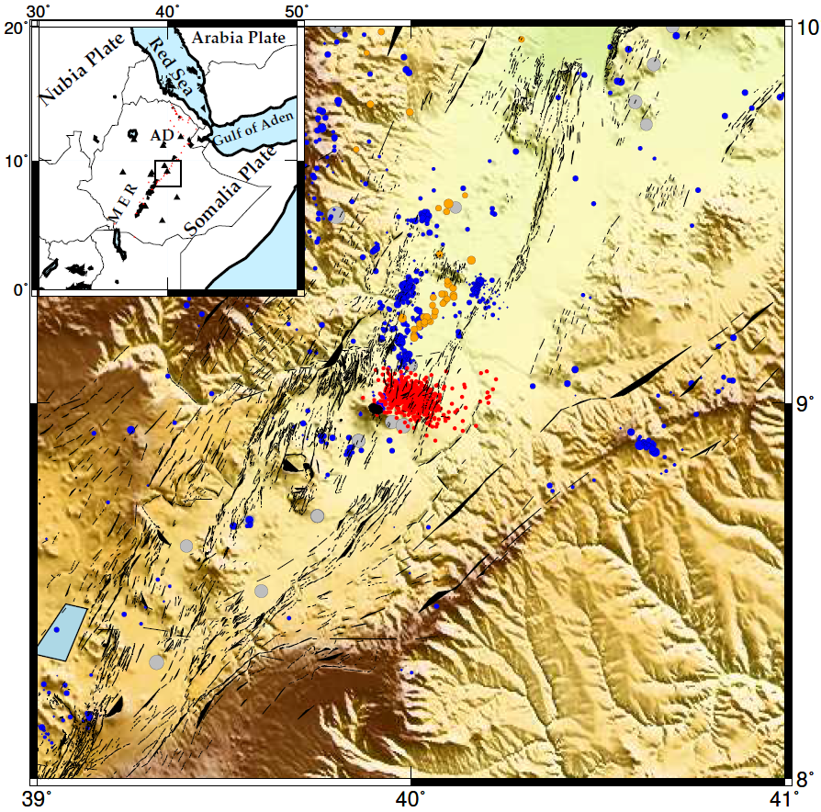
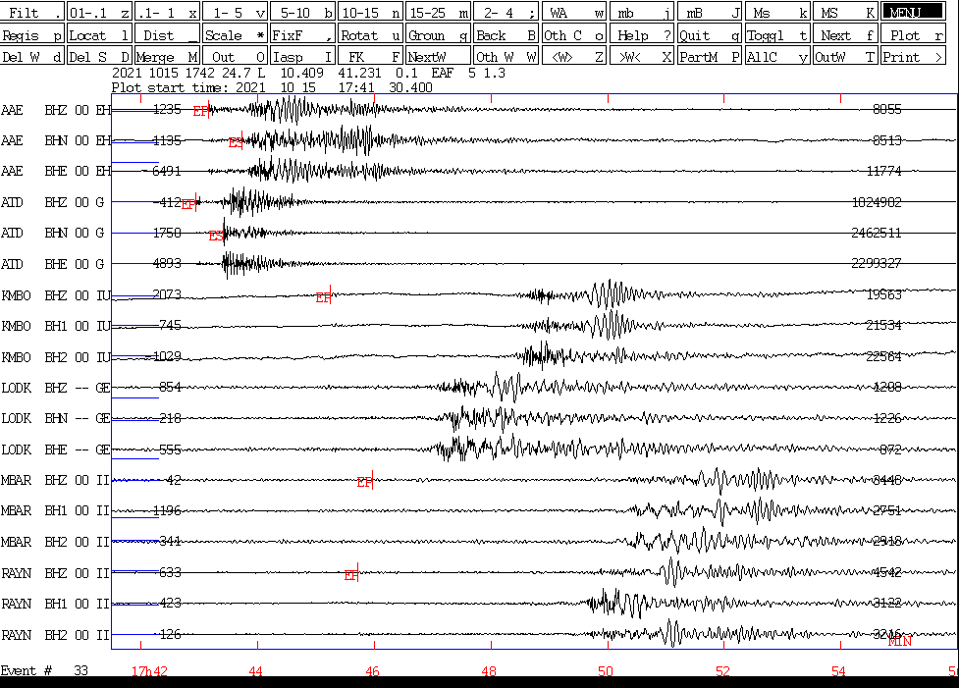
Volcano Seismology in Afar and northern Main Ethiopian Rift (MER): potential sources for ground truth events
Atalay Ayele
Institute of Geophysics Space Science and Astronomy
P2.3-508
Seismic record for an event with weak Pn phases
. Seismicity around the Afar depression. The ellipses mark distinct volcanic centers in the region.
Figure 7 red spots show swarms of Fentale volcano in 2015
Recommending more RSTT training to improve travel time curves

