Slide 1

Volcano Seismology in Afar and northern Main Ethiopian Rift (MER): potential sources for ground truth events
Atalay Ayele
Institute of Geophysics Space Science and Astronomy, Addis Ababa University, Addis Ababa, Ethiopia
Afar and the Main Ethiopian rift are the most volcanically active and well developed part of the East African Rift System (EARS)
Observational seismology with reasonable seismic station deployment brought better data
Over 20 volcano-tectonic earthquake sequences have occurred in Afar and the northern main Ethiopian rift for the last couple of decades
Volcano seismology is a strong tool for investigating active volcanoes for basic and applied science research.
The data can be used for calibrating RSTT curves
Please do not use this space, a QR code will be automatically overlayed
P2.3-508

Slide 2
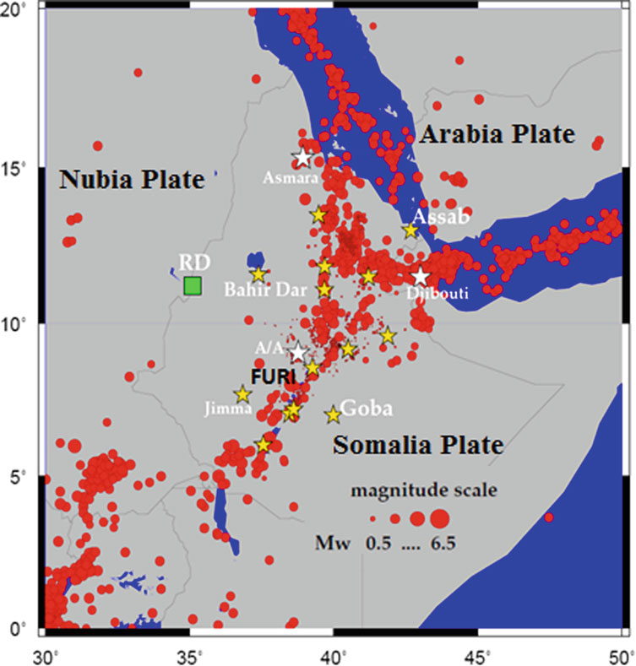
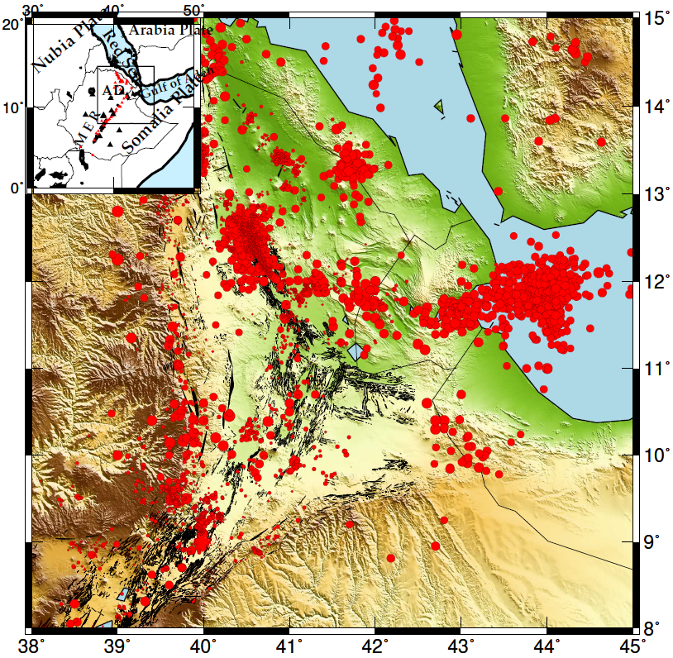
Introduction to volcano seismology
Normal continental lithosphere is too strong to rift apart without some synchronous assistance by magmatic dyke intrusions and related processes (Buck, 2006)
Figure 1. Seismicity in Ethiopia and the neighboring region (Ayele, 2017). The red dots show locations of earthquakes where circle size is proportional to magnitude in the range 0.5–6.5 Mw. The white stars show capital cities in the region and the yellow stars show major towns in Ethiopia. AA, Addis Ababa and RD (green box) is the Ethiopian Renaissance Dam.
Please do not use this space, a QR code will be automatically overlayed
Figure 2. Zoomed version of the fist map with focus in the Afar Depression. The black lines are faults (Aguistini et al., 2011) with partial coverage and red dots are major earthquake recorded so far with modern instruments.
Px.x-xxx

Slide 3
Objectives and importance related with the verification regime
There are two fundamental objectives of studying volcano seismology in our region
Afar and the Main Ethiopian rift area is one of the few most interesting places to study active continental rifting and volcanism. Volcano seismology is the simplest and cheapest way of indicating future volcanic erupetions.
A number of active volcanoes are found nearby major Ethiopian cities and towns. The threat posed by those active volcanoes in the MER has until now been underestimated. Future explosive eruptions similar to those of the past 10 k.y. would blanket major cities in the rift valley. Therefore volcano monitoring is indispensable for proper disaster risk management.
The other objective related with the theme of this conference is .
To use the seismic phase arrival data sourced from these known volcanoes and improve earth models for predicting seismic travel-times for more accurate calculation of event locations.
We need distance-dependent, one-dimensional (1D) Earth models to calculate seismic event locations quickly and in near real-time. RSTT (Regional Seismic Travel Time) is a seismic velocity model and computer software package that can be implemented for this purpose (Begnaud et al., 2020).
To this affect we need more training in our sub-region to generate practical and implementable travel-time curves for accurate event location.
Please do not use this space, a QR code will be automatically overlayed
Px.x-xxx

Slide 4
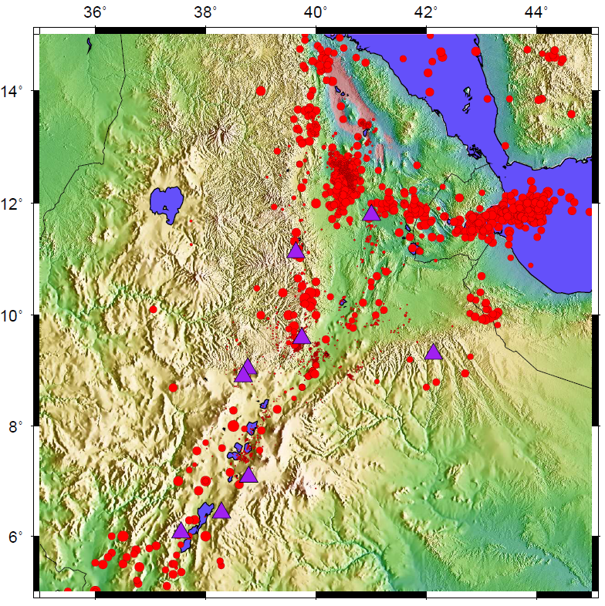
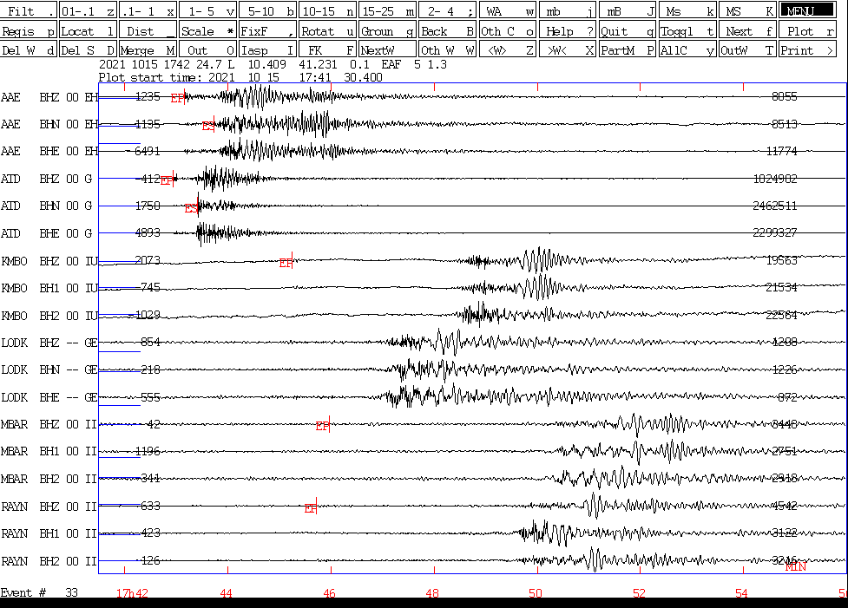
Methods and data used
Figure 3. Volcanoes active in the last 10, 000 years, the red ones are those which demonstrated to be active in historical time.
Figure 4. Permanent seismic station distribution in Ethiopia shown by purple triangles and red dots are showing seismicity
Figure 5. Seismic records for an event that occurred around the Afar depression, showing the challenge of picking weak Pn phases
Please do not use this space, a QR code will be automatically overlayed
Px.x-xxx

Slide 5
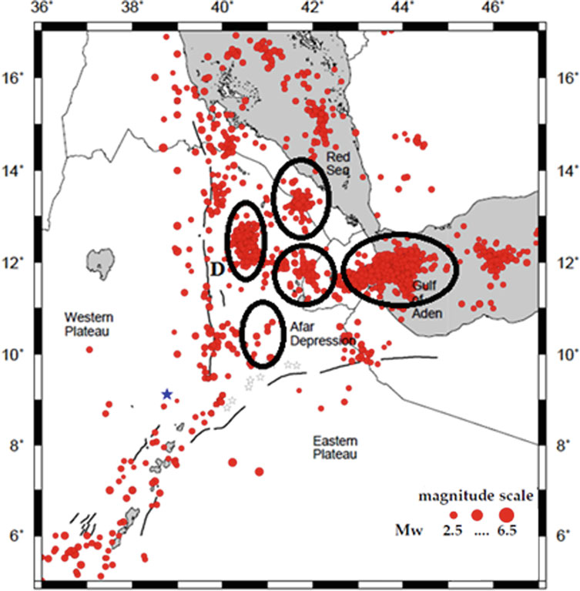
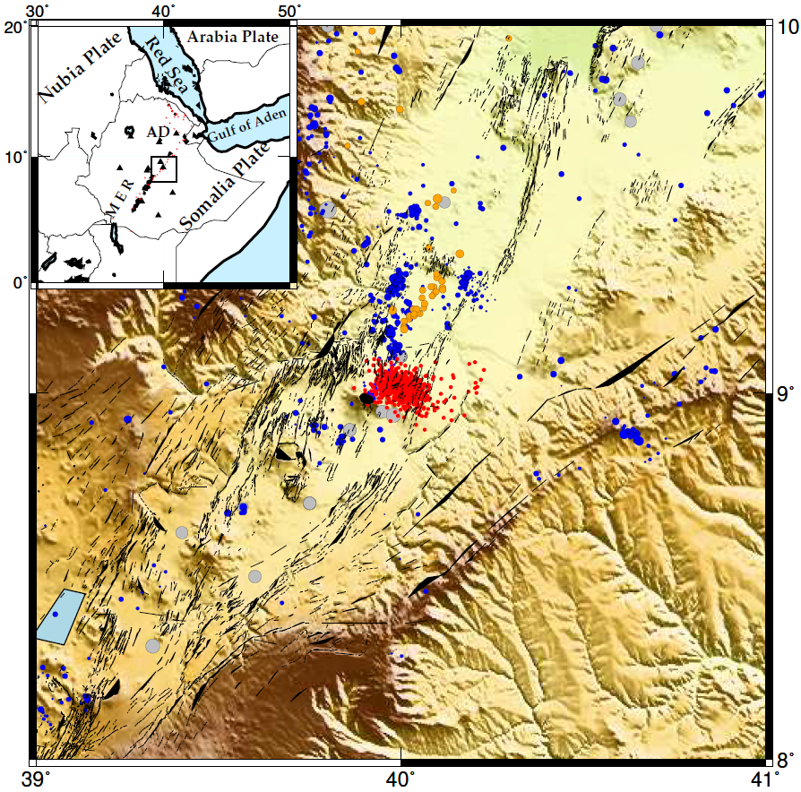
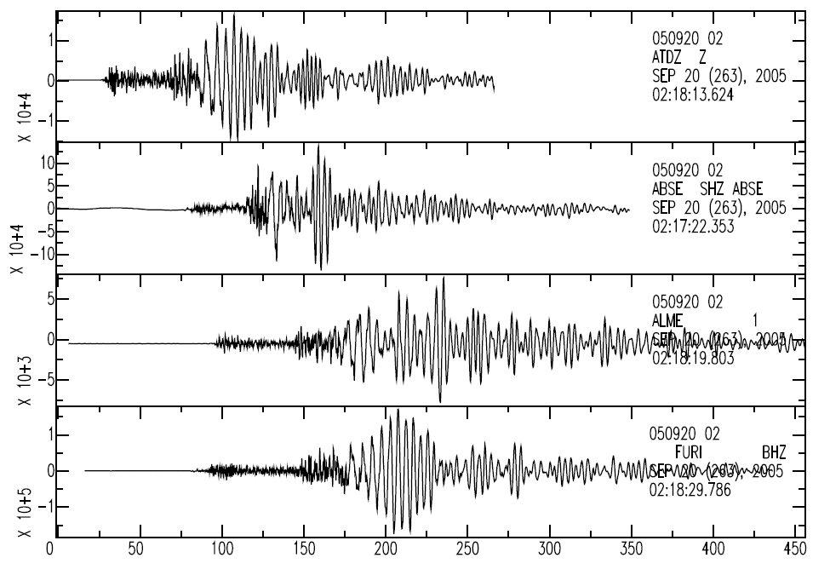
Results and Discussions
Figure 8. Seismograms for an earthquake in the Dabbahu that occurred in 2005 showing dominance of low frequencies that trails the record.
Figure 6. Seismicity around the Afar depression. The ellipses mark distinct volcanic centers in the region. The letter D shows Dabbahu mega dike intrusion that sustained over a period of 10 years starting from 2005 to 2014.
Figure 7 red spots show swarms of Fentale volcano in 2015
Please do not use this space, a QR code will be automatically overlayed
Px.x-xxx

Slide 6
Conclusions and Recommendations
Volcano-seismology can tell us a lot on the different features of the source region, while models for low-frequency seismicity offer insight into magma (or other fluid) dynamics.
Almost all of active volcanoes in East Africa are unmonitored which is a challenge for disaster risk management
We are having problems of deriving a reasonable travel time curve in this volcano dominated region but surface waves are normally well developed at far distance. To this effect,
We recommend Improving event location accuracy using RSTT-based travel time corrections using volcanic earthquakes as ground truth events with reasonable accuracy in the 5- 10 km range.
Please do not use this space, a QR code will be automatically overlayed
Px.x-xxx

Slide 7
References
Agostini, A., Bonini, M., Corti, G., Sani, F., & Mazzarini, F. (2011). Fault architecture in the Main Ethiopian Rift and comparison with experimental models: Implications for rift evolution and Nubia-Somalia kinematics. Earth and Planetary Science Letters, 301(3-4), 479–492. https://doi.org/10.1016/j.epsl.2010.11.024
Ayele A (2017) Probabilistic seismic hazard analysis (PSHA) for Ethiopia and the neighboring region. J Afr Earth Sci:134–265
Begnaud, M. L., S. C. Myers, B. A. Young, J. R. Hipp, D. Dodge, and W. S. Phillips (2020). Updates to the Regional Seismic Travel Time (RSTT) Model: 1. Tomography. Pure Appl. Geophys., 24 pp. doi: 10.1007/s00024-020-02619-5
Buck,W.R.(2006).“The role of magma in the development of the Afro-Arabian Rift System,”in The Afar Volcanic Province within the East African Rift System, edsG.Yirgu,C.J.Ebinger,andP.K.H.Maguire(London:GeologicalSociety), 259,43–54.
Please do not use this space, a QR code will be automatically overlayed
Px.x-xxx

