Slide 1
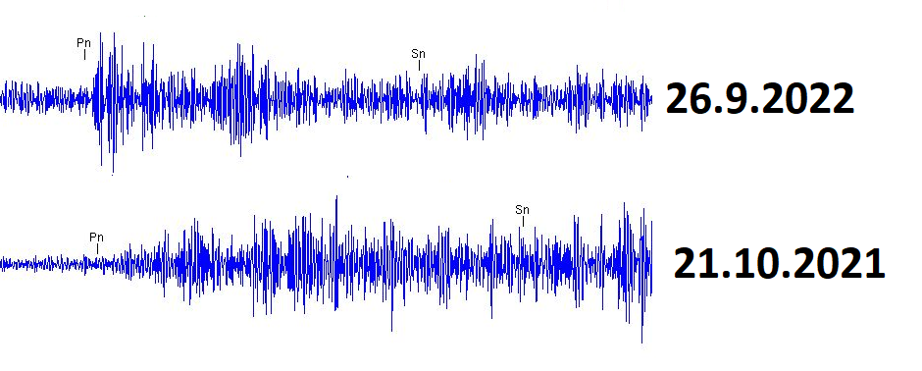
Evaluation of Nordstream-explosions applying NDC-in-a-Box Software
Ulrike Mitterbauer NDC-AT / GeoSphere Austria
P2-3- 306
- Two REB-events were classified as suspicious events by the Austrian National Data Center:
26.9.2022 00:03 UTC, mb 3.1
26.9.2022 17:03 UTC, mb 3.2
- Testing the capabilities of the NDC
Forensic analysis
Analysis local data with waveform-analysis-tools provided within NDC-in-a-Box

