Slide 1
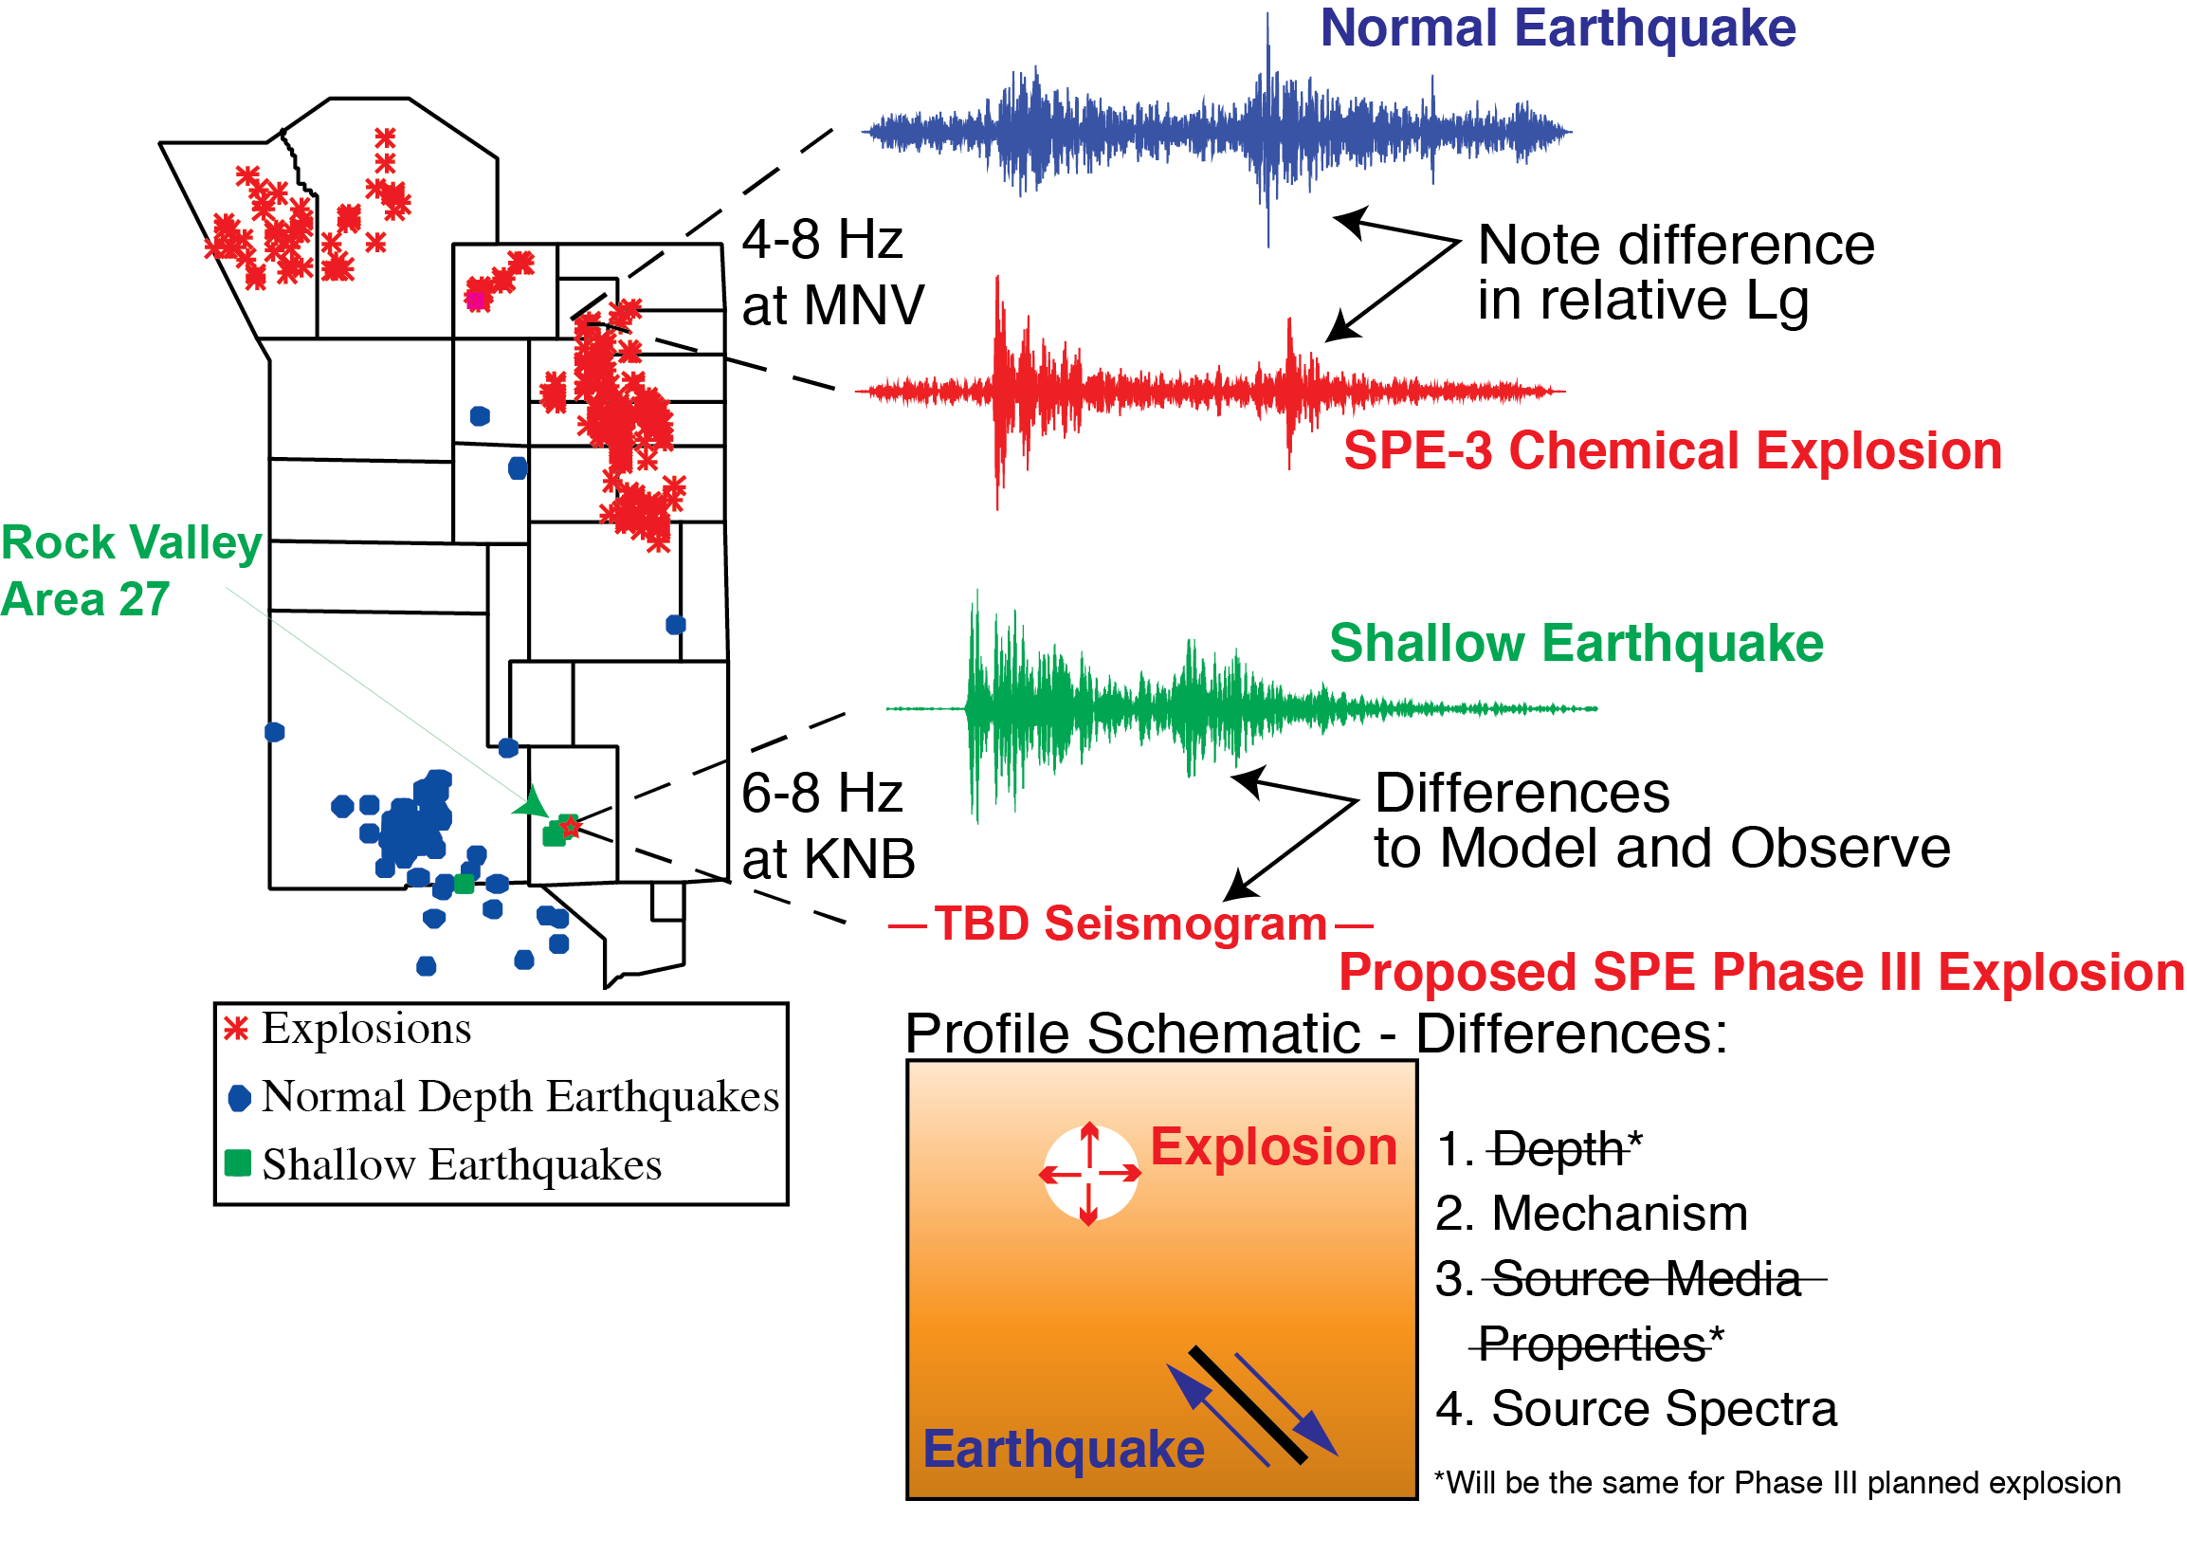
The Rock Valley Direct Comparison instrumentation plan
Robert E. Abbott¹, Richard Alfaro-Diaz², Arben Pitarka³, and Cleat Zeiler⁴
¹Sandia National Labs, ²Los Alamos National Lab, ³Livermore National Lab, ⁴Nevada National Security Sites
P2.3-127
SPE Phase III - Rock Valley Direct Earthquake-Explosion Comparison (RV/DC) experiment will allow a direct evaluation of our source type discrimination/identification models.
Large chemical explosion (~10 tons) at site of one of the 1993 Rock Valley Earthquakes (depth ~1.5-2.0 km) recorded at same stations, plus a small Green’s function explosion below that first
The poster will focus on the plan for a regional, multi-physics, sensor array to record the chemical explosions.

