Slide 1
REB and SEL3 bulletins for CPUP scope measurement
Caballero A., Fugarazzo R., Figueres V., Gadea M.
Facultad de Ciencias Exactas y Naturales / Universidad Nacional de Asunción
In order to analyze worldwide seismic events we use the REB and SEL3 seismic bulletins from CTBTO, an objective is to highlight the different seismic zones and shadow zones.
The methods applied during this research are AutoDRM, then python scripts by myself to implement some statistical and geospatial analysis with the ArcGIS plataform.
A time window from 2018 to 2020 were analyzed, tectonic plates boundaries are able to be drawn with seismic events display, we obtained statistical values such as the mean, max and min magnitudes.
Using the REB and SEL3 as inputs for geospatial software such as GIS and programing language allows us to draw the seismogenic zones.
Please do not use this space, a QR code will be automatically overlayed
P2.3-816

Slide 2
Introduction
Since Capacity Building installation at our National Data Center on 2012 year, data from IMS network (BDFB, LPAZ, PLCA and CPUP) arrives to our server in order to perform daily routine analysis and research. Another advantages from CTBTO services to our NDC are the secure web potal and AutoDRM services from where we are able to obtain the REB and SEL3 seismic bulletins, these are the main input for statistical studies that we will conduct for this research.
Please do not use this space, a QR code will be automatically overlayed
P2.3-816

Slide 3
Analysis of reviewed bulletins 2018-2022
Key points for achievement are:
Analysis of REB and SEL3 for event mapping.
Show the cluster and the seismic zones
Highlight the CPUP data scope for the IMS into a map
Please do not use this space, a QR code will be automatically overlayed
P2.3-816

Slide 4
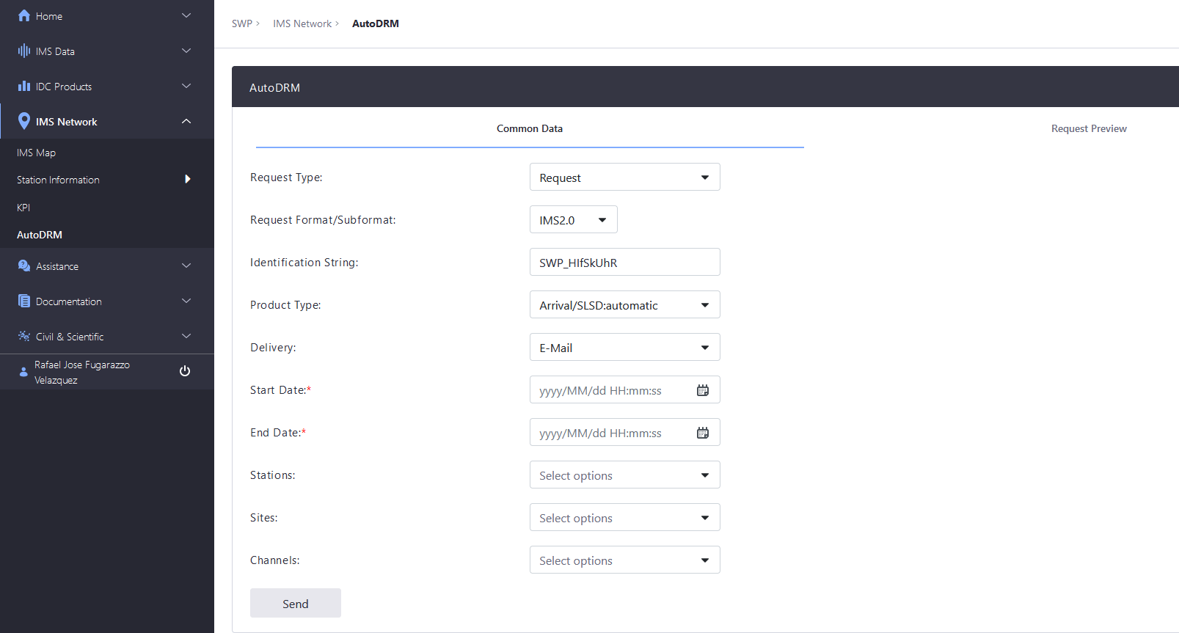
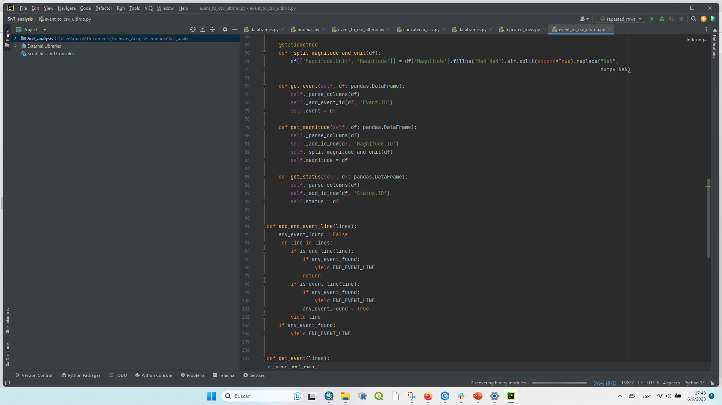
Data management and processing
Data downloading
Auto DRM from Secure web portal (CTBTO)
Data management
Sorting and handling of data using the Python scripts.
Please do not use this space, a QR code will be automatically overlayed
P2.3-816

Slide 5
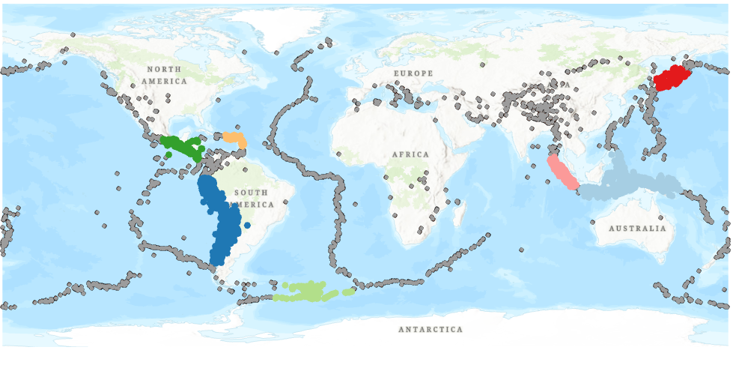
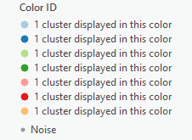
Clusters of CPUP REB bulletin and Shadow zones
Those are events no recorded by CPUP station
CPUP detections (yellow) and all IMS stations detection (black)
Noise
Please do not use this space, a QR code will be automatically overlayed
P2.3-816

Slide 6
Statistical reports
Please do not use this space, a QR code will be automatically overlayed
P2.3-816

Slide 7
Statistical reports
Please do not use this space, a QR code will be automatically overlayed
P2.3-816

Slide 8
Conclusion
The seismic zones can be clearly observed using spatial statistics tool from the ArcGIS Pro “DBSCAN”(ML algorithm) as well as the seismic zones were not covered by CPUP bulletin. Also, the difference of 0.5 in the mean values of magnitudes can be observed, as well as the values of the minimum and maximum.
Please do not use this space, a QR code will be automatically overlayed
P2.3-816

