Slide 1
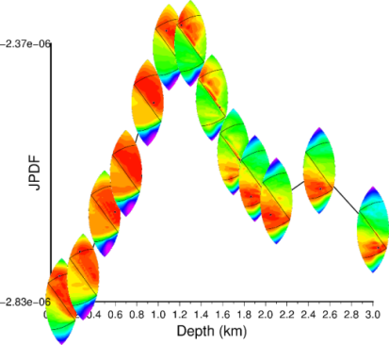
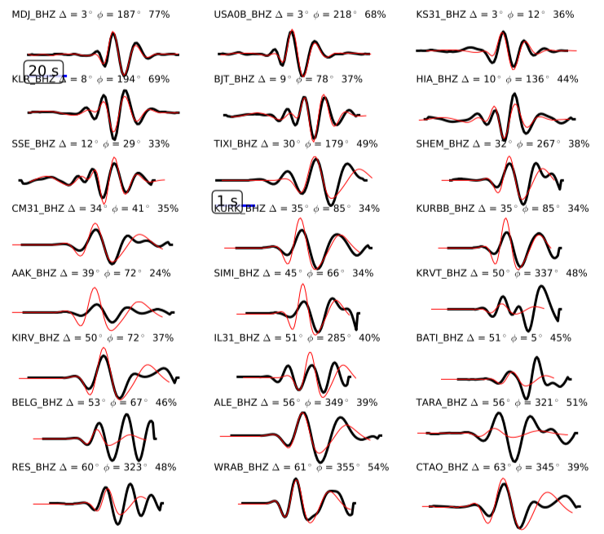
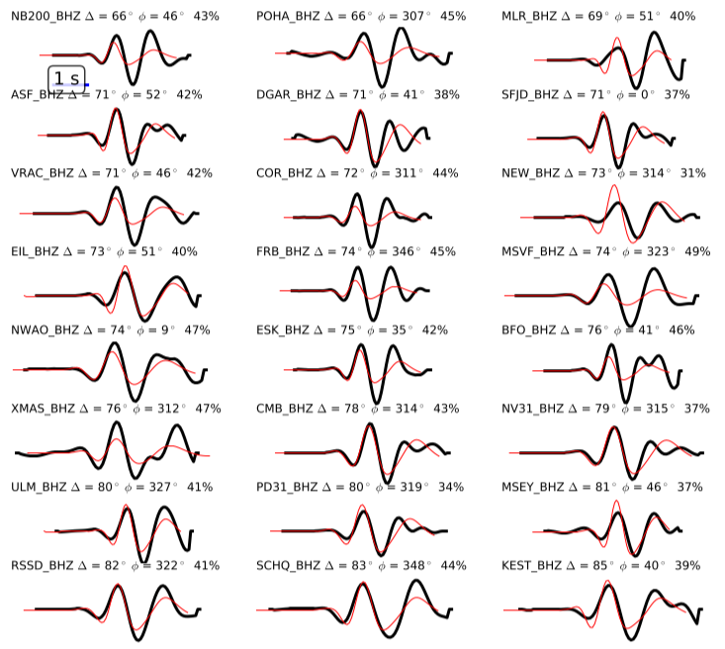
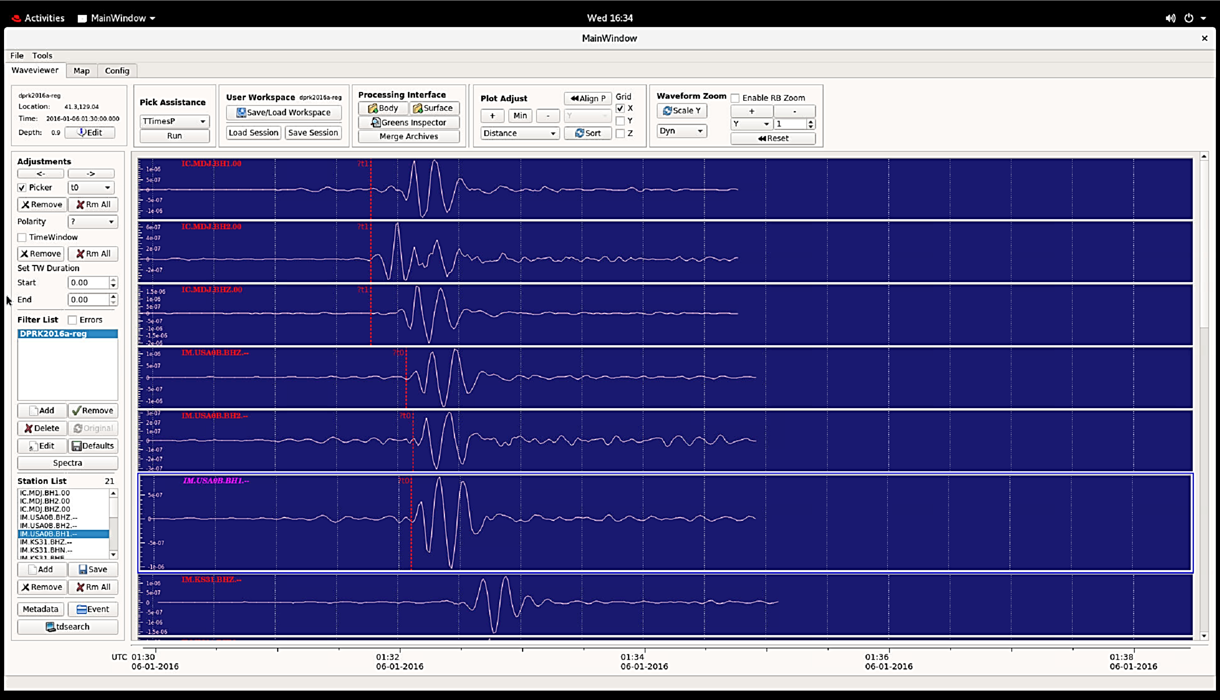
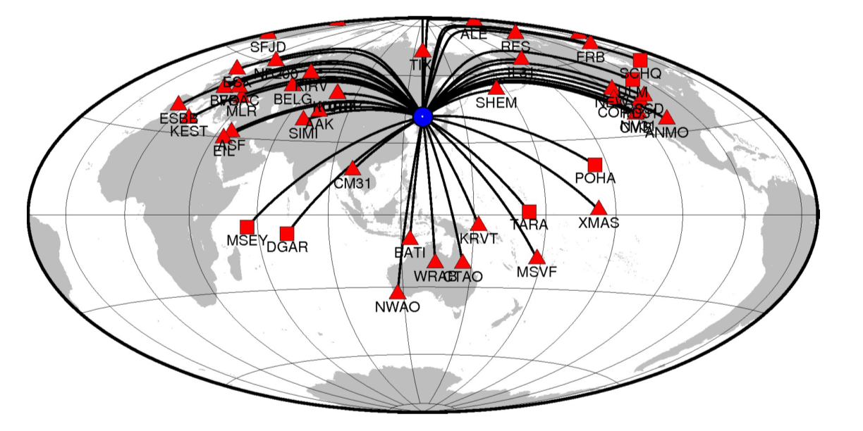
ParMT – Parallel Software for Shallow Seismic Events Joint Moment Tensor, Depth and Magnitude Determination
Ivan Kitov¹, Mikhail Rozhkov², Jeff Leifer², Ilya Dricker²
¹ PTS CTBTO, Vienna, Austria; ²Instrumental Software Technologies, Inc., USA
P2.3-410
Source mechanism and event depth are two parameters which may be crucial for the event discrimination task. To introduce them into the PTS commissioning, we have continued development, testing and tuning of ParMT software suite for IDC Expert Technical Analysis and Special Studies.
ParMT (parallel moment tensor) is a GUI/scripting tool for shallow seismic event depth determination and source parameters characterization.
Source properties are estimated via grid search over moment tensors. We follow Tape and Tape (2015) to uniformly discretize the moment tensor space, then determine the optimal moment tensor, magnitude and depth by comparing observed seismograms with synthetic waveforms.
Greens Functions are calculated using libraries modified from Computer Programs in Seismology (Herrmann, 2002) for use in parallel processing. hudson96 program is used for teleseismic body waves synthetics and hspec96 (FK-integration) is used for regional surface waves. Millions of synthetic waveforms to be generated within minutes to fully explore the moment tensor search space.
Use of InstaSeis seismograms based on AxiSEM generated Green’s function databases (IRIS’s Syngine http://ds.iris.edu/ds/products/syngine/)
Several waveform objective functions can be used.
The software solves for the moment tensor for major types of sources (ISO, DC, CLVD) and source-receiver distances.
Teleseismic body and regional surface waves are used.
Convenient scripting mechanism for retrieval FDSN and IMS data is supplied.

