Slide 1
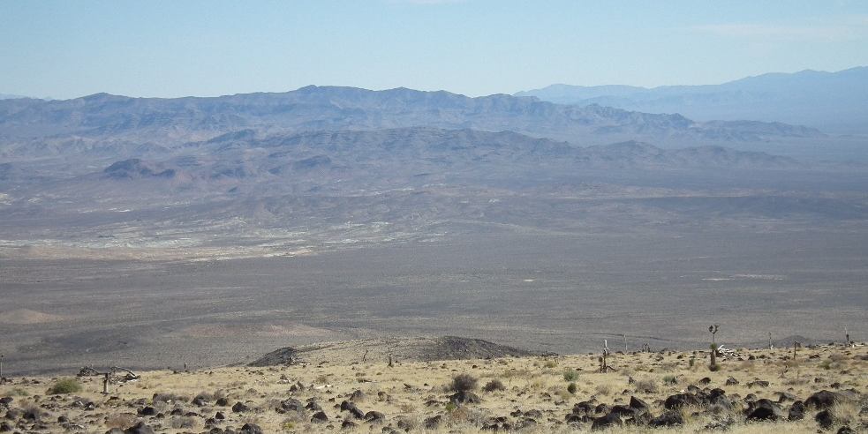
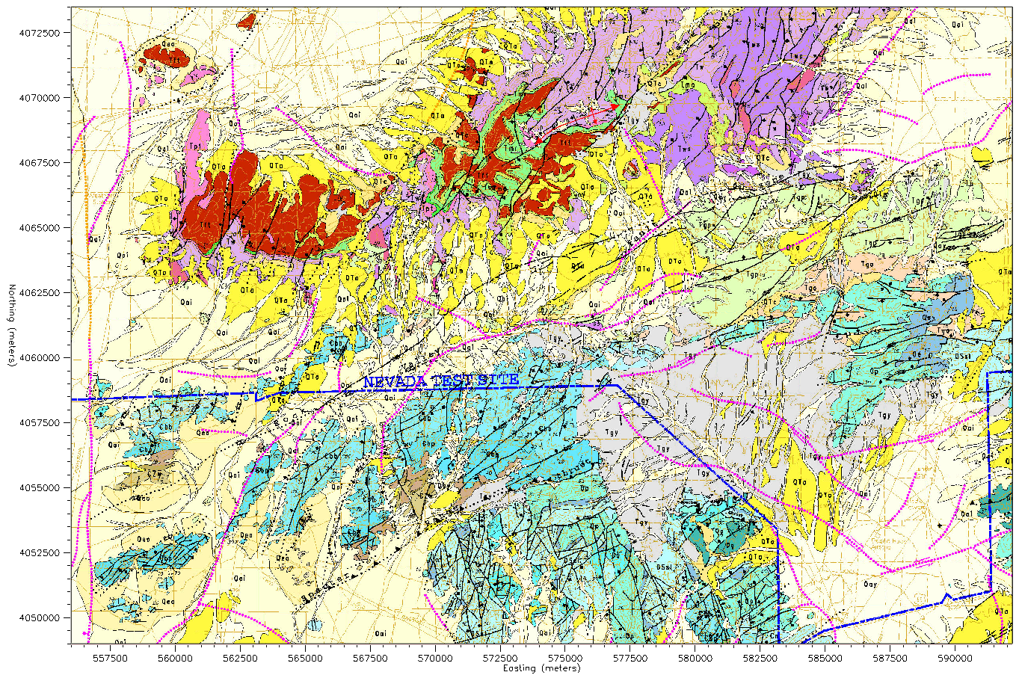
Investigation of the P/S Discriminant al Local Distances Using Simulated Waveforms
Arben Pitarka and William R. Walter
Lawrence Livermore National Laboratory
T2.3-484
Rock Valley
Simulated 0-10Hz P/S Spatial Distribution at Rock Valley
Using High Performance Computing
Introduction: We used high-frequency (0-10Hz) ground motion simulations to emulate the Rock Valley Direct Comparison (RV/DC) experiment in order to investigate the generation and propagation of seismic waves at local distances, and the performance of the P/S source discriminant
Method: The numerical experiments were performed using high-performance computing on the LLNL computer clusters and SW4 a highly efficient finite-difference computer program
Results: Our simulations suggest that at local distances the P/S discriminant is mainly affected by the degradation of the radiation pattern of direct P and S waves due to wave scattering effects in the shallow crust
Conclusions: P/S ratio averaging over a broad azimuthal range tend to minimize the effects spatial variations of P and S radiation patterns on the P/S. Consequently spatial averaging can enhance the performance of the local P/S discriminant
P/S Earthquake
P/S Explosion
Free Surface Vs
A2
A2
A1
A3
A1
A3
Rock Valley Geological Framework
Model (GFM)
A1: Typical earthq. and
explos. waveforms
A2:Earthq. looks
like an explos.
A3: Explos. looks
like an earthq.
Skull Mountain Domain
Rock Valley Domain
Specter Range Domain
Good separation of Earthq. and Explos. for averaged P/S (bold traces)
Rock Valley Seismic Velocity Model
Good station coverage and P/S averaging
improves the performance of P/S discriminant
at local distances
This work was performed under the auspices of the U.S. Department of Energy by Lawrence Livermore National Laboratory Contract DE-AC52-07NA27344. Lawrence Livermore National Security, LLC. LLNL-PRES-831342

