Slide 1

Investigation of the P/S Discriminant at Local Distances Using Simulated Waveforms
Arben Pitarka and William R. Walter
Lawrence Livermore National Laboratory
We used high-frequency (0-10Hz) ground motion simulations to emulate the RV/DC experiment in order to investigate the generation and propagation of seismic waves at local distances, and the performance of the P/S source discriminant
The numerical experiments were performed using high-performance computing on the LLNL computer clusters and SW4 a highly efficient finite-difference computer program
Our simulations suggest that at local distances the P/S discriminant is mainly affected by the degradation of the radiation pattern of direct P and S waves due to wave scattering effects in the shallow crust
P/S ratio averaging over a broad azimuthal range tend to minimize the effects spatial variations of P and S radiation patterns on the P/S. Consequently spatial averaging might enhance the performance of the local P/S discriminant
Please do not use this space, a QR code will be automatically overlayed
T2.3-484

Slide 2
Introduction
In this study we investigate the impact of wave propagation effects on the performance of the P-S ratio local discriminant during the third phase of the Source Physics Experiment (SPE), the Rock Valley Direct Comparison (RV/DC), that is being conducted at the Nevada National Security Site. The SPE RV/DC project addresses the goal of development and testing seismic source discrimination techniques. During the experiment a chemical explosion will be detonated near the hypocenter of a shallow earthquake. The experiment will provide ground truth data needed for calibrating existing source discrimination techniques and improvements of physics-based computer codes that are used in seismic sources modeling and simulation of source and wave propagation related waveform signatures. The direct waveform comparison on a dense network of seismic sensors will enable the investigation of seismic source signatures and discrimination between explosion and earthquakes sharing the same propagation path.
Please do not use this space, a QR code will be automatically overlayed
T2.3-484

Slide 3
Objectives
The objective of this study is the investigation of differences in the P/S ratio at local distances for collocated isotropic (explosion) and double-couple (earthquake) point sources using ground motion simulations on a 0-10Hz frequency range.
The simulated waveforms can be used to investigate the implication of structural complexities in spatial variations of the P/S ratio and the potential improvements of the P/S discriminant through stations averaging
Please do not use this space, a QR code will be automatically overlayed
T2.3-484

Slide 4
Methods/data
We used high-frequency (0-10Hz) ground motion simulations to emulate the RV/DC experiment in order to investigate the generation and propagation of seismic waves at local distances, and the performance of the P/S source discriminant. The numerical experiments were performed using high-performance computing on the LLNL computer clusters and SW4 (Petersson and Sjogreen,2018) a highly efficient finite-difference computer program that allows anelastic wave propagation modeling in heterogenous media with surface topography. We used the Geological Framework Model (GFM) a local velocity model developed for the Rock Valley area which for the purpose of this study we modified in order to include small-scale heterogeneity in the upper 7 km of the crust. The heterogeneity is modeled by correlated depth-dependent stochastic velocity and density perturbations to the original GFM.
Please do not use this space, a QR code will be automatically overlayed
T2.3-484

Slide 5
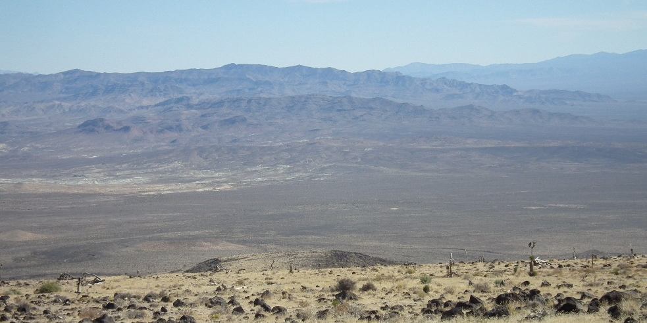
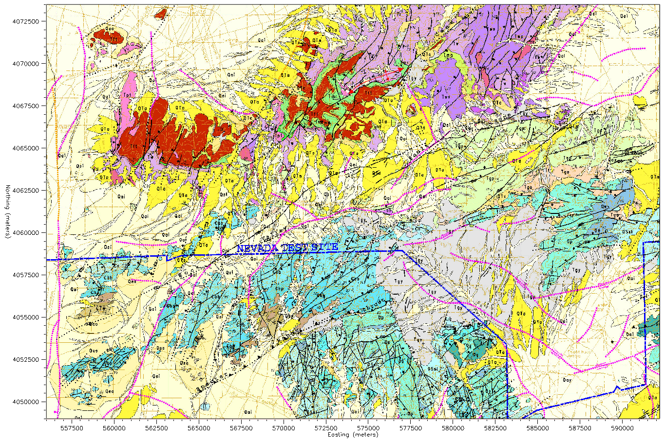
Rock Valley Geological Framework Model (GFM)
From: L. Prothro
Rock Valley looking south from Skull mountain
SM:Volcanic rocks;
tertiary sed
RV: Alluvial deposits
SR: Paleozoic, Precambrian
Deposits, Alluvial deposits
Skull Mountain Domain
Rock Valley Domain
Specter Range Domain
(+/-200m/s)
Vp1600m/s, Vs=500m/s
Local RV GFM
Vp=1800m/s, Vs=900m/s
grid spacing: 4-16 m
max freq: 8 Hz
(+/-600m/s)
(+/-700m/s)
Vp=2200m/s, Vs=1200m/s
Vp=5000m/s, Vs=2900m/s
Please do not use this space, a QR code will be automatically overlayed
Figure 1. Geological Framework Model (GFM) for the Rock Valley area. Top panels: Rock valley looking south from the Skull mountain (left), and
local geology model (right). Bottom panels: Geological stratigraphy at the Rock Valley (left), local RV Geological Framework Model (GFM) (right)
T2.3-484

Slide 6
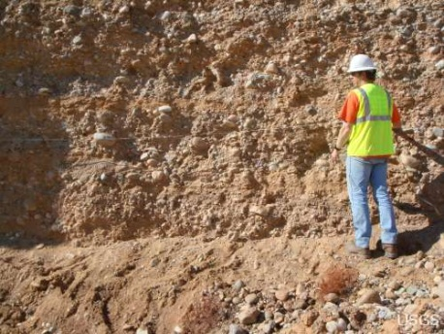
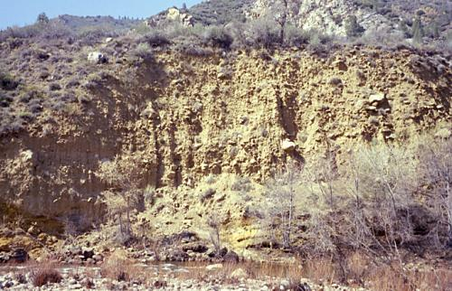
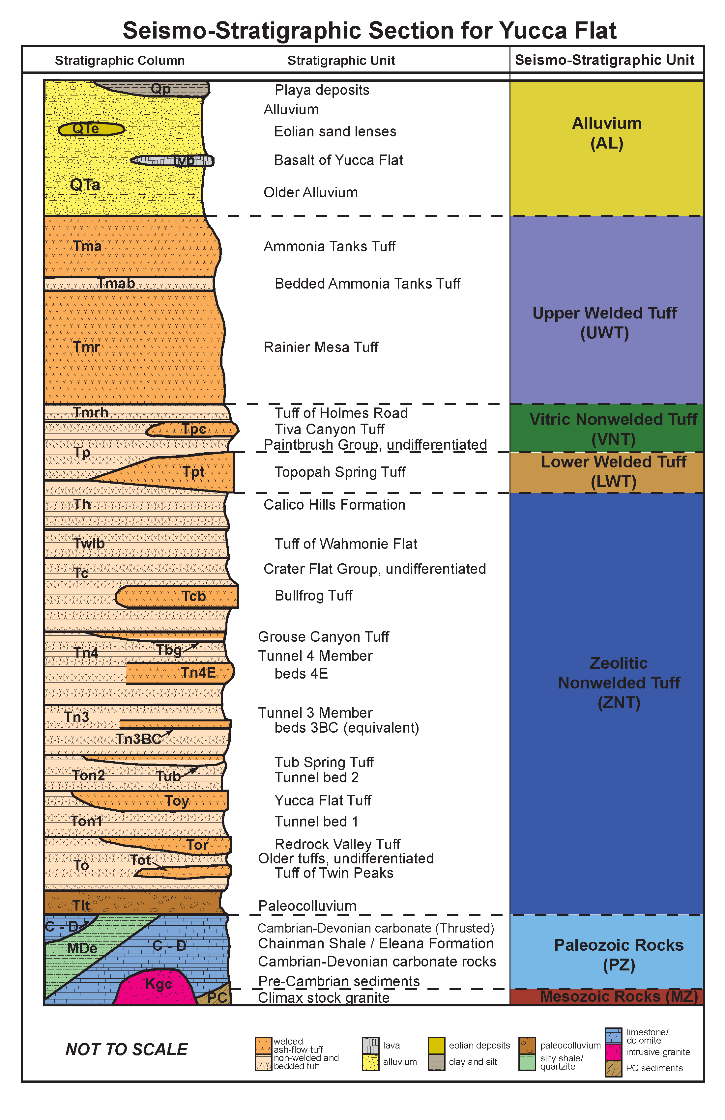
Modeling Small-Scale Structural Complexities using Correlated
Stochastic Perturbations of Velocity in the GFM Using VonKarman Model
Local Geology
(from Ezzedine et al., 2019)
Seismic Velocity Model With Small Scale Stochastic Perturbations
(from Pitarka and Mellors, BSSA 2020
Von Karman L_{h}=1km L_{z}=0.25km H=2
von Karman
Von Karman L_{h}=1km L_{z}=0.25km H=0.7
Please do not use this space, a QR code will be automatically overlayed
Figure 2. Modeling small-scale structural complexities using correlated stochastic perturbation of velocity generated with the vonKarman model. In order to improve the performance of our high-frequency wave propagation simulations for the Rock Valley experiment we introduced depth dependent correlated stochastic perturbations into the RV GFM model
T2.3-484

Slide 7
Rock Valley Geological Framework Model (GFM)
P/S Earthquake
P/S Explosion
1D Velocity Model
Unperturbed P and S radiation patterns due
to radially homogenous wave propagation effects
1D Model
A1
P/S Earthquake
P/S Explosion
A1
A1
3D Velocity Model
Strongly modified P and S radiation patterns
due to 3D wave propagation effects
3D Model
A2
A2
Please do not use this space, a QR code will be automatically overlayed
Figure 3. 0-10 Hz simulated spatial variations of P/S ratio for collocated doble couple earthquake point source (left panels) and isotropic
explosion point source at Rock Valley, using a 1D local velocity model (top panels) and 3D GFM velocity models. The local 3D wave propagation
effects deform the spatial radiation pattern of P and S waves. The resulting deformed P/S spatial pattern follows the velocity model spatial complexity
T2.3-484

Slide 8
Correlation of the Spatial P/S Variation with the Shallow Local Structure
Simulated Local wave Propagation Effects on P/S
Local P and S waves are strongly
affected by wave propagation effects
P/S Earthquake
P/S Explosion
Free Surface Vs
A2
A2
A1
A3
A3
A1
A1: Typical earthq. and explos. waveforms
A2:Earthq. that looks like an explos.
A3: Explos. that looks like an earthq.
Please do not use this space, a QR code will be automatically overlayed
Figure 4. Simulated wave propagation effects on P/S ratio. Waveform comparison of synthetic seismograms for an earthquake source (black traces)
and explosion source (red traces) computed at stations A1, A2, and A3 indicated by triangles shown in the top panels. Note the similar waveforms at
stations A2 where the earthquake looks like an explosion and station 3 where the explosion looks like an earthquake.
T2.3-484

Slide 9
Demonstration of Wave Propagation Effects on Simulated Waveforms at a Circular Array of Stations Centered at the Source
East
Similar waveforms
North
North
West
East
Similar waveforms
West
South
South
Please do not use this space, a QR code will be automatically overlayed
Figure 5. Comparison of the vertical component of simulated ground motion velocity for collocated earthquake (black traces) and explosion (red traces) on a
circular array of stations centered at the RV GZ (dotted green circle on the right panel). Note that the local geology along the wave path significantly affects
waves generated from the isotropic and double-couple sources, resulting in generation of P-S conversions and surface waves that affect the P/S ratio expected
from these point sources
T2.3-484

Slide 10
Spatial Variation of Simulated P/S on a Circular Array of Stations
Array C1 (5 km)
Array C2 (10 km)
Please do not use this space, a QR code will be automatically overlayed
Figure 6. Investigation of the azimuthal variations of the P/S ratio on two circular arrays of stations. Array C1 has a radius of 5 km, and array C2 indicated by the green circle has a 10km radius.
Top panels: P/S ratios computed for the explosion (red dots) and earthquake (black dots). Bottom panels compare the synthetic seismograms at stations where the P/S ratio is very similar for both sources ( stations C.02.02, C.02.11, and C.02.19) and very different at station C.01.15
T2.3-484

Slide 11
Spatial Averaging of Simulated P/S in the Frequency Range 0-10Hz
-The average P/S is higher for the explosion source
-There are several areas where P/S for Earthq.
and Expl. sources are similar
Conclusion:
Good station coverage and P/S averaging
improves the performance of P/S discriminant
at local distances
Figure 7. Effect of spatial averaging of the local P/S ratio for the explosion (red trace) and earthquake (black trace).
The colored dots indicate individual measurements of the P/S at different location over the domain covered by the TV-DC GFM model.
The separation between the red and black line at epicentral distances > 6km suggests that station averaging can improve the performance
of the local P/S discriminant
Please do not use this space, a QR code will be automatically overlayed
T2.3-484

Slide 12
Results
Our simulations suggest that at local distances the P/S discriminant is mainly affected by the degradation of the radiation pattern of direct P and S waves due to wave scattering effects in the shallow crust.
P/S averaging over a network of stations with good azimuthal coverage improves the overall performance of the discriminant in the considered local distance range
Please do not use this space, a QR code will be automatically overlayed
T2.3-484

Slide 13
Conclusions
Hybrid velocity models that combine deterministic and stochastic properties of the underground structure is necessary for modeling wave signatures affecting the P/S discriminant.
2. For shallow RV earthquakes and explosion, regional wave scattering effects degrade the P and S wave radiation patterns causing the seismic P/S discriminant to be less dependent on the source radiation pattern and less effective with distance. P/S ratio averaging over a broad azimuthal range tend to minimize the effects spatial variations of P and S radiation patterns. Consequently, spatial averaging might enhance the performance of the local P/S discriminant.
Please do not use this space, a QR code will be automatically overlayed
T2.3-484

Slide 14
References
Petersson N. A., and B.E. Sjogreen (2018). SW4 Users Guide, Version 2.01, Lawrence Livermore National Laboratory, LLNL‐SM‐741439.
Pitarka A., and R. Mellors (2021) Using Dense Array Waveform Correlations to Build a Velocity Model With Stochastic Variability, Bull. Seismo. Soc. Am.,1–21, doi: 10.1785/0120200206
Please do not use this space, a QR code will be automatically overlayed
This work was performed under the auspices of the U.S. Department of Energy by Lawrence Livermore National Laboratory Contract DE-AC52-07NA27344. Lawrence Livermore National Security, LLC. LLNL-PRES-831342
T2.3-484

