Slide 1
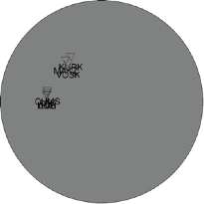
Full Moment Tensor and Source Characteristics of Nuclear Explosions at the Lop Nor Test Side, China
Jonas A. Kintner
Los Alamos National Laboratory, Los Alamos, New Mexico, USA
P2.3-490
Objective
This study is intended to exercise ability to estimate moment tensors with little available data for remote seismic events of interest.
Methods
We use the MTUQ software (Modrak & Tape, 2022) to conduct a detailed analysis of these selected events at the Lop Nor test site.
Results
All events show locally good fits for source types that correspond to an isotropic explosion, solutions vary by velocity model selection.
Some solutions are poorly constrained due to data availability and quality.
Example of source type trades off with model selection
Conclusions
This study demonstrates the importance of model selection for moment tensor analysis. Preliminary 3D waveform modeling suggest we can achieve improved source type constraints even in a monitoring scenarios with poor azimuthal coverage.

