Slide 1
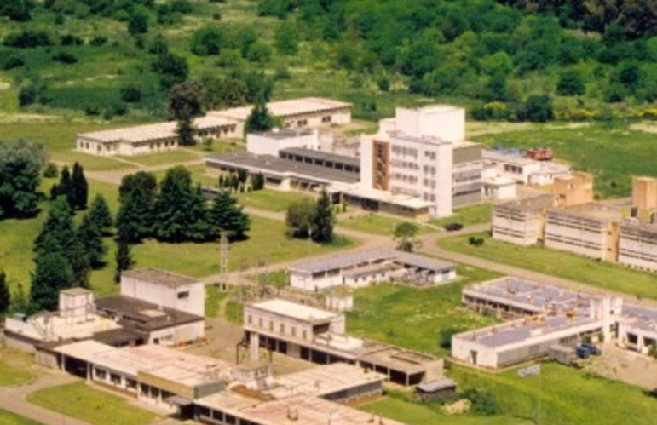
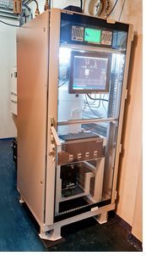
STAX monitor measurements at 99Mo production plant (CAE) in Argentina
Mauro Nuñez¹, Román Pino¹, Andrés Zapata¹, Federico Fernandez Baldis^{1,} Eduardo Carranza²,
Eduardo Nassif¹, Ricardo Sagarzazu¹, Horacio Boccoli¹
¹ INVAP S.E. Argentina, ² CNEA – Planta de Producción de Radioisótopos por Fisión (CAE - CNEA) Argentina
P2.4-243
WHAT´S STAX?
Source Term Analysis of Xenons
Measuring Radioxenons at the Source
MIPF´s
RR
NPP
Emission Sources
WHERE..?
Radioisotope Fission Production Plant – (CAE) Ezeiza Atomic Center
Buenos Aires - Argentina
Specific plant constraints
To cope with high concentration activity (~ countrates)
Noble Gas emission peaks (low dilution regime)
Small available room/dimensions
Ease to maintainance
- Accurate measurement of Radioxenons/NG
(¹³³ Xe – ¹³⁵ Xe – ^{131m} Xe – ^{133m} Xe – ^{85m} Kr – ^{135m}Xe)
Come and see our Poster ……!!!
(#243 - Session 2.4 – Friday, June 23rd)
How to solve it ?

