Slide 1
Possible influence of subtropical anticyclones on monitoring the GRULAC region
¹Bonfim, C.E.S.; ¹Curzio, ¹R; Kranzfeld, ¹L; Medeiros, T.; ²Oliveira, R.A.A.C. ; ²Andrade, E.R.
1-Brazilian Army/ Chemical Biological Radiological and Nuclear Defense Institute
2-Brazilian Army/ Military Institute of Engineering (IME)
Evaluation of the influence of atmospheric circulation dynamics on the detection of radionuclides in stations ARP 01, ARP03, BRP11, CLP 18, CLP19, ECP24, FRP31 and PAP50.
Time series 6 years (2017-2022) from GRULAC Stations
Comparison of detections from stations in the northern (FRN31 and PAP50) and southern hemisphere (ARP01, ARP03, BRP11, CLP18, CLP19) in relation to the ECP24 station at the IZTC.
The presence of anticyclones/cyclones near the stations is a significant parameter in the detection of ⁷Be.
P2.4-495

Slide 2
Introduction
Of the existing nuclear reactors in the world, the Latin American and Caribbean Group (GRULAC) region currently has a total of six nuclear power plants operated by Argentina, Brazil and Mexico and 16 research reactors being operated by Argentina, Brazil, Chile, Colombia , Jamaica, Mexico and Peru.
The Comprehensive Nuclear-Test-Ban Treaty Organization (CTBTO) has established an International Monitoring System (IMS) for treaty verification based on waveform and radionuclide (RN) technologies.
The RN network is made up of 80 stations, 63 of which are certified, of which 12 have been operating in the GRULAC region since 2016.
Each RN station collects radionuclide aerosols daily and your gamma spectrum is sent to the International Data Center (IDC) in Vienna for analysis.
P2.4-495

Slide 3
Introduction
Treaty verification requires that any anthropogenic radionuclides present in the atmosphere also be detected and identified. There are many possible anthropogenic radionuclides arising from several sources:
hospitals and medical research facilities where radiopharmaceuticals are used, dispensed or discarded (EZEIZA-CNEA);
university or other research institutions where radioactive markers are used (RA-06; RA-04; RA-03; RA-01; RA-00; IEN-R1; IEA-R1; IPEN/MB-01; IPR-R1; RECH-1; IAN-R1; JM-1; CHICAGO 9000; MARK III; RP-0 and RP-1.
nuclear energy reactors that release noble gases (ATUCHA; EMBALSE and ANGRA), among otheres
In addition to the existing natural background radioactivity, therefore, also an anthropogenic background, and IMS experience already indicates that radionuclides from some of these sources are detected daily.
P2.4-495

Slide 4
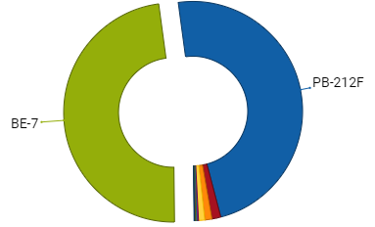
Introduction
⁷Be and ²¹²Pb are naturally occurring radionuclides and gamma emitters that are constantly detected by stations as we can see in the figure on the side.
In this work, we will evaluate the behavior of ⁷Be detected in the GRULAC region, influenced by the meteorological conditions of the region where different wind regimes are established, including the subtropical anticyclones of the South Atlantic and South Pacific, the low-level jets to the west and east of the Andes and the trade winds.
Figure 1: CTBT Detection (2023).
P2.4-495

Slide 5
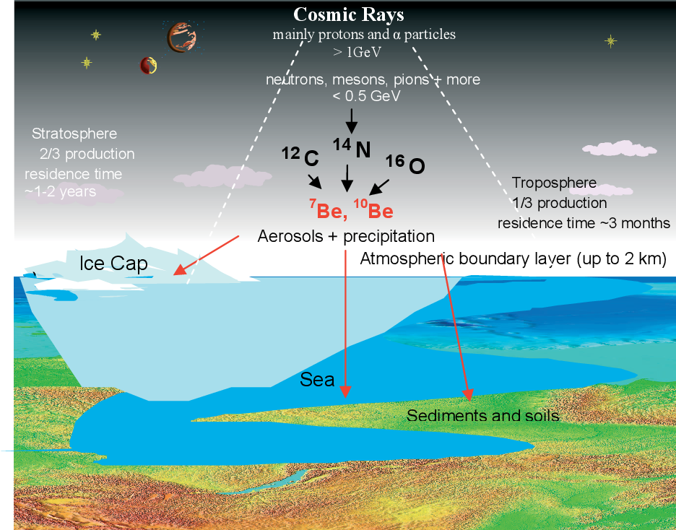
Introduction
⁷Be decays with a half-life of 53.3 days and is abundantly produced in the lower stratosphere and upper troposphere (Tilley et al., 2002) from the fragmentation of atmospheric gas nuclei, mainly nitrogen and oxygen.
Production rates in the stratosphere are twice as high as in the troposphere (Lal and Peters, 1962).
⁷Be bind to aerosol particles and are transported by winds and redistributed vertically by gravitational sedimentation and are finally removed by wet and dry deposition in the lower troposphere.
Figure 2: Atmospheric production and transport of ⁷Be and ¹⁰Be.
Source: Kulan (2007).
P2.4-495

Slide 6
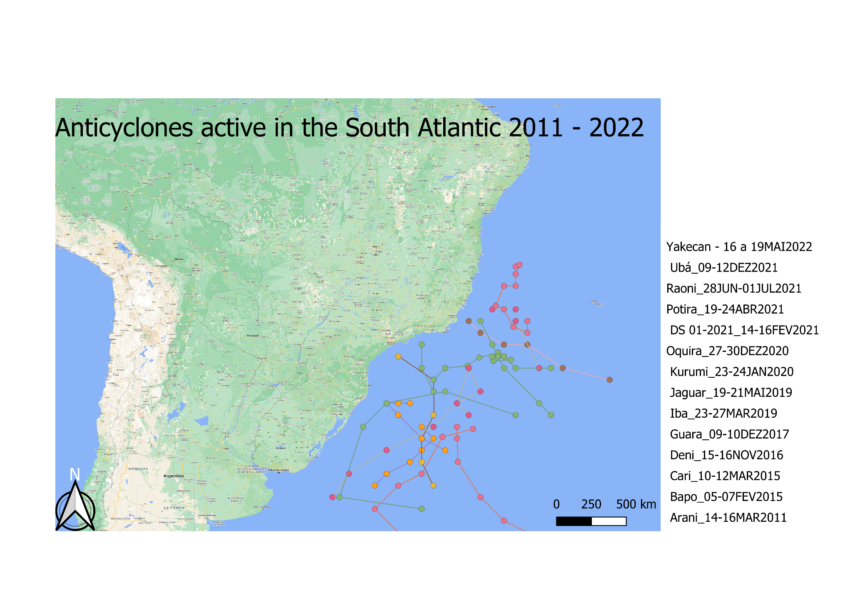
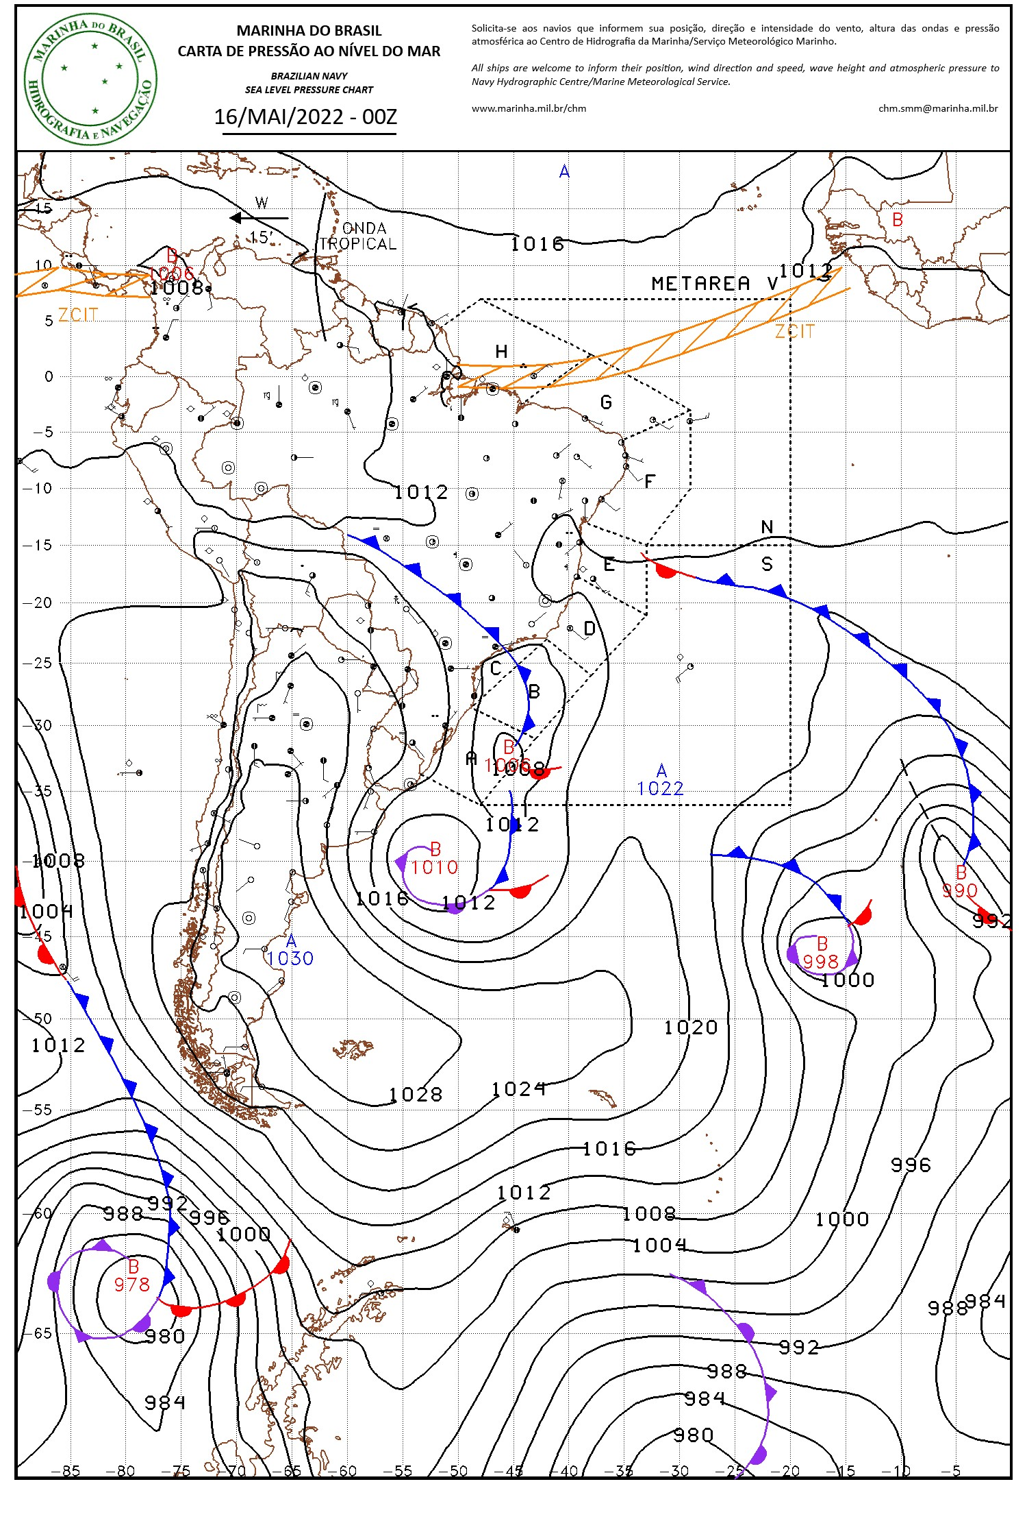
Introduction
Subtropical anticyclones (SAs) is salient element of the large-scale atmospheric circulation within both hemispheres. SAs are semi-permanent high-pressure systems situated over each subtropical ocean basin that both influence and respond to sea surface temperature (SST), precipitation, atmospheric moisture transport, and wind-driven ocean circulation.
Therefore, it is believed that the anticyclone and its effects may interfere with radionuclide detection.
P2.4-495
Figure 3: Subtropical anticyclones.

Slide 7
Objectives
Evaluate the GRULAC Region using the RN stations installed and certified by the IMS;
Collect the radionuclide data obtained by these stations;
Evaluate the behavior of the stations;
Monitor radionuclides in atmospheric particulate matter in the region;
Evaluate the behavior of ⁷Be at the stations;
Compare ⁷Be detections between stations;
Evaluate the possible influence of subtropical anticyclones on monitoring the region; and
Evaluate the influence of Ferrel and Hadley cells in the detection of ⁷Be in the region.
P2.4-495

Slide 8
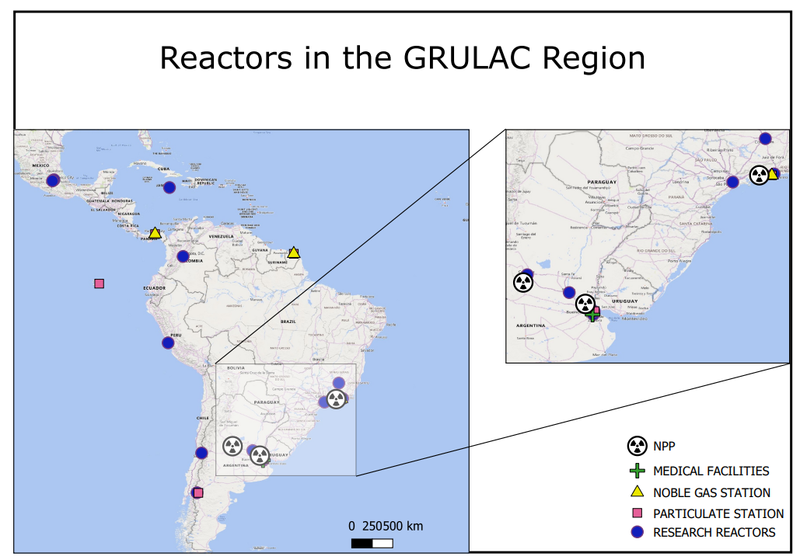
Methods/data
This evaluation took as reference:
1. Local
1.1. RN stations;
1.2. Research Reactors;
1.3. Nuclear Plants; and
1.4. Medical Facilities.
2. Sample Collection
3. Statistical Analysis
3.1. RN Toolkit; and
3.2. Meteorological Data of the
Region.
P2.4-495
Figure 4: RN´s Station; NPP, Medical Facilities and Research Reactors in Grulac Region.

Slide 9
Methods/data
Local
TYPE | STATION | LAT | LON | ALT | COUNTRY | FLAG
PARTICULATE | ARP01 | -34,539 | -58.465 | 31,00 | Argentina
 | ARP03 | -41.146 | -71.157 | 849,00 | Argentina
 | BRP11 | -22.991 | -43.416 | 7,00 | Brazil
 | CLP18 | -53.137 | -70.878 | 20,00 | Chile
 | CLP19 | -27.125 | -109.345 | 152,00 | Chile
 | ECP24 | -0.614 | -90.351 | 10,00 | Ecuador
 | FRP31 | 5.171 | -52.689 | 9,00 | French Guiana
 | PAP50 | 8.983 | -79.533 | 90 | Panama
NOBLE GAS | BRX11 | -22.991 | -43.416 | 7,00 | Brazil
 | CLX19 | -27.125 | -109.345 | 152,00 | Chile
 | FRX31 | 5.171 | -52.689 | 9,00 | French Guiana
 | PAX50 | 8.983 | -79.533 | 90,00 | Panama
NPP | ANGRA | -22.984 | -44.483 | - | Brazil
 | ATUCHA | -33.926 | -59.260 | - | Argentina
 | EMBALSE | -32.102 | -44.483 | - | Argentina
MF | EZEIZA | -34.827 | -58.645 | - | Argentina
TYPE | STATION | LAT | LON | COUNTRY | FLAG
RESEARCH REACTOR AT GRULAC | RA-06 | -41.112 | -71.413 | Argentina
 | RA-04 | -32.959 | -60.628 | Argentina
 | RA-03 | -34.812 | -58.577 | Argentina
 | RA-01 | -34.572 | -58.511 | Argentina
 | RA-00 | -31.440 | -64.192 | Argentina
 | IEN-R1 | -22.865 | -43.226 | Brazil
 | IPEN/MB-01 | -23.566 | -46.738 | Brazil
NOBLE GAS | IPR-R1 | -19.872 | -43.966 | Brazil
 | RECH-1 | -33.428 | -70.525 | Chile
 | IAN-R1 | 4.661 | -74.109 | Colômbia
 | JM-1 | 18.006 | -76.748 | Jamaica
NPP | CHICAGO 9000 | 19.509 | -99.119 | Mexico
 | MARK III | 19.293 | -99.390 | Mexico
 | RP-0 AND RP-10 | -12.084 | -77.008 | Peru
P2.4-495

Slide 10
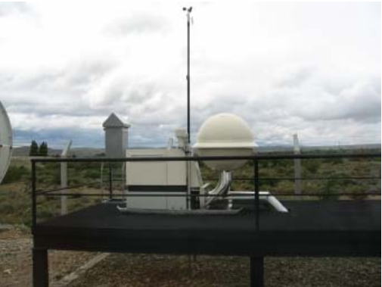
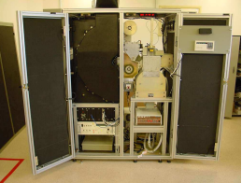
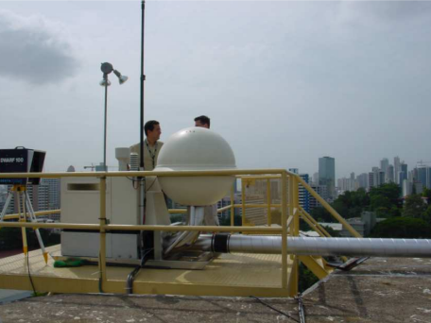
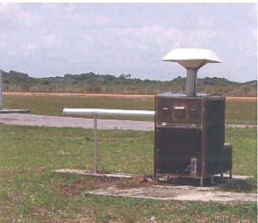
Methods/data
2. Sample collection
TYPE | STATION | MODEL
PARTICULATE | ARP01 | a manual station and includes two Valaire-PR34-50 with EG&G ORTEC HPGe
 | ARP03 | Air Sample Snow White with Canberra HPGe
 | BRP11 | RASA
 | CLP18 | RASA
 | CLP19 | RASA
 | ECP24 | RASA
 | FRP31 | TGD152 by SFI with Eurisys HPGe
 | PAP50 | Air Sample Snow White with Canberra HPGe
Figure 5: JL-900 Snow White, ARP03.
Figure 6: Front view of the RASA with open doors. BRP11.JL-900 Snow White, ARP03.
.
Figure 7: JL-900 Snow White, PAP50.
Figure 8: Air Sample TGD152, FRP31.
P2.4-495
Notes:
The samples are measured on an electrically cooled Canberra HPGe Coaxial P-type Detector, GC5020 of 50 % relative efficiency. The detector electronics consist of a DAS2000 (Canberra), a standard digital unit that includes the amplifier, high voltage, signal processor and multi-channel analyser.

Slide 11
Methods/data
3. Statistical analysis
3.1. RN Toolkit
Radionuclide data were downloaded via the RN Toolkit software, from 2017 to 2022. The RN Toolkit is a web software tool providing fast and easy access to data for radionuclide detections of the IMS network all over the world.
3.2. Meteorological Data of the Region
The metereological data for the study were taken from ERA5-Land Daily Aggregated - ECMWF Climate Reanalysis.
P2.4-495

Slide 12
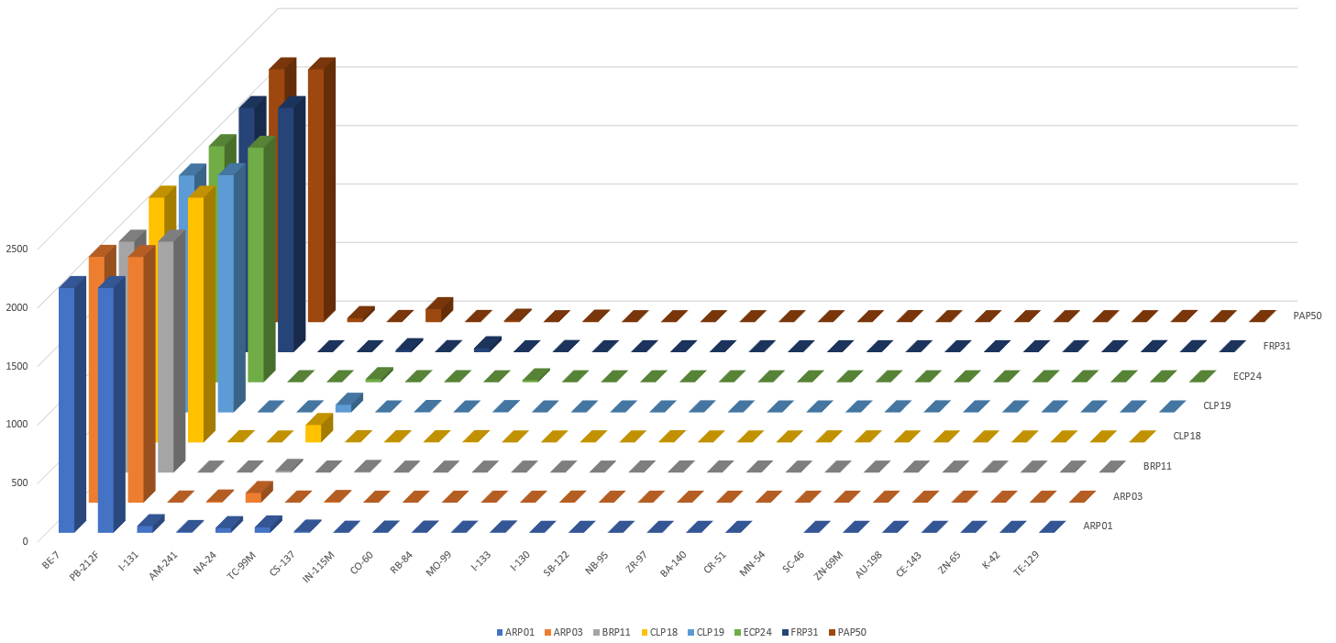
Results
CTBT detection at GRULAC´s Station - Interactive analysis
P2.4-495

Slide 13
Results
Analysis of Meteorological Data in the Region
For the analysis of the influence of meteorological parameters, data on precipitation, temperature, zonal and seasonal wind components and atmospheric pressure extracted from ERA5-Land Daily Aggregated - ECMWF Climate Reanalysis were used and correlated with data extracted from CTBTO stations.
P2.4-495

Slide 14
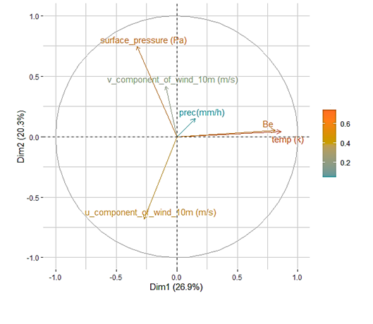
Results
Analysis of Meteorological Data in the Region
Principal component analysis (PCA) is often used on environmental variables to reduce them to a few “axes” (Krebs 1989, ter Braak 1995). in the main component the axes are uncorrelated, eliminating the problem of multicollinearity for subsequent tests of relationships between environmental variables (ter Braak 1995, Zar 1999). This problem is clearly seen in the charts above. This is how the PCA is proposed to determine the level of correlation between the environmental variables and Be-7.
We performed a principal components analysis on the 4 environment variables and BE-7 (Precipitation, Temperature, U and V component of wind) to determine the most important environmental gradients. The data were standardized (i.e., mean = 0 and variance = 1) to account for differences in measurement scales. The eigenvalues and corresponding factor loadings of the four principal components (axes) were calculated based on the correlation matrix of environmental variables.
P2.4-495

Slide 15
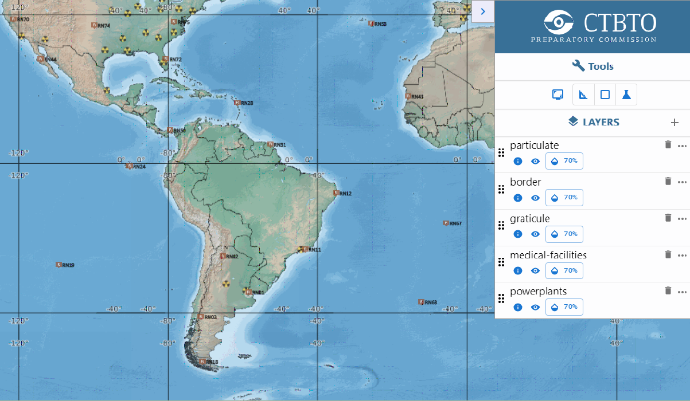
Results
Intertropical Convergence Zone (ITZC)
Web Grape IBS
30ºN
H
N.E. tradewinds
Hadley Cell
COMPARISON
L
PAP50
FRP31
North hemisphere
ECP24 x FRN31
ECP24 x PAP50
South hemisphere
ECP24 x BRP11
ECP24 x ECP19
ECP24 x ARP01
ECP24 x ARP03
ECP24 x CLP18
Intertropical convergence zone (ITZC)
ECP24
H
Hadley Cell
Hadley Cell
H
S.E. tradewinds
BRP11
CLP19
30ºS
ARP01
ARP03
Ferrel Cell
Ferrel Cell
H
L
CLP18
Westerlies
P2.4-495

Slide 16
Results
Comparison Be-7 History in Grulac Region North hemisphere
P2.4-495

Slide 17
Results
Comparison Be-7 History in Grulac Region South hemisphere
P2.4-495

Slide 18
Results
Comparison Be-7 History in Grulac Region South hemisphere
P2.4-495

Slide 19
Conclusion
The GRULAC region is virtually free of relevant particulate radionuclides associated with the verification regime;
The non-existence of relevant particulates shows the efficiency and effectiveness of safety standards regarding the use of nuclear energy in the region;
GRULAC's regional network of IMS RN stations offers an opportunity using ⁷Be as an atmospheric particulate tracker;
The time series of ⁷Be fluxes can be interpreted as precipitation associated with atmospheric variations associated with circulation patterns promoted by the Ferrel and Hadley cells;
The presence of anticyclones (high pressure centers) close to the stations favor the greater absorption of ⁷Be aerosolized by the RN stations, implying in higher concentrations of ⁷Be detected, while the opposite happens for regions of low pressure.
P2.4-495

Slide 20
References
D.R. Tilley, C.M. Cheves, J.L. Godwin, G.M. Hale, H.M. Hofmann, J.H. Kelley, C.G. Sheu, H.R. Weller,Energy levels of light nuclei A=5, 6, 7,Nuclear Physics A,Volume 708, Issues 1–2, 2002.
International Atomic Energy Agency (IAEA), Research Reactor in Latin America and the Caribbean, 17-28241.
Kulan, A. “Atmospheric Production and Transport of Cosmogenic 7Be and 10Be.” (2007).
LAL, Devendra; PETERS, B. Raios cósmicos produziram radioatividade na Terra. Kosmische Strahlung II/Cosmic Rays II , p. 551-612, 1967.
Lee, S.-K., C. R. Mechoso, C. Wang and J. D. Neelin (2013), Interhemispheric influence of the northern summer monsoons on the southern subtropical anticyclone , J. Climate, In-press.
L Terzi and M Kalinowski 2017 World-wide seasonal variation of 7Be related to large-scale atmospheric circulation dynamics J. of Environ. Radioact. 178-179 1-15
Marques, Alessandra Abe Pacini Schmidt. The Role of Hydrogen and Beryllium Isotopes As Tracers of Solar and Climate Variability. 2010.
MATTHEWS, K. M. The CTBT verification significance of particulate radionuclides detected by the International Monitoring System. Ministry of Health, National Radiation Laboratory, 2005.
Muñoz Sabater, J., (2019): ERA5-Land monthly averaged data from 1981 to present. Copernicus Climate Change Service (C3S) Climate Data Store (CDS).
P2.4-495

