Slide 1
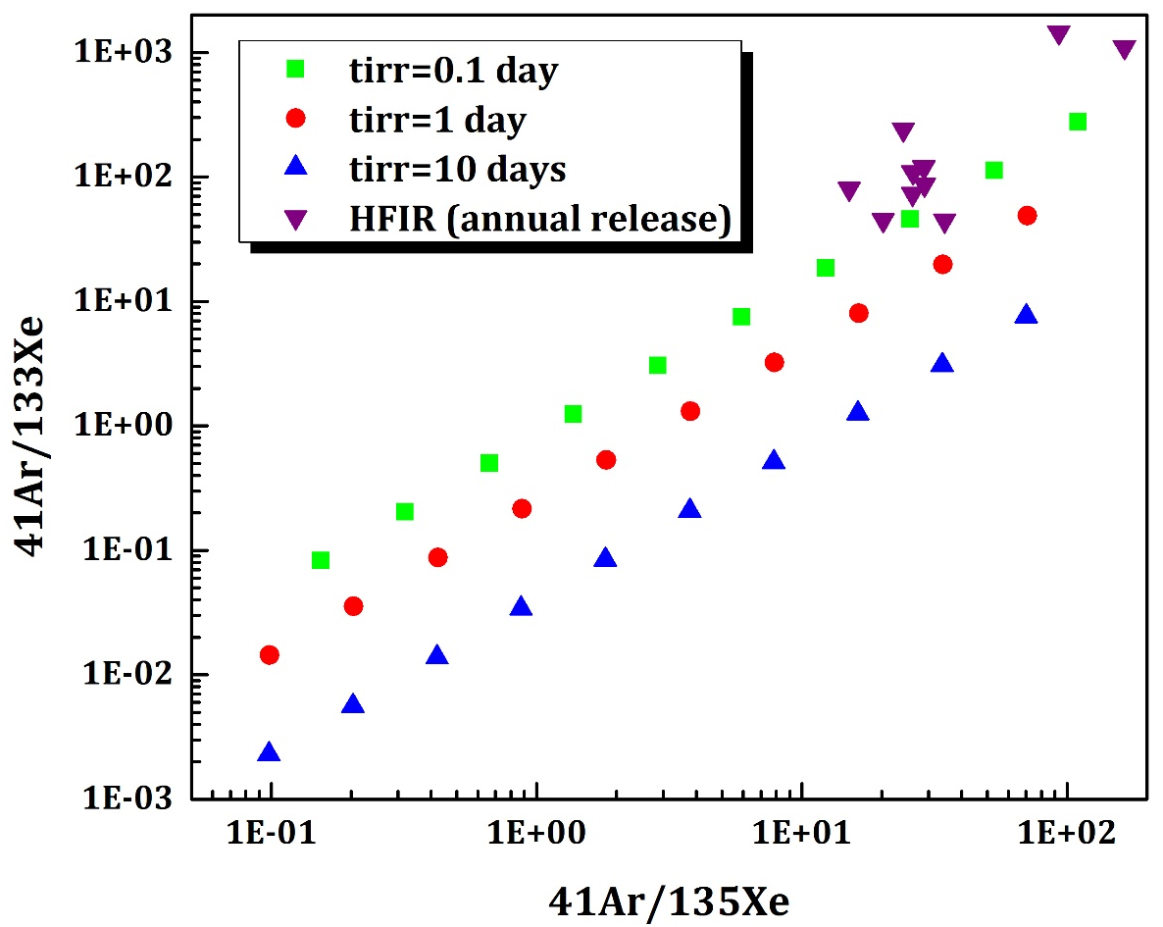
Method comparison on using different cross sections for simulating the radioxenon to radioargon activity ratios created by neutron activation
Martin Kalinowski¹, Pouneh Tayyebi²,
1 Comprehensive Nuclear-Test-Ban Treaty Organization
2 Nuclear Science and Technology Research Institute
P2.4-610
³⁷Ar is used in on-site inspection (OSI).
The measurement of ³⁷Ar is difficult and its releases from nuclear reactors not well known.
By using ⁴¹Ar as proxy for ³⁷Ar, the reactor inventory can be investigated, and the release rates may be estimated.
⁴¹Ar may also be used as proxy for estimating impact on IMS stations by radioxenon generated through neutron activation.
See also e-poster P2.4-608
This e-poster investigates what parameters are important to be considered in simulation of neutron activation of argon to reach these goals.

