Slide 1
Method comparison on using different cross sections
for simulating the radioxenon to radioargon activity ratios
created by neutron activation
Martin Kalinowski¹, Pouneh Tayyebi²,
1 Comprehensive Nuclear-Test-Ban Treaty Organization
2 Nuclear Science and Technology Research Institute
Neutron activation production of ³⁷Ar in nuclear reactors
Detection of ³⁷Ar during OSI activities
Possible confusion of reactor based production with nuclear explosion based production of ³⁷Ar
Comparing different neutron activation cross sections for radioargon production
Reproducing published data with MATLAB simulation
Comparing argon to xenon ratios simulated by MATLAB with reported HFIR releases
The nuclear cross-sections for producing radioargon from stable argon activation are identical or very similar with only one exception
MATLAB simulations of radioargon generation compare well with the results of published data
The releases of ⁴¹Ar from the HFIR reactor can be reproduced with simulations
⁴¹Ar can be used as proxy for ³⁷Ar release estimations
Please do not use this space, a QR code will be automatically overlayed
P2.4-610

Slide 2
Introduction
³⁷Ar is produced via neutron activation of stable argon or calcium in nuclear reactors. This isotope is used in on-site inspection activities. Therefore, its background in the atmosphere from nuclear reactors is an important parameter in interpretation of the on-site measurement results. Since its measurement is complicated, only few reports exist on the amount of its production in the reactors. The radioxenon isotopes or ⁴¹Ar can be used as a proxy for ³⁷Ar, if both are produced through neutron activation. The activity ratio of the proxy to ³⁷Ar can be used to determine the source term of ³⁷Ar. In this presentation the parameters affecting the simulation of these ratios are presented, most importantly the cross section. The results for different cross sections compared and discussed.
Please do not use this space, a QR code will be automatically overlayed
P2.4-610

Slide 3
Objectives
Finding the best cross section database for radioargon produced via neutron activation of air
Finding the best parameters (cross-section, irradiation times, decay times) to reproduce with simulations the argon to xenon ratios of reported HFIR releases
Determining a method for estimation of ³⁷Ar releases using ⁴¹Ar as a proxy.
Please do not use this space, a QR code will be automatically overlayed
P2.4-610

Slide 4
Methods/data
Comparing cross-sections from different sources
MATLAB simulation of neutron activation of stable argon and radioxenon
Comparing simulated ³⁷Ar, ³⁹Ar, and ⁴¹Ar activities with results of Egnatuk et al. (2012)
Comparing simulated ⁴¹Ar to radioxenon activity ratios with reported HFIR releases using different irradiation and decay times
Please do not use this space, a QR code will be automatically overlayed
P2.4-610

Slide 5
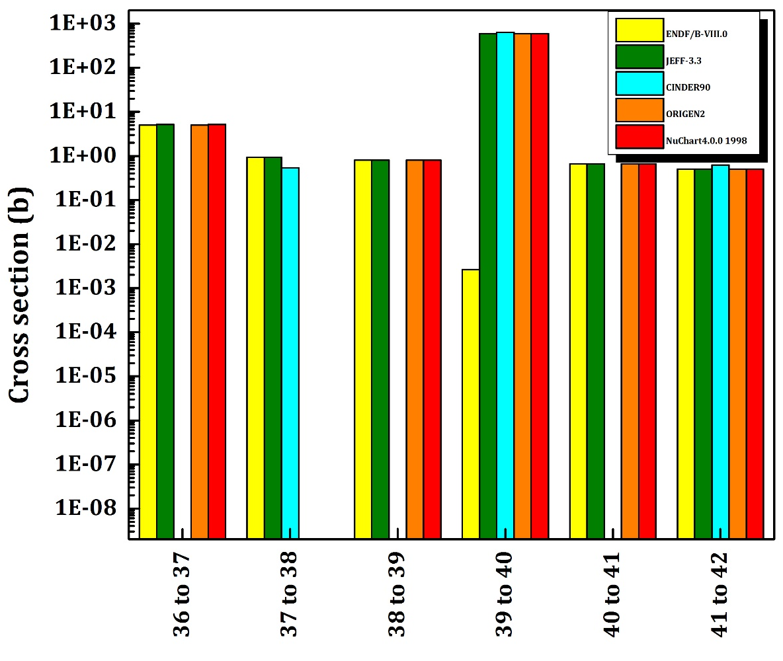
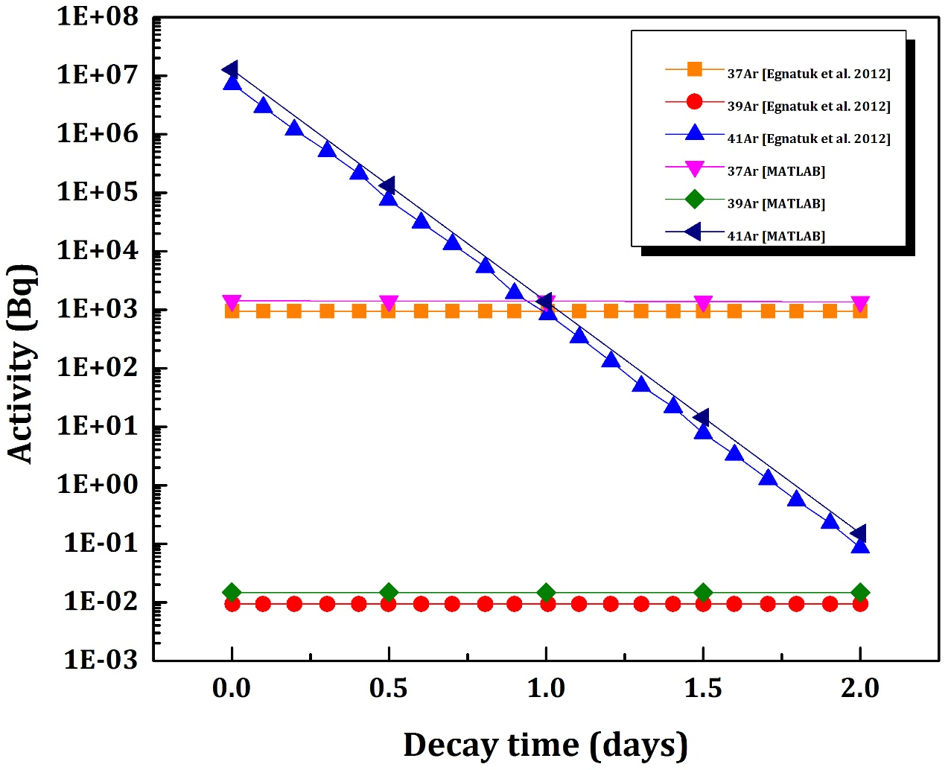
Results
Please do not use this space, a QR code will be automatically overlayed
Comparison of Ar(n,γ) cross sections from different references
Radioargon activities after 4 hours irradiation with decay up to 2 days. Comparison between Egnatuk et al. 2012 and MATLAB simulation.
P2.4-610

Slide 6
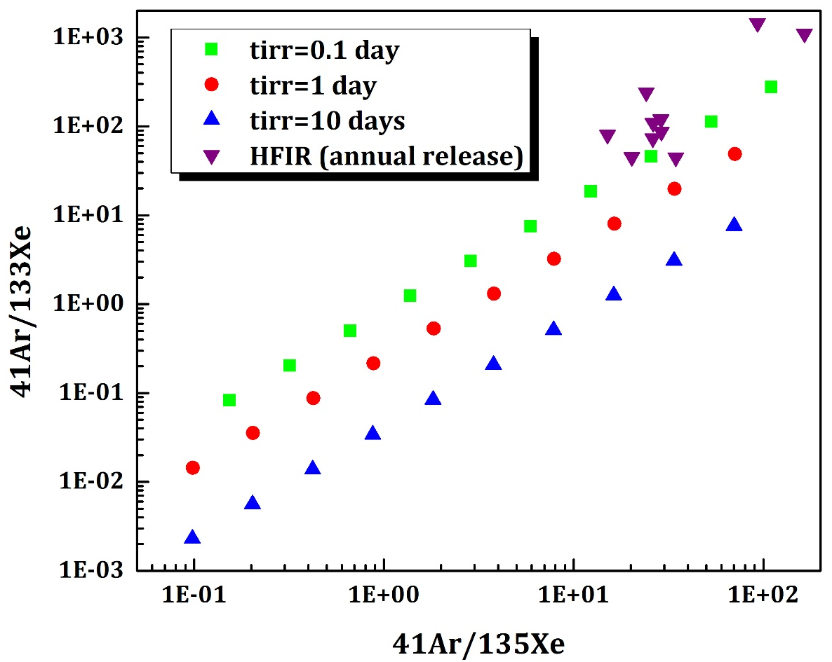
Results
MATLAB simulation: the activity ratios after 0.1 day, 1 day and 10 days irradiation.
HFIR: annual release.
Please do not use this space, a QR code will be automatically overlayed
P2.4-610

Slide 7
Results
Irrespective of the data source, the neutron activation cross sections for producing ³⁷Ar, ³⁹Ar and ⁴¹Ar from stable argon are identical or very similar with only one exception. Therefore, any of the data sources under comparison here can be used.
MATLAB simulations of producing ³⁷Ar, ³⁹Ar and ⁴¹Ar from stable argon by activation compare well with the results of Egnatuk et al. (2012).
MATLAB simulations with different irradiation times and different decay times are compared with annual releases reported for the HFIR reactor for ⁴¹Ar, ¹³⁵Xe and ¹³³Xe. The combination of these isotopes show good agreement between simulations and reported releases, if an irradiation time of 0.1 days (2.4 hours) and a decay time of 0.3 days (7.2 hours) are selected.
Please do not use this space, a QR code will be automatically overlayed
P2.4-610

Slide 8
Conclusion
The releases of ⁴¹Ar from the HFIR reactor can be reproduced with MATLAB simulations under the assumption of 2.4 hours irradiation time and a retention time of 7.2 hours.
⁴¹Ar can be used as proxy for ³⁷Ar release estimations by using the same irradiation and retention time assumptions and applying decay corrections accordingly.
Please do not use this space, a QR code will be automatically overlayed
P2.4-610

Slide 9
References
Christine M. Egnatuk, et al., J Radioanal Nucl Chem (2012) 291:257–260, DOI 10.1007/s10967-011-1254-0
Oak Ridge Reservation Annual Site Environmental Report (ASER) 2006-2016
ORIGEN 2.1
NuChart4.0.0 1998
ENDF/B-VIII.0
CINDER90
JEFF-3.3
Please do not use this space, a QR code will be automatically overlayed
P2.4-610

