Slide 1
Using Open Source Data to Make Data Fusion with International Monitoring System Data and to Understand and Correlate Radionuclide Detections at the International Monitoring System Station RN43
M.M. Mounja¹, A. Rizzo², G. Ottaviano². C.Telloli²
¹Mauritania National Authority of Radiation, Safety and Nuclear Security (ARSN), Nouakchott, Mauritania
²ENEA, Italian National Agency for New Technologies, Energy and Sustainable Economic
Development, Bologna, Italy.
The historical analysis of the occurrence of relevant radionuclides at IMS station RN43 over the past ten years showed that the main contributor was Cs-137, causing several level 3 and level 4.
A descriptive statistical analysis of the Cs-137 occurrence was performed.
Atmospheric Optical Depth data have been used as an indirect measurement of the presence of dust and haze in the atmosphere.
We have noticed some coincidence with the appearance of Cs-137 and augmented aerosol loading on Noaukchott in spring 2007, 2008, 2010 and 2014.
Better understanding of the background of the stations
Measurements around the station could be beneficial
New collaborations
Please do not use this space, a QR code will be automatically overlayed
P2.4-775

Slide 2
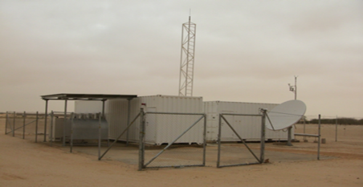
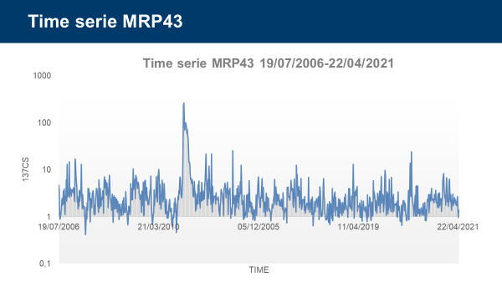
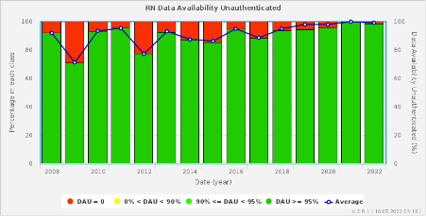
Introduction
Place your institution logo here after removing this text box!
RN43
Installed in 2003
Certified in 2006
Please do not use this space, a QR code will be automatically overlayed
P2.4-775

Slide 3
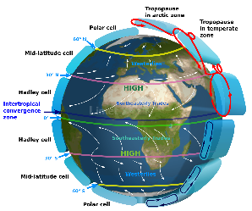
Objectives
Place your institution logo here after removing this text box!
The historical analysis of the occurrence of relevant radionuclides at RN43 over the past ten years showed that the main contributor was Cs-137, causing several level 3 and level 4.
Our objective was to understand better the occurance of Cs137 and possible correlation with atmospheric phenomena
Please do not use this space, a QR code will be automatically overlayed
P2.4-775

Slide 4
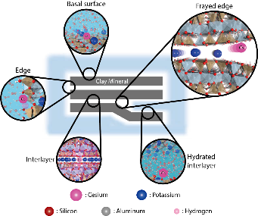
Methods
Place your institution logo here after removing this text box!
We had been working with statistical analysis since 2016 thanks to a collaboration with the department of Statistic at the University of Bologna
A descriptive statistical analysis of the Cs-137 occurrence was performed
Cs easily adheres on light clay particles
The deposition of Cesium in Sahara region has not been completely assessed so the resuspension.
Measurements in sand in North Africa (Baggoura et al., 1998) showed the most activity levels are found near the Mediterranean sea. The Saharan part of the country exhibits the lowest measured levels.
Please do not use this space, a QR code will be automatically overlayed
P2.4-775

Slide 5
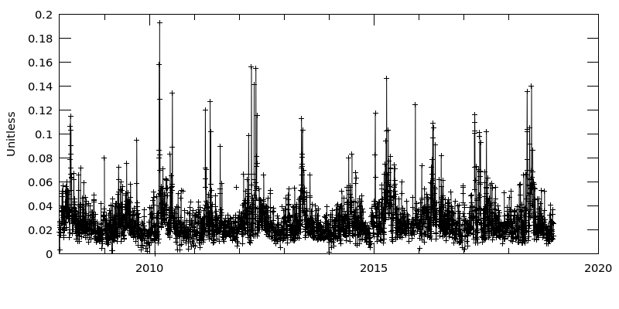
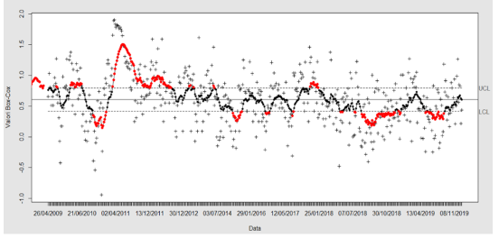
Results
Place your institution logo here after removing this text box!
“Analyses and visualizations were produced with the Giovanni online data system, developed and maintained by the NASA GES DISC.
Please do not use this space, a QR code will be automatically overlayed
P2.4-775

Slide 6
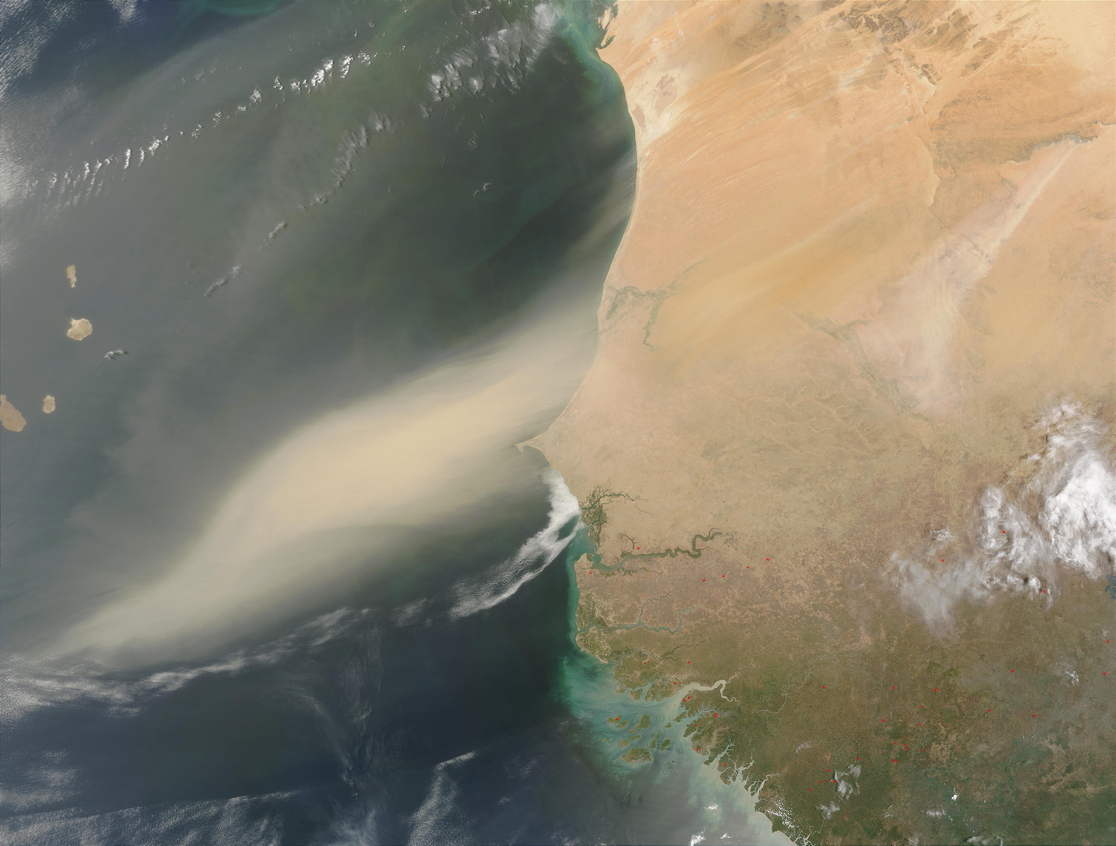
Conclusion
Place your institution logo here after removing this text box!
We have studied some statistical approach to the measurement of Cs137 detected at RN43 IMS radionuclide station located in Nouakchott.
Level 5 and 4 detected by IDC are associated with high values of aerosol loading
Applying control charts could help to highlight deviation from the normal statistic of the measurements
We have noticed seasonability of appearance of Cs-137 during springs
Further studies to investigate correlations will be done in the future, thanks to the collaboration between Mauritania NDC adn Italian NDC
Please do not use this space, a QR code will be automatically overlayed
P2.4-775

Slide 7
References [Optional slide Font: Arial Regular Size 20]
Place your institution logo here after removing this text box!
Please do not use this space, a QR code will be automatically overlayed
P2.4-775

