Slide 1
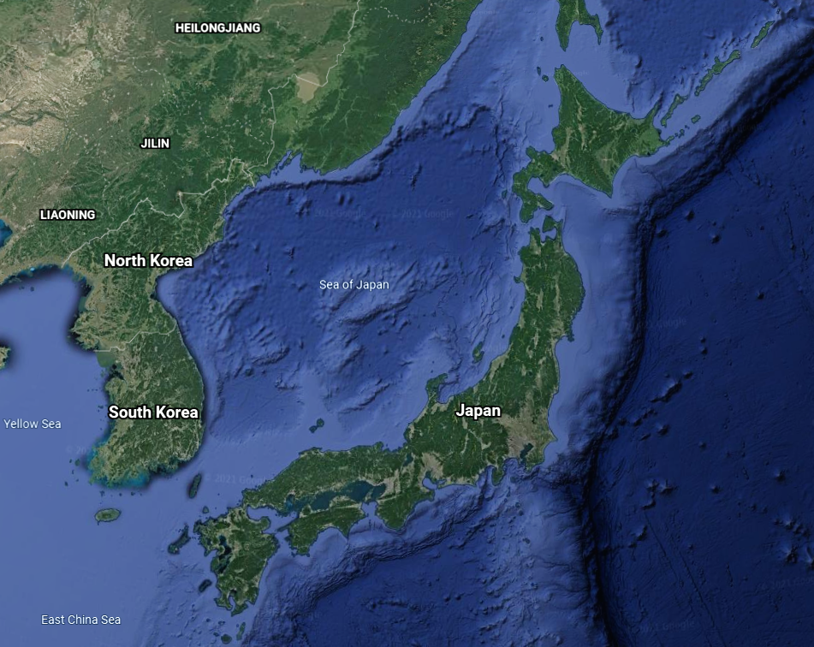
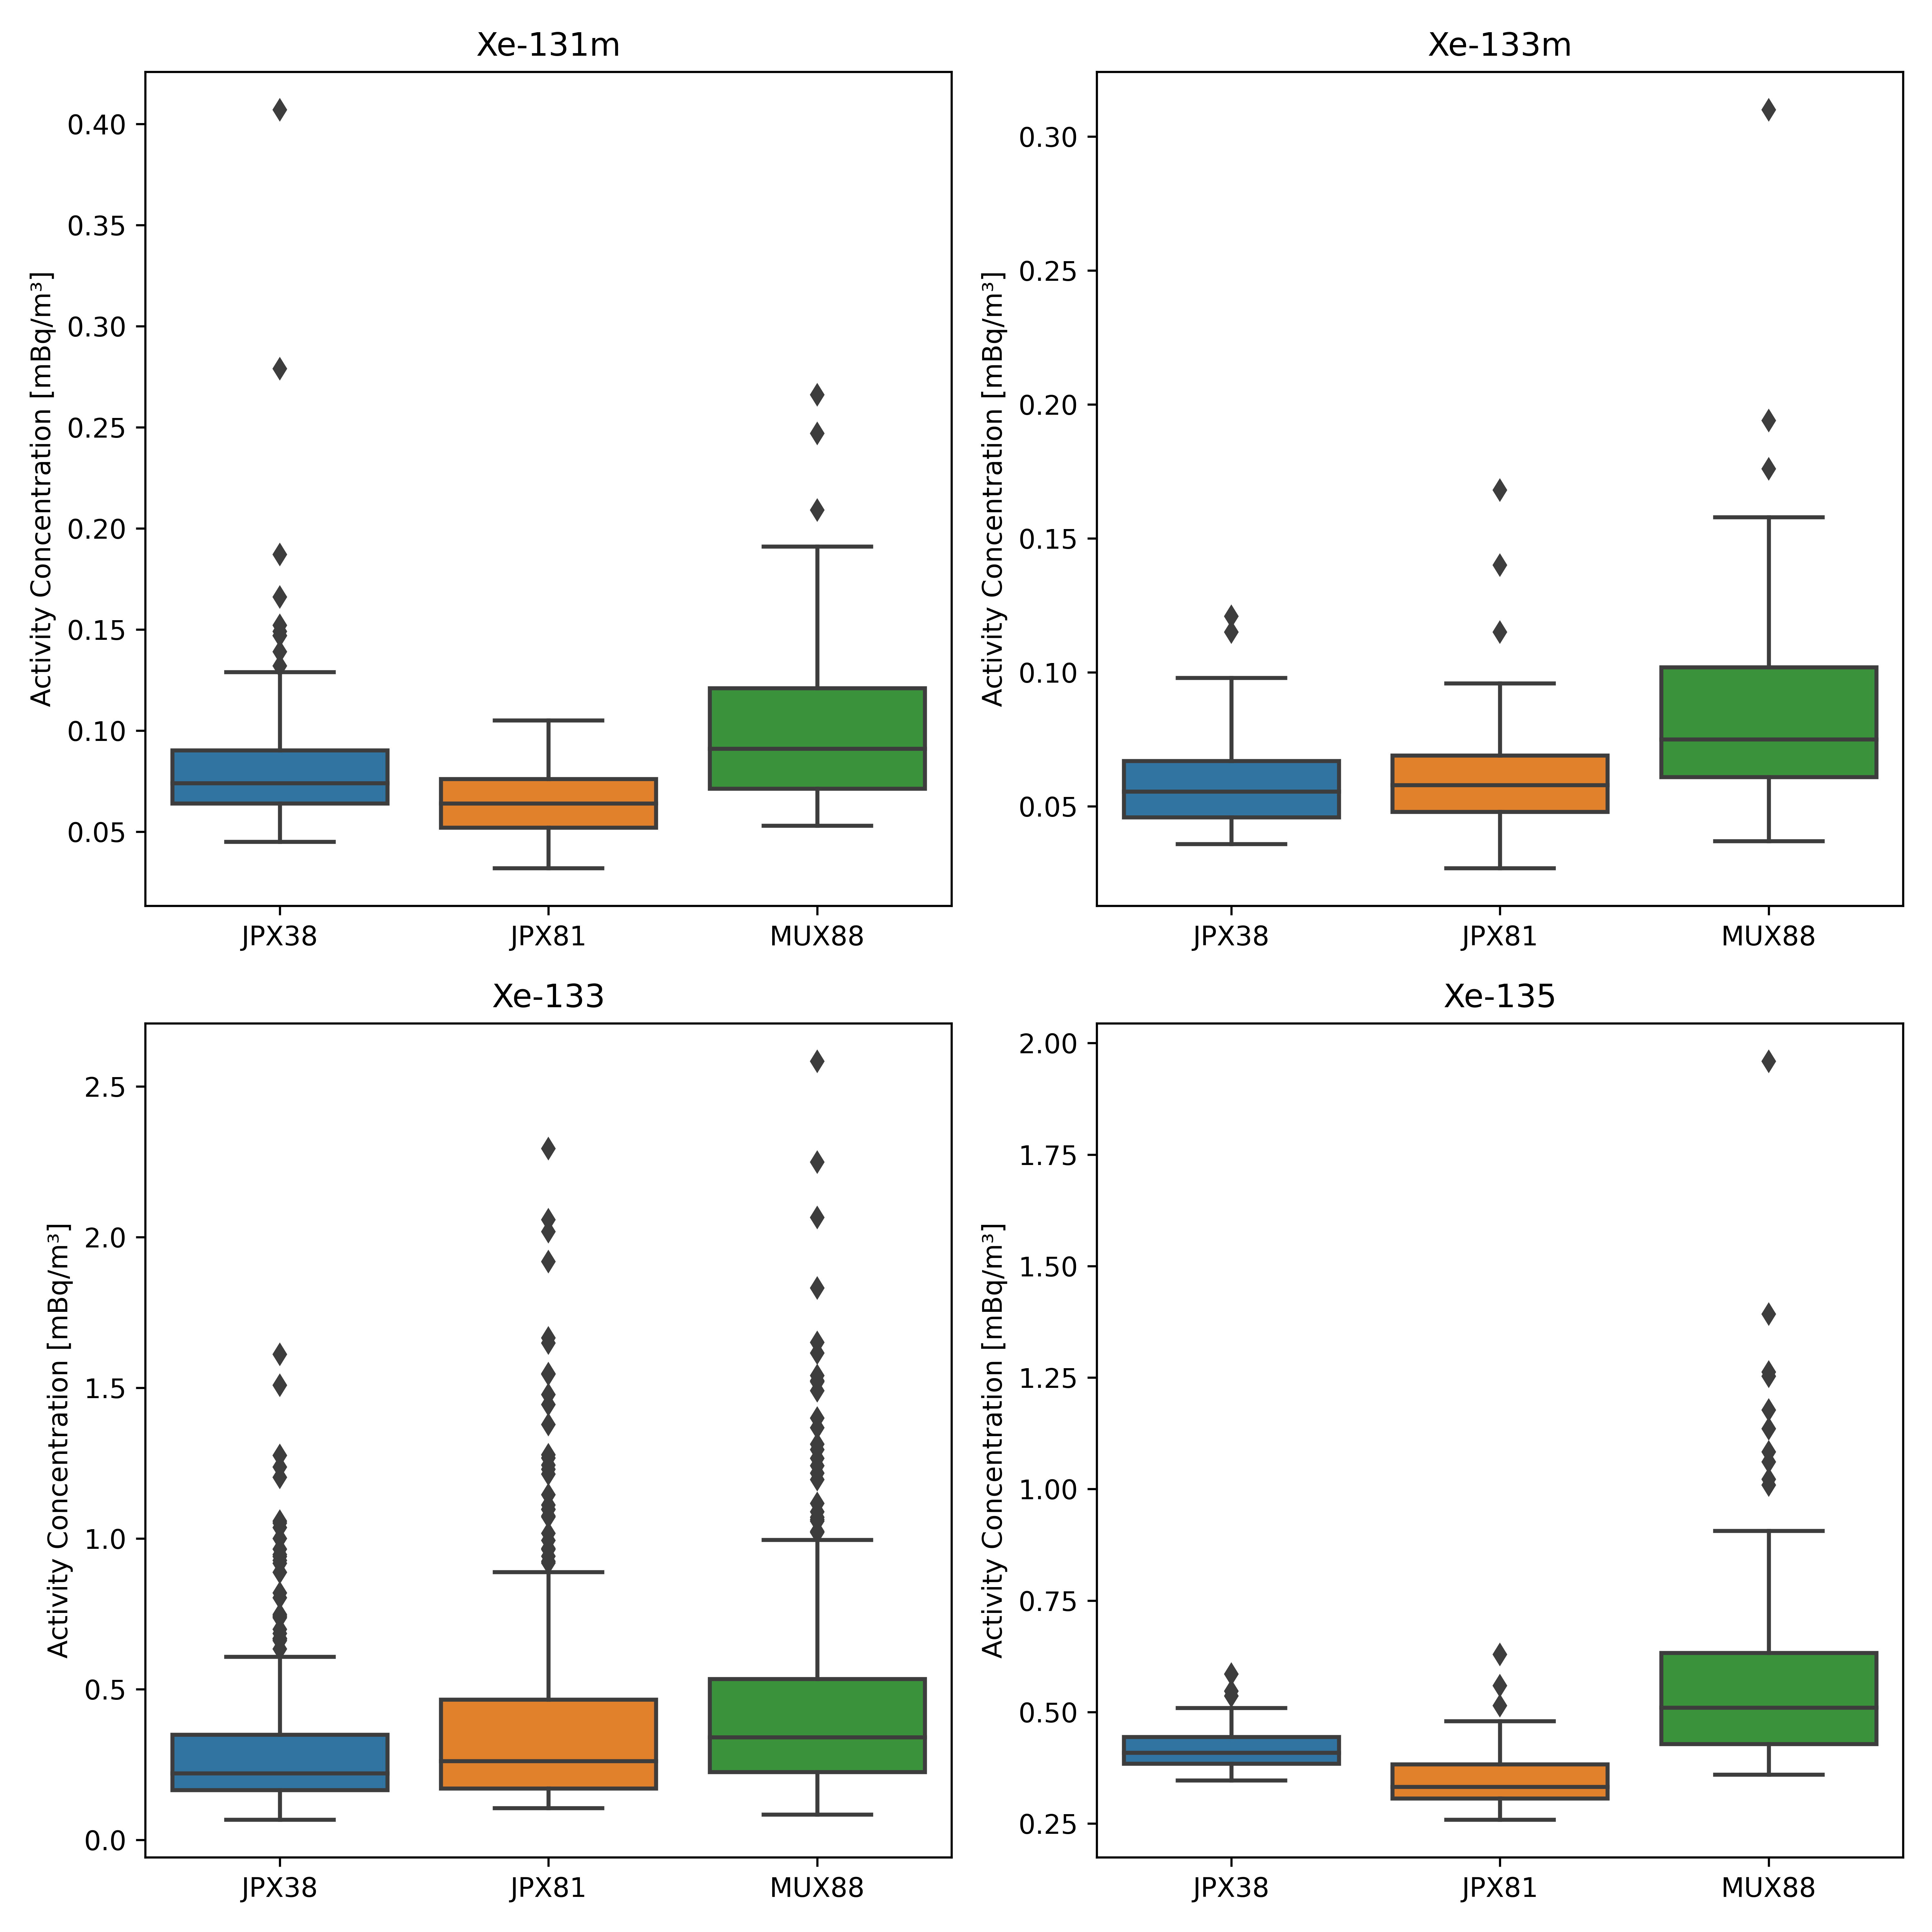
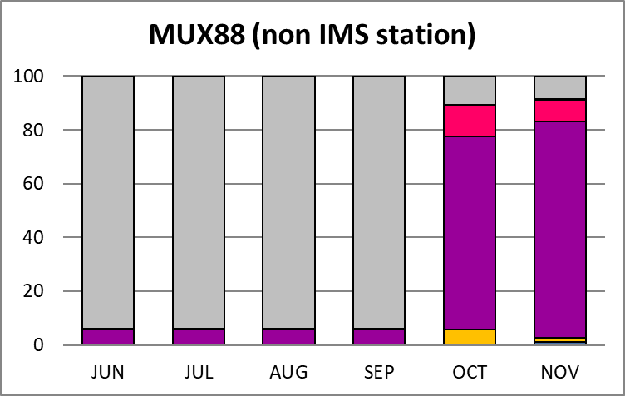
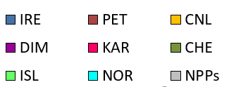
Status and preliminary analysis of ongoing temporary radioxenon noble gas background campaigns in Japan
J. Baré, J. Merešová, S. Yoon, P.T. Cruz, H. Tatlisu, J. Kuśmierczyk-Michulec, A. Gheddou, M. Kalinowski
CTBTO, Vienna, Austria
P2.4-604
Xenon isotopes (^{131m}Xe, ^{133m}Xe, ¹³³Xe and ¹³⁵Xe) are the best radioactive signatures of underground nuclear explosions
In 2017, the Government of Japan has decided to make a voluntary contribution to the
CTBTO with the objective of further enhancing the capabilities of the verification regime.
Two transportable NG TXL-SAUNA systems were deployed in Japan:
Horonobe (JPX81),
Mutsu (MUX88).
These non-IMS systems started operating in February 2018 and March 2018, respectively.
More than 6200 samples have been collected to date. Together with the IMS NG system
RN38 in Takasaki, they form a unique mini-network configuration.
Continued operation of the two systems has been financially supported with funding from
European Union Council Decisions, and is now further continued with funding from Japan
In this e-poster:
O&M of the transportable systems are discussed
preliminary analysis of the data sets is given
periods of elevated detections are tentatively explained
using ATM simulations
Further scientific analysis of the data sets is ongoing with the
aim of using these data to enhance methods for noble gas data
analysis and related IDC products for all IMS noble gas systems
Horonobe
Mutsu
RN38

