Slide 1
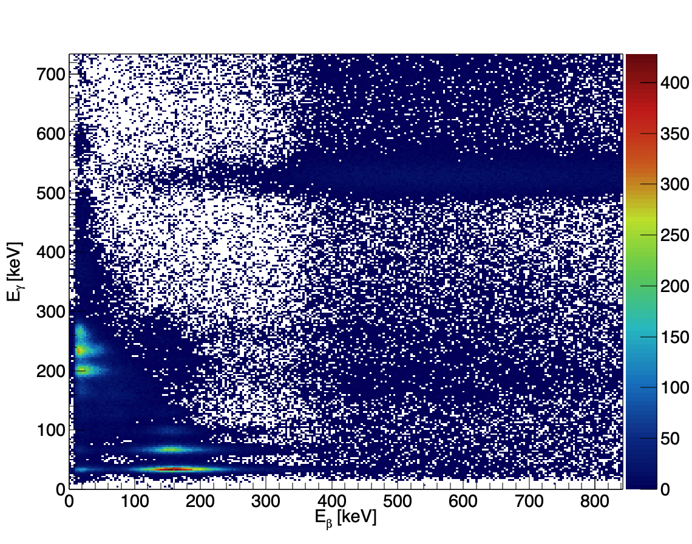
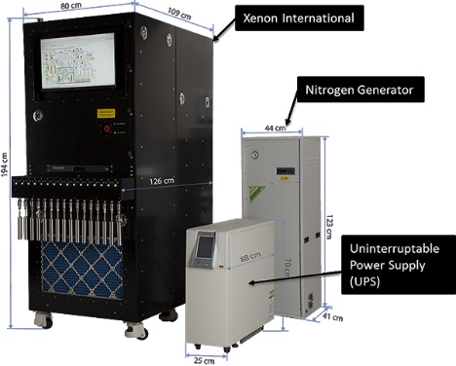
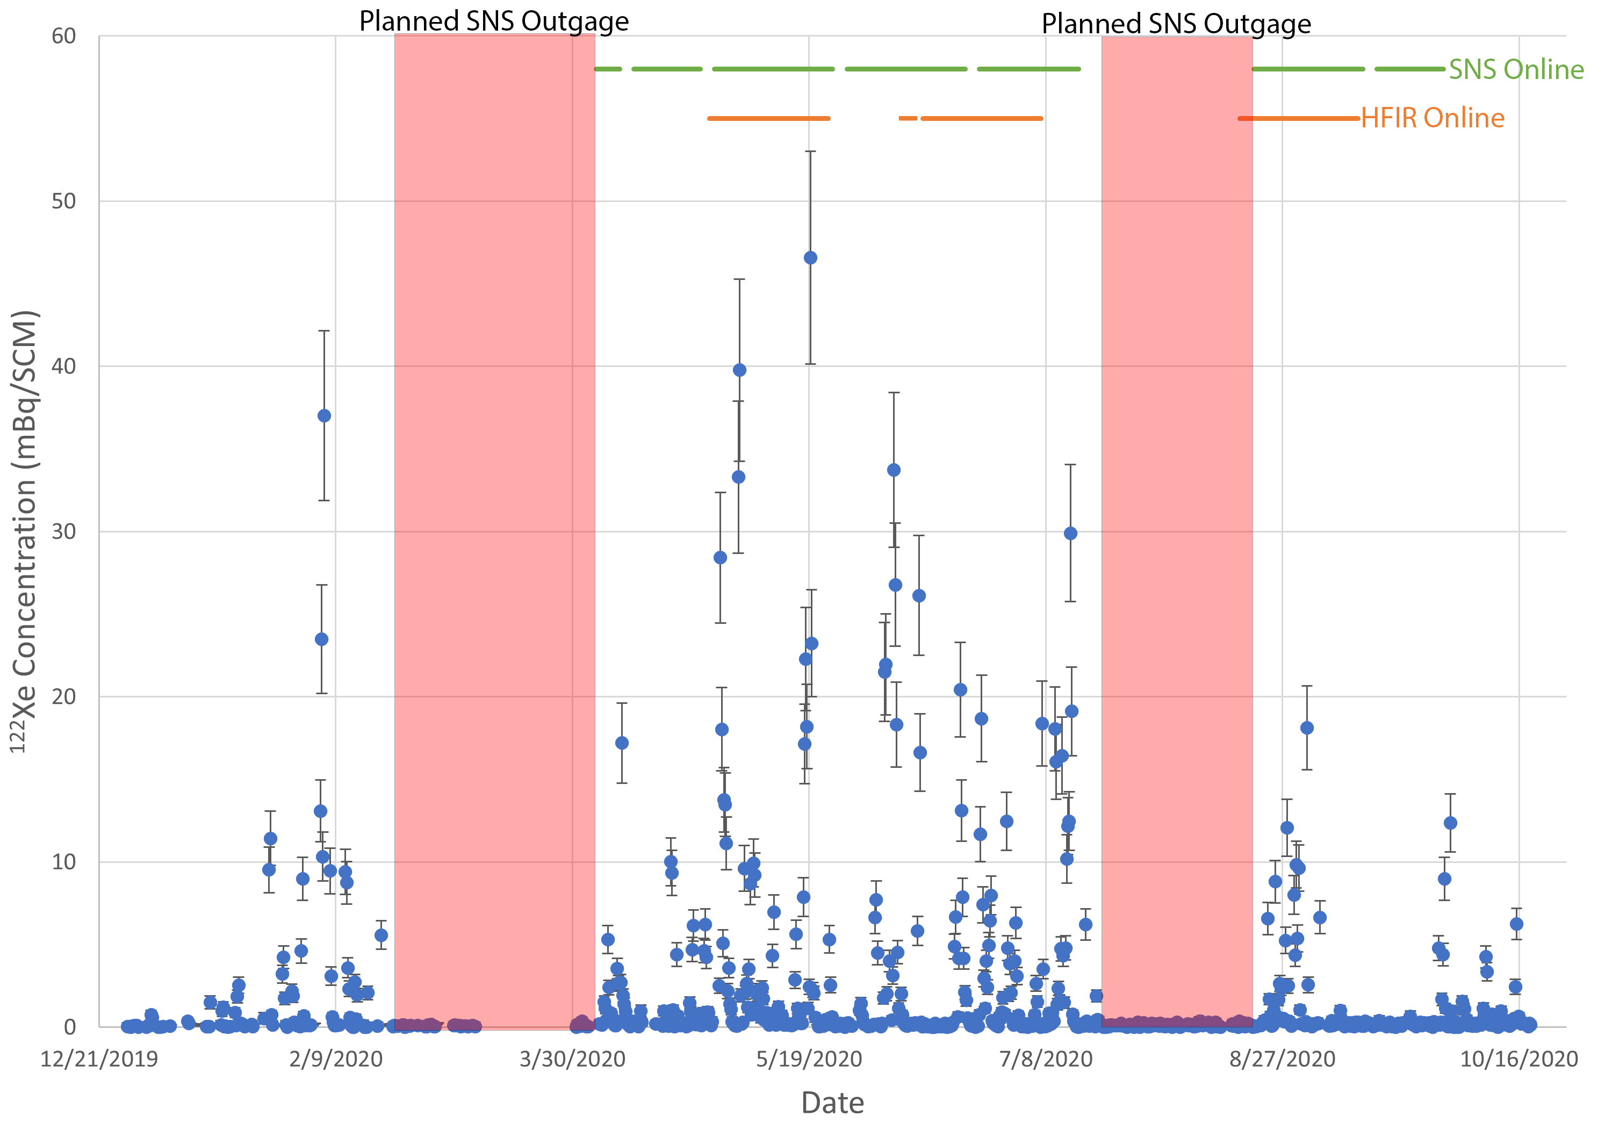
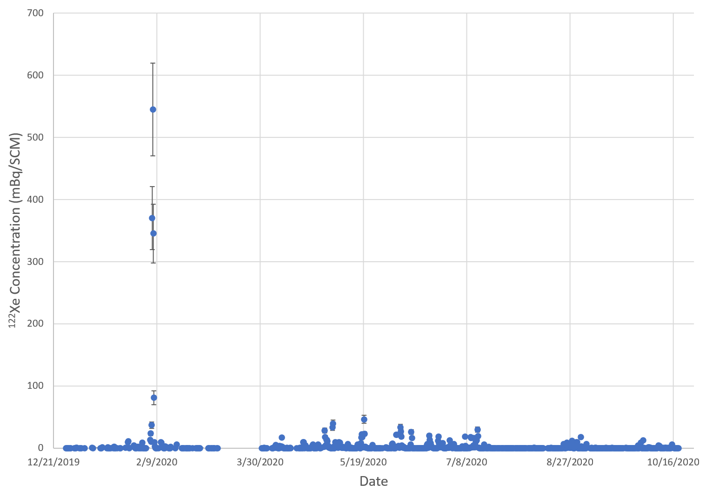
Detection and Analysis of Anomalous Radioxenon Isotopes
Michael Mayer, Matthew Cooper, James Ely, Paul Eslinger,
Michael Foxe, James Hayes, Justin McIntyre, Mark Panisko
Pacific Northwest National Laboratory Richland, WA USA
P2.4-215
Xenon International observed new xenon isotopes while undergoing system testing in Knoxville, TN
Next generation radioxenon system
Better sensitivities and larger Xe volume than current systems
Isotopes of xenon were observed to be ¹²⁵Xe, ¹²⁷Xe, and ^{129m}Xe, and ¹²²Xe
¹²⁵Xe and ¹²²Xe both decay down to a radioactive iodine.
Newly observed isotopes suggest new source of interfering xenon background (scientific research facilities)
Neutron irradiation and spallation facilities can produce and release xenon
New isotopes interfere with all traditional ROIs used for activity calculations
Algorithms will continue to calculate normally, but concentrations and ratios will not make sense
¹²⁵I might cause issues with ¹³³Xe activity concentration due to its long half-life if there is a large amount in the detector
PNNL-SA-186132
This Ground-based Nuclear Detonation Detection (GNDD) research was funded by the National Nuclear Security Administration, Defense Nuclear Nonproliferation Research and Development (NNSA DNN R&D).

