Slide 1
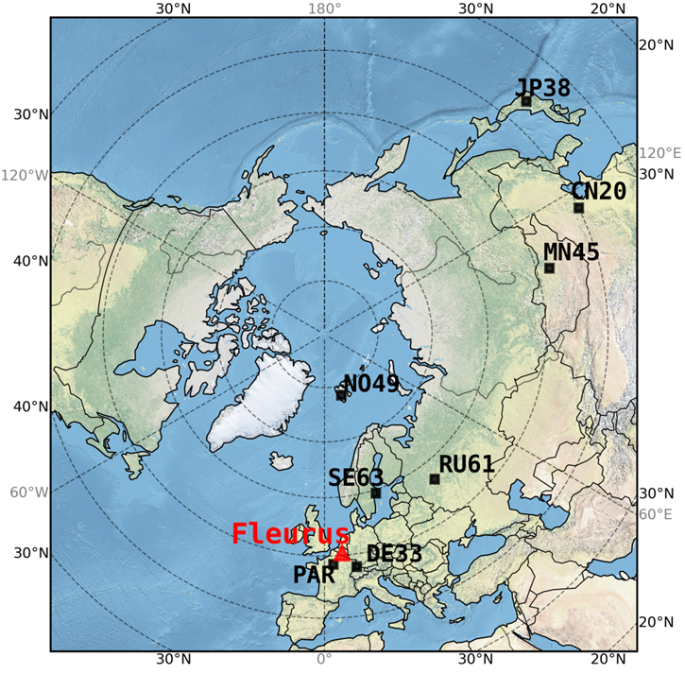
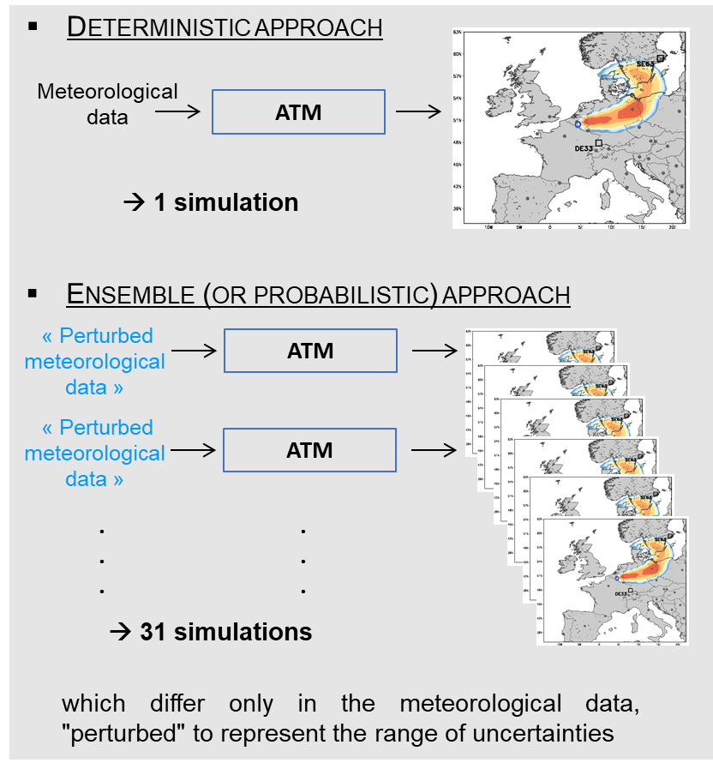
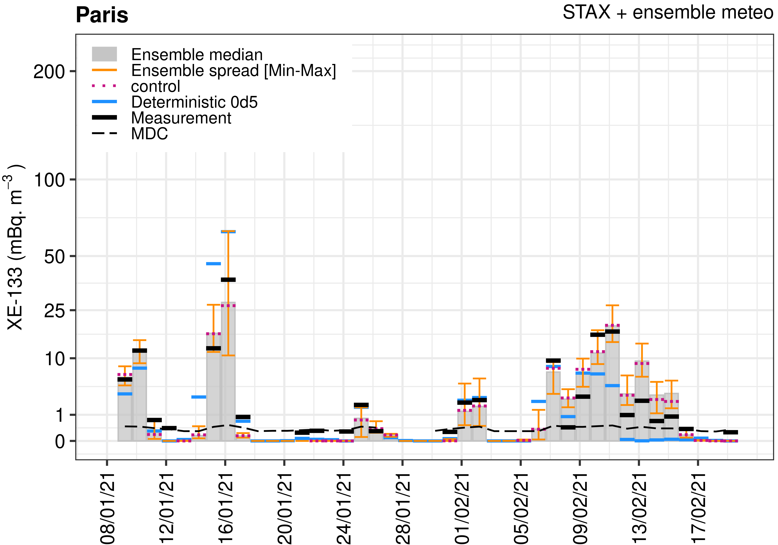
Tackling the Quantification of Meteorological Uncertainties
for the Global Scale Simulation of the ¹³³Xe Atmospheric Background
Generoso S., Achim P., Morin M., Gross P., Topin S., Douysset G.
CEA, DAM, DIF, F-91297 Arpajon, France
P2.4-232
January-February 2021
In this study, an optimal set-up to assess :
Meteorological uncertainties in ATM
The use of ensemble meteorological data as provided by weather prediction centers for CTBTO applications
With actual measured ¹³³Xe emissions and probabilistic meteorology…
How is ATM performing concretely ?
→ Come and see the poster !
And share feedbacks from a NDC perspective

