Slide 1
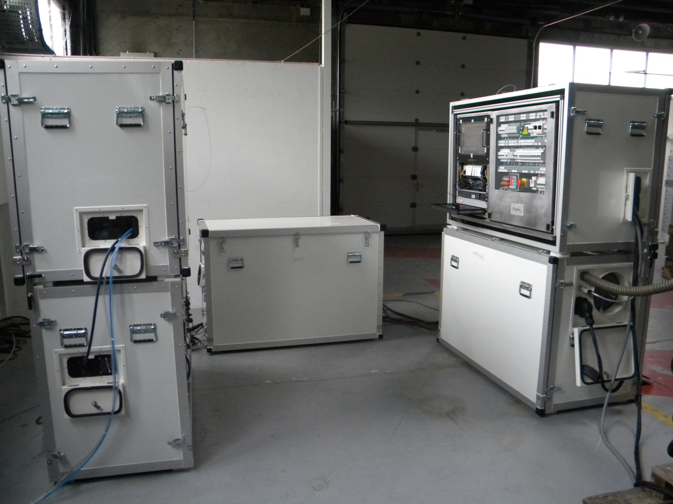
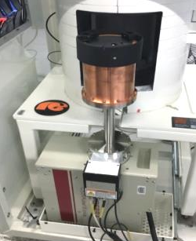
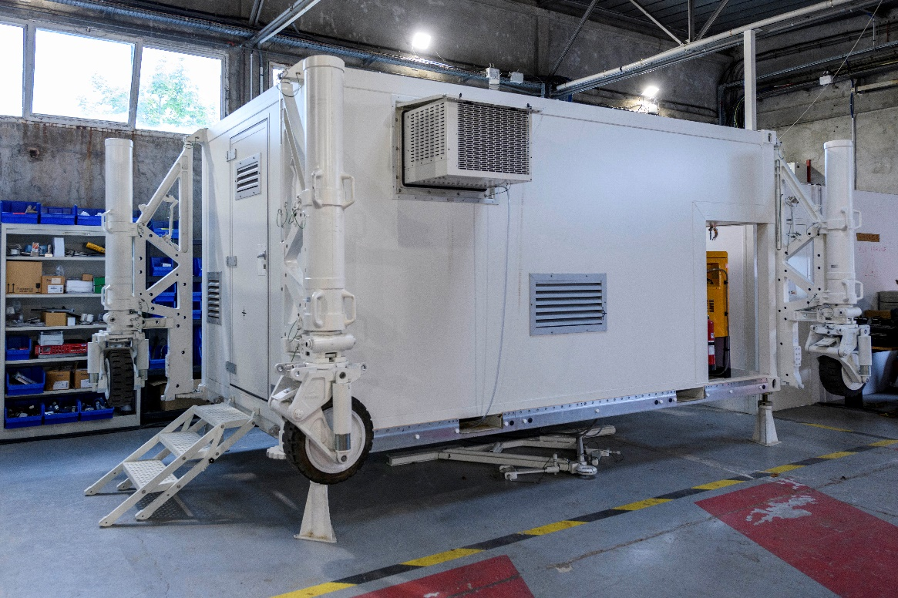
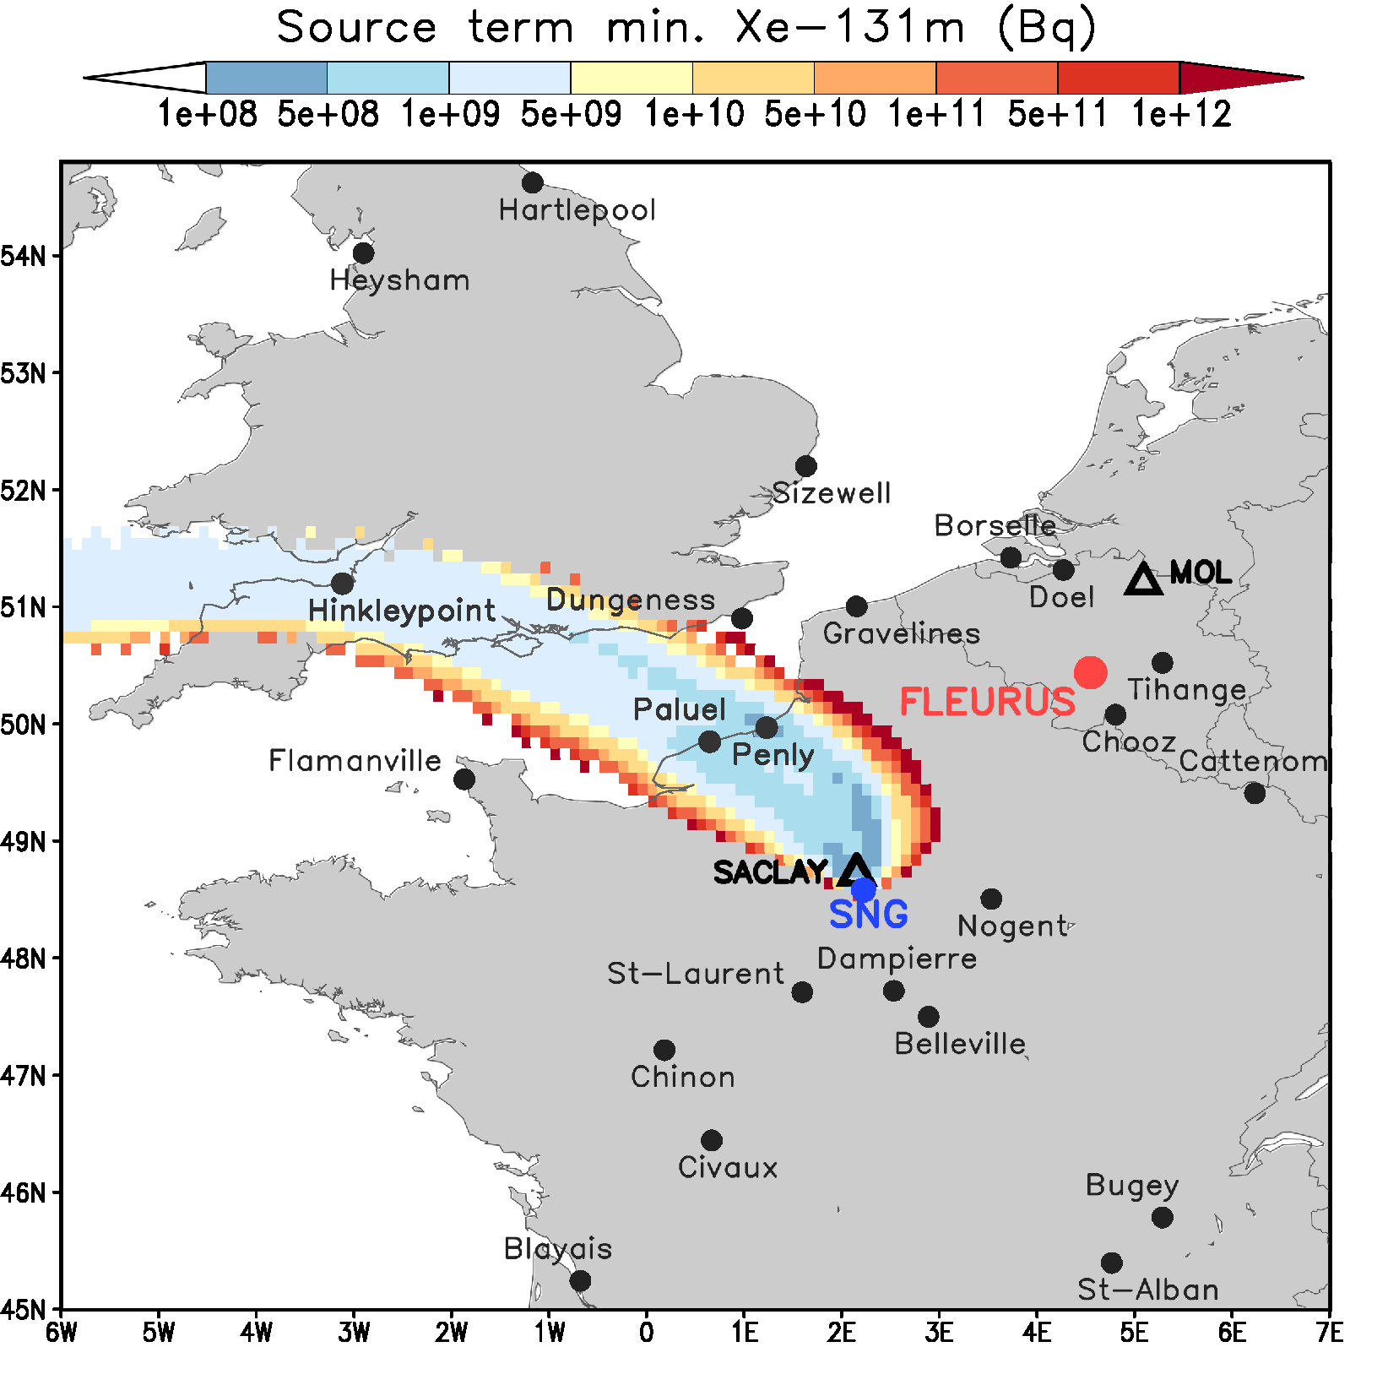
Summary of Radioxenon Detections with the SPALAX-New Generation System
S. Topin, P. Gross, P. Achim, M. Morin, S. Generoso, G. Douysset
CEA/DAM Ile de France
P2.4-459
Detection: High resolution βγ coincidence
Qualification periods: 6 months Paris + 6 months Ottawa
Paris
PIPSBox: β detector (CEA/Mirion)
Ottawa
+
HPGe: γ detector
SPALAX-NG: Modular Version
Abnormal Xe-131m/Xe-133 ratios
Performances |  | SPALAX-1 | SPALAX-NG
Cycle duration Air flow Xe volume Detection modes (High resolution) |  | 24 h | 4h, 8h, 12h
 |  | 15 m³/h | 35 m³/h
 |  | 1,3 cm³ (8 h) | 4 cm³ (8 h)
 |  | Direct γ | Direct γ and (β−γ)
Sensitivity (mBq/m³) | Xe-133 | 1 (8h) | 0.1 (12h) – 0.2 (8h)
 | Xe-135 | 1 (8h) | 0.1 (12h) – 0.2 (8h)
 | Xe-131m | 20 (8h) | 0.1 (12h) – 0.2 (8h)
 | Xe-133m | 6 (8h) | 0.1 (12h) – 0.2 (8h)
SPALAX-NG: Stand alone Version
Correlation with local Iodine sources

