Slide 1
Summary of Radioxenon Detections with the SPALAX-New Generation System
S. Topin, P. Gross, P. Achim, M. Morin, S. Generoso, G. Douysset
CEA/DAM Ile de France
SPALAX-New Generation (SNG) system has been CTBTO qualified during 2 periods of continuous operation near Paris (France) and in Ottawa (Canada) in 2019 and 2020 respectively. The full set of data obtained enable to challenge our knowledge on radioxenon (RXe) background
SPALAX-NG is the new generation of French radioxenon sampler. It takes benefit of 15 years feedback on SPALAX system and recent developments including new adsorbant materials and new βγ detection system. A sensitivity better than 0.2 mBq/m⁻³ is obtained for the 4 relevant RXe
The number of detections increased a lot with the SNG over the qualification periods. > 15% of the samples included > 2 RXe isotopes. Unusual detection of Xe-131m has been observed and partially explained by ATM. MIRC chart triggers have been confirmed.
New generation of RXe samplers lead to increase drastically the number of detections. It is leading to revise our knowledge of RXe background. In particular, this work demonstrates the importance of the local iodine sources on the Xe-131m background.
Please do not use this space, a QR code will be automatically overlayed
P2.4-459

Slide 2
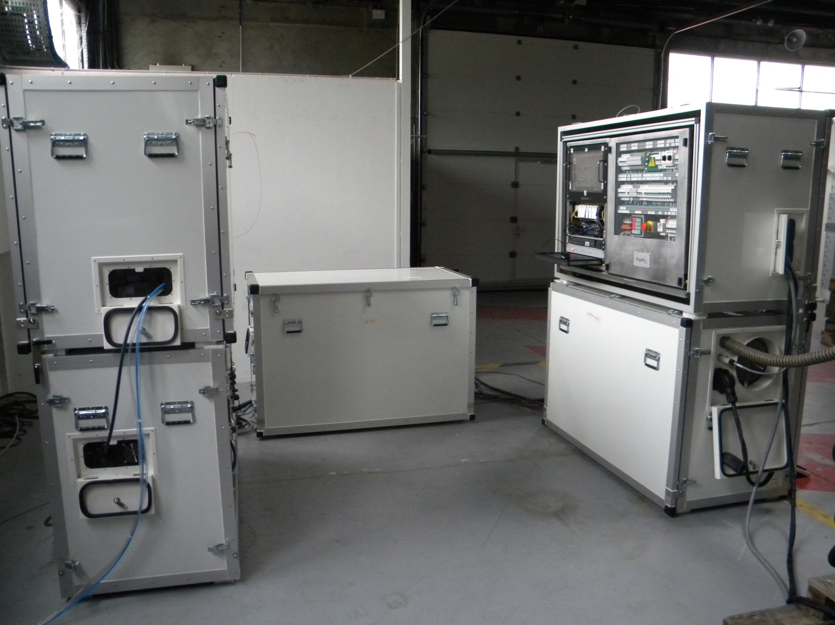
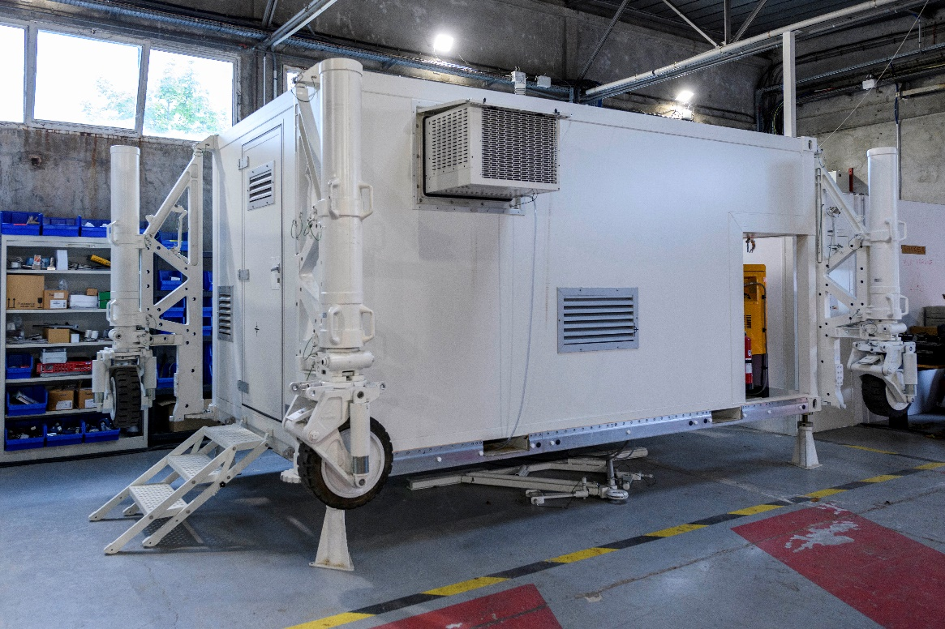
Introduction
The SPALAX-NG system is the French sampler produced by Cegelec Defense [see P4.4-736 and exhibitor stand n°26] to detect RXe releases following a nuclear test and RXe background.
This system takes the benefit of > 15 years of operation of the SPALAX system and is commercialized in 2 config: Modular or fully stand-alone in Shelter version
2 periods of 6 months nominal and continuous operation were required to qualify the new generation system for the IMS network
1st period was performed in the CEA/DAM Ile de France premises, 30 kms south of Paris, in Sept 18 – April 19
2nd period was performed by an independent organization (requested by PTS) in the Health Canada premises in Ottawa (Canada) in Dec 19 – June 20
The system is qualified for IMS network since 2021. This presentation detailed the detections obtained during the 2 SNG qualification periods.
Please do not use this space, a QR code will be automatically overlayed
P2.4-459

Slide 3
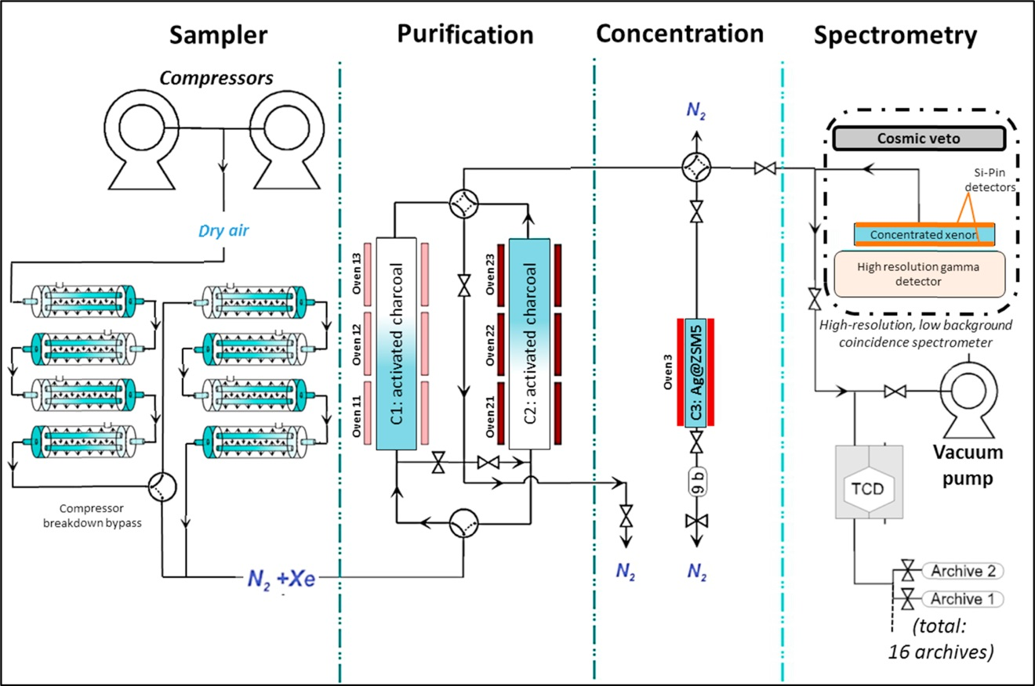
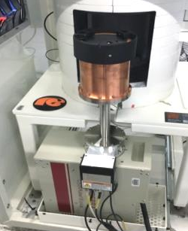
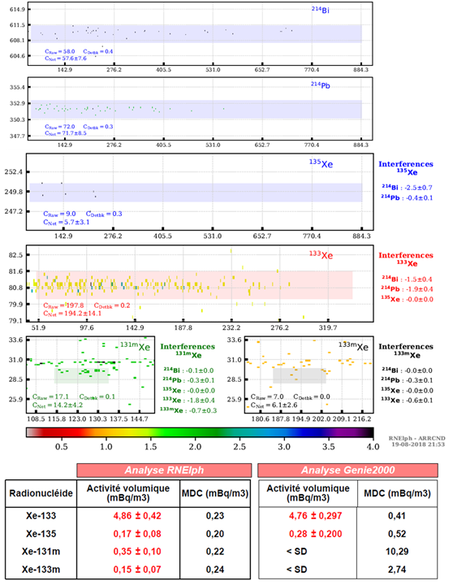
Methods/data – SPALAX-NG description & performances
Performances
SNG description
 |  | SPALAX-1 | SPALAX-NG
Cycle duration Air flow Xe volume Detection modes (High resolution) |  | 24 h | 4h, 8h, 12h
 |  | 15 m³/h | 35 m³/h
 |  | 1,3 cm³ (8 h) | 4 cm³ (8 h)
 |  | Direct γ | Direct γ and (β−γ)
Sensitivity (mBq/m³) | Xe-133 | 1 (8h) | 0.1 (12h) – 0.2 (8h) – 0.5 (4h)
 | Xe-135 | 1 (8h) | 0.1 (12h) – 0.2 (8h) – 0.5 (4h)
 | Xe-131m | 20 (8h) | 0.1 (12h) – 0.2 (8h) – 0.5 (4h)
 | Xe-133m | 6 (8h) | 0.1 (12h) – 0.2 (8h) – 0.5 (4h)
High resolution βγ coincidence detector
Sample automatic report (RNELPh software)
PIPSBox: β detector (CEA/Mirion)
Please do not use this space, a QR code will be automatically overlayed
+
HPGe: γ detector
P2.4-459

Slide 4
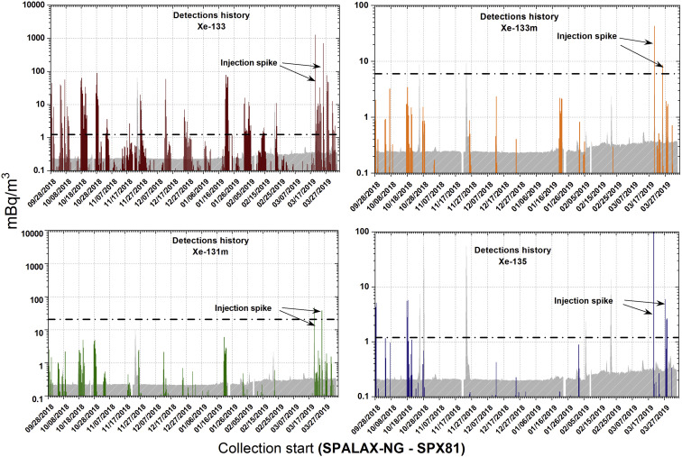
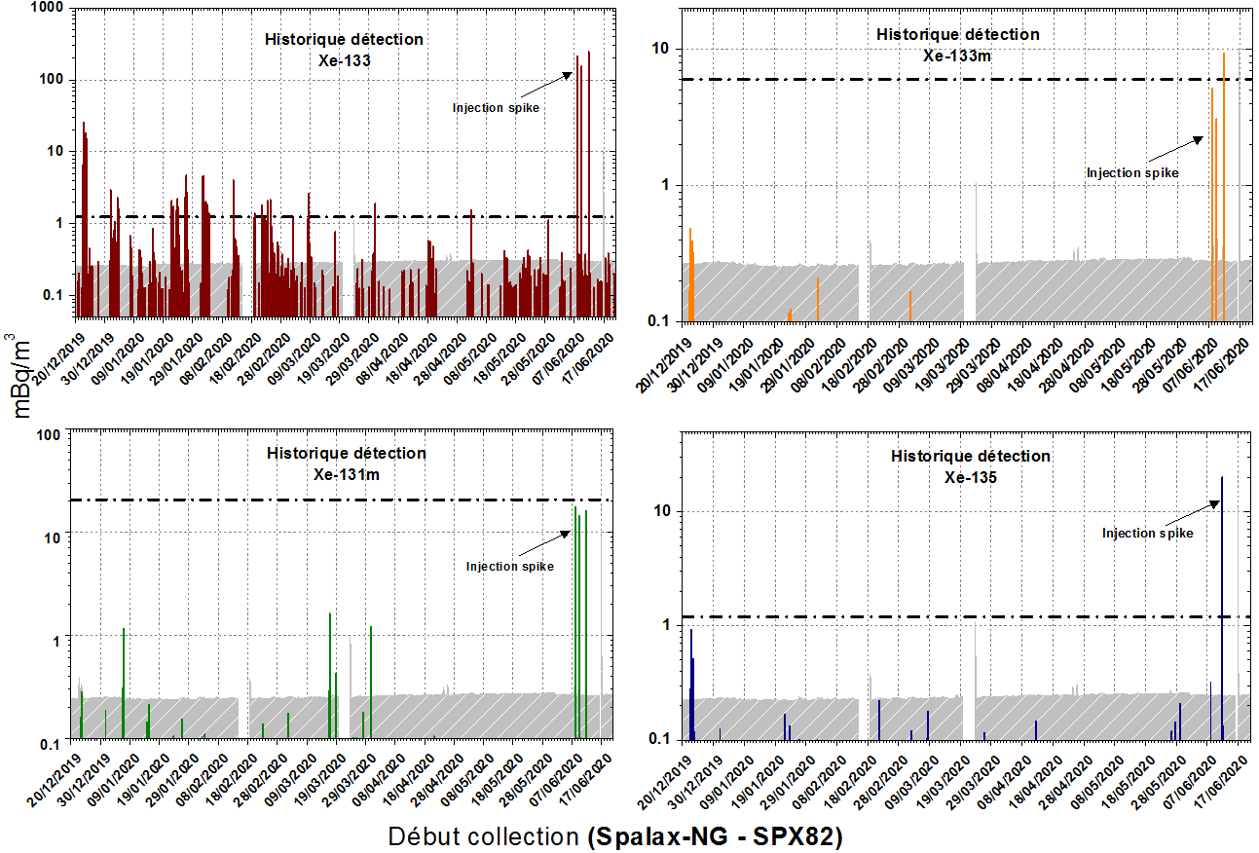
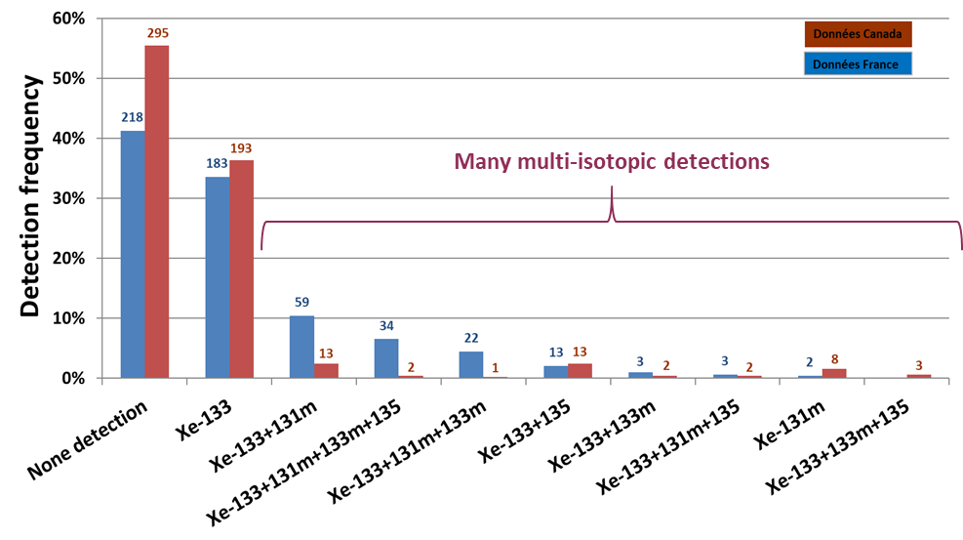
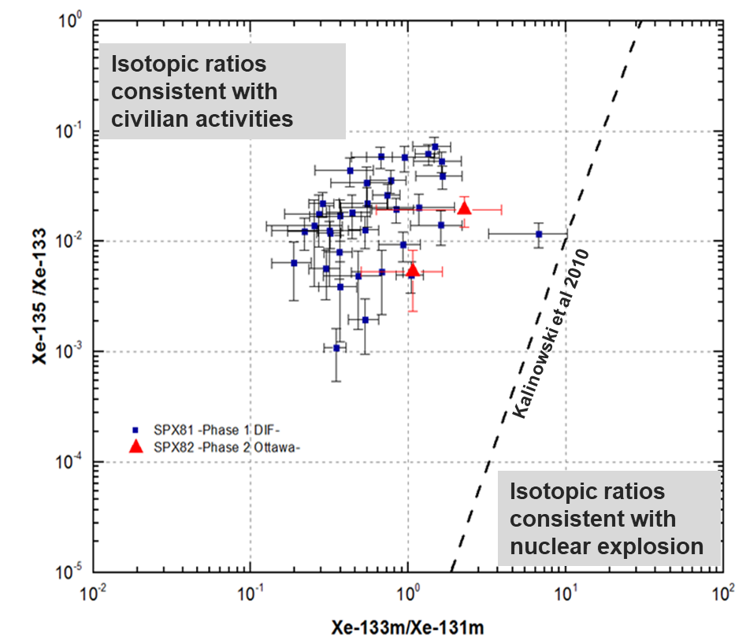
Results – Rxe detection and Isotopic ratios
Ottawa
SPALAX-1 MDC
SNG MDC
Paris & Ottawa detection logs
Paris
Ottawa
Sample compositions
Paris
MIRC
Ottawa
Please do not use this space, a QR code will be automatically overlayed
Presence of Xe in > 50% of the samples
More than 2 isotopes in > 15% of the samples
Some samples with unusual detections of single Xe-131m
Abnormal Xe-131m/Xe-133 ratios
Many detections of 4 RXe samples
Ratios consistent with the usual triggers
P2.4-459

Slide 5
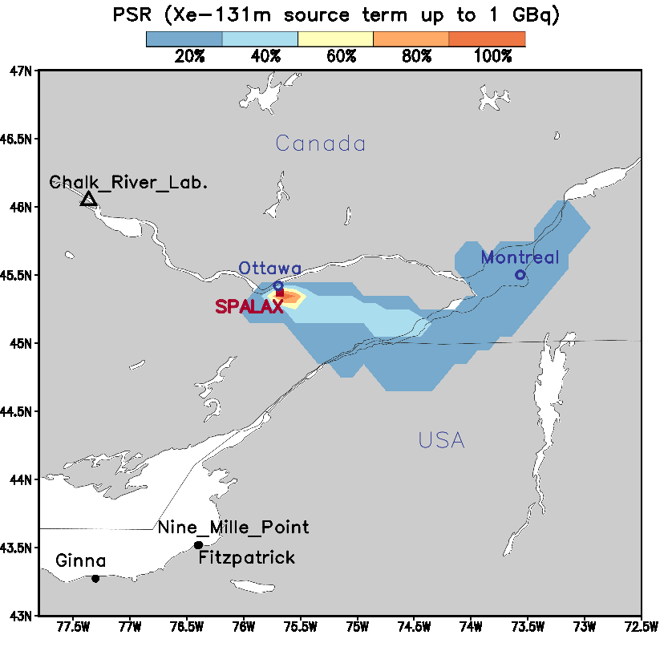
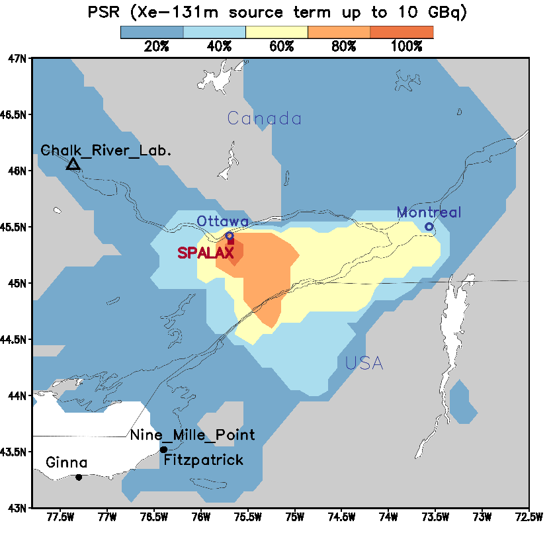
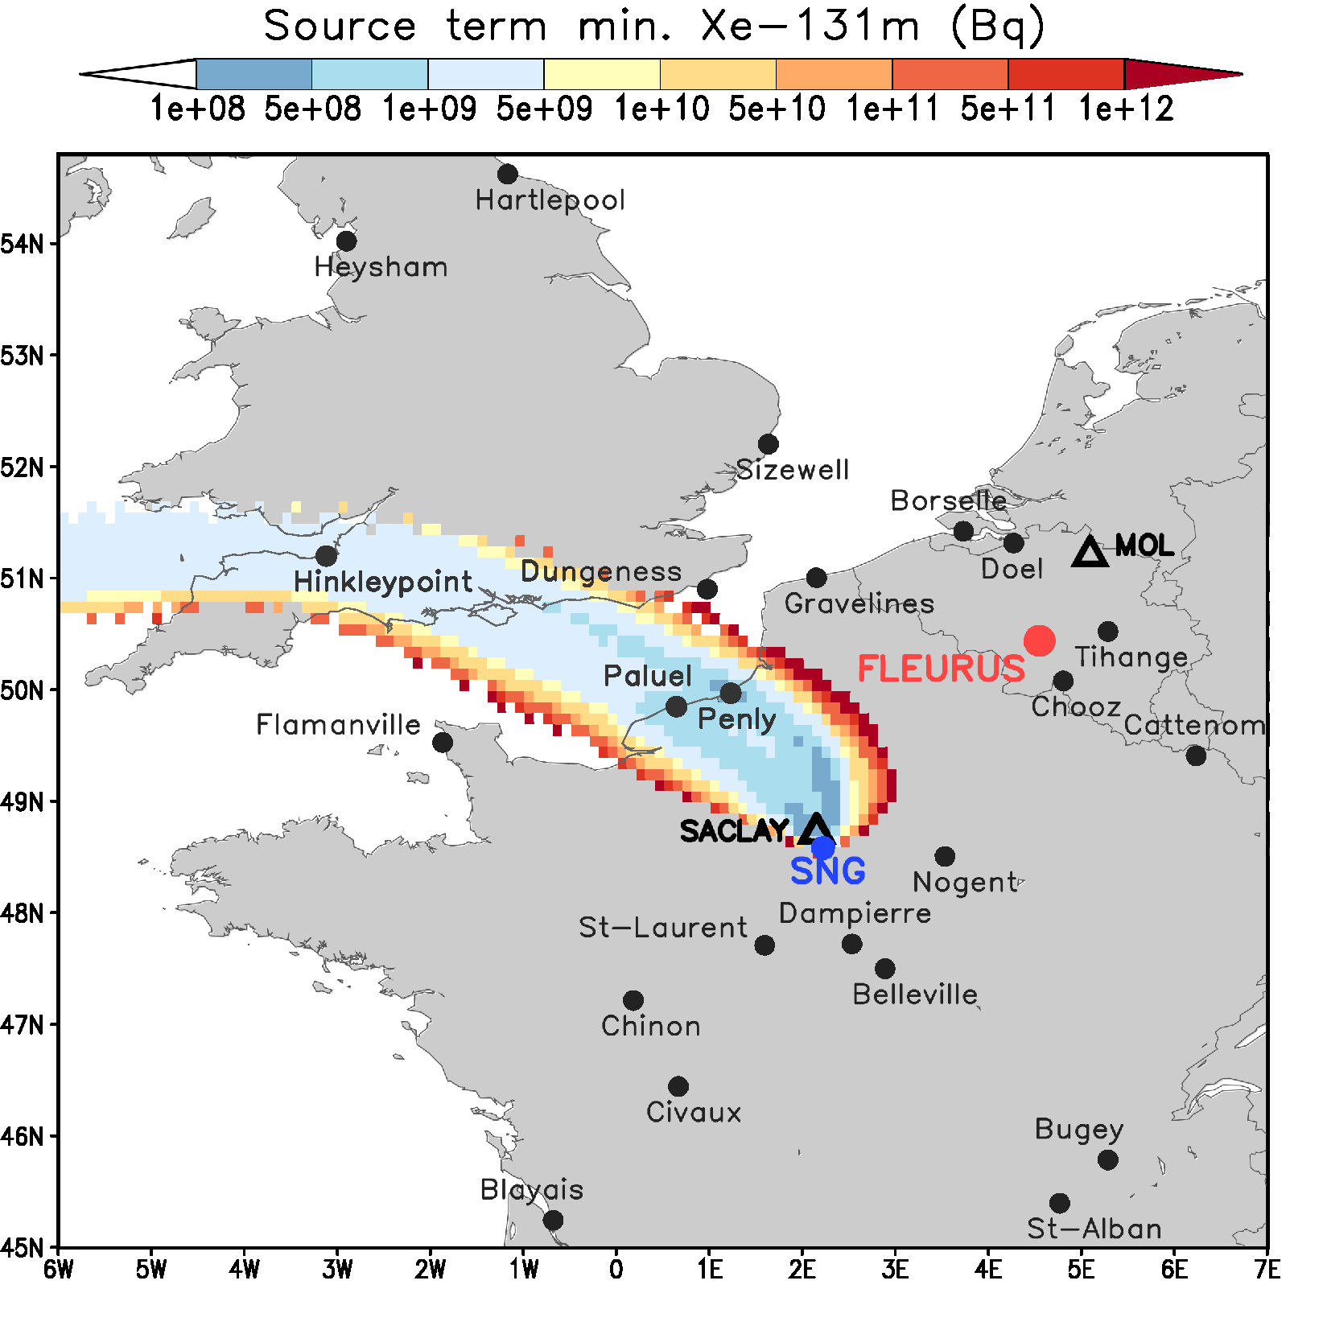
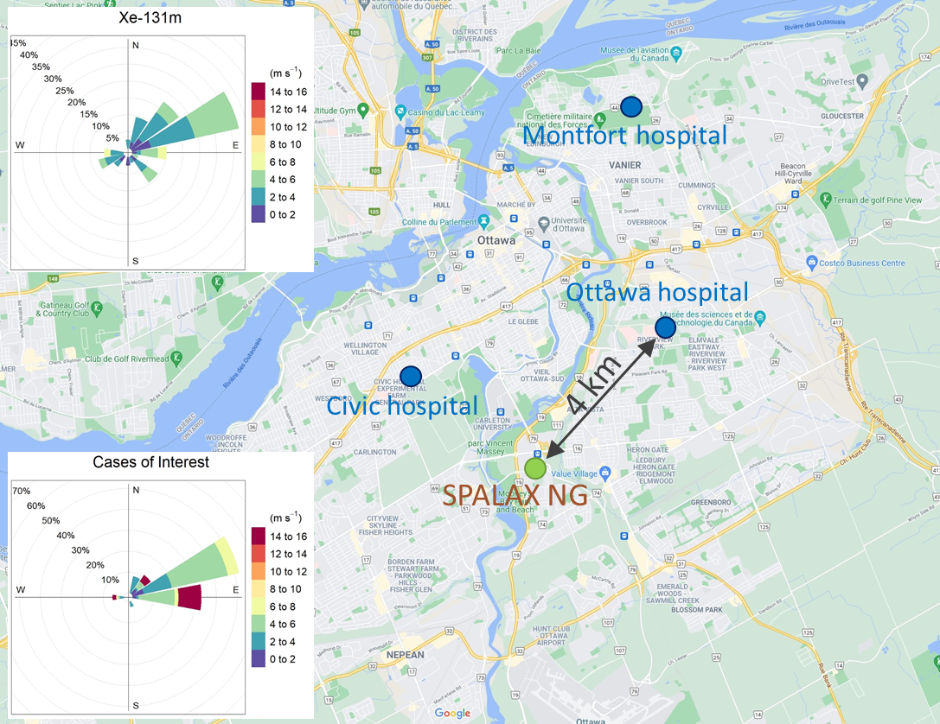
Case of Xe-131m and Xe-133 detections on Dec. 31, 2018
(higher isotopic ratio: 5.9)
Results – ATM calculations for unusual Xe-131m detections
ATM + PSR – Dec. 31,2018 sample
131m/133 = 5.9
1 → PSR using FLEXPART / GFS 0.25° → Regional scale?
(100%=regions where a single source can be at the origin of the 5 main Xe-131m detections)
Paris
Local producer of radioelements for medical applications using I-131 (Saclay, 15 km northwest of SPALAX-NG)
Source Term consistency confirmed with local radioprotection service.
Ottawa
Inconsistent with NPPs or former CRL
Hospital with nuclear medicine ? 3 hospitals report nuclear medicine)
Manufacturing / packaging of pharmaceutical products (I-131) as observed at CEA Paris?
2 → Local scale?
Please do not use this space, a QR code will be automatically overlayed
P2.4-459

Slide 6
Conclusions
SPALAX-NG qualified for IMS network since July 14th, 2021. Commercialized by Cegelec Defense.
High levels of sensitivity confirmed during the 2 qualification phases in Paris and in Ottawa (Canada). That led to an increase of multi-isotope detections
3 and 4 isotope charts consistent with the usual triggers.
Samples with single Xe-131m are unusual. Detection with single Xe-131m (or with low Xe-133 concentrations) are associated with particular wind directions, different from those observed for other xenon detections. They are due to local sources
Xe-131m releases from these local industrial sources (and undetectable until now) and global Xe-133 background may affect measured isotopic ratios within the framework of the CTBT
Please do not use this space, a QR code will be automatically overlayed
P2.4-459

Slide 7
References
Please do not use this space, a QR code will be automatically overlayed
S. Topin et al. (2020), 6 months of radioxenon detection in western Europe with the SPALAX-New generation system - Part1: Metrological capabilities, J. Env. Rad., 225, https://doi.org/10.1016/j.jenvrad.2020.106442.
P. Achim et al. (2021), 6 months of radioxenon detection in western Europe with the SPALAX-New generation system – Part 2: Atmospheric transport modelling, J. Env. Rad., 226, https://doi.org/10.1016/j.jenvrad.2020.106455.
P2.4-459

