Slide 1
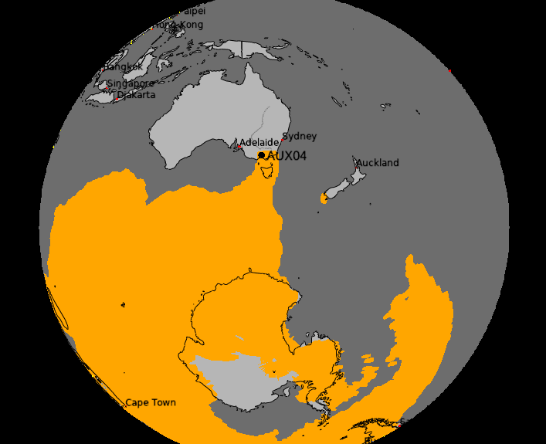
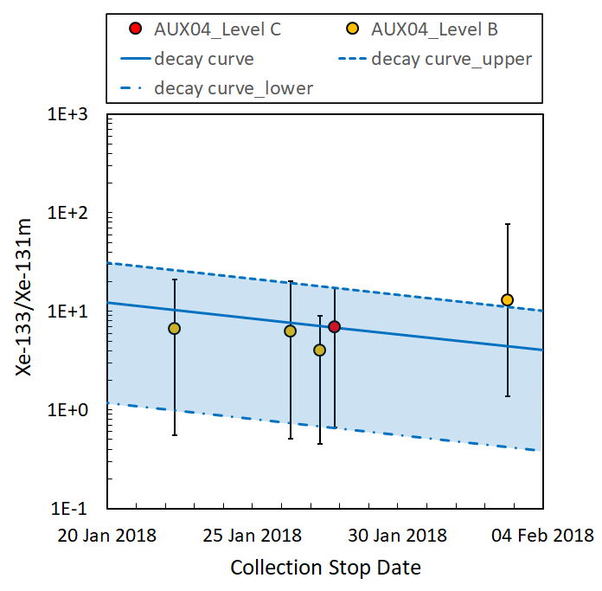
Investigating the Possible Source Region from Atmospheric Transport Modelling Utilizing the Evolution Consistency of Isotopic Ratios Measured in the IMS Radionuclide Network
Robin Schoemaker, Yuichi Kijima, Joshua Kunkle, Boxue Liu,
Jolanta Kuśmierczyk-Michulec, Anne Tipka, and Martin Kalinowski - CTBTO
P2.4-334
To enhance sample association and isotopic ratio analyses, we present an efficient means to utilize the possible source region (PSR) from atmospheric transport modelling, focussing solely on Level B/C samples required for decay consistency analysis
The standard PSR utilizes all samples in a fixed timeframe relevant for a predefined Level C episode. An alternate approach might look at those multi-isotopes suitable for isotopic ratio analysis related to the consistency of the isotopes’ evolution.
Case studies are presented of which one is further examined in this presentation. A curated PSR from atmospheric transport modelling (ATM) is computed for isotopic-ratio-specific samples including information from the field of regard (FOR) to exclude potential irrelevant multi-isotope Level B samples as well.
An extended timeframe backward reveals a possible associated release date for the source hypothesis.
15 Jan 2018

