Slide 1
Investigating the Possible Source Region from Atmospheric Transport Modelling Utilizing the Evolution Consistency of Isotopic Ratios Measured in the IMS Radionuclide Network
Robin Schoemaker, Yuichi Kijima, Joshua Kunkle, Boxue Liu,
Jolanta Kuśmierczyk-Michulec, Anne Tipka, and Martin Kalinowski
CTBTO
To enhance sample association and isotopic ratio analyses, we present an efficient means to utilize the possible source region (PSR) from atmospheric transport modelling, focussing solely on Level B/C samples required for decay consistency analysis.
The standard PSR utilizes all samples in a fixed timeframe relevant for a predefined Level C episode. An alternate approach might look at those multi-isotopes suitable for isotopic ratio analysis related to the consistency of the isotopes’ evolution.
Case studies are presented of which one is examined in this presentation. A curated PSR is computed for isotopic-ratio-specific samples including information from the field of regard (FOR) to exclude potential irrelevant multi-isotope Level B samples as well.
ATM supports isotopic ratio analyses, for multi-isotope Level C episodes, with release location and (potential extended) release time estimates. This approach can be generalized and applied systematically to all stations and all episodes.
P2.4-334

Slide 2
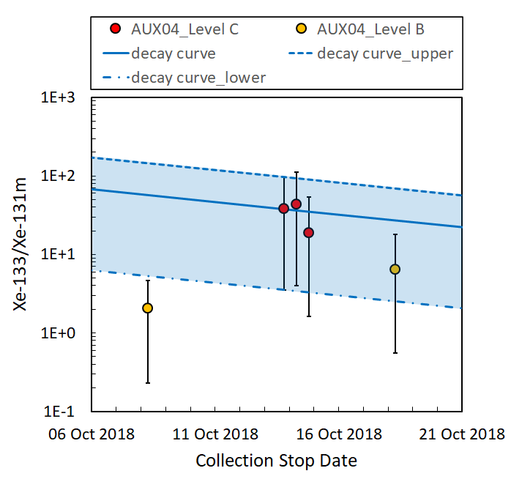
Introduction
In the International Data Centre (IDC) spectrum analysis pipeline, noble gas samples from the International Monitoring System (IMS) radionuclide stations are processed and categorized. Multi-isotope observations of Level C plus prior/post Level B samples close enough in time, at one or more IMS radionuclide stations, can be associated (sample association).
For such multi-isotope sequences, the consistency of the isotopic ratios in subsequent samples with radioactive decay might indicate that the isotopes contained in different samples (prior/post Level B) are from the same release.
The computed possible source region by atmospheric transport modelling (ATM) provide and supports sample association by looking – for multiple samples – at the common region of release at some time in the past for the source hypothesis at hand. It therefore supports isotopic ratio analyses as well.
P2.4-334

Slide 3
Objectives
The objective of this short study answers:
For that, specific case studies are explored that use:
The samples required for decay consistency analysis.
The time constraint of backward modelled PSRs.
The Source-Receptor Sensitivity (SRS) fields (having a baked-in temporal constraint of 14 days back in time per sample) used to compute the Field of Regard and the Possible Source Region.
Can a sample-customized possible source region computation yield accurate results for sample episodes utilizing only the critical samples required – associated to the same source – for the consistency of isotopic ratio evolution?
FOR (Field of Regard):
The FOR denotes the potential source domain for material detected within one single sample. It’s closely related to the standard SRS fields, and can actually be regarded as a set of pre-defined visualizations of the SRS fields.
PSR (Possible Source Region):
The PSR is a scenario-specific ATM product, computed by solving an inversion problem whereby source hypotheses are tested across the globe for a certain period of interest ($≤$ 14 days). It returns a time-dependent global distribution of correlation coefficients.
P2.4-334

Slide 4
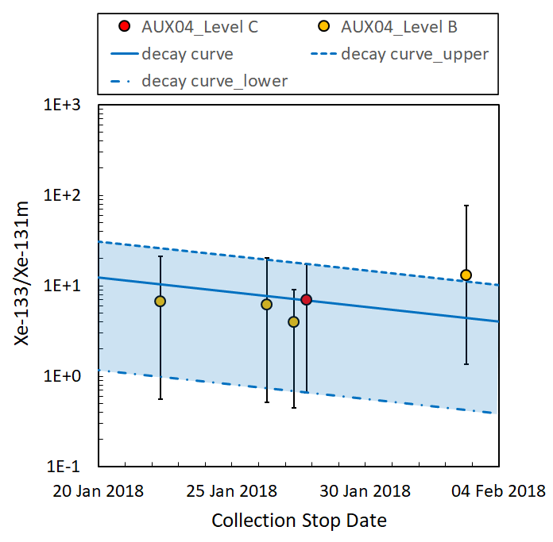
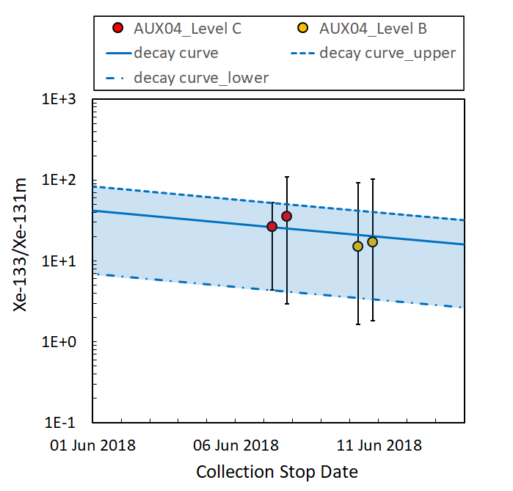
Methods/Data
2 consecutive
Level C samples
3 consecutive
Level C samples
1 Level C sample
P2.4-334
Examples of case studies involving multi-isotopic Level C sample episodes

Slide 5
Methods/Data
1 ratio-specific
Level C sample (+ 4 x Level B)
3 ratio-specific consecutive Level C samples (+ 2 x Level B)
The dates for non-ratio-specific Xe-131m Level C
samples
not present
The dates for non-ratio-specific Xe-133 Level C
samples
+/- 7 days around
ratio-specific Level C episode
P2.4-334
Ratio-specific Level B and/or C Samples vs. all Level C samples for 1 and 3 Level C samples

Slide 6
Methods/Data
1 ratio-specific
Level C sample (+ 4 x Level B)
3 ratio-specific consecutive Level C samples (+ 2 x Level B)
The dates for non-ratio-specific Xe-131m Level B
samples
The dates for non-ratio-specific Xe-133 Level B
samples
+/- 7 days around
ratio-specific Level C episode
P2.4-334
Ratio-specific Level B/C Samples vs. all Level B samples for 1 and 3 Level C samples

Slide 7
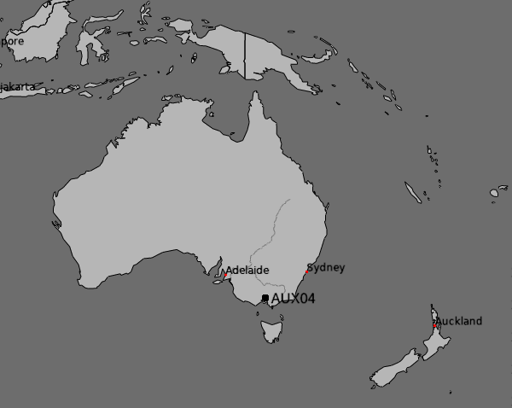
Methods/Data
Example: take the episode with 1 Level C sample . . .
Source hypothesis (civil)
P2.4-334
IMS NG samples @ AUX04
. . . plus 4 Level B samples (discard all those non-ratio-specific samples)

Slide 8
Methods/Data
We assume:
All PSRs in these case studies are for Xe-133. But for decay consistency analysis, we use at least two isotopes (Xe-133 and Xe-131m) and focus on episodes of Level C (these Level C episodes are the point of focus/reference to start with for the consistency analysis).
The episode time frame around Level C samples is set on +/- 7 days.
1 Level C sample episode
P2.4-334

Slide 9
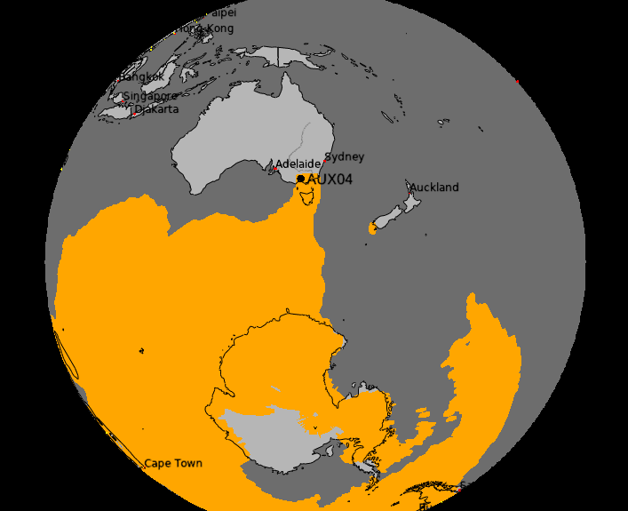
Results
2 February 2018 0600 - 14-day integral
Field of Regard
The FOR excludes the 2 Feb. Level B sample for both isotopes.
?
P2.4-334
FORs include these samples . . . for just one release (and same source hypothesis)?

Slide 10
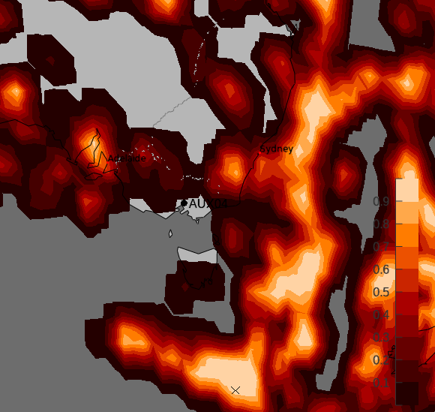
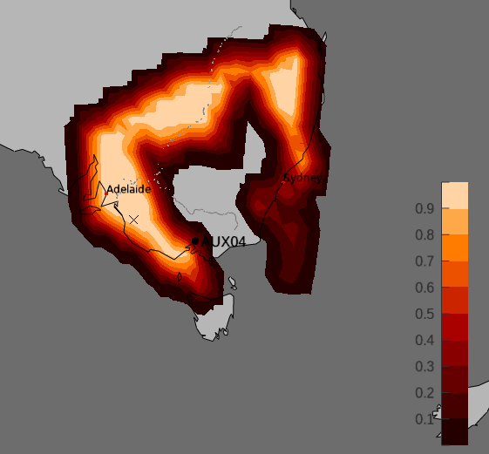
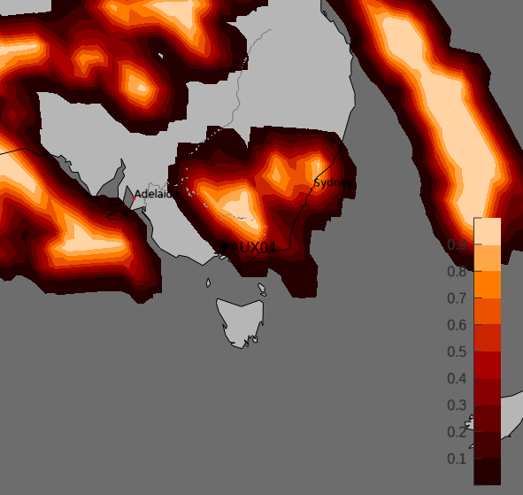
Results
PSR
24 January
PSR
PSR
15 January
Color bar is correlation coefficient.
P2.4-334
PSR for the three clustered samples gives 3 dates for the source hypothesis. Strictest algorithm.
20 January

Slide 11
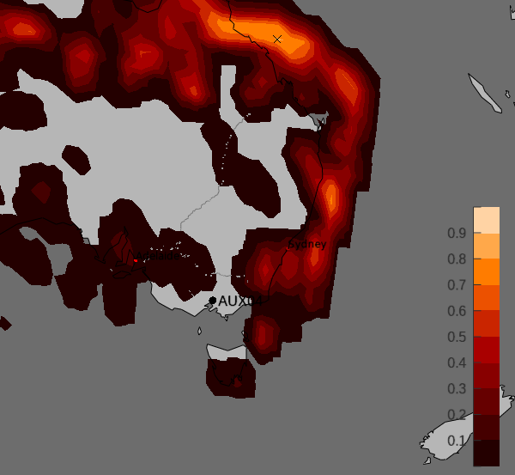
Results
PSR for all four samples gives 1 date for the source hypothesis. Strictest correlation algorithm.
P2.4-334
15 January
One possible release date: 15 January 2018

Slide 12
Results
If we just use decay consistency analysis in isotopic ratio analysis studies, we cannot exclude the 2 February Level B sample for the predefined sample episode.
Using ATM’s FOR, however, we see that Level B on 2 February is not associated to the source hypothesis so that three or four samples remain that might be associated while extending the PSR backward timeframe.
Using ATM’s curated PSR, we now assume that the clustered (3) samples are one release. But is Level B on 22 January associated?
If so, 15 Jan. is the only release date (between 14 – 28 January).
If not, the Level B sample belongs to another release (same source hypothesis).
15 Jan 2018
P2.4-334

Slide 13
Conclusion
ATM supports isotopic ratio analyses with release location and (potential extended) release time estimates.
Utilizing ATM’s PSR (and the FOR) using just those samples that have multi-isotopes for a predefined sample episode, makes it possible to compute the PSR – constrained to 14-day backward SRS files per sample – for an earlier start date for a given episode.
For the case study shown: 28 January instead of 2 February.
This approach can be generalized and applied systematically to all stations and all episodes to enhance the IDC product Standard Screened Radionuclide Event Bulletin (SSREB) and Expert Technical Analysis (ETA).
See also e-Poster P2.1-521 by Josh Kunkle et al.: “Development of Automatic Procedures for Selecting Samples Associated with a Release Event Based on the Evolution Consistency of Isotopic Ratios.”
P2.4-334

