Slide 1
Influence of Synoptic Situations on the Trajectories of Air Masses Coming from Nuclear Power Plants located in Neighboring Countries to Cuba
Celia Angelica Caveda Ramos
Center for Radiation Protection and Hygiene
Studies prior to the installation of the CTBTO station in Havana, Cuba are carried out to identify the synoptic situations that contribute to the transit of air masses from potential sources of radioactive noble gases
Progressive trajectories of accidental releases from the Turkey Point and Laguna Verde Nuclear Power Plants were estimated using the HYSPLIT trajectory model and under the influence of four synoptic situations
The trajectories of the air masses from Turkey Point NPP only transited the Cuban territory during the weak influence of the migratory high pressures of continental origin
Accidental releases from the Turkey Point NPP are a potential source of radioactive noble gases if they were detected at the Havana station under the influence of this synoptic pattern
Please do not use this space, a QR code will be automatically overlayed
P2.4-273

Slide 2
Introduction
Cuba adhered to the Comprehensive Nuclear Test Ban Treaty on February 4, 2021. Therefore, the installation of a CTBTO station has been proposed to demonstrate compliance with the Treaty.
Since 1986 Cuba has had a National Environmental Radiological Monitoring Network, whose main objective is to detect radiological anomalies in the environment due to the occurrence of accidental radioactive releases at local, regional and global scale. This National Network also participates in decision making for the adoption of protective measures and provides the information required for the response to radiological and nuclear emergencies. The guiding and methodological Center of this National Network is the Center for Radiation Protection and Hygiene (CRPH), located in Havana, western half of Cuba. The CTBTO station will be installed at the CRPH.
In Cuba's radiological and nuclear emergency response planning, transboundary accidental releases at the Laguna Verde and Turkey Point Nuclear Power Plants located in Mexico and the U.S.A respectively, were identified as one of the hazards. The Turkey Point and Laguna Verde Nuclear Power Plants are potential sources of radioactive noble gases on a regional scale.
Please do not use this space, a QR code will be automatically overlayed
P2.4-273

Slide 3
Objectives
Studies are currently being carried out prior to the installation of the CTBTO station to estimate the trajectories of air masses from these potential sources of radioactive noble gases. This study would contribute to discriminate between detections of noble gases from nuclear tests and those from nuclear accidents.
The objective of this work is to identify the synoptic situations that would contribute to the transit through Cuba of air masses from these nuclear facilities.
Please do not use this space, a QR code will be automatically overlayed
P2.4-273

Slide 4
Methods/data
Daily synoptic situations that influenced Cuba's weather were identified by means of daily forecasts from the Institute of Meteorology and surface pressure maps.
Progressive trajectories of accidental releases from the two nuclear power plants were estimated using the HYSPLIT trajectory model. The simulations were run at an altitude of 500 m AGL.
Four types of synoptic situations were analyzed:
Case I. Classic cold front
Case II. Nearby influence of the Oceanic Anticyclone.
Case III. Low pressure system of wide circulation located over the northern portion of the Yucatan Peninsula.
Case IV. Weak barometric gradient
Please do not use this space, a QR code will be automatically overlayed
P2.4-273

Slide 5
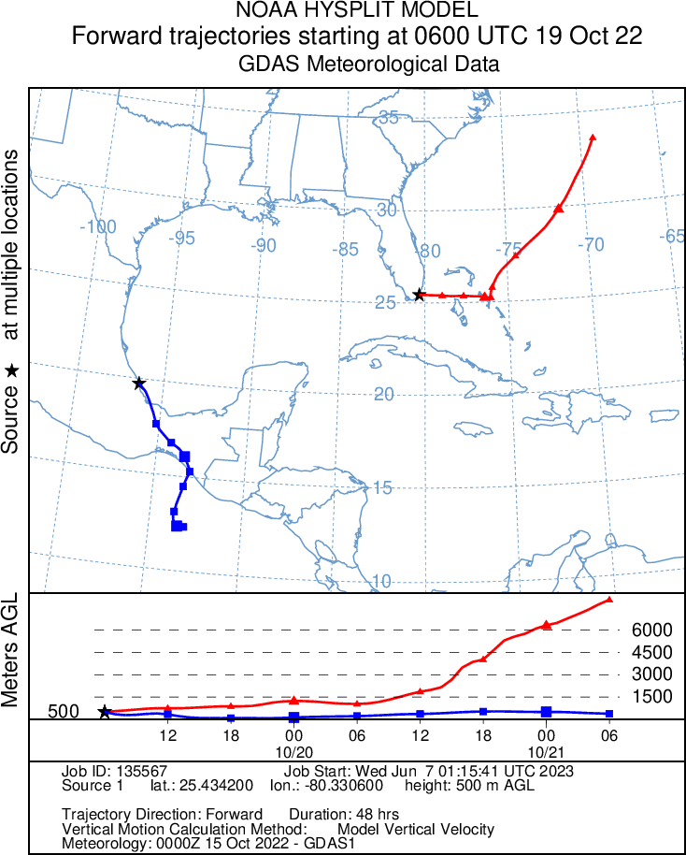
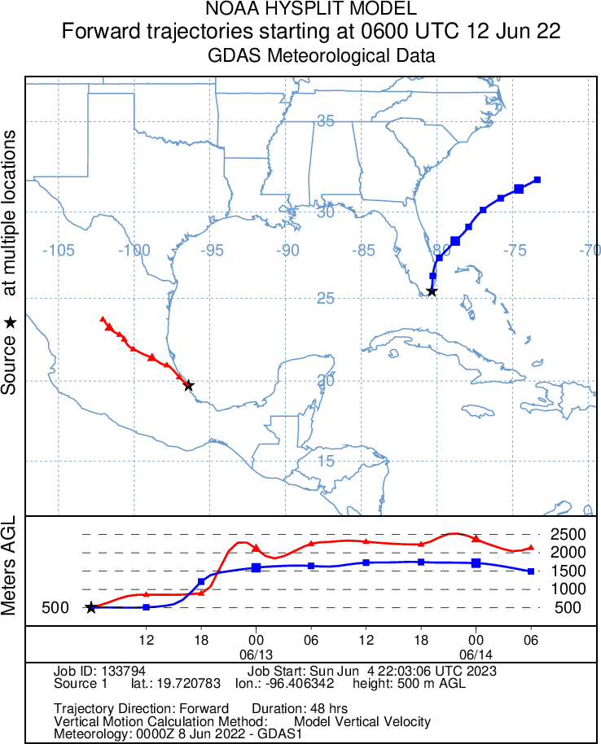
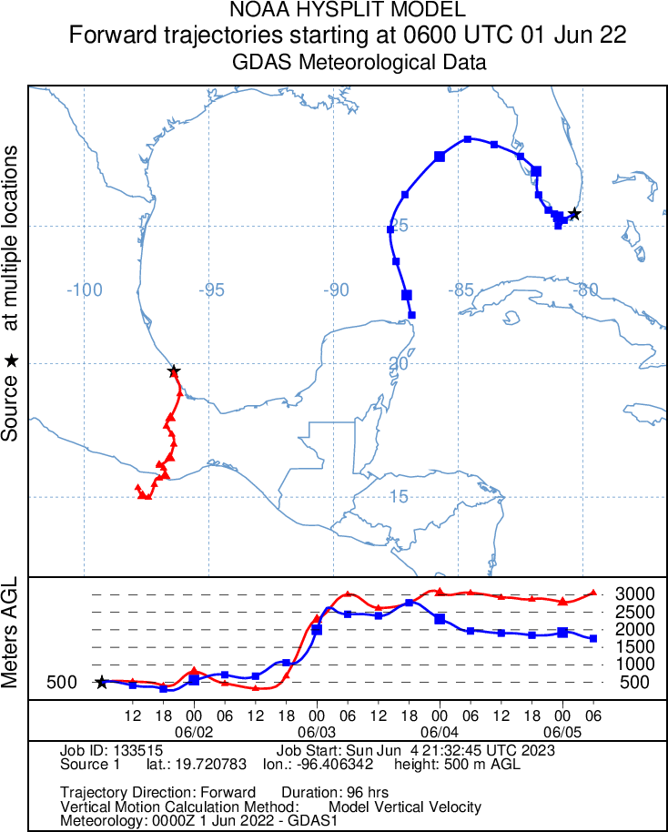
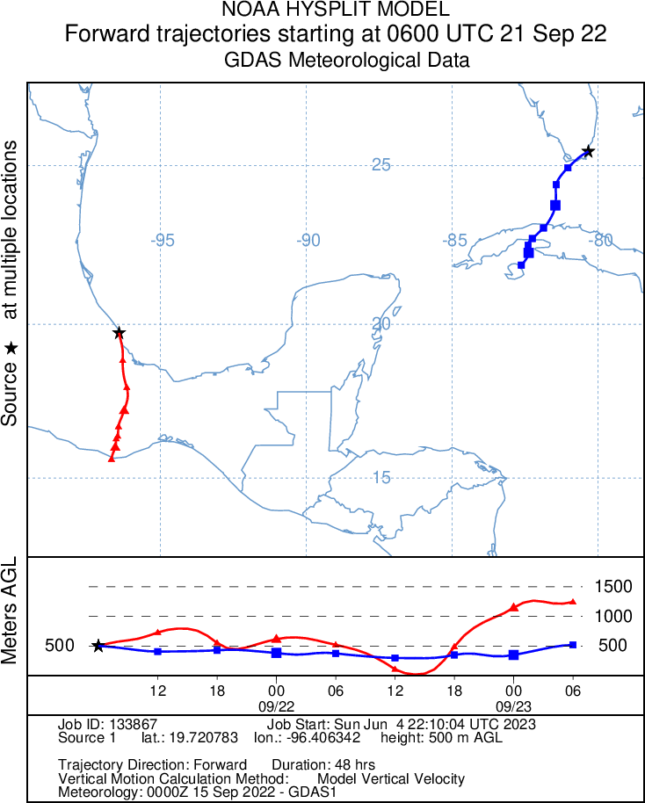
Results
Case II. The nearby influence of the Oceanic Anticyclone is produced when the anticyclone penetrates in the form of a wedge over all of Cuba, covering the Gulf of Mexico and the southeast of the U.S.A. This synoptic pattern causes the air masses coming from these nuclear facilities to be deviated in one case towards the Mexican territory and in the other towards to the area adjacent to the eastern coast of the U.S.A.
Case IV. The weak influence of continental migratory high pressure over the western half of Cuba, with a centre over the southeastern U.S.A, caused the trajectories of the air masses coming from the Turkey Point NPP to transit the Cuban territory. Air masses take approximately 24 hours to start their transit over Cuban territory. On the other hand, the air masses coming from the Laguna Verde NPP transited through Mexican territory due to another high pressure centre located in the Gulf of Mexico.
Case I. The trajectories of the two nuclear power plants moved away from Cuban territory. The classic cold front is preceded by southerly winds. Behind the classic cold front, migratory high pressures of continental origin leave northeasterly and northerly winds over the Gulf of Mexico.
Case III. The widely circulating low pressure system caused air masses from Turkey Point NPP to integrate into the circulation of this system and move away from Cuban territory. During this period of execution, an area of low pressure in the seas near the Yucatan Peninsula caused air masses from Laguna Verde NPP to cross Mexico.
Please do not use this space, a QR code will be automatically overlayed
P2.4-273

Slide 6
Conclusion
The results obtained with the HYSPLIT trajectory model showed that no transit of the air masses would occur if Cuba was under the influence of a classical cold front, the nearby influence of the Oceanic Anticyclone and a low-pressure centre with a wide circulation over the northern portion of the Yucatan Peninsula.
Air masses from the Turkey Point Nuclear Power Plant transited over the western half of Cuba during the weak influence of migratory high pressures. Accidental releases from this nuclear facility are a potential source of radioactive noble gases, for this synoptic pattern, if were detected at the Havana station.
Accidental releases from the Laguna Verde Nuclear Power Plant, for the four synoptic situations analysed, are not a potential source if radioactive noble gases were detected at the CTBTO station to be installed in Havana, Cuba.
Please do not use this space, a QR code will be automatically overlayed
P2.4-273

