Slide 1
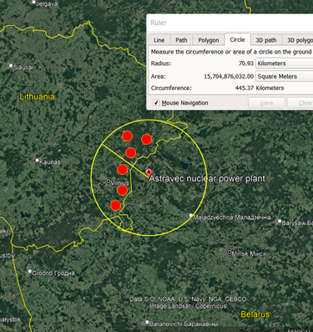
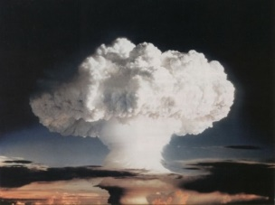
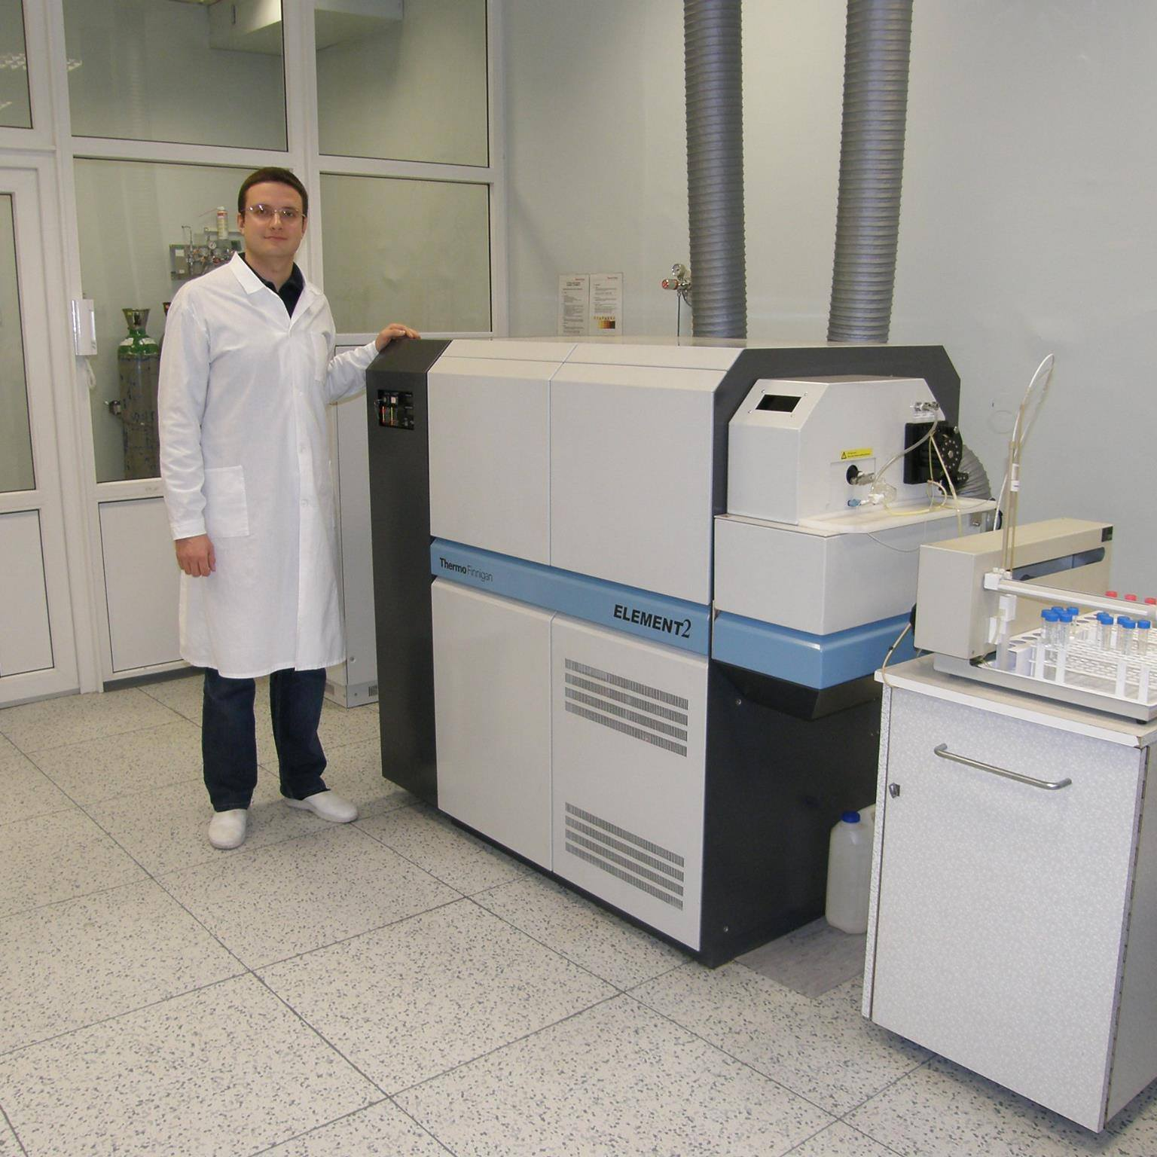
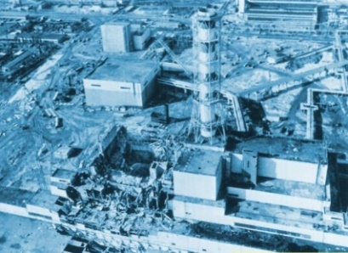
Isotopic “Zero Point” Background Screening for Fallout Emission Assessment
A. Puzas et al.
Center for Physical Sciences and Technology, LITHUANIA
P2.4-602
ICP-MS
Alpha, gamma spectrometry
?
Isotopic ratios!
Geographical sampling places and the Astravec Nuclear Power Plant location (yellow circle represents the 70 km zone from the Astracec NPP)
Found plenty of fallout!

