Slide 1
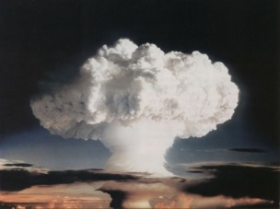
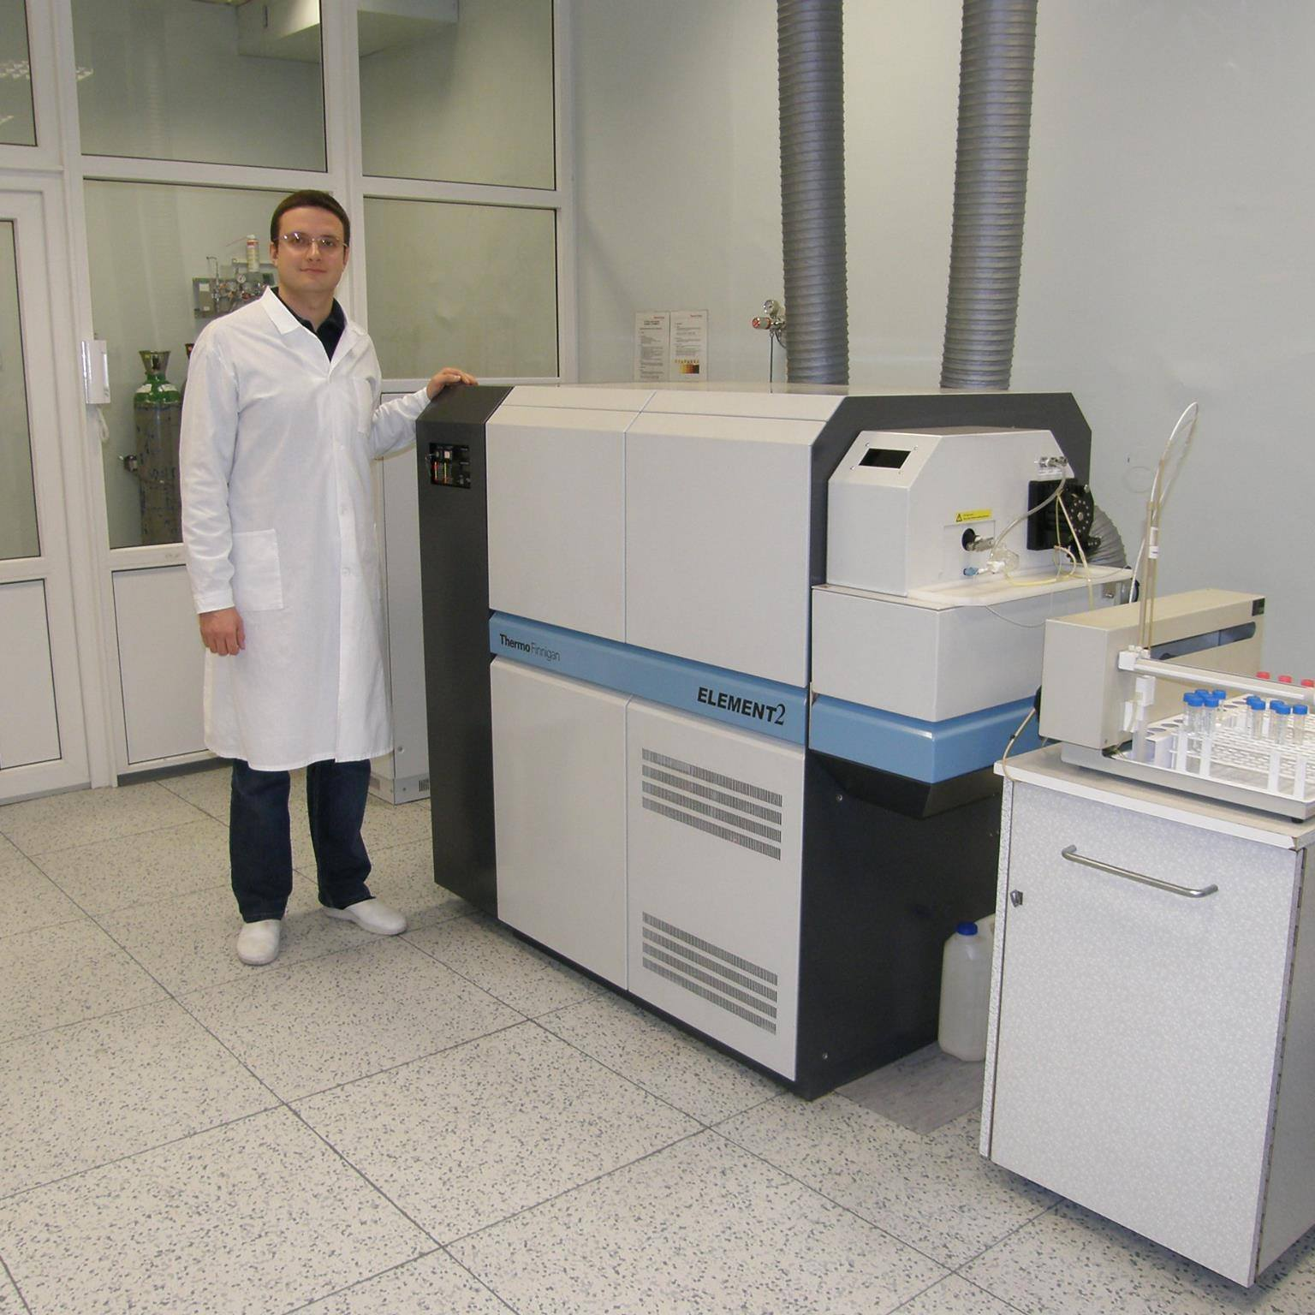
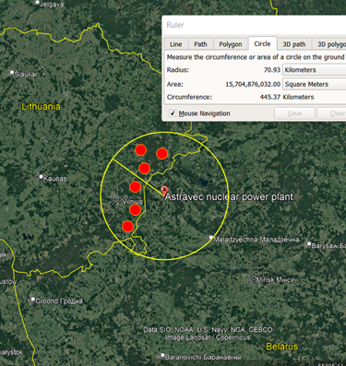
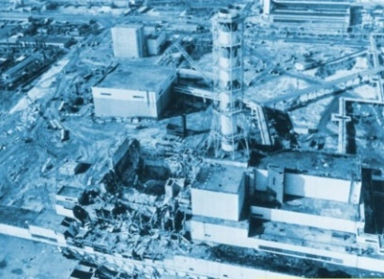
Isotopic “Zero Point” Background Screening for Fallout Emission Assessment
A. Puzas et al.
Center for Physical Sciences and Technology, LITHUANIA
Found plenty of fallout!
ICP-MS
Alpha, gamma spectrometry
Please do not use this space, a QR code will be automatically overlayed
P2.4-602

Slide 2
Introduction
Isotopic composition analysis allows the identification of an artificial source of radionuclides.
1 Fig. Fallout in Northern hemisphere
2 Fig. Chernobyl NPP accident (1986)
²⁴⁰Pu/²³⁹Pu = 0.180 ± 0.007(1σ) (Kelley et al., 1999)
²⁴⁰Pu/²³⁹Pu = 0.403 ± 0.003(1σ) (Muramatsu et al., 2000)
²³⁸Pu/²³⁹⁺²⁴⁰Pu = 0.04 ± 0.01 (Mietelski and Was, 1995)
²³⁸Pu/²³⁹⁺²⁴⁰Pu = 0.51 ± 0.03 (Remeikis et al, 1995)
Please do not use this space, a QR code will be automatically overlayed
¹³⁷Cs/^{239,240}Pu activity ratio for the global fallout is 26 ± 3 for the 2023 year (Luksiene etl al. 2015)
P2.4-602

Slide 3
The goal is to determine radionuclide local contamination source vs. global contamination through the isotopic ratio assessment.
Please do not use this space, a QR code will be automatically overlayed
P2.4-602

Slide 4
Methods/data
Emission source: local vs. global
where A% is a local source contribution in %, A_{sample} is its experimental value and A_{local}, A_{global} are typical activity and atomic ration for the source and for the global fallout.
Please do not use this space, a QR code will be automatically overlayed
P2.4-602

Slide 5
Methods/data
Sample preparation
Undisturbed meadow and forest soil samples, were sieved (50 g dry mass + ²⁴²Pu tracer added);
Pu chemical separation and concentration: ion exchange resin DOWEX 1X8 + afterwards U/TEVA, TRU resins.
Sampling and measurements
Samples:
undisturbed meadow soils, 0-5 cm depth profile, with upper layer.
Measurement equipment:
HPGe gamma spetrometry – for caesium-137,
Inductively-coupled plasma mass spetrometry – for plutonium-239 and plutonium-240,
alpha spectrometry – for plutonium-238 and plutonium-239,240 determination.
Please do not use this space, a QR code will be automatically overlayed
P2.4-602

Slide 6
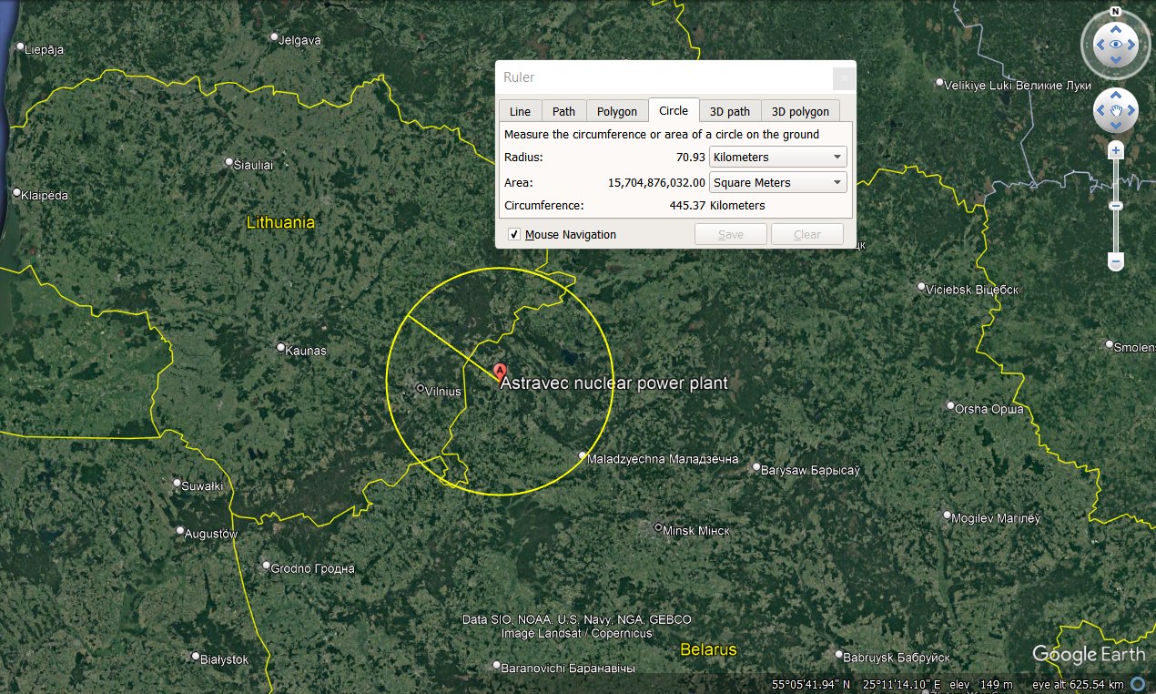
Results
Please do not use this space, a QR code will be automatically overlayed
Fig. 3. Geographical sampling places and the Astravec Nuclear Power Plant location (yellow circle represents the 70 km zone from the Astracec NPP)
P2.4-602

Slide 7
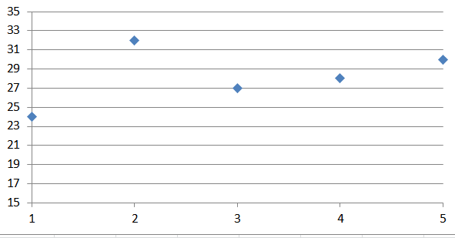
Results
Emission source identification through caesium and plutonium isotopic information
¹³⁷Cs specific activity concentration in meadow soil samples varied from 1.11 Bq kg⁻¹ to 16.80 Bq kg⁻¹. Plutonium isotope activity concentrations ranged from 0.01 Bq kg⁻¹ to 0.25 Bq kg⁻¹ ²³⁸Pu and from 0.05 Bq kg⁻¹ to 0.80 Bq kg^{-1 239,240}Pu. The calculated ²³⁸Pu/^{239,240}Pu activity ratios and ²⁴⁰Pu/²³⁹Pu atomic ratios are 0.02–0.08 and 0.16–0.19, respectively. ²³⁸Pu/^{239,240}Pu activity and ²⁴⁰Pu/²³⁹Pu atomic ratios in the southeastern part of Lithuania indicate the Northern hemisphere global nuclear weapon test emissions.
¹³⁷Cs/²³⁹⁺²⁴⁰Pu isotopic ratio representing global fallout value
Please do not use this space, a QR code will be automatically overlayed
P2.4-602

Slide 8
Conclusion
Conclusions
¹³⁷Cs and plutonium isotope source in southeastern Lithuania is mainly nuclear tests debris.
²³⁸Pu/^{239,240}Pu activity and ²⁴⁰Pu/²³⁹Pu atomic ratios in undisturbed soils do not vary significantly.
Please do not use this space, a QR code will be automatically overlayed
P2.4-602

