Slide 1
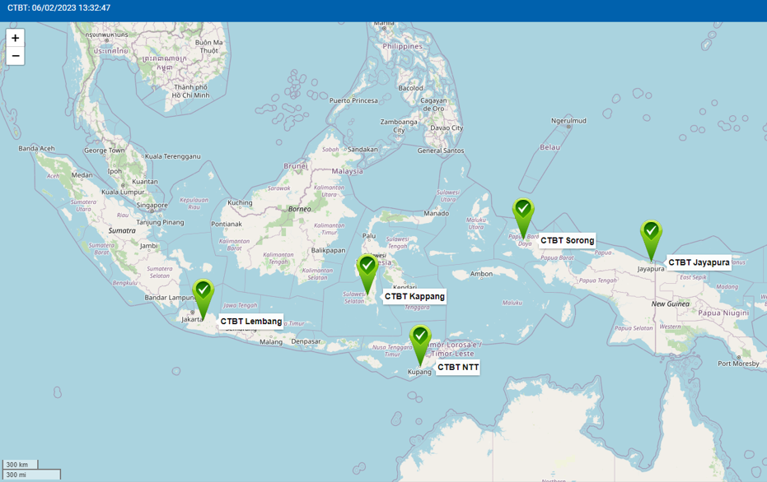
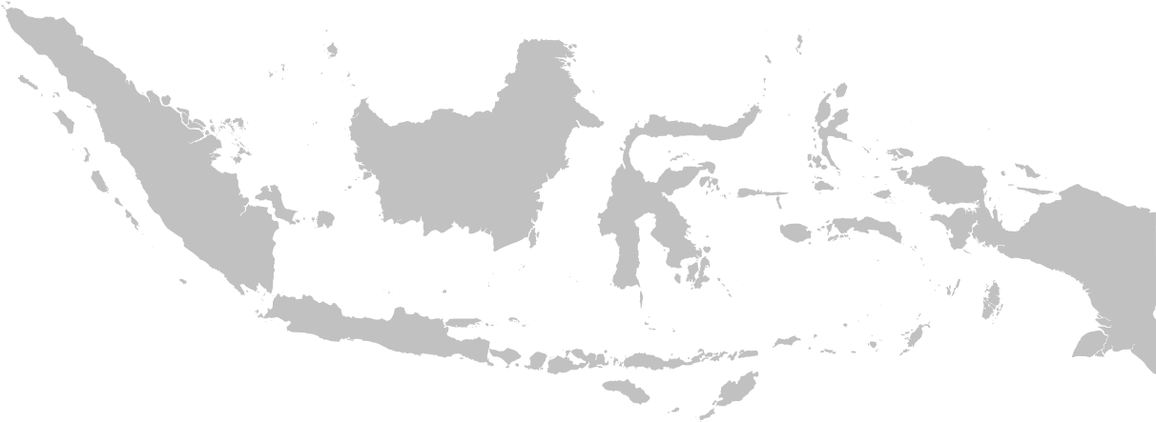
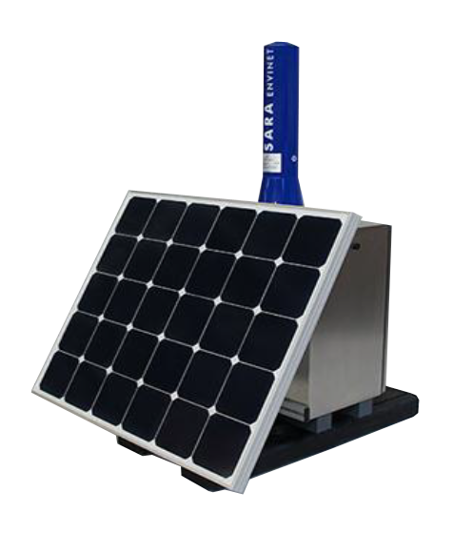
The Indonesian – Radiation Detector Monitoring System (I-RDMS),
a Nuclear Early Warning System for Transboundary Radioactive Release Detection
Alifia Rahmawati
Nuclear Energy Regulatory Agency of Indonesia (Badan Pengawas Tenaga Nuklir – BAPETEN)
P2.4-200
Specification requirement
Configuration in BAPETEN
Function test in CTBT station
Operation of I-RDMS
Location Survey
MUST BUILD A RELIABLE NUCLEAR EARLY WARNING SYSTEM, WHY?
Average backround GDR in CTBT Station Based on IRDMS data (nSv/h)
TRANSBOUNDARY RELEASE CHALLENGE
1
Radioactive release from an NPP accident (e.g., Fukushima 2011) or military activity might spread across the national border to Republic of Indonesia’s territory. → transboundary release threat.
A NATIONAL STRATEGY THAT CAN BE IMPLEMENTED
KAPI 79,17±3,28
SIJI 70,46±0,48
JAY 13,17±1,49
Indonesia – Radiation Data Monitoring System (I-RDMS)
2
Potential threat might spread across 13,466 islands throughout Indonesia with a coastline of 54,716 km. → where and when the transboundary release will arrive to Indonesia?
LEM 50,19±0,69
BATI 35,18±1,63
Indonesia commitment by ratifying related international convention:
Nuclear Non-Proliferation Treaty (NPT), ratified with Act No 8/1978.
Convention on Early Notification of a Nuclear Accident, ratified with PR No. 81/1993.
The Southeast Asia Nuclear Weapon Free Zone Treaty (SEANWFZ), ratified with PR No. 9/1997.
Conclusions
The I-RDMS at the CTBT station continues to provide environmental radioactivity monitoring data with varying values for each region.
BAPETEN is working with the BMKG to gradually increase the number of detectors to expand the surveillance area in Indonesia. Beside of 5 CTBT stations in 2018, BAPETEN also had installed 17 stations in BMKG stations since 2019-2022 and continue to achieve the target.
Recommendations
Hopefully there will be an opportunity to share knowledge from countries that have similar systems on how to maintain the equipment, ensure the data quality, alayze the data, share the data to the related stakeholder, and respond the radiological alarm/notifications.
ENVINET SARA-101-L4-H Detector Spectroscopic Gamma Detector – NaI(Tl) Scintillation Detector 1,5“ x 1,5”
3
Operation
Daily monitoring
Gamma dose rate (GDR) trendline, temperature, battery voltage, connection status
I-RDMS Installation in CTBT station
The placement at the Indonesia CTBT station produces verification of information regarding any incident of nuclear weapons related activity and whether the effects of radiation reached Indonesia. It is also purposed to obtain the baseline data on environmental radioactivity under normal conditions.
Alarm
Technical failure or increasing GDR (rotating alarm, email, SMS)
Preventive maintenance & energy calibration
1. Ensure the data quality and equipment performance
2. Prevent any potential failure

