Slide 1
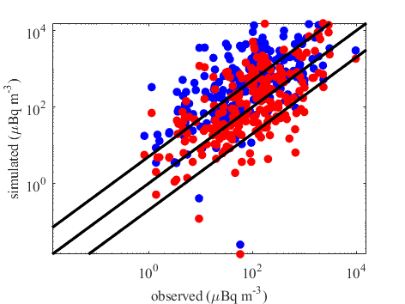
Modelling wet deposition to improve test-ban monitoring
Stijn Van Leuven^{1,2,3}, Pieter De Meutter^{1,2}, Johan Camps¹, Piet Termonia^{2,3} & Andy Delcloo^{2,3}
¹SCK CEN, ²Royal Meteorological Institute of Belgium, ³Ghent University
The simulation of wet deposition of radionuclides in atmospheric transport modelling (ATM) remains uncertain due to the parameterisation schemes used in simulations.
We explore a new method to optimise the efficiency of the wet scavenging processes in ATM.
Improvement of model-observation correspondence
Our method improves the modelling of wet deposition, while being very computationally inexpensive.
This can enhance the quality of source reconstruction in the context of test-ban monitoring.
$$IN$$
$$CCN$$
$$C_{rain}$$
$$C_{snow}$$
● before ● after
Please do not use this space, a QR code will be automatically overlayed
P2.4-654

Slide 2
INTRODUCTION
Atmospheric transport modelling (ATM) is crucial for source reconstruction in the context of test-ban monitoring
ATM used in this study Flexpart v10.4
Scavenging by
cloud condensation nucleation
Wet deposition is one of the main contributors to depletion of particulate radionuclides from the atmosphere
ice nucleation
$$IN$$
$$CCN$$
snow collection
rain collection
$$C_{snow}$$
$$C_{rain}$$
Scavenging is exponential decay process
$$c\left(t+Δt\right)=c\left(t\right)exp\left(−ΛΔt\right)$$
$Λ=Λ(I,d_{p})$ ►
$c$ | - | activity concentration [$Bq m^{−3}$]
$Λ$ | - | scavenging coefficient [$s^{−1}$]
$Δt$ | - | timestep [$s$]
Please do not use this space, a QR code will be automatically overlayed
$I$ | - | rain intensity [$mm h^{−1}$]
$d_{p}$ | - | particle diameter (distribution) [$µm$]
P2.4-654

Slide 3
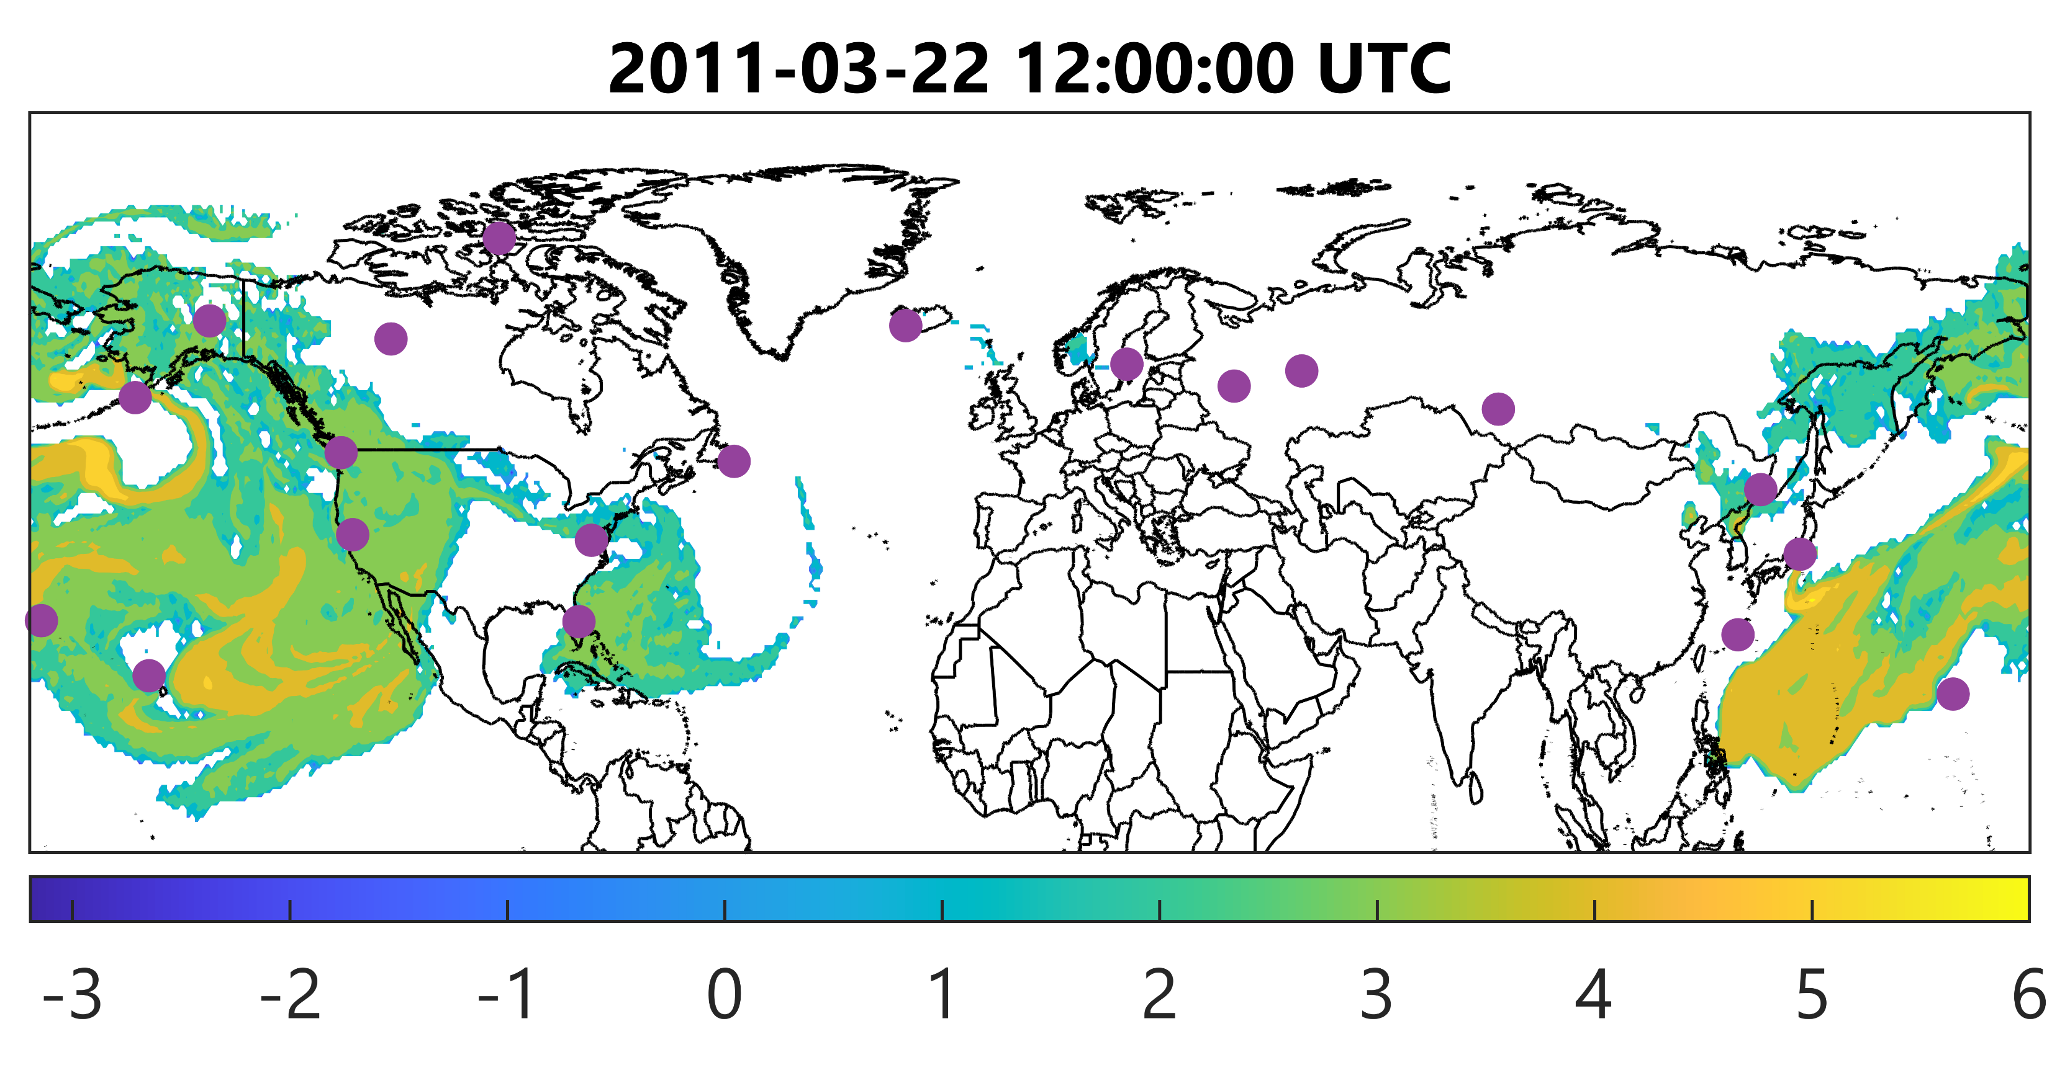
OBJECTIVES
The simulation of wet deposition in ATM remains uncertain due to the parameterisation schemes used in simulations
In Flexpart this uncertainty can be captured in the scavenging parameters ($CCN$, $IN$, $C_{rain}$, $C_{snow}$)
We explore a new method to optimise the efficiency of these parameters, which should improve wet deposition modelling in ATM
Case study
$\log_{10}(c)$ [µBq/m³]
Fukushima nuclear power plant incident (2011)
¹³⁷Cs transport and deposition
Measurements from International Monitoring System (IMS)
◄ Default scavenging in Flexpart overestimates activity air concentration by a factor ~6
Please do not use this space, a QR code will be automatically overlayed
P2.4-654

Slide 4
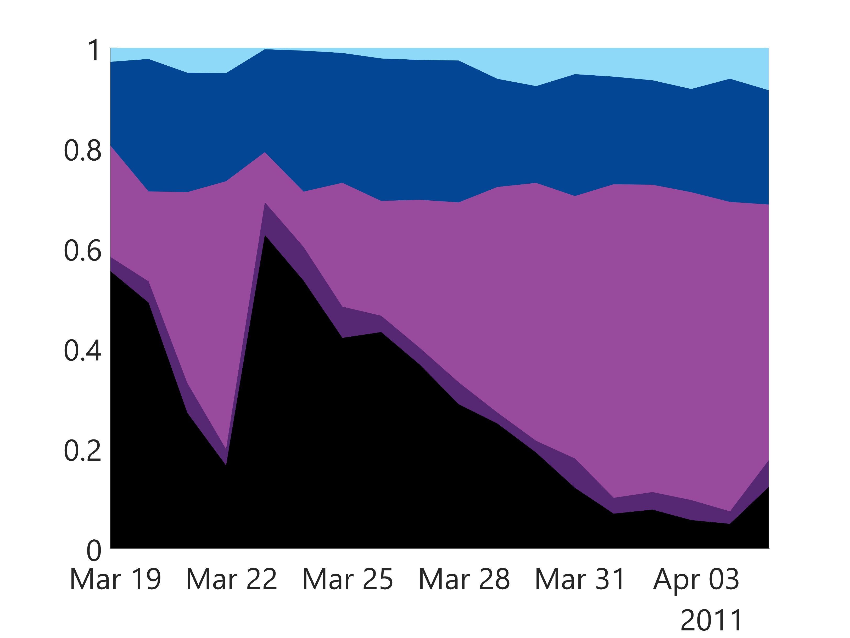
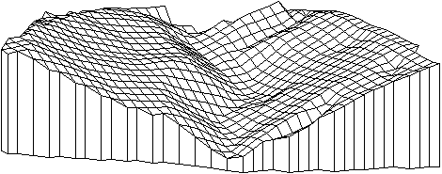
METHODOLOGY
3-step systematic framework
▼ Simulation for IMS station RN71
1
Define the contributions of individual scavenging processes ($CCN$, $IN$, $C_{rain}$, $C_{snow}$) for each measurement:
$$IN$$
$$CCN$$
$$c=c_{0}−Σ_{i}Δc_{i}$$
$$Δc_{i}/c_{0}$$
$$C_{snow}$$
2
Apply appropriate scaling scheme to scavenging processes:
$$C_{rain}$$
$$c$$
$$Δc_{i}=\left(c+Δc_{i}\right)A_{i}$$
3
Minimise cost function by varying $A_{i}$’s:
Please do not use this space, a QR code will be automatically overlayed
$$F(A_{i})={\left(\log_{10}c\left(A_{i}\right)−\log_{10}c_{obs}\right)}^{2}$$
▲ minimisation in 4D parameter space (schematic example)
P2.4-654

Slide 5
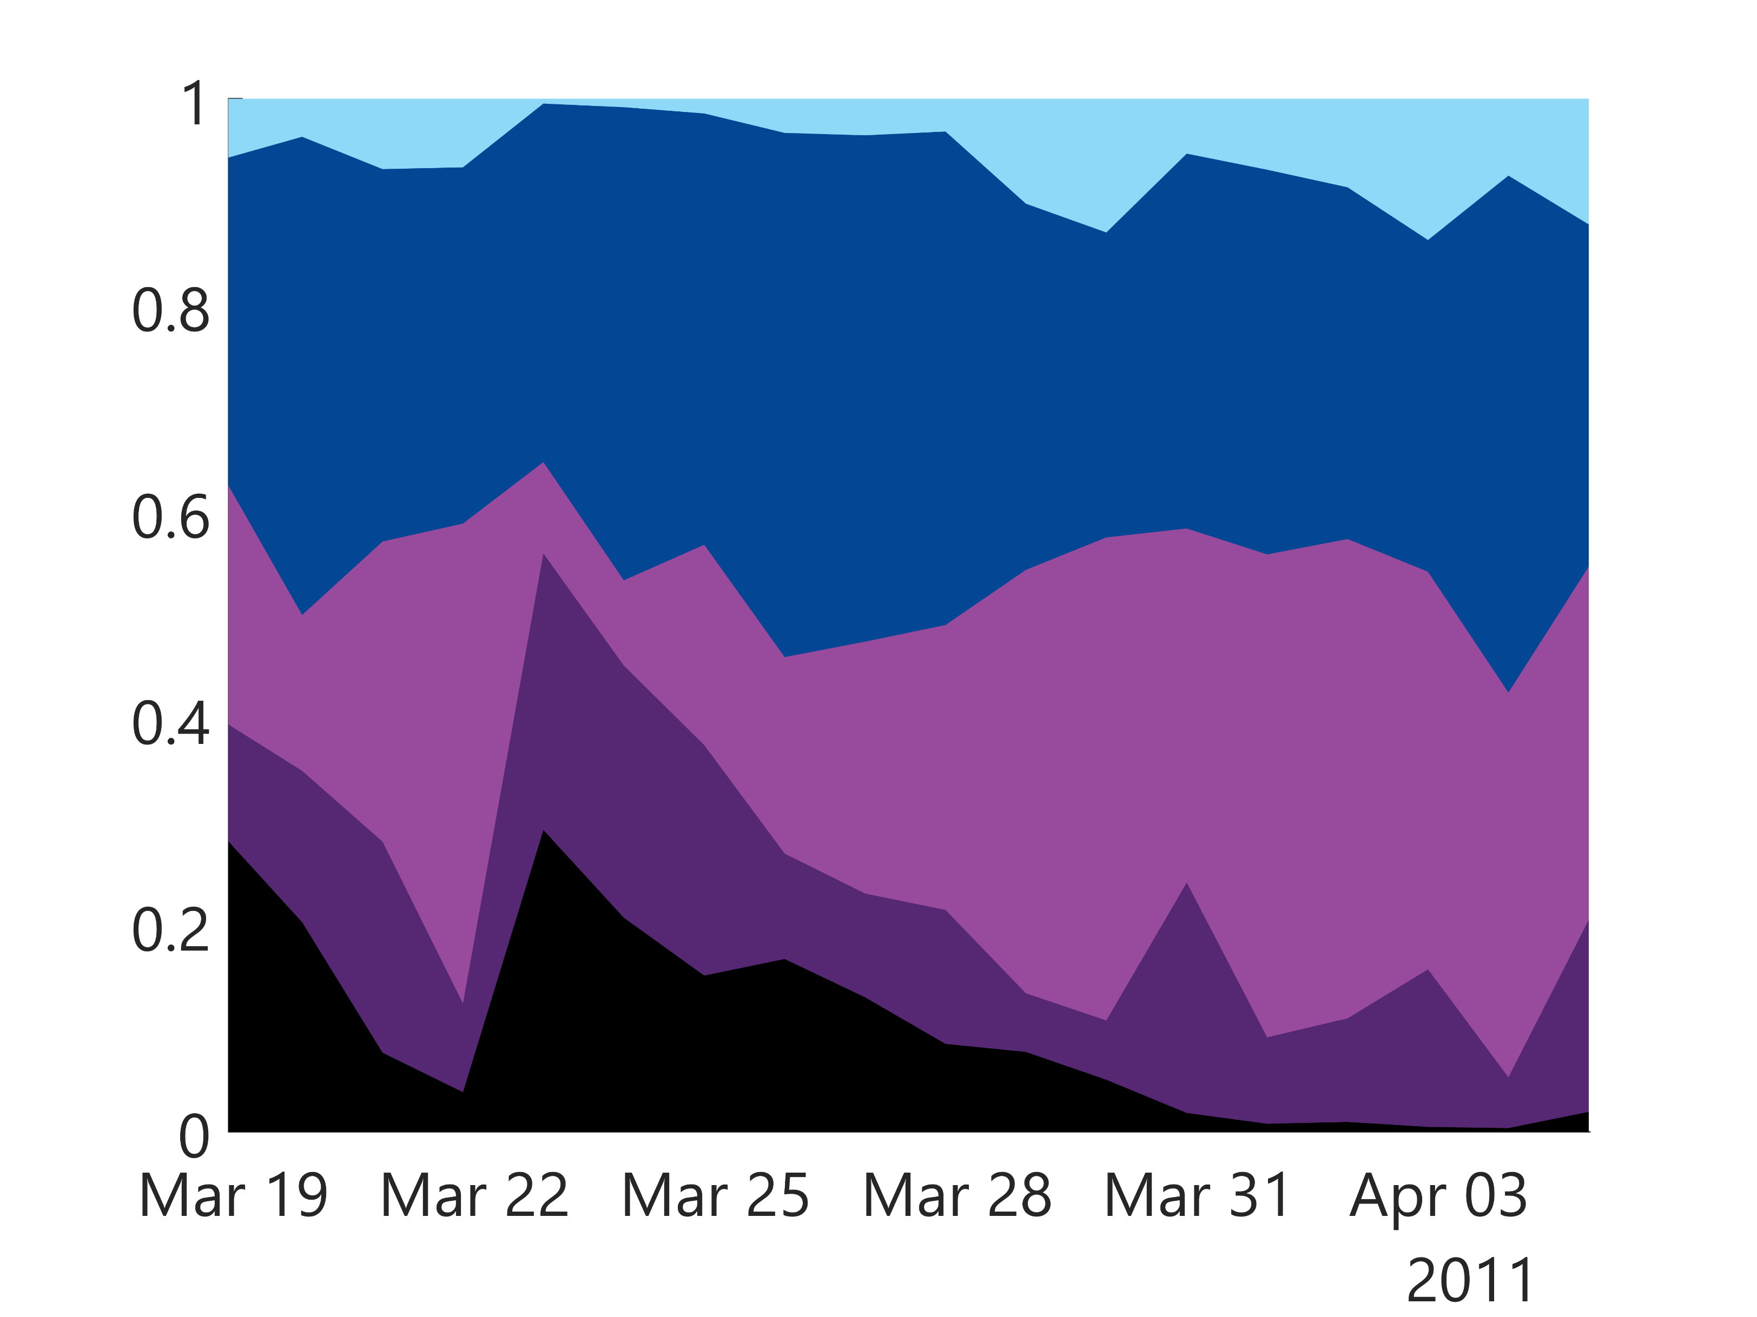
RESULTS
Before
After
Removes bias between observations and model
METHODOLOGY
Scaling factor for all scavenging processes increased
Due to compensating effects, the relative contribution of some processes can decrease despite the above
▲ Measurements vs. default model
▲ Measurements vs. optimised model
$$Δc_{i}/c_{0}$$
$$Δc_{i}/c_{0}$$
Please do not use this space, a QR code will be automatically overlayed
$$c$$
$$CCN$$
$$IN$$
$$C_{rain}$$
$$C_{snow}$$
P2.4-654
▲ Simulation for IMS station RN71
▲ Simulation for IMS station RN71

Slide 6
CONCLUSION
The proposed optimisation scheme is able to improve model-observation correspondence by scaling the wet scavenging contributions of the different scavenging processes
This method is much more efficient than a brute force method, as it only requires one simulation
Improving the modelling of wet deposition in ATM can aid CTBT monitoring by enhancing the quality of source reconstruction
paper (pre-print): Van Leuven, S., De Meutter, P., Camps, J., Termonia, P. and Delcloo, A., 2023, An optimisation method to improve modelling of wet deposition in atmospheric transport models: applied to FLEXPART v10.4, EGUsphere, https://doi.org/10.5194/egusphere-2023-357
Please do not use this space, a QR code will be automatically overlayed
P2.4-654

