Slide 1
Recent Developments of Molten Salt Reactor Technology and its Possible Impact on Global Radioxenon Emission
[Sri Sundari Retnoasih¹, Tatiana Boitsova²]
¹National Research and Innovation Agency of Republic of Indonesia (BRIN) ²CTBTO Preparatory Commission OSI/T
The recent development of MSR showed that a potential Radioxenon release can be increased. The aim of this research is to provide an update on the MSRs’ development in the world to estimate the likelihood time of an increase in overall Radioxenon emissions.
The study literature is the approach for this research by using literatures from different resources which consist 18 scientific journals, 23 websites, 5 technical reports, and 8 presentations which cover several main topics to estimate the increase in Radioxenon emissions.
A literature showed that China is the leading country for having an excellent progress for the MSR development by 2025. Another following countries such as UK, Canada, US, Denmark, Russia and Indonesia are expected to start their operation between late 2020s – 2030s
China expects to start the operation of their experimental reactor on 2025, following by another countries which expect to start on late 2020s – early 2030s. According to research, the first increase in global Radioxenon emissions due to the MSR's operation could be expected in 2028.
Please do not use this space, a QR code will be automatically overlayed
P2.4-592

Slide 2
Introduction
Radionuclide detection is a method that can provide a forensic proof from a nuclear explosion on the International Monitoring System (IMS) technologies. The recent development of generation-IV reactors such as MSR showed that a potential Radioxenon release can be increased based on the operation of these MSRs. The aim of this research is to provide an update on the MSRs’ development in the world to estimate the likelihood time of an increase in overall Radioxenon emissions.
Please do not use this space, a QR code will be automatically overlayed
P2.4-592

Slide 3
Objectives
This research focus on the several countries which shows the progress. 25 institutions and companies in many countries are developing MSRs. By country, China is leading the development of MSR while the UK, Russia, US, Denmark, Canada, and Indonesia working on the MSR projects .
Country | Name of the MSR | Stage | Estimated Operation
Canada | IMSR400 | Conceptual Design | 2025-2040
China | TMSR-LF1 | Commissioning | 2025
Denmark | CMSR | Conceptual Design | 2027
Indonesia | ThorCon | Detailed Design | 2035
Russia | FLiBe burner MSR | Conceptual Design | 2031
United Kingdom | SSR-U | Basic Design | 2030
United State | LFTR | Conceptual Design | 2030
Please do not use this space, a QR code will be automatically overlayed
P2.4-592

Slide 4
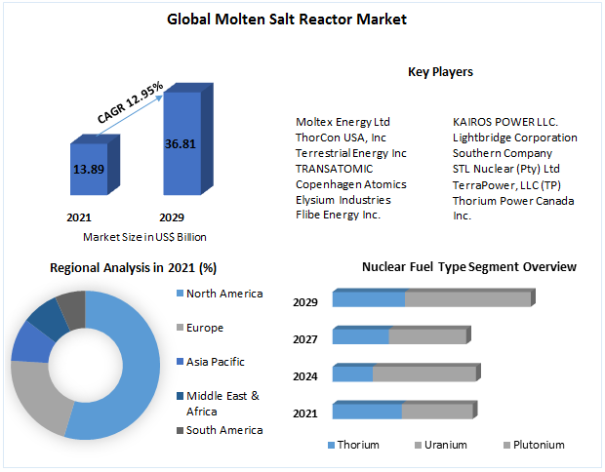
Methods
Study Literature
Global Trend of MSR
Radioxenon Inventory from NPP
Simulation of Radioxenon Release from MSRE
Estimation of Radioxenon Release
Kalinowski, M.B., Tatlisu Halt. (2021).
Eslinger, P.W., et al. (2021).
https://www.maximizemarketresearch.com/market-report/global-molten-salt-reactor-market/102879/
Haas, Derek., Kowalczyk, Joseph. (2020).
Please do not use this space, a QR code will be automatically overlayed
The study literature is the approach for this research by using literatures from different resources which consist 18 scientific journals, 23 websites, 5 technical reports, and 8 presentations which cover several main topics as shown at the diagram to estimate the likelihood time of an increase in overall Radioxenon emissions.
P2.4-592

Slide 5
Results
China
US
Russia
Indonesia
Denmark
UK
Canada
A literature showed that China is the leading country for having an excellent progress for the MSR development. SINAP aims for a 2 MWt pilot plant (TMSR-LF1) initially, then a 10 MWt experimental reactor (TMSR-LF2) by 2025, and a 100 MWt demonstration plant (TMSR-LF3) with full electrometallurgical reprocessing by about 2035, followed by 1 a GW demonstration plant. Another following countries such as UK, Canada, US, Denmark, Russia and Indonesia are expected to start their operation between late 2020s – early 2030s
2020
2025
2030
2030s
Operational
Commissioning
Commercial Building, Prototype
Design, Licensing, Experimental
Please do not use this space, a QR code will be automatically overlayed
P2.4-592

Slide 6
Conclusion
Country
Canada
China
Denmark
Indonesia
Russia
United Kingdom
United State
Estimated Operation
2025-2040
2025
2027
2035
2031
2030
2030
The research has been conducted by studying literatures which showed that MSRs have been progressively developing in some countries led by China, and following by Canada, the United States, the United Kingdom, Denmark, Indonesia and Russian Federation. Each country has its own stage which currently being dominated on the conceptual design stage. China expects to start the operation of their experimental reactor on 2025, following by another countries which expect to start on late 2020s – early 2030s. According to research, the first increase in global Radioxenon emissions due to the MSR's operation could be expected in 2028.
2028
Global Radioxenon Increased
Please do not use this space, a QR code will be automatically overlayed
P2.4-592

Slide 7
References
Burnett, J.L., et al. (2019). Radionuclide Signature of Molten Salt Reactor. 2019 CTBT Science and Technology Conference.
E.L. Compere, et al. (1975) Fission Product Behavior in Molten Salt Reactor Experiment. Oak Ridge National Laboratory.
Eslinger, P.W., et al. (2021). Possible impacts of molten salt reactors on the International Monitoring System. Journal of Environmental Radioactivity Vol 234.
Haas, Derek., Kowalczyk, Joseph. (2020). Radioxenon Emission Estimates for Molten Salt Reactors. Workshop on Sources of Man-made Isotope Production.
IAEA Technical Reports Series No. 489. (2021) Status of Molten Salt Reactor Technology.
IAEA Nuclea Energy Series No. NR-T-1.18 (2021)Technology Roadmap for Small Modular Reactor Development
IAEA SMR Booklet 2022 Edition. Advances in Small Modular Reactor Technology Developments.
Kalinowski, M.B., Tatlisu Halt. (2021). Global Radioxenon Emission Inventory from Nuclear Power Plants for the Calendar Year 2014. Pure and Applied Geophysics Vol 178.
Kalinowski, M.B., Tuma, M.P., 2009. Global radioxenon emission inventory based on nuclear power reactor reports. J. Environ. Radioact. 100(1), 58-70.
Kim, B.J., et al. (2010). Monitoring for Xenon Radionuclides and CTBT Verification. Transactions of the Korean Nuclear Society Autumn Meeting
LEE, Tae Joon. (2022). Global Trend of Molten Salt Reactor. Transactions of the Korean Nuclear Society Spring Meeting.
Lobner, Peter. 2021. Denmark’s Seaborg Technologies CMSR Power Barge Concept. Seaborg Technologies.
T.W. Bowyer. 2020. A review of Global Radioxenon Background Research and Issues.
https://aris.iaea.org/sites/MSR.html
Engineering:Molten salt reactor - HandWiki
http://www.thoriumenergyworld.com/china.html
https://www.powermag.com/china-approves-commissioning-of-thorium-powered-reactor/
https://www.world-nuclear-news.org/Articles/Chinese-molten-salt-reactor-cleared-for-start-up
https://www.marketwatch.com/press-release/molten-salt-reactor-market-till-2030-2023-05-23
https://www.visiongain.com/report/molten-salt-reactors-market-2021/
https://dataintelo.com/report/molten-salt-reactor-market/
https://smrroadmap.ca/
Please do not use this space, a QR code will be automatically overlayed
P2.4-592

