Slide 1
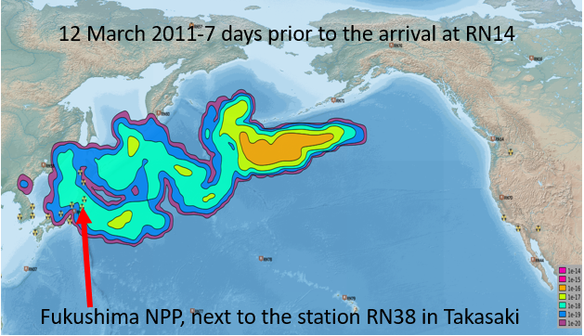
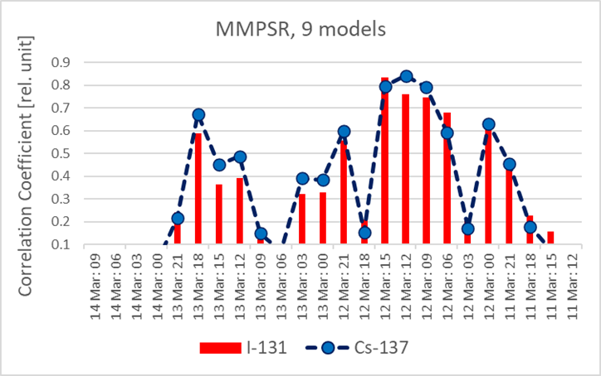
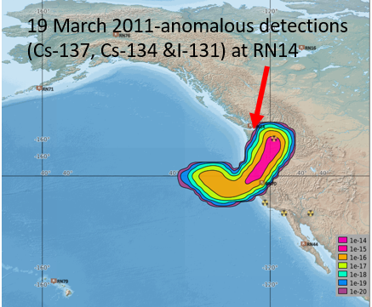
The added value of using the multi model approach in defining the Possible Source Region (PSR): the Fukushima incident as use case
J. Kuśmierczyk-Michulec, R. Schoemaker, A.Tipka, Y. Kijima, B. Liu, M. Kalinowski
CTBTO
Px.x-xxx
How does an ensemble of ATM models help in determining
the PSR when multiple radionuclides are involved? Case study of the Fukushima incident.
For this study, we will look at the radioactivity measurements registered in the aftermath of the Fukushima incident by the IMS network.
Taking advantage of additional models delivered by the CTBTO-WMO response system, a Multiple Model Possible Source Region (MMPSR) is calculated.
The question is whether using multiple models or multiple radionuclides helps identifying the source of radioactive detections.
This question will be address in this presentation.
Multiple Model Possible Source Region (MMPSR) calculated using 9 ATM models, for two radionuclides I-131 and Cs-137.

