Slide 1
The added value of using the multi model approach in defining the Possible Source Region (PSR): the Fukushima incident as use case
J. Kuśmierczyk-Michulec, R. Schoemaker, A.Tipka, Y. Kijima, B. Liu, M. Kalinowski
CTBTO
Atmospheric transport modelling (ATM) supports the radionuclide verification technology by providing a link between radionuclide detections and the regions of their possible source.
For this study, we will look at the radioactivity measurements registered in the aftermath of the Fukushima accident by the International Monitoring System (IMS) network.
The added value of using multi model approach in defining the Possible Source Region (PSR) is demonstrated.
The multi model approach addresses the ATM uncertainties by indicating the degree in consistency of geographic areas and times being covered in the regions of possible sources.
Please do not use this space, a QR code will be automatically overlayed
P2.4-302

Slide 2
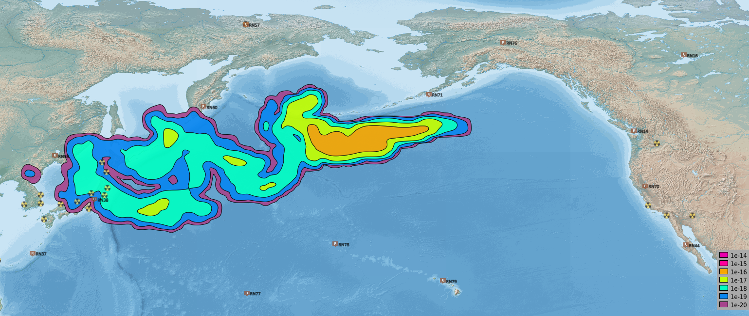
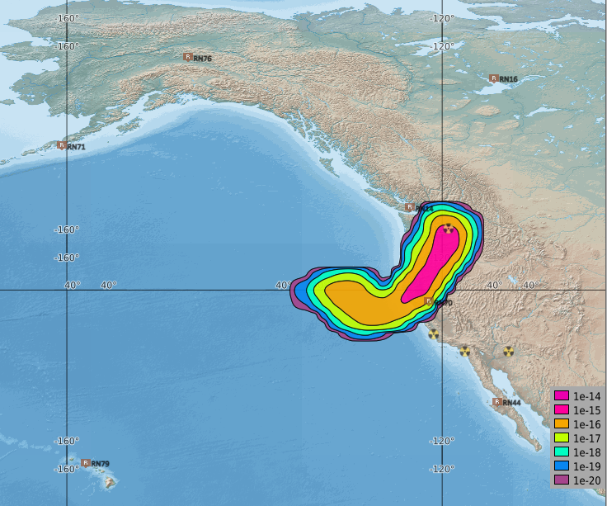
Introduction
Atmospheric transport modelling (ATM) supports the radionuclide verification technology by providing a link between radionuclide detections and the regions of their possible source. In the case of an anomalous detection registered by the International Monitoring System (IMS) particulate network classified as Level 5, CTBTO sends a request for support to Regional Specialized Meteorological Centres (RSMCs). In response, they produce and upload their own backward simulations.
For this study, we will look at the CTBT-relevant radionuclides detected in the aftermath of the Fukushima incident by the IMS network. One of such stations that frequently observed samples qualified as Level 5, was RN14. Example of the ATM backward simulation is shown below.
12 March 2011-7 days prior to the arrival at RN14
19 March 2011-anomalous detections (Cs-137, Cs-134 &I-131) at RN14
P2.4-302
Please do not use this space, a QR code will be automatically overlayed
Fukushima NPP, next to the station RN38 in Takasaki

Slide 3
Objectives
To address the inherent uncertainties of the ATM simulations associated with the dynamics of the atmosphere, CTBTO cooperates with the World Meteorological Organization (WMO) and its Regional Specialized Meteorological Centres (RSMCs) in the field of dispersion modelling.
Taking advantage of additional models delivered by the CTBTO-WMO response system, a Multiple Model Possible Source Region (MMPSR) is calculated.
The Possible Source Region (PSR) algorithm calculates and displays the correlation between measured and simulated activity concentrations (SRS values) for each grid point in time and space. An MMPSR is derived from the overlapping or simple averaging of an ensemble of single model PSR results.
The question is whether using multiple models or multiple radionuclides helps identifying the source of radioactive detections.
This question will be address on the next slides.
P2.4-302
Please do not use this space, a QR code will be automatically overlayed

Slide 4
Methods/Data (1/2)
Due to the scale of the Fukushima accident, anomalous anthropogenic detections (classified as Level 5 or Level 4) and anomalous radioxenon detections (classified as Level C) were frequently observed.
Assessments of the releases have been performed by many organizations using different models. It was determined that noble gases like Xe-133, and radionuclides like I-131, Cs-137 and Cs-134 were the main components of theses radioactive releases.
The largest amount of Xe-133 was released between 11 and 15 March 2011, Cs-137 between 12 and 19 March 2011, Cs-134 after 15 March, and the largest amount of I-131 mostly between 15 and 17 March (IAEA, 2015).
P2.4-302
Upper Right Panel: Radionuclide detections at RN14 , between 18 March and 29 April 2011.
Lower Right Panel: SRS values between 18 March and 25 March 2011, as predicted by the ATM model (in a forward mode), corresponding to the release of emissions from Fukushima NPP on 12 March 2011.
Please do not use this space, a QR code will be automatically overlayed

Slide 5
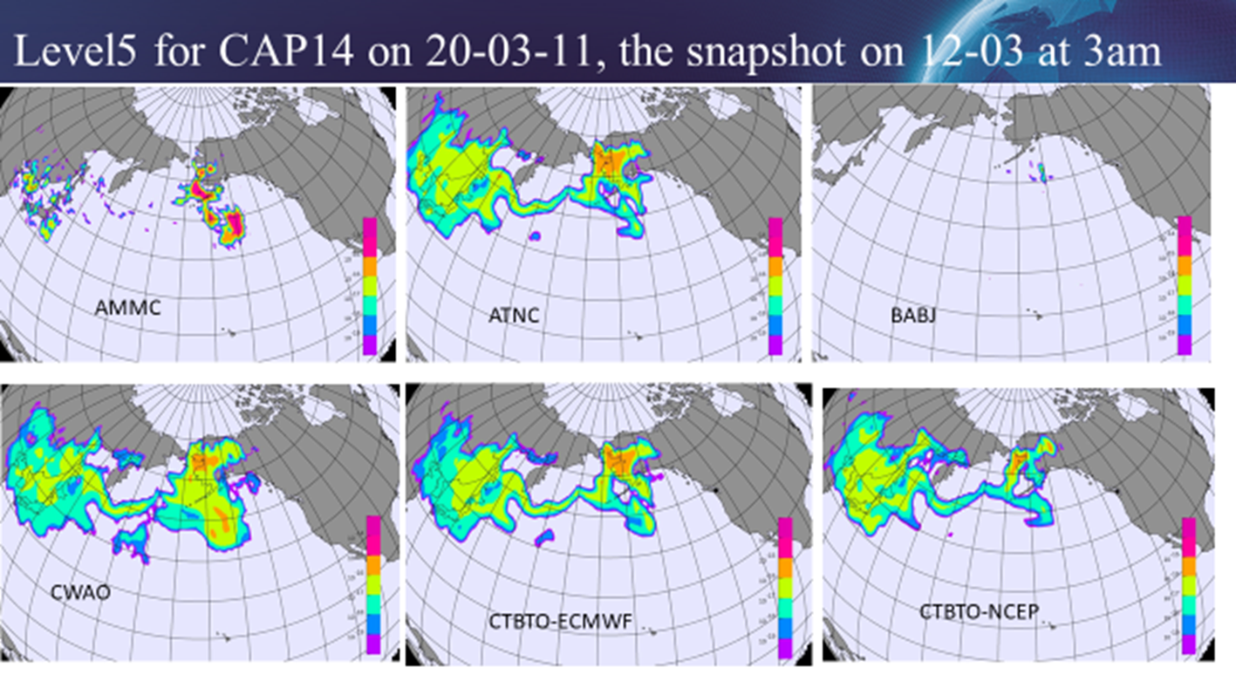
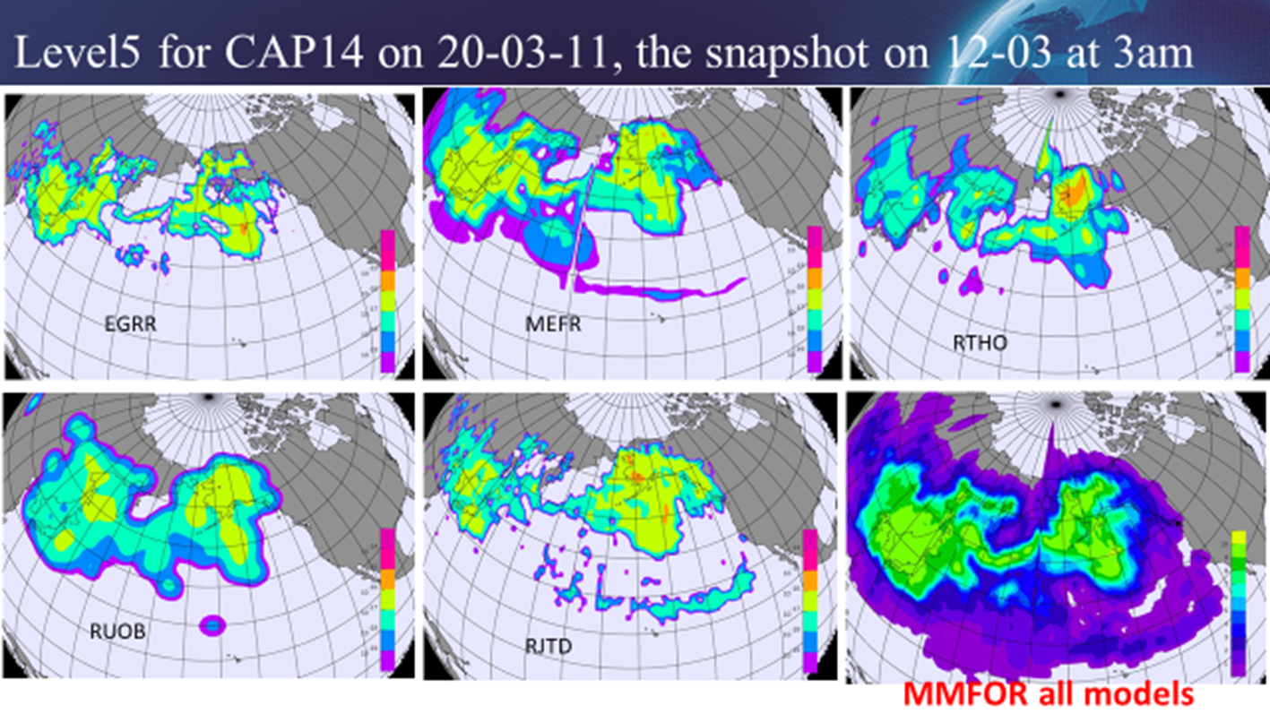
Methods/Data (2/2)
In response to anomalous detections, classified as level5, observed at the IMS station RN14, RSMCs provided their own ATM backward simulations.
For the purpose of this study, a short episode between 18 and 22 March 2011, will be investigated.
Since the results provided by two RSMCs (i.e. AMMC & BABJ) look very different (see Left Panel), two cases will be considered: 11 models (i.e. all) and 9 models (without AMMC & BABJ).
The advantage of measuring two radionuclides I-131 & Cs-137 on a daily basis during that period will be evaluated, too.
P2.4-302
Left Panel: Comparison of air mass backward simulations (SRS files) from RSMCs received in response to Level5 at CAP14. All snapshots illustrate the same situation i.e. 8 days prior to the arrival at the station. The last (bottom-right) image shows the overlapping result, MMFOR, for all models.
Please do not use this space, a QR code will be automatically overlayed

Slide 6
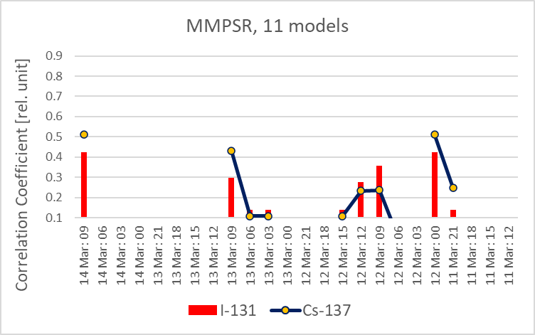
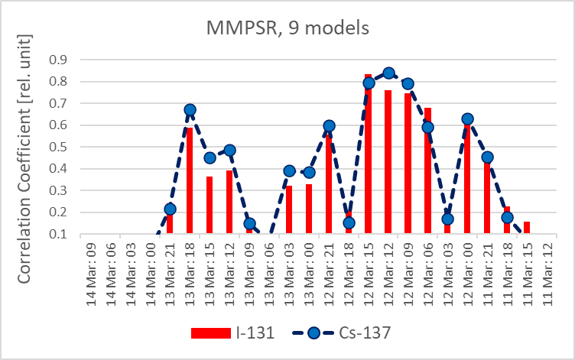
Results (1/2)
Left Panels (Upper & Lower) provide the answer to the questions:
Is it possible that detections observed at IMS station RN14 between 18 and 22 March 2011 come from the Fukushima Nuclear Power Plant (NPP) ?
If yes, when did a release happen?
MMPSR results (Left Panels) demonstrate that the detections at RN14 can be related to emissions from the Fukushima NPP. It is possible that they were emitted between 12 & 14 March (Upper Panel) or between 12 & 13 March (Lower Panel). Indeed, as it is confirmed by many studies, radionuclides were emitted during these days.
Much lower scores obtained in case of results based on 11 models can be attributed to lower degree in consistency of input data (i.e. 9 plus 2 models considered as “underperforming”). It demonstrates the importance of selecting good quality members.
The results are calculated for I-131 (red bars) and independently for Cs-137 (dark blue dots). Differences between them are subtle, not exceeding about 10%.
P2.4-302
Please do not use this space, a QR code will be automatically overlayed

Slide 7
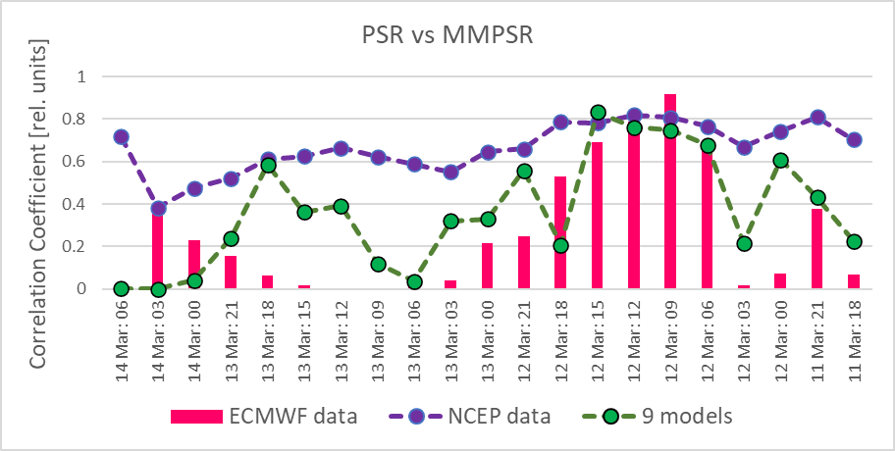
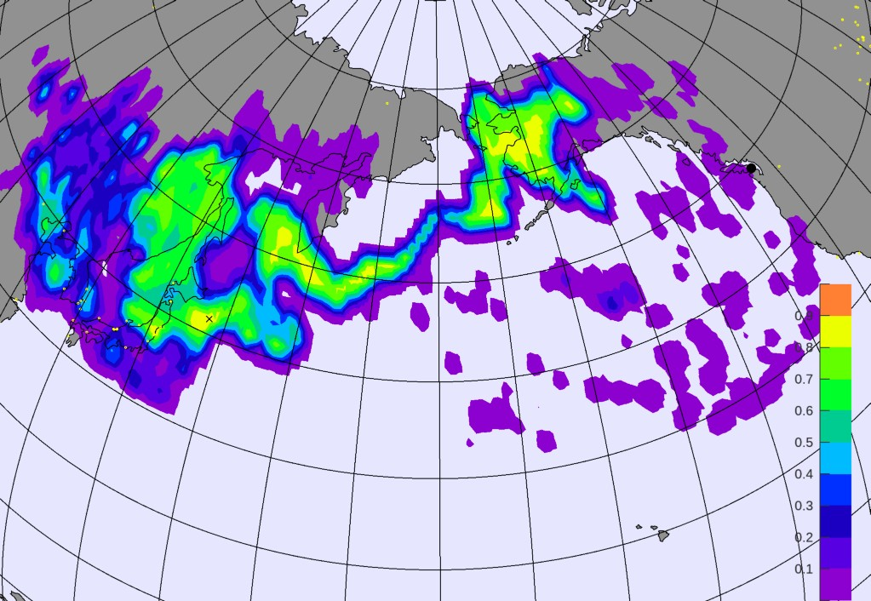
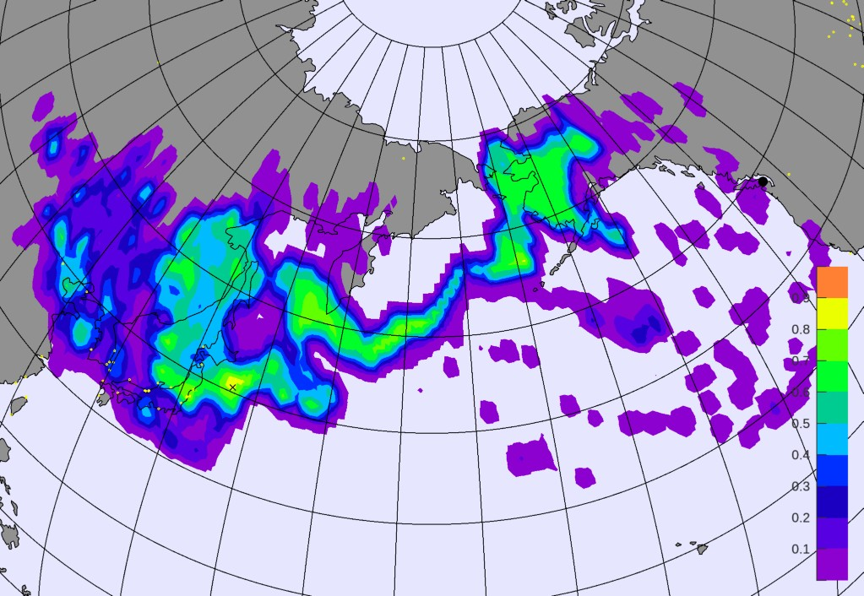
Results (2/2)
The PSR results produced by single models, i.e. ATM model FLEXPART with ECMWF data (Left Panel, pink bars) and FLEXPART with NCEP data (left Panel, violet dots) agree for 12 March but disagree for 13 of March. In such a case a result produced by multiple models (9 models, green dots) is more reliable.
Two Lower Panels illustrate a difference between PSRs calculated for a single radionuclide (i.e. Cs-137) and PSR calculated for two radionuclides i.e. Cs-137 & I-131 (MultiPSR approach).
P2.4-302
Please do not use this space, a QR code will be automatically overlayed
PSR, Cs-137
PSR, Cs-137&I-131

Slide 8
Conclusions
Identifying the source of radioactive detections at the International Monitoring System (IMS) stations is both challenging and central to the CTBTO mandate.
ATM systems are essential for this purpose. However, this is not a simple task given the diffusive nature of the atmosphere and the limitations on estimating its true state.
The multi model approach addresses the ATM uncertainties by indicating the degree in consistency of geographic areas and times being covered in the regions of possible sources. In general, having the results based on the multiple models increases their credibility. However, it is recommended to check the results produced by single models to be aware of their performance.
P2.4-302
Please do not use this space, a QR code will be automatically overlayed

Slide 9
References
IAEA, (2015), The Fukushima Daiichi Accident Report by the Director General, International Atomic Energy Agency, https://www-pub.iaea.org/MTCD/Publications/PDF/Pub1710-ReportByTheDG-Web.pdf
Kuśmierczyk-Michulec, J., Tipka, A., Schoemaker, R., Kalinowski, M., 2022. Quality assessment of the different Possible Source Region (PSR) algorithms. EGU General Assembly 2022, Vienna, Austria, 23–27 May 2022, EGU22-8689, https://doi.org/10.5194/egusphere-egu22-8689
P2.4-302
Please do not use this space, a QR code will be automatically overlayed

