Slide 1
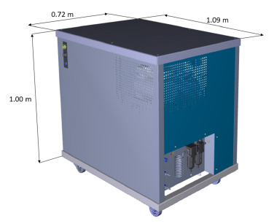
Deploying a Radioxenon Sensor Array to the North of England
M. A. Goodwin¹, B. Milbrath², A. Petts³, A. Ringbom⁴, D. L. Chester¹, T. W. Bowyer², L. Lidey²,
J. C. Hayes², P. W. Eslinger², M. Mayer², D. Keller², M. Aldener⁴, T. Fritioff⁴, S. Liljegren⁴, J. Kastlander⁴,
C. Toth⁵, J. P. Stowell⁶, P. Chadwick⁶, B. Brooks⁷, R. Neely⁷, S. J. Leadbetter⁸
¹ AWE, Aldermaston, UK; ² Pacific Northwest National Laboratory (PNNL), WA, US; ³ EDF Energy, UK; ⁴ FOI, Sweden
⁵ Science Technologies & Facilities Council (STFC), UK; ⁶ University of Durham, UK; ⁷ Leeds University, UK; ⁸ Met Office, Exeter, UK
P2.4-370
The XENAH Collaboration has deployed an array of SAUNA Q_{B} systems to the North of England, to monitor for releases from Hartlepool Nuclear Power Station. This e-poster shares some of the preliminary results from the measurement campaign, which coincides with source measurements using a stack-monitoring system and measurements of samples collected from the site.

