Slide 1
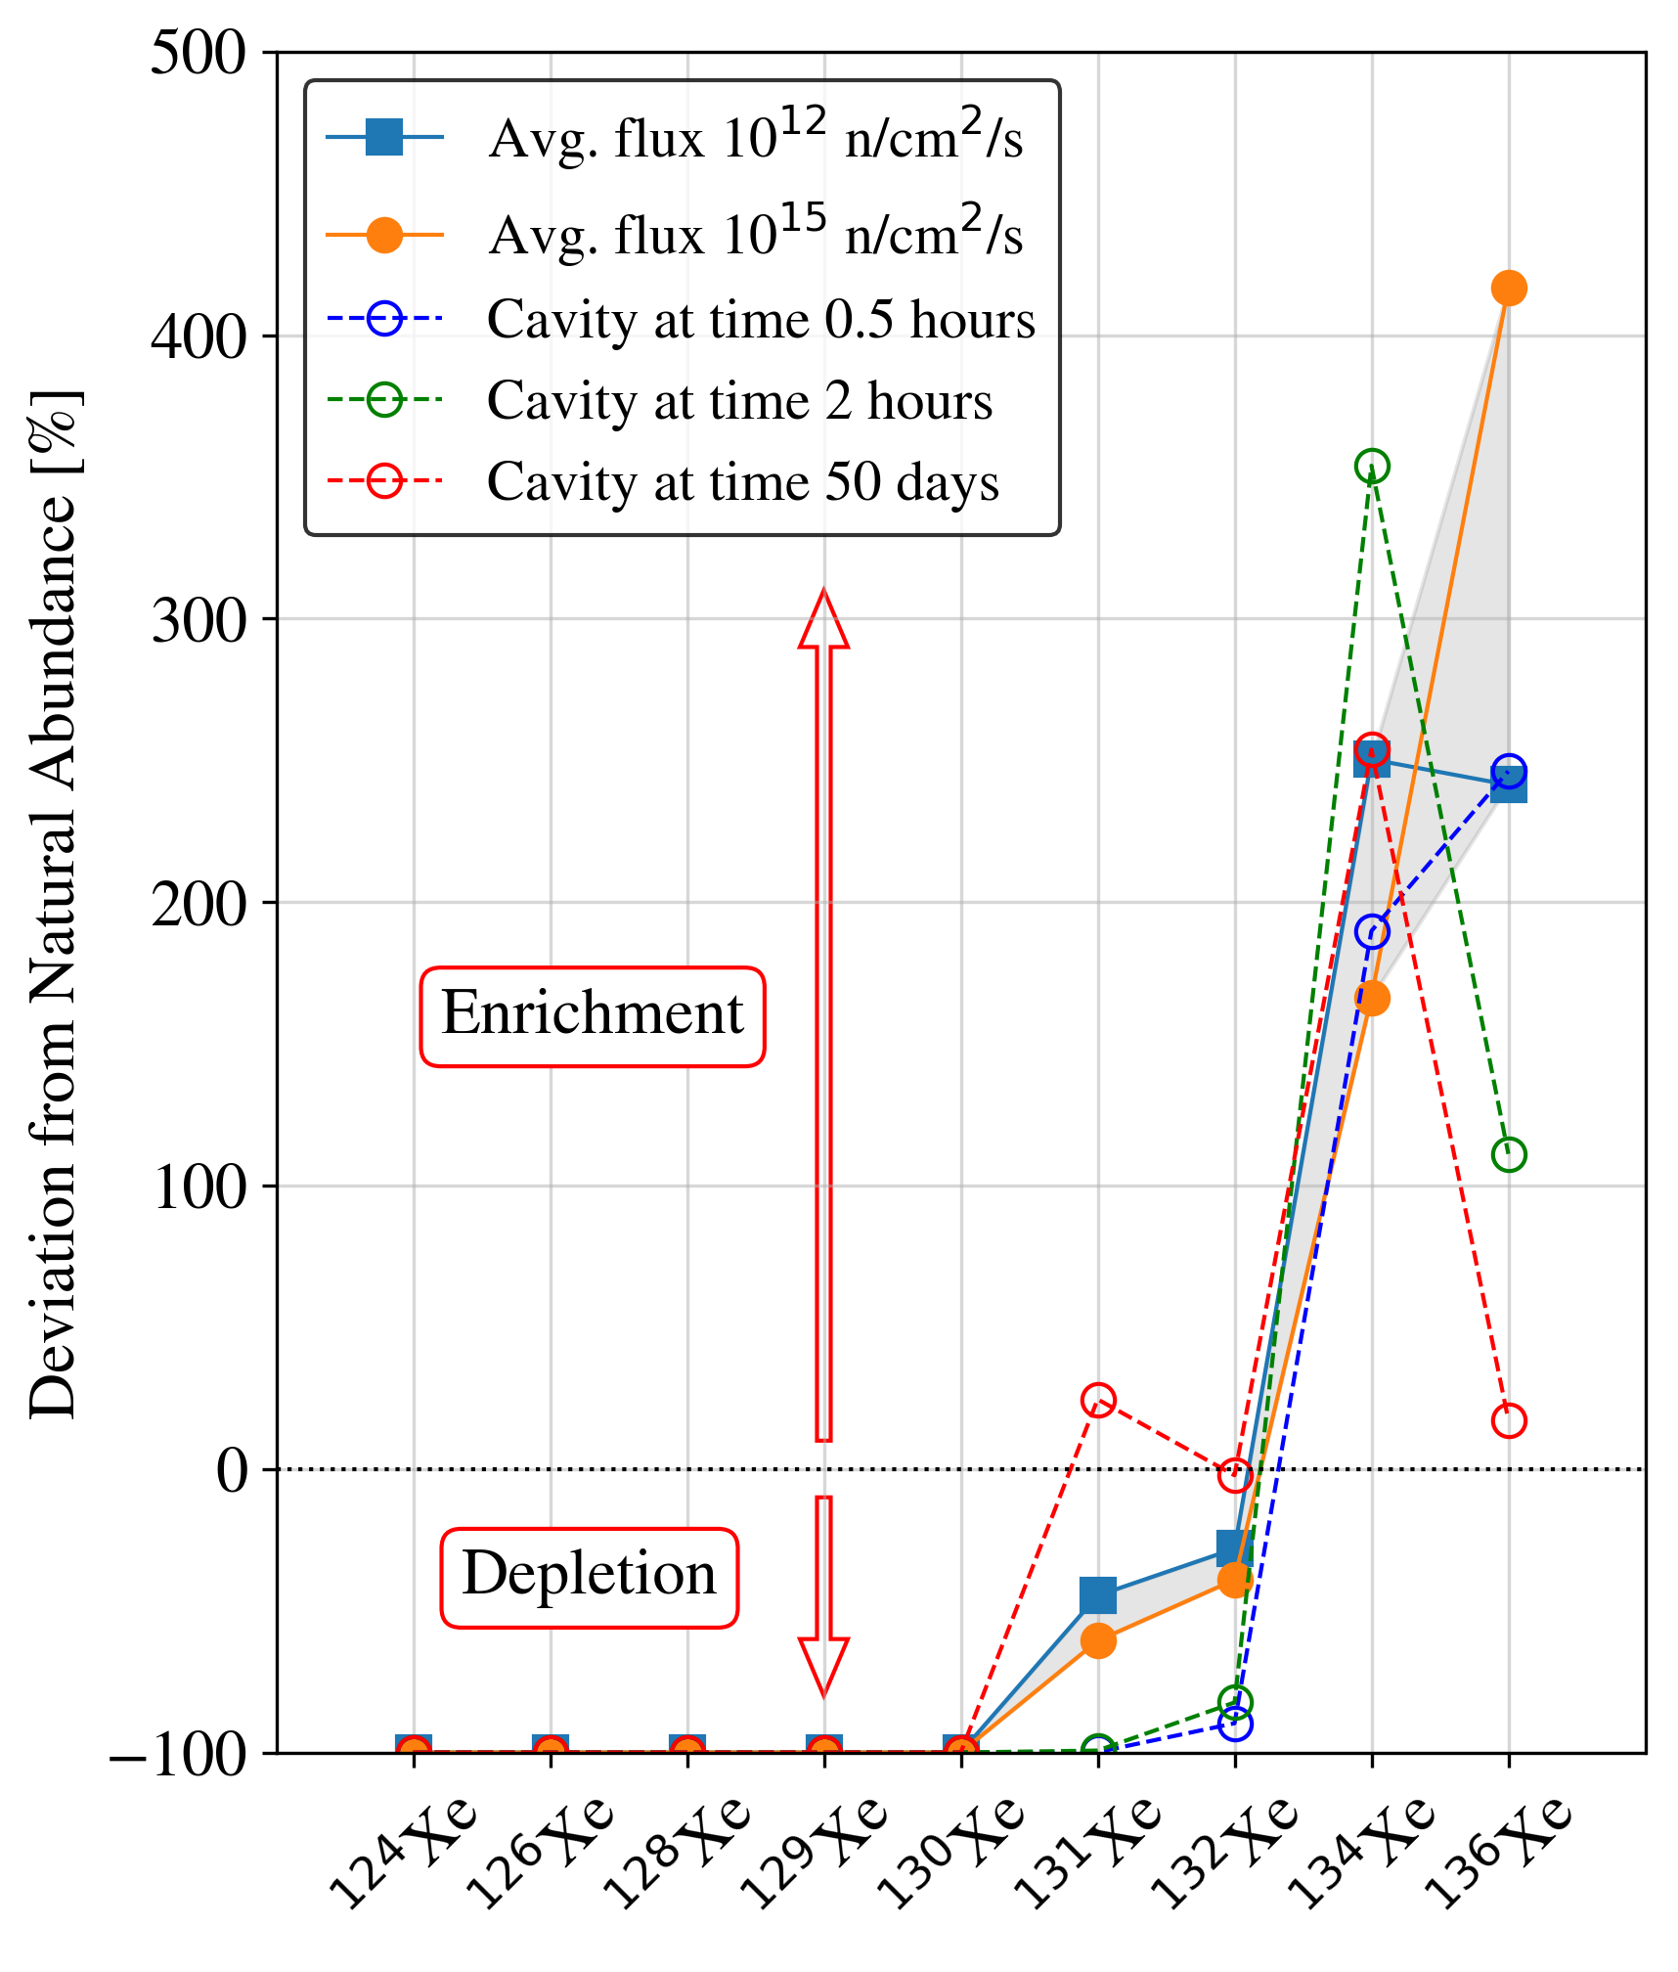
Stable Isotopic Ratios: From Civil Facilities to Nuclear Explosions
Daniel. L. Chester, Matthew. A. Goodwin
Atomic Weapons Establishment, Aldermaston, United Kingdom
P2.4-567
Based on the composition of stable xenon isotopes, is there a way to discriminate between the natural background, reactor gas and nuclear explosion gas?
Traditionally, nuclear treaty monitoring efforts (for RN) are focused on the measurement of radioactive fission products.
Here, we assess the possibility of confirming nuclear explosions based on the stable xenon isotopes resulting from fission.
Simulations performed at the UK National Data Centre suggest that nuclear explosion gas and nuclear reactor gas have distinct non-natural compositions that are dependent on fractionation time and burn-up.
Differentiation between gas released from nuclear fuel and gas released from an underground cavity post- nuclear explosion may be possible based on the stable xenon composition.
The ¹³⁴Xe / ¹³⁶Xe may be a particularly useful discriminator in this regard.
UK Ministry of Defence © Crown Owned Copyright 2023/AWE

