Slide 1
UK Ministry of Defence © Crown Owned Copyright 2023/AWE
Stable Isotopic Ratios: From Civil Facilities to Nuclear Explosions
Daniel L. Chester¹, Matthew A. Goodwin¹
1. Atomic Weapons Establishment, Aldermaston, United Kingdom
Expected radioxenon ratios from nuclear power reactors are well established. Is it possible distinguish between reactor Xe, explosion Xe and natural Xe based on the stable isotopic composition of gas samples?
ORIGEN simulations have been performed to assess the behaviour of stable Xe isotopes in a typical thermal reactor over time under different flux conditions. The same has been done with a simplistic underground explosion –cavity model.
Gas compositions are shown to change depending on time spent within the system (reactor and cavity). Reactor flux influences certain stable isotope ratios.
The ¹³⁴Xe / ¹³⁶Xe may be an especially useful nuclear explosion discriminator.
It could be possible to differentiate explosion gas from reactor gas and from the natural background based on the relative abundances of stable Xe isotopes. This information may also provide insight into fractionation time in an underground environment.
Please do not use this space, a QR code will be automatically overlayed
P2.4-567

Slide 2
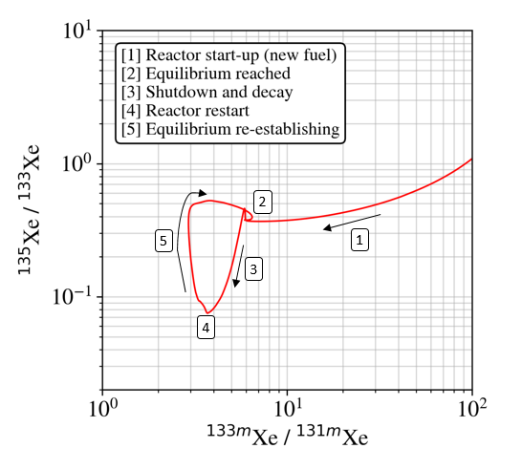
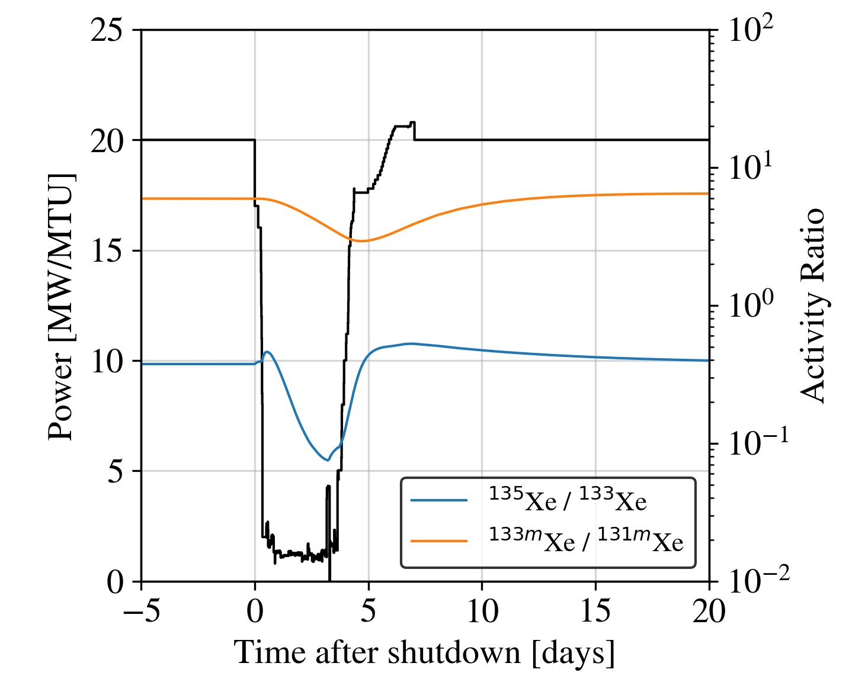
UK Ministry of Defence © Crown Owned Copyright 2023/AWE
Introduction
Figure 2. Radioxenon activity ratios as reactor power (black) fluctuates during a refuelling outage.
Traditionally, nuclear treaty monitoring efforts (for RN) are focused on the measurement of radioactive fission products (“radionuclides”).
The CTBT relevant radioxenons are ¹³³Xe (t_{1/2} 5.3 days), ¹³⁵Xe (t_{1/2} 9.1 hours), ^{133m}Xe (t_{1/2} 2.2 days) and ^{131m}Xe (t_{1/2} 11.9 days).
The measurement of nuclear explosion relevant material in atmospheric samples is impeded by a global background of radionuclides from civil nuclear sources. Nuclear Power Plants (NPPs) emit radioxenon into the atmosphere frequently.
The expected radioxenon ratios are well known for nuclear reactors during normal operation and re-fuelling periods [1].
Figure 1. Four-isotope plot, showing fluctuation in expected radioxenon activity ratios during reactor start-up with new fuel, shutdown and re-start.
Please do not use this space, a QR code will be automatically overlayed
P2.4-567

Slide 3
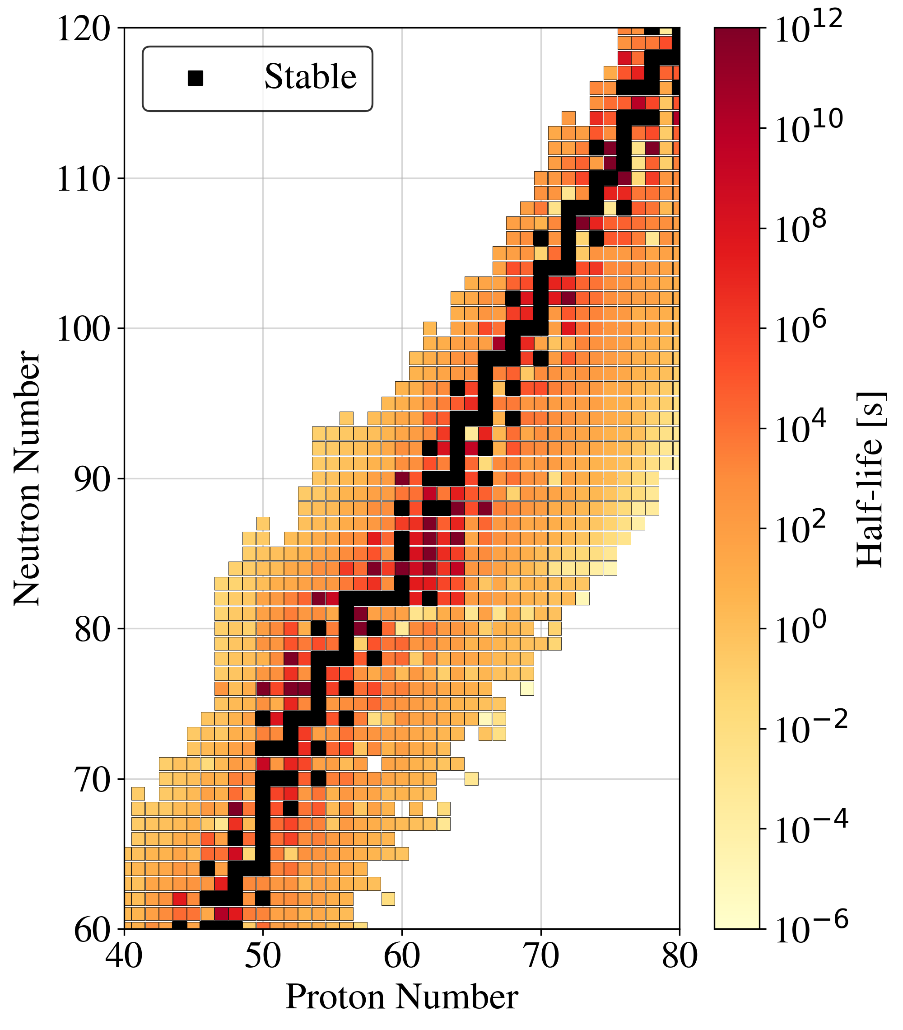
UK Ministry of Defence © Crown Owned Copyright 2023/AWE
Objectives
All radionuclides decay towards stability, hence there is an abundance of stable isotopes formed as a result of nuclear fission.
There may be more information to gain from gas samples than can be gained solely from radionuclide analysis.
Stable xenon ratios within spent fuel can be used to infer reactor operational parameters [2].
Stable ruthenium isotopes present on atmospheric filters have previously been used to assess the provenance of nuclear releases [3].
Here, we assess the possibility of confirming nuclear explosions based on the stable xenon isotopes resulting from fission.
Based on the composition of stable xenon isotopes, is there a way to discriminate between the natural background, reactor gas and nuclear explosion gas?
Please do not use this space, a QR code will be automatically overlayed
Figure 3. The chart of the nuclides. Xe is proton number 54.
P2.4-567

Slide 4
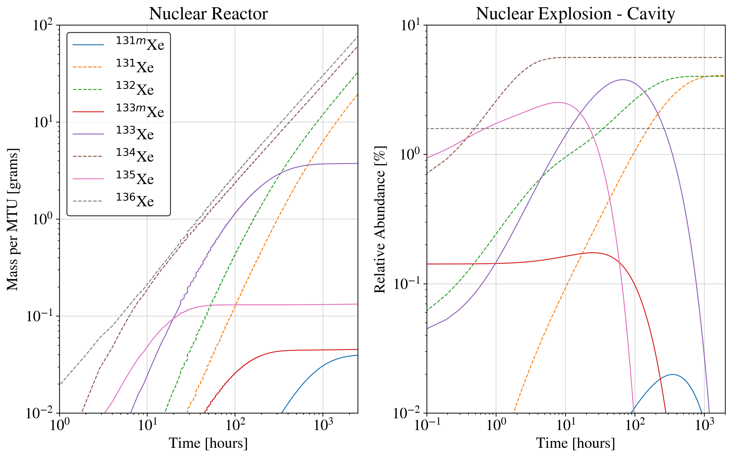
UK Ministry of Defence © Crown Owned Copyright 2023/AWE
Methods/Data
Nuclear Reactor Simulations
A dataset containing the modelled isotopic inventory of a nuclear reactor was produced. Simulations were performed with the ORIGEN module within SCALE 6.2.4 [4], using in-built cross section libraries for PWR reactor fuel irradiated under a constant thermal flux.
Nuclear Explosion – Cavity Simulation
A dataset containing the modelled isotopic inventory of an underground cavity after a nuclear explosion was produced. Simulations were performed using an in-house developed code [5], and were based on the ²³⁵U high energy fission split and subsequent decay/ingrowth within an entirely closed system [6]. No fractionation or chemical behaviour is accounted for.
Please do not use this space, a QR code will be automatically overlayed
Figure 4. Left – Mass of xenon isotopes produced during (thermal) irradiation of 3% enriched uranium (left). Data is shown for an average neutron flux of 10¹⁴ cm⁻² s⁻¹. Right – Relative abundances of xenon isotopes produced after nuclear fission (high energy neutrons) of ²³⁵U, and subsequent decay/ingrowth in an underground environment.
Note: Stable (or very long lived) isotopes are represented by dashed lines, and unstable radioisotopes are represented by solid lines.
P2.4-567

Slide 5
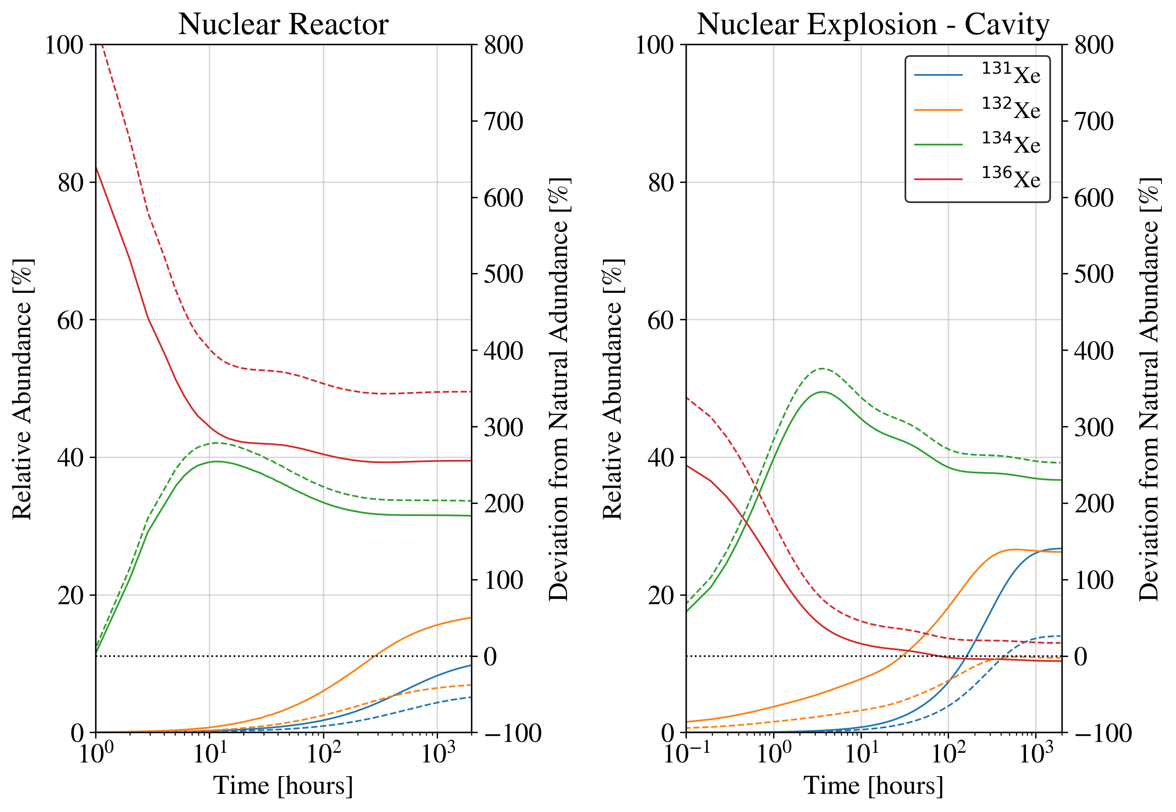
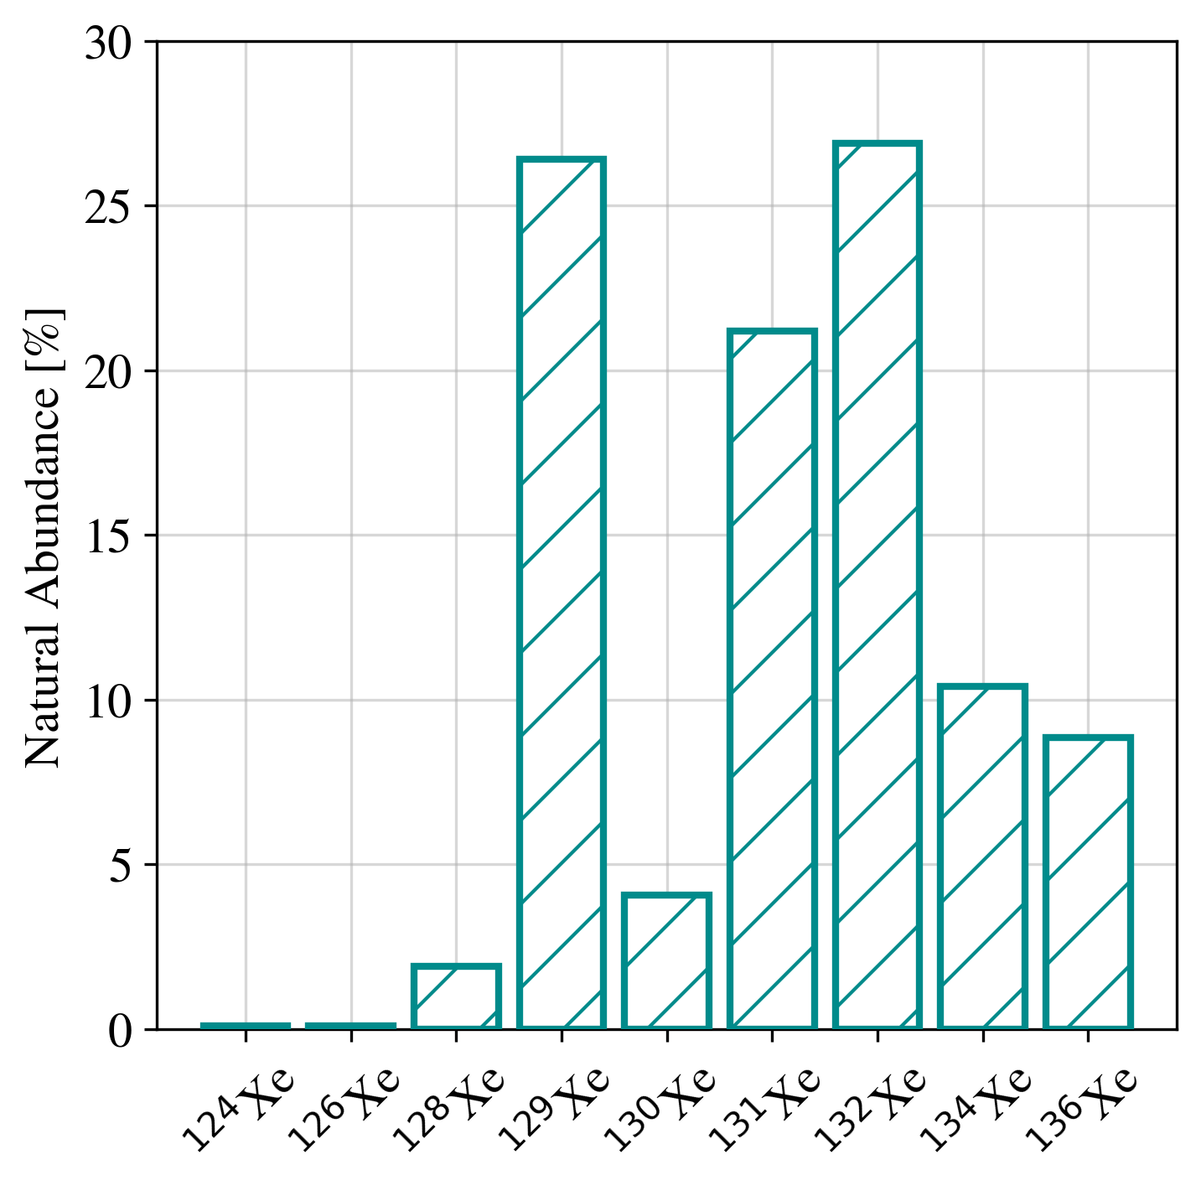
UK Ministry of Defence © Crown Owned Copyright 2023/AWE
Results
If the volatile gas released from nuclear fuel was sampled and purified for xenon, the gas would have a certain composition depending on the time spent in reactor (burn-up).
The same is true for explosion cavity gas.
Regardless of time, there would be a distinct difference between these compositions and the natural composition of xenon.
Please do not use this space, a QR code will be automatically overlayed
Figure 5. Left – Abundances of stable xenon isotopes in reactor gas (avg. neutron flux of 10¹⁴ cm⁻² s⁻¹) Right – nuclear explosion cavity gas (right) over time. The black dotted line shows no deviation from natural abundance.
Note: Relative abundances are solid lines (left axis) and the deviations from natural abundances are dashed lines (right axis). Isotopes below A = 131 are not shown due to negligible values.
Figure 6. Natural xenon abundances.
P2.4-567

Slide 6
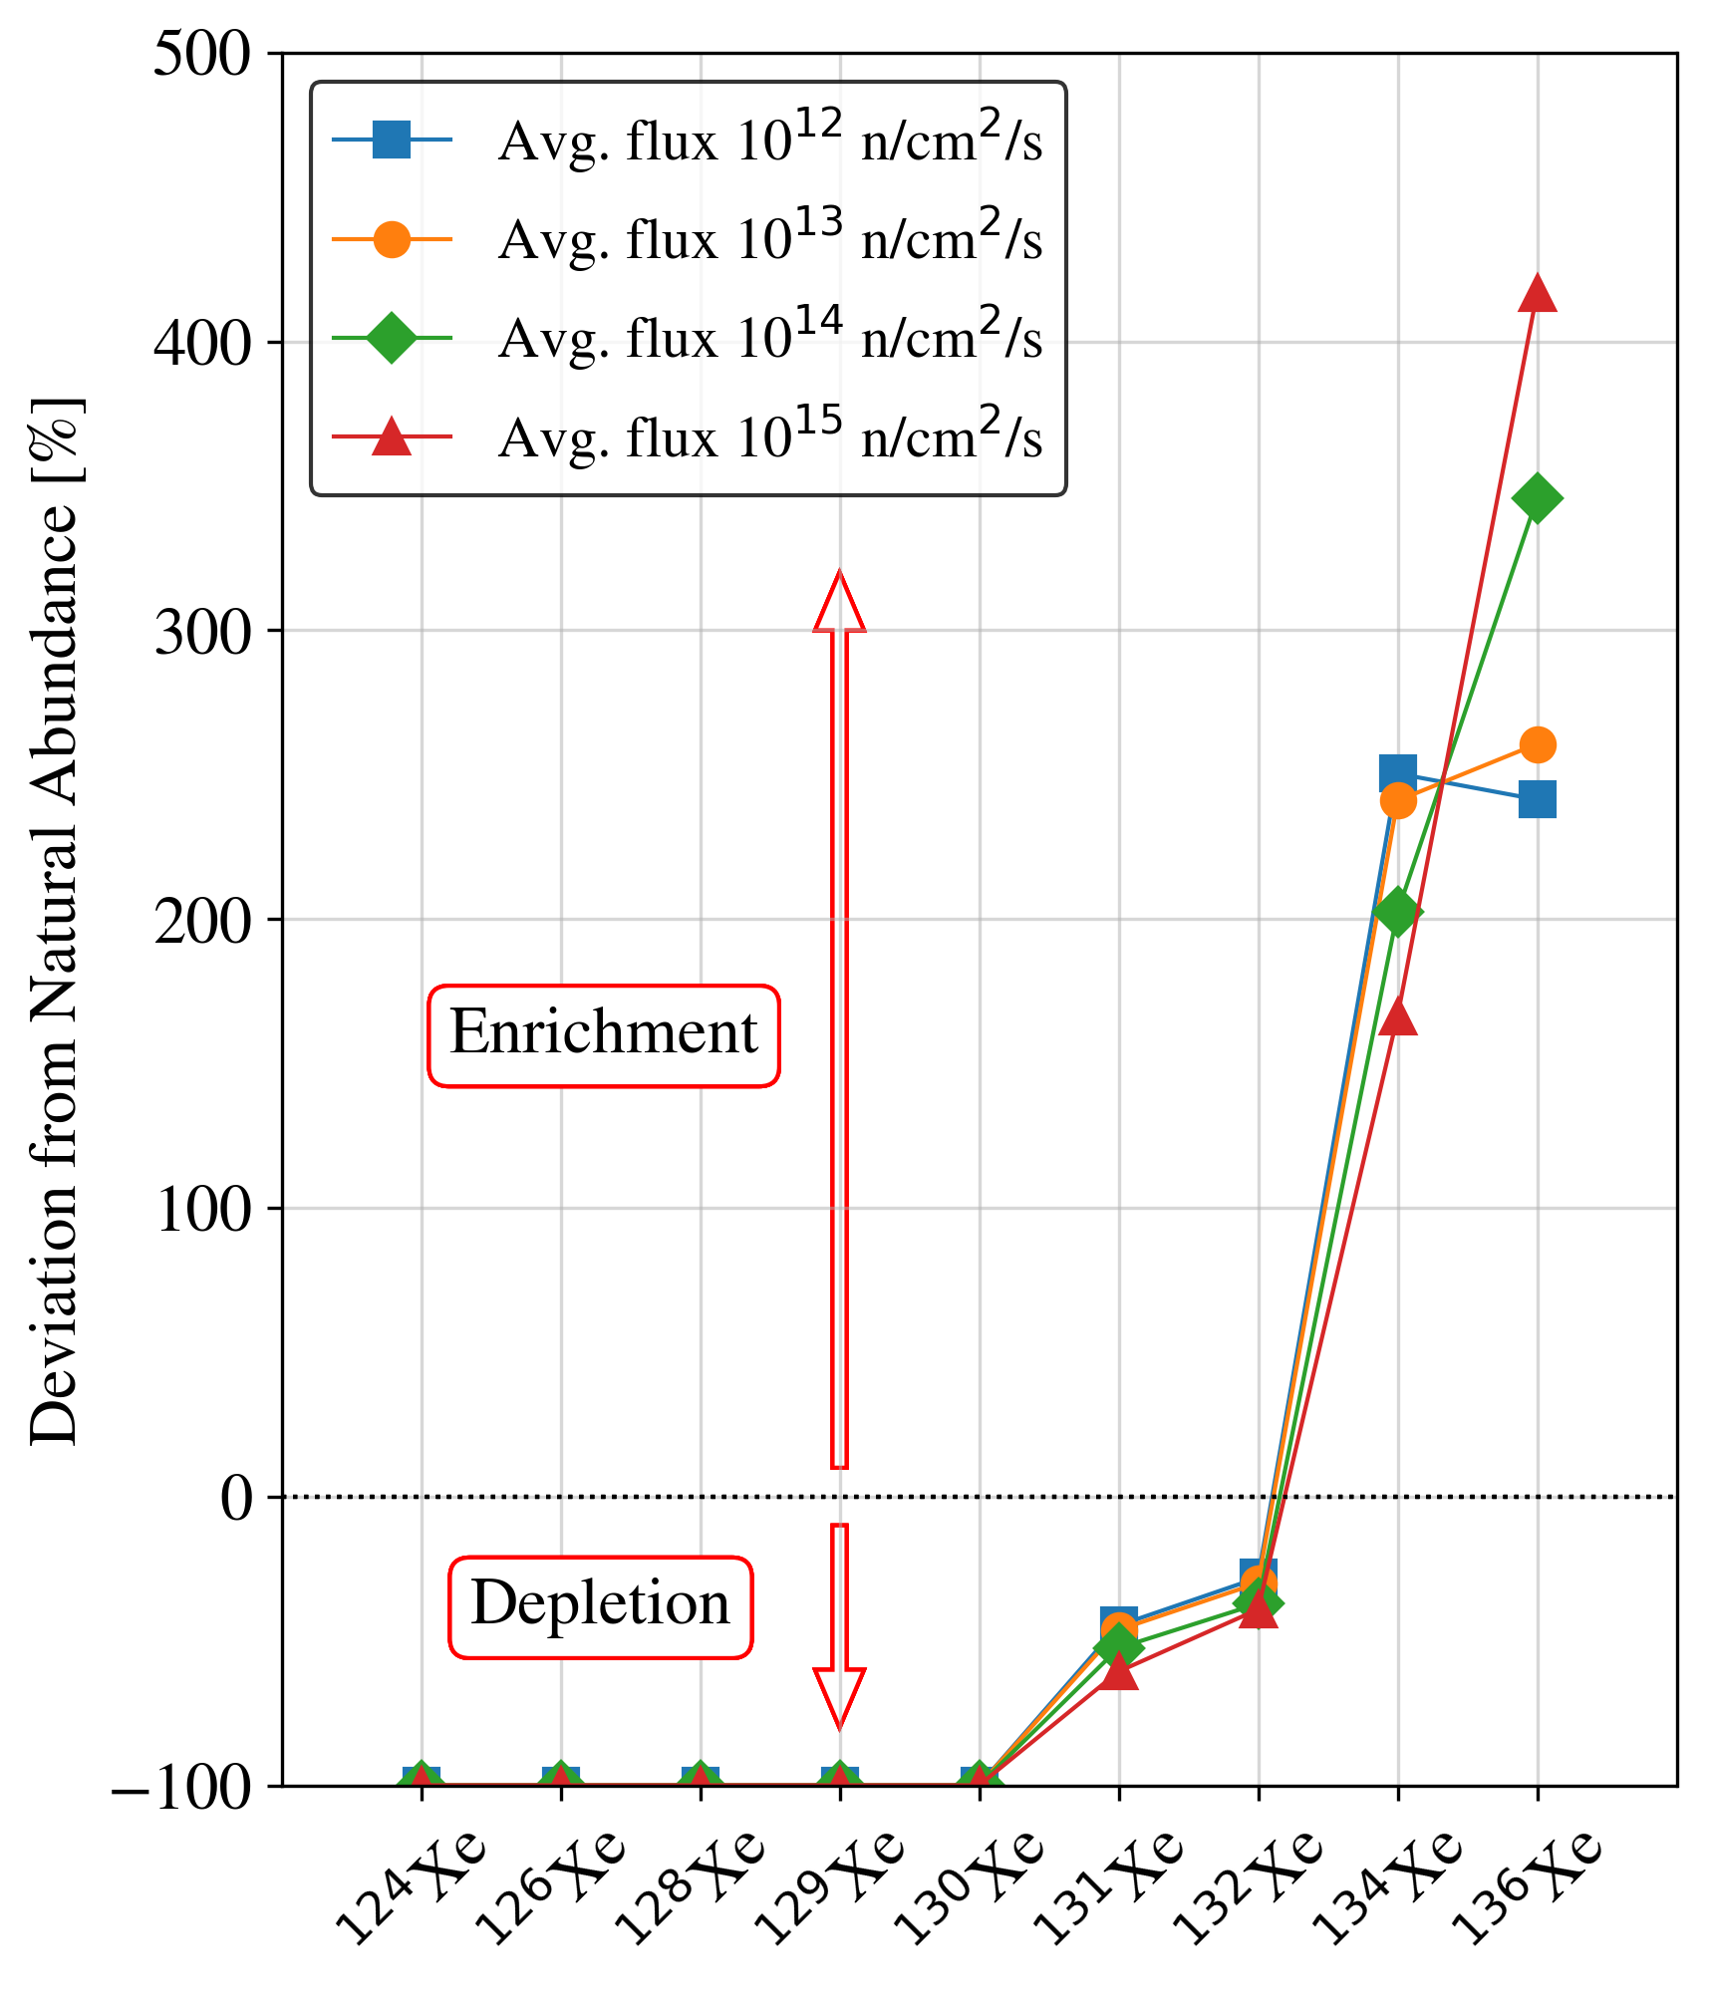
UK Ministry of Defence © Crown Owned Copyright 2023/AWE
Results
Reactor gas at equilibrium is depleted in low mass stable isotopes and enriched in high mass isotopes in comparison to natural xenon.
The abundances of ¹³⁴Xe and ¹³⁶Xe are especially sensitive to the average neutron flux [2].
Higher neutron flux results in greater production of ¹³⁶Xe via ¹³⁵Xe(n,γ)¹³⁶Xe reaction (~2.6 x10⁶ b cross-section).
Formation of low mass isotopes hindered by long lived isotopes higher in mass chain.
Please do not use this space, a QR code will be automatically overlayed
Figure 7. Composition of reactor gas (at equilibrium) for different average thermal neutron flux values.
P2.4-567

Slide 7
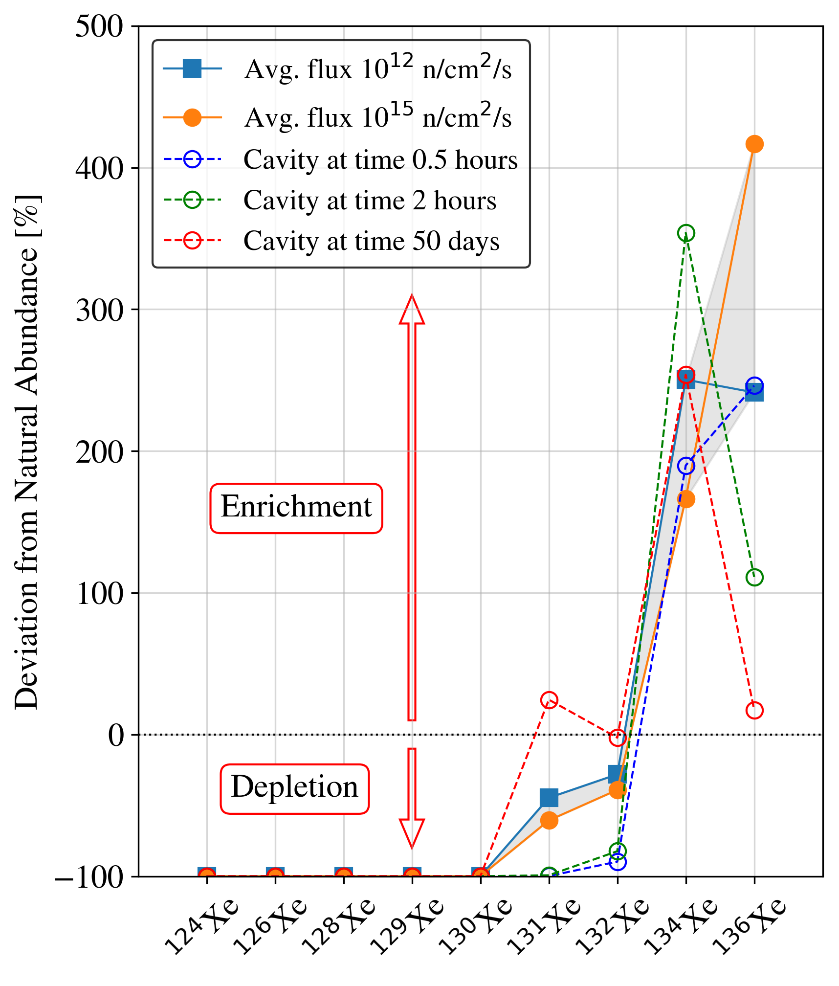
UK Ministry of Defence © Crown Owned Copyright 2023/AWE
Results
Cavity gas released early (< 1 hr after t₀) is hard to distinguish from reactor gas at equilibrium based on the stable xenon isotopes alone (aside from further ¹³¹Xe and ¹³²Xe depletion).
After two hours, the cavity gas is distinct from reactor gas (at equilibrium) based on the abundances of ¹³⁴Xe and ¹³⁶Xe.
The abundance of ¹³⁶Xe relative to ¹³⁴Xe in (aged) cavity gas is reduced due to low ¹³⁶I concentrations and lack of consistent neutron flux (no ¹³⁵Xe absorption).
There is still a significant deviation after 50 days (when radioxenons may be harder to measure due to decay), especially when considering the ¹³⁴Xe abundance.
Figure 8. Deviation of stable xenon isotopes from natural abundances in reactor gas at equilibrium (solid lines) and modelled cavity gas released at different times (dashed lines). The grey shading shows the boundaries of varying the average neutron flux (see Figure 7).
Please do not use this space, a QR code will be automatically overlayed
P2.4-567

Slide 8
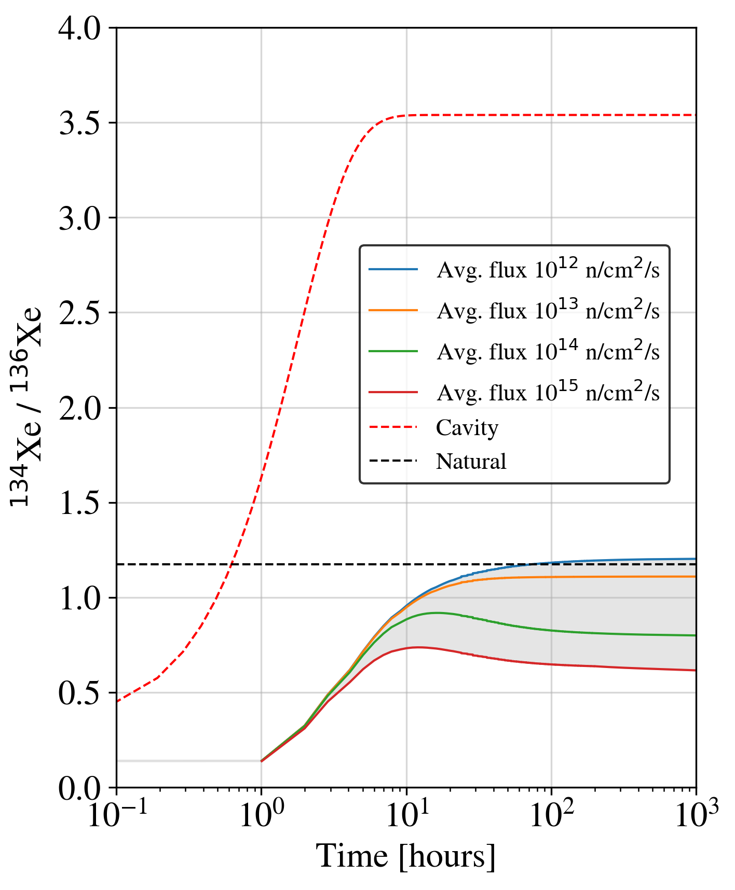
UK Ministry of Defence © Crown Owned Copyright 2023/AWE
Results
Again, young cavity gas is hard to distinguish from reactor during start- up and at equilibrium.
For removal of xenon from the cavity at times greater than 1 hour after t₀, the ¹³⁴Xe / ¹³⁶Xe ratio has increased enough to become distinctive.
Measuring this ratio could therefore be a way to discriminate between material produced in nuclear explosion scenarios from nuclear reactor gas and natural gas.
Figure 9. The change in ¹³⁴Xe / ¹³⁶Xe ratio over time in reactor for various average neutron fluxes, compared with gas within nuclear explosion cavity.
Please do not use this space, a QR code will be automatically overlayed
P2.4-567

Slide 9
UK Ministry of Defence © Crown Owned Copyright 2023/AWE
Conclusion
Based on simulations performed at the United Kingdom National Data Centre:
Gas released from nuclear reactor fuel and from within an underground explosion cavity could be differentiated from the natural background based on the relative abundances of stable xenon isotopes. This is true for all times over which the xenon can be removed from the system (i.e. removed from their parent radionuclides).
This is assuming no dilution of these xenon isotopes in air (containing xenon in natural abundances).
As expected, reactor gas is enriched in higher-mass stable xenon isotopes (¹³⁴Xe and ¹³⁶Xe) and is depleted in lower-mass stable isotopes (below A = 134). The abundances of ¹³⁴Xe and ¹³⁵Xe are sensitive to the neutron flux in the reactor [2].
Depending on the fractionation time, there may be a way to distinguish between nuclear explosion cavity gas and nuclear reactor gas (at equilibrium):
Gas removed from the cavity a short time after t₀ (< 1 hour) is harder to differentiate based on stable xenon isotopes alone.
Delayed removal of xenon from the cavity may provide an opportunity to differentiate between this, reactor gas and natural gas based on stable xenon isotope analysis. This may hold true when assessing only the ¹³⁴Xe / ¹³⁶Xe ratio.
Stable xenon isotope measurements may provide an insight into the time after t₀ at which xenon gas was removed from the cavity (fractionated). This is a key unknown variable during radionuclide event analysis.
Measurement of stable isotopes within IMS Noble Gas samples and within reactor stack samples may provide validation of these ideas.
Please do not use this space, a QR code will be automatically overlayed
P2.4-567

Slide 10
UK Ministry of Defence © Crown Owned Copyright 2023/AWE
References
Kalinowski et.al, Discrimination of Nuclear Explosions against Civilian Sources Based on Atmospheric Xenon Isotopic Activity Ratios (2010), Pure and Applied Geophysics, 167, 517-539.
Hayes & Jungman, Determining reactor flux from xenon-136 and cesium-135 in spent fuel (2012), Nuclear Instruments and Methods in Research Physics A, 690, 68-74.
Hopp et.al., Non-natural ruthenium isotope ratios of the undeclared 2017 atmospheric release consistent with civilian nuclear activities (2020), Nature Communications, 11, 2744.
Rearden & Jessee, SCALE Code System (2018), ORNL/TM-2005/39.
Goodwin et.al., A Consideration of Radioxenon Detections Around the Korean Peninsula (2021), Pure and Applied Geophysics, 178, 2651–2664.
England & Rider, Evaluation and Compilation of Fission Product Yields (1993), LA-UR-94-3106; ENDF-349.
Please do not use this space, a QR code will be automatically overlayed
P2.4-567

