Slide 1
Xenon Background Estimation Tool: Better Screening for
CTBT-relevant Events in a Radioxenon Background
Robin Schoemaker, Yuichi Kijima, Jolanta Kuśmierczyk-Michulec,
Boxue Liu, Anne Tipka, Jonathan Baré, and Martin Kalinowski
CTBTO
Emissions of four radioxenon isotopes relevant for CTBT monitoring are frequently observed by the noble gas sensors of the International Monitoring System (IMS). These emissions originate from worldwide nuclear facilities, are ever-present and highly variable, and pose a challenge for the global monitoring of nuclear tests.
A sequence of research and development projects has been initiated, aiming to explore and build a software environment to estimate the background radioxenon concentrations at IMS stations. We focus on several scientific methods built on ATM and radionuclide statistical expertise to be utilized in these software prototypes.
XeBET (Xenon Background Estimation Tool) is one such prototype that will later this year be able to demonstrate the statistically significant difference between prediction and measurement (activity concentration); either through a residual or directly.
XeBET paves the way, with results from other projects, to provide the radionuclide pipeline of the IDC with an operational implementation of a xenon background flag to provide a more reliable precursor for better screening.
P2.4-335

Slide 2
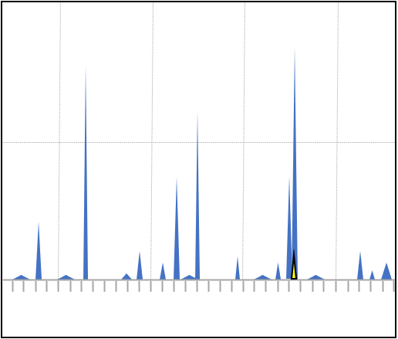
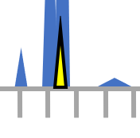


Introduction 1/3
A persistent problem . . .
Radionuclide emissions from man-made global sources are frequently observed by the CTBT noble gas network. These ever-present and highly variable emissions weaken the global monitoring of nuclear explosions.
noble gas ‘haystack’,
(xenon radioisotopes)
?
P2.4-335

Slide 3
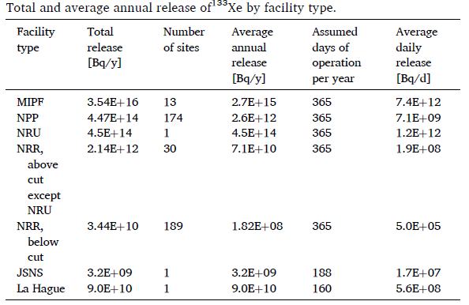
Introduction 2/3
M. Kalinowski, JER 261, 2023
Medical Isotope Production Facilities (MIPFs)
Nuclear Power Plants (NPPs)
Nuclear Research Reactors (NRRs)
P2.4-335
T. Bowyer et al., JER 115, 2013

Slide 4
Introduction 3/3
“Maximum reasonable radioxenon releases from medical isotope production facilities and their effect on monitoring
nuclear explosions”,
T. Bowyer et al., JER 115, 2013)
P2.4-335
Global maximum calculated daily concentration of Xe-133 expected emission from current isotope producers (see ref.), assuming releases of 10¹² Bq/day.
Xe-131m (11.96d) // Xe-133 (5.24d)
Xe-133m (2.20d) // Xe-135 (9.14h)

Slide 5
Objective
When we analyse the noble gas data coming from the IMS stations, the current IDC procedures involve a three-level (A, B, C) qualification process for measuring signals based on a decision threshold and abnormal threshold categorization scheme: no significant signal, a nominal signal, and an abnormal signal.
All these signals may contain to some degree a radioxenon background component from known sources.
A suitable and wished-for approach to advance these procedures would involve a quantifiable estimation of the radioxenon background on a per-sample basis in the form of a flag, a binary index for a statistically significant consistency between the prediction based on known sources and the IMS measurement making distinguishing a nuclear explosion signal from a known-source background signal more reliable.
P2.4-335
T. Bowyer et al., JER 115, 2013

Slide 6

Methods/Data
We learned a lot from previous ATM Challenges (see References). So a project portfolio was formed covering several projects and studies funded in an EU framework, roughly scheduled in the multi-year timeframe as shown.
2021
2022
2023
Evaluation System
A quantifiable estimation of the radioxenon background by means of a best-method approach on a per-sample basis.
A software system to assess the performance of new challenges in xenon background estimation in a multidisciplinary setting.
Inter-comparison Exercise
An extensive effort to explore both ATM and radionuclide statistical expertise to ultimately characterize the anomaly detection, release time, location, and the source type and strength and assess the best methods.
XeBET
P2.4-335
Estimate with greater certainty a nuclear explosion event’s location and strength.
Source Term Estimator

Slide 7
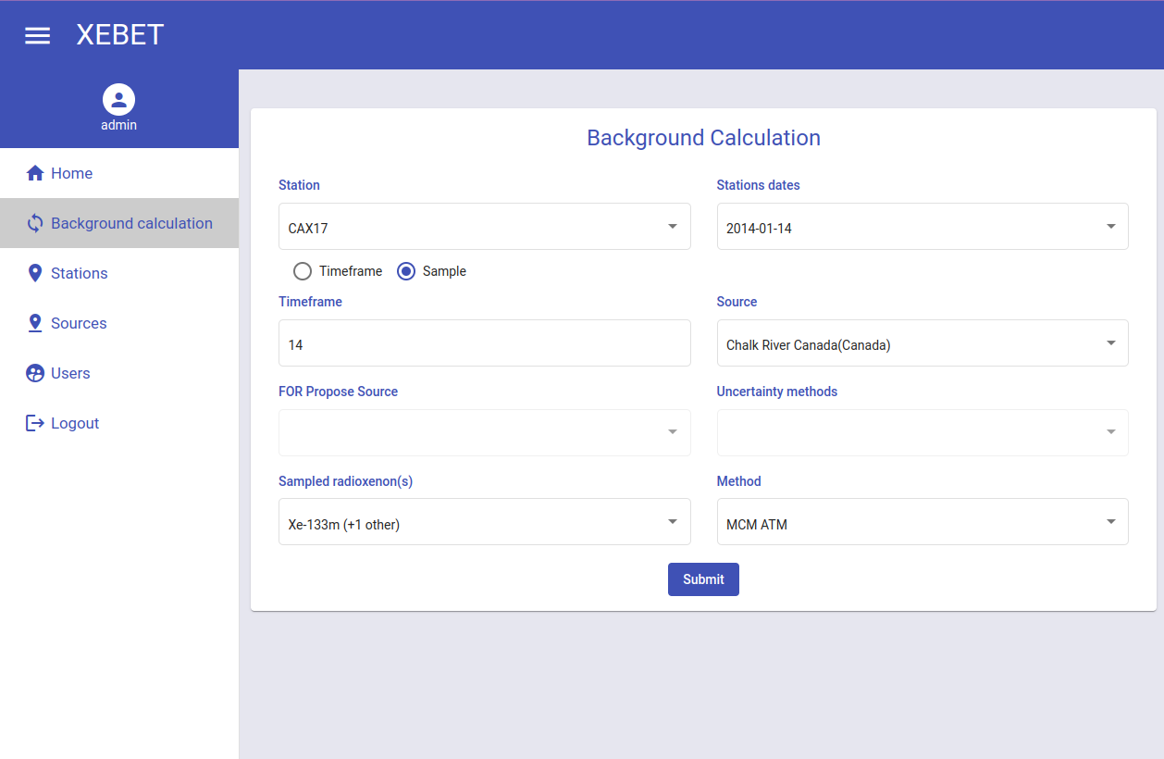
Results 1/2
2023
Frontend layer/GUI (user input):
Station and sample: date/time/timeframe
Known source(s): date/time/timeframe
Emission strength: PDF (time/timeframe)
  if available
Radioxenons
Method
A quantifiable estimation of the radioxenon background by means of a best-method approach on a per-sample basis.
XeBET
Modular functional layer (methods): Monte Carlo method, general Machine Learning and statistical methods.
Backend layer (database access): IMS data, ATM SRS fields (and future ensemble fields), emission inventory data, curated datasets.
P2.4-335
XeBET output: Flag for statistically significant difference between prediction and measurement (activity concentration); either through a residual or directly.

Slide 8
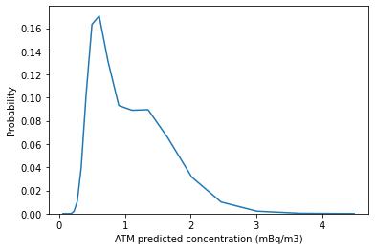

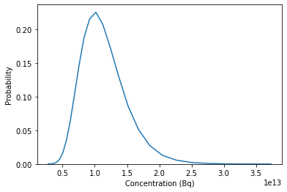
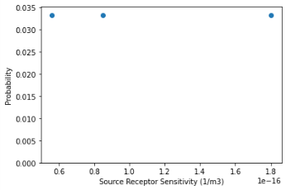
Results 2/2
Functional prototype. Example shown with hypothetical test data result for Monte Carlo Method with sparse ATM input (for now).
Predicted activity concentration PDF
IMS sample measurement
0.74
4.3
P2.4-335
Emission PDF
For all cases we can compute a residual PDF for a flag, but in clear cases (here) we can already flag the prediction as YES (statistically significant difference).
(sparse) ATM data

Slide 9

Concluding remarks
2023
2024+
XeBET
Assessing the prototype software
Advancing the methods
Review and decision
XeBET II
XeBET project ends late 2023 as does STE.
Source Term Estimator
!
P2.4-335

Slide 10
References
Three ATM Challenges (between 2015 – 2020) that laid the groundwork for the current XeBET projects:
Eslinger et al., International challenge to predict the impact of radioxenon releases from medical isotope production on a comprehensive nuclear test ban treaty sampling station, Journal of Environmental Radioactivity 157 (2016)
Maurer et al., International challenge to model the long-range transport of radioxenon released from medical isotope production to six Comprehensive Nuclear-Test-Ban Treaty monitoring stations, Journal of Environmental Radioactivity 192 (2018)
Maurer et al., Third international challenge to model the medium- to long-range transport of radioxenon to four Comprehensive Nuclear-Test-Ban Treaty monitoring stations, Journal of Environmental Radioactivity 255 (2022)
P2.4-335

