Slide 1
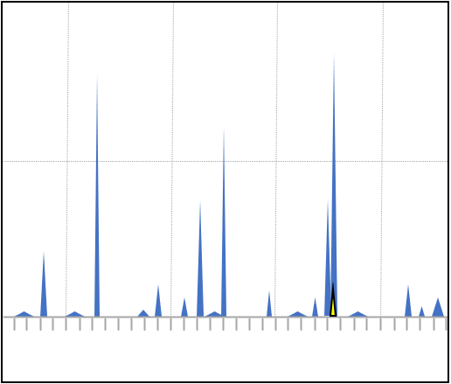
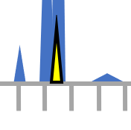
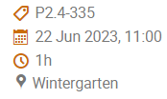
Xenon Background Estimation Tool: Better Screening for CTBT-relevant Events in a Radioxenon Background
Robin Schoemaker, Yuichi Kijima, Jolanta Kuśmierczyk-Michulec,
Boxue Liu, Anne Tipka, Jonathan Baré, and Martin Kalinowski - CTBTO
P2.4-335
Emissions of four radioxenon isotopes relevant for CTBT monitoring, originating from worldwide nuclear facilities, are ever-present and highly variable, and pose a challenge for the global monitoring of nuclear tests.
A sequence of research and development projects has been initiated, aiming to explore and build a software environment to estimate the background radioxenon concentrations at IMS stations. We focus on several scientific methods built on ATM and radionuclide statistical expertise to be utilized in these software prototypes.
XeBET (Xenon Background Estimation Tool) is one such prototype that will later this year be able to demonstrate the statistically significant difference between prediction and measurement (activity concentration); either through a residual or directly
Come see me during the e-Poster session to learn more (or by access online):
T. Bowyer et al., JER 115, 2013

