Slide 1
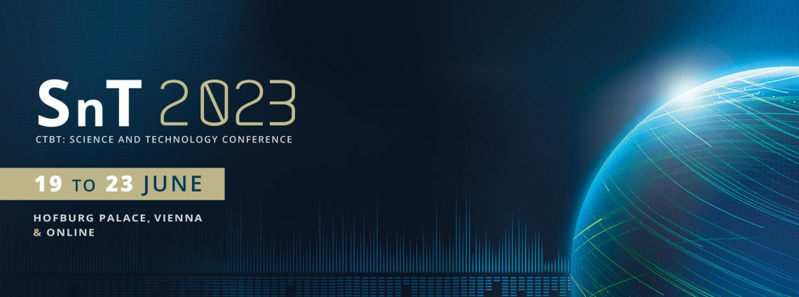
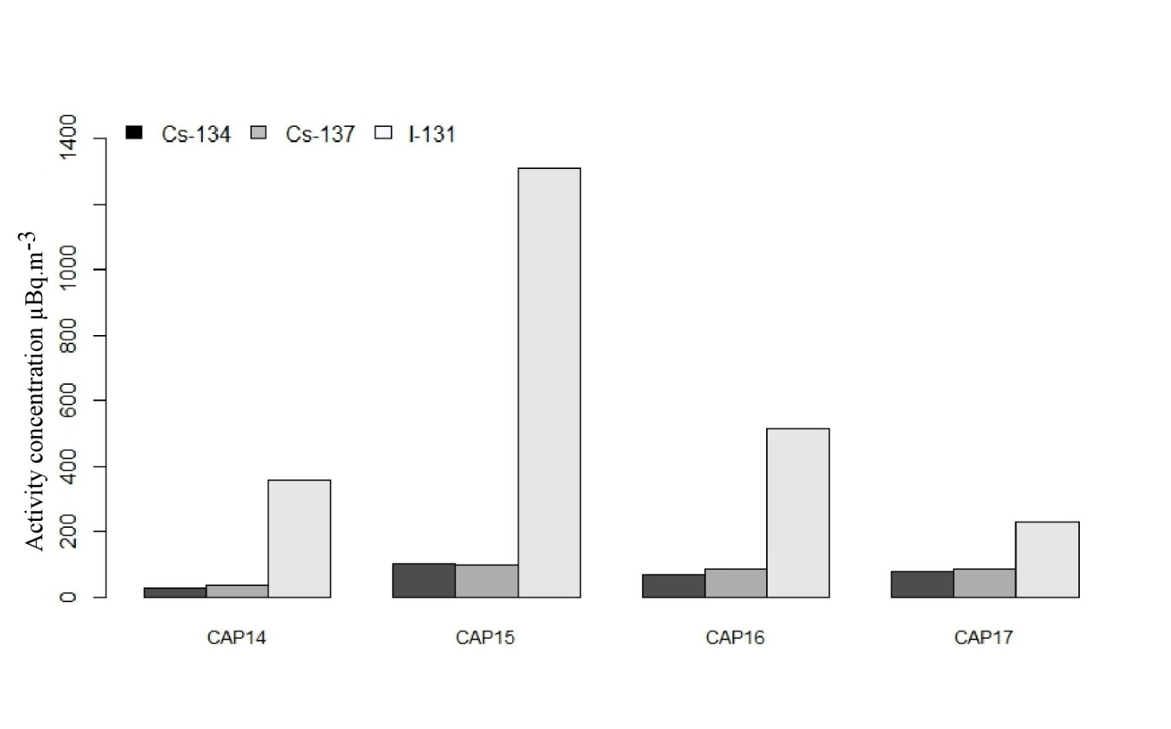
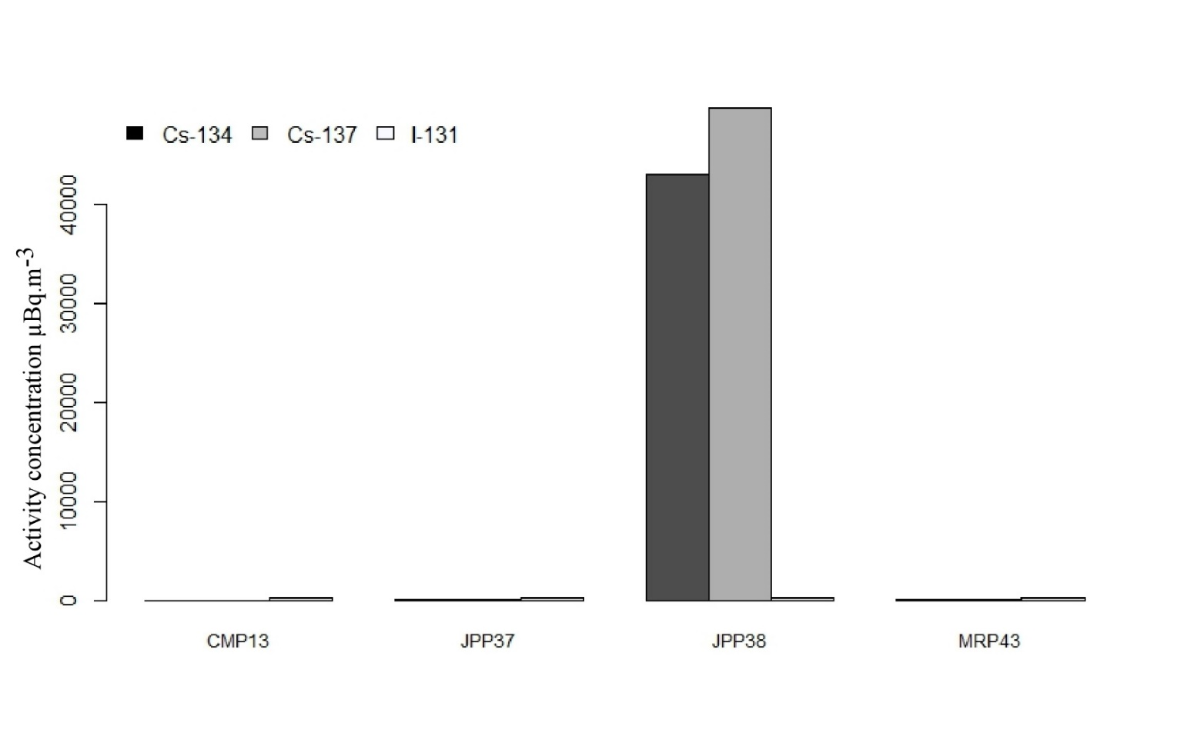
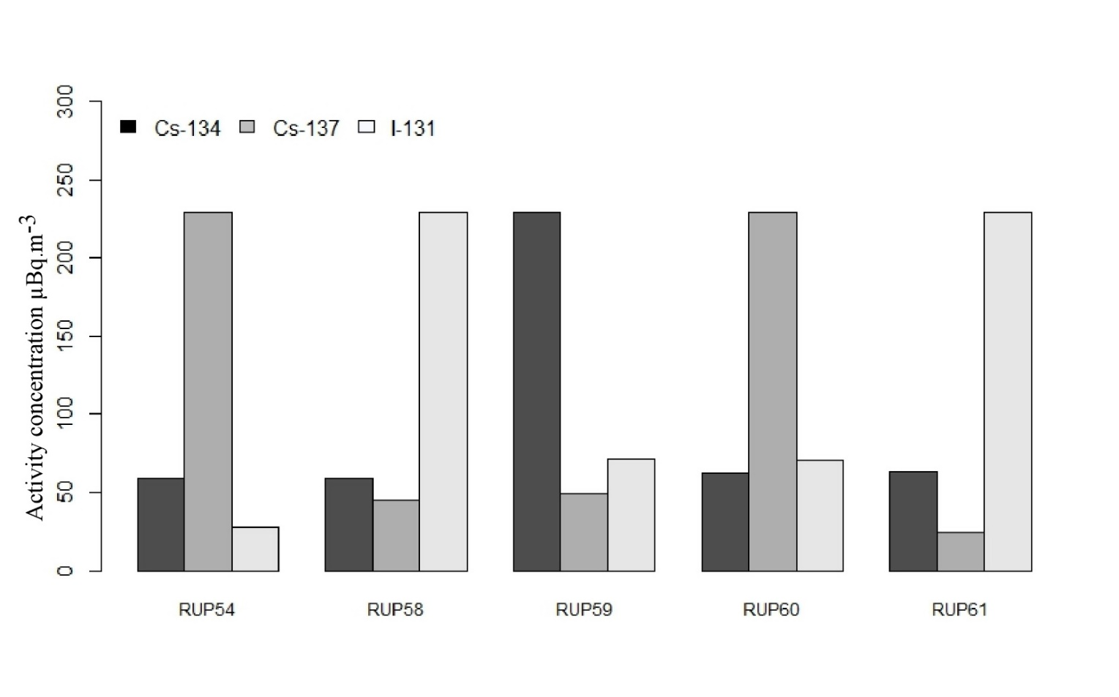
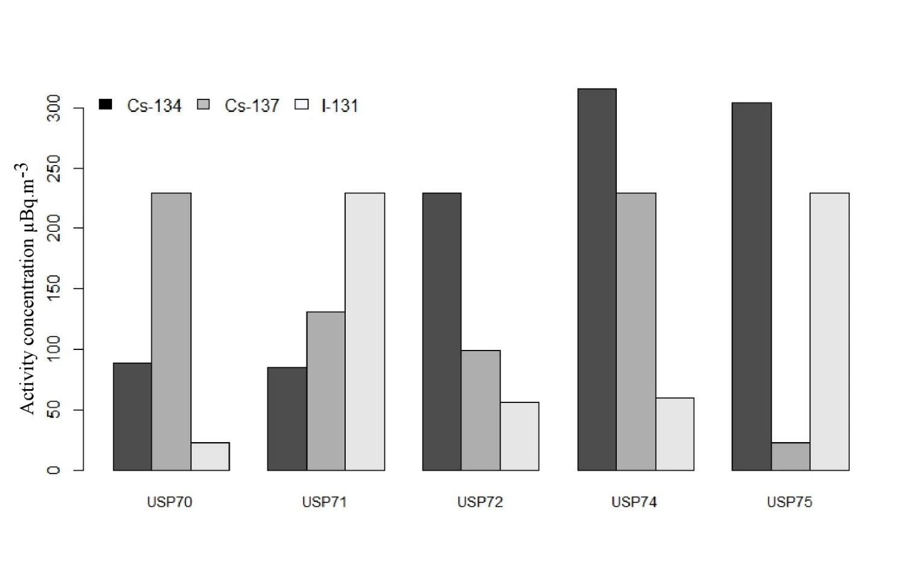
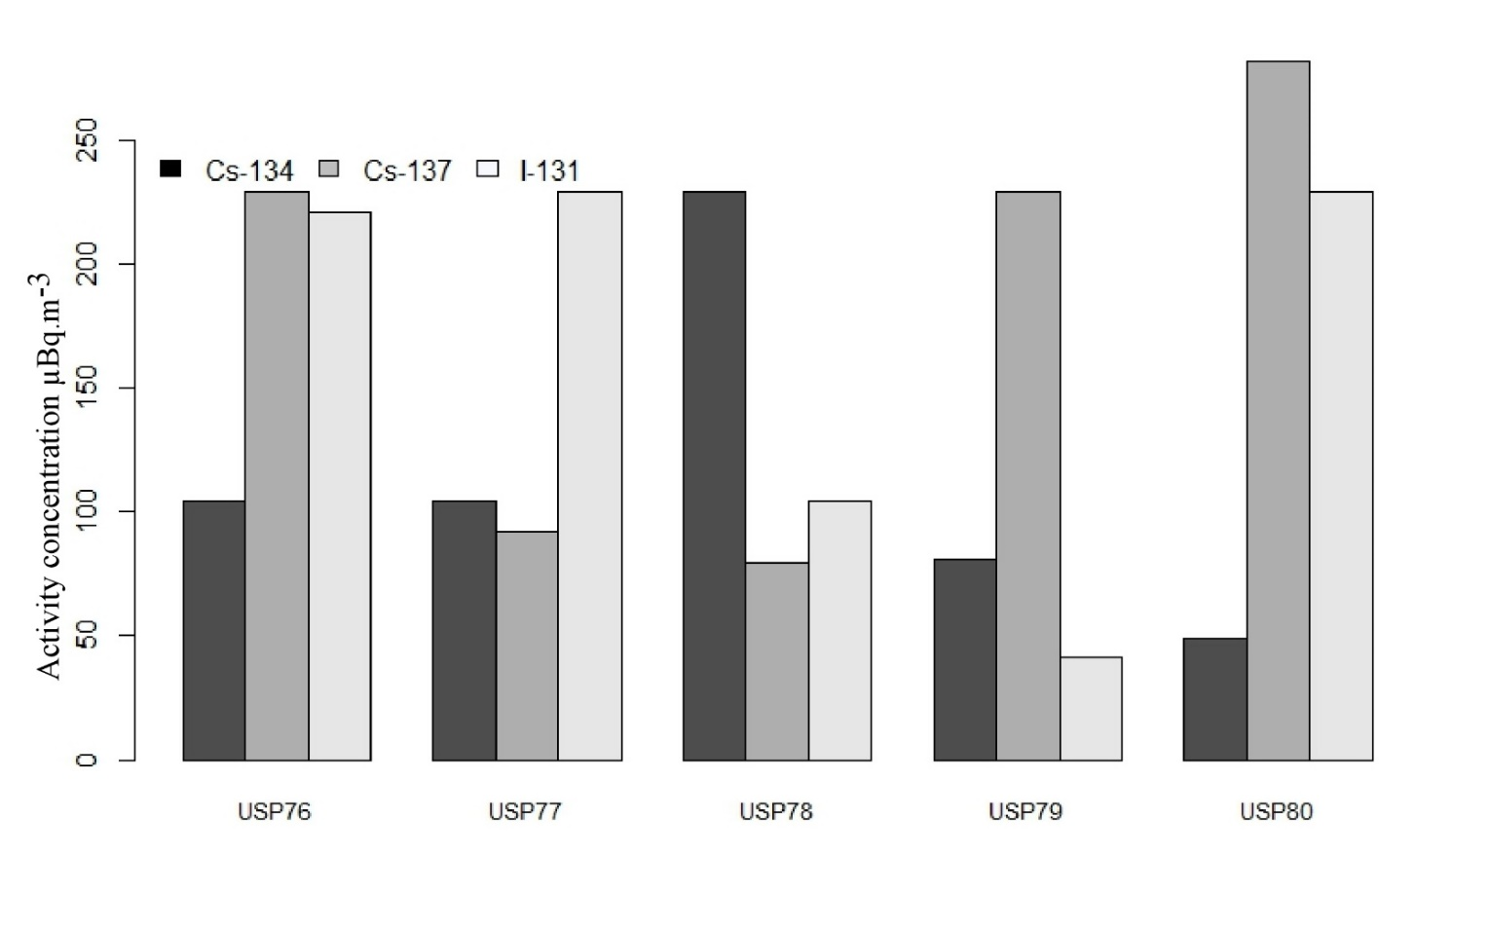
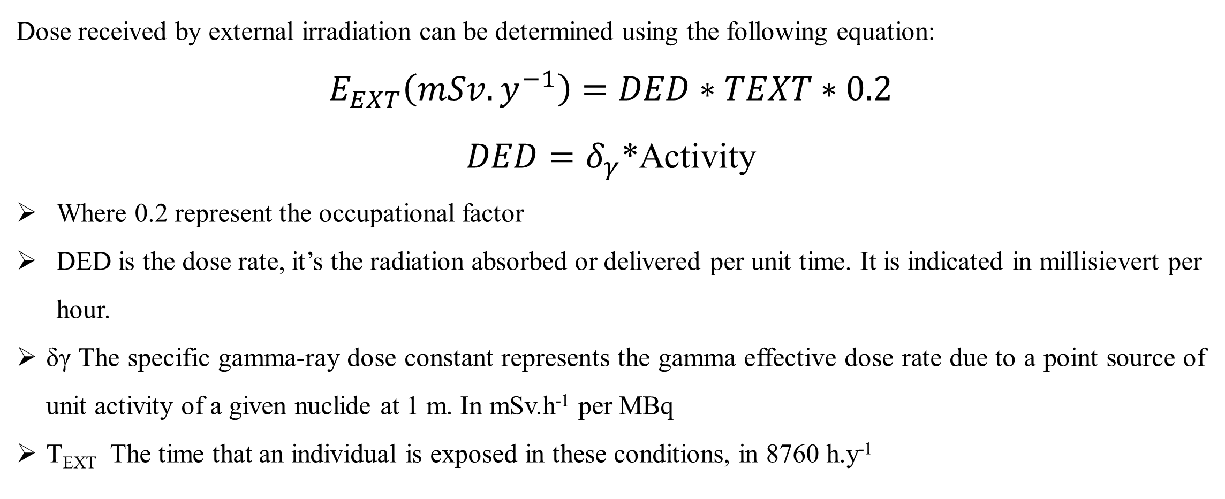
Assessment of the anthropogenic radionuclides Cs-137, Cs-134 and I-131 detected by the International Monitoring System (IMS)
Lightning
Talks
P2.4-044
Modou NIANG^{1,2,4*} Abdelhakim Gheddou³, Ndeye Arame BOYE FAYE^{1,4}
¹ Laboratory of Atoms Lasers, Department of Physic, Cheikh Anta Diop University, Dakar, Senegal
² Institute of Applied Nuclear Technology (ITNA), Cheikh Anta Diop University, Dakar, Senegal
³ Comprehensive Nuclear-Test-Ban Treaty Organization (CTBTO)
⁴ Senegalese Authority of Radioprotection and Nuclear Safety (ARSN), L/14 Scat Urbam Mariste, Senegal
Email:* maloniang24@gmail.com
ABSTRACT
The higthest activity concentration of Cs-137 (49841,8614 ± 51,1305007) Bq.m⁻³ and Cs-134 (43036,0844 ± 180,105347) Bq.m⁻³ are detected at JPP38 station. Then I-131 (1312,32329 ± 579,068501) Bq.m⁻³ is detected at CAP15 station. The ratio Cs-134/Cs-137 is equal to 0.86. It’s close to 1 suggests that radioactive material was released from the same type of source material. I suppose these radionucleides are released by the Fukushima Daiichi Accident.
The first detection in africa radionucleide sation was reported 02/04/2011 and 26/03/2011 respectively for CMP13 and MRP43. Figure.3 show the collection stop
The mean activity concentration detected at CMP13 are (5.445605045 ± 0.474661794) Bq.m⁻³ , (7.256718169 ± 0.543336762) Bq.m⁻³ and (14.79545456 ± 0.721528916) Bq.m⁻³ respectively for Cs-134, Cs-137 and I-131. Then the mean activity concentration detected at MRP43 are (36.91158206 ± 0.902377094) Bq.m⁻³ , (36.06350396 ± 0.902824553) Bq.m⁻³ and (312.5712181 ± 6.869309606) Bq.m⁻³ respectively for Cs-134, Cs-137 and I-131. The ratio Cs-134/Cs-137 are 0.7 and 1.02 respectively for the stations CMP13 and MRP43. I suppose these radionucleides are released by the same source. In these country they are not nuclear power plant, in fact these fission product can be released by the Fukushima Daiichi Accident.
We are used the mean activity concentration of these radionucleides (Cs-137, Cs-134 and I-131) for assessment the dose received by workers in the CMP13 and MRP43 station and member of public around the station.
In fact, the value of external dose received are 8.171 10⁻⁷ mSv.y⁻¹ and 6.83 10⁻⁸ mSv.y⁻¹ respectively in the MRP43 and CMP13. Indicating that the value are relatively lower than the annual effective dose criterion 1 mSv.y⁻¹ . It can be proposed that workers do not spend unnecessary time in the radionucleide station. The goal is to maintain the exposure of workers as low as possible (ALARA).
Anthropogenic radionuclides have been injected into the atmosphere by nuclear weapons program, nuclear weapons testing, nuclear power plants and uranium mining. In this work, we considered the activity concentrations of anthropogenic radionuclides (Cs-137, Cs-134 and I-131 ) detected in the IMS (International Monitoring System) during 15 Mars 2011 to 30 June 2011.The main objective are to determine the activity concentrations of anthropogenic radionuclides, classify the IMS (Radionuclide) according to the radioelement mapping and establish radioactivity levels in the IMS (Radionuclide) as well as radiological risk assesment for workers in the IMS.
DATA COLLECTION
The measurements of activity concentrations were conducted using a high volume air filtration unit operated on a routine methodology from a network of station, which belong to the International Monitoring System (IMS) and is operated by the CTBTO. In the station, 500-1000 m³/h of air is continuously filtered by using various types of filter papers. The particulate radionuclides collection efficiency is good, the collectors are designed to catch more than 80 % of particles with diameter larger than 0.2 µm. Each samples was collected during a 24 h period. After sampling 24 h decay period is observed before analyzing samples. In fact, all radionuclides that have a short half-life will be reduced from the analysis. The activity concentrations of radionulcides were measured with high-resolution germanium.
The nuclide must emit gamma radiation (to enable detection by the IMS gamma-spectroscopic systems); with a primary gamma energy greater than 50 keV (the high-resolution detectors employed in the IMS are relatively insensitive to lower-energy gamma radiation); and with a primary gamma intensity (fraction of decay events which produce the gamma radiation) greater than 0.1%.
The IMS Radionuclide Network
Data were downloaded via the RN toolkit software (V.0.3.5) from the CTBTO website. RNToolkit is a web software tool to provide CTBTO authorized users fast and easy access to radionuclide detections of the IMS network based on IDC analysis. As an illustration, we present in (Figure.1) the radionucleides detected at JPP38 Takasaki Gunma Japan. We used the same protocol for all Radioncleides station. Be-7 is using for quality control of the IMS station
Figure.1: CTBT detections at JPP38
Peak Detectability
Detectability reflects the peak significance for a predefined risk level. It is derived from the values of SCAC, LC and baseline (B) within a range of channels: SCAC= Single Channel Analyzer Curve ,LC=Critical Limit
Detectability < 1
(SCAC structure below LC):
Not a significant peak
Detectability >=1
(SCAC structure above LC):
The peak is confirmed
Method of calculating doses
Dose received by external irradiation can be determined using the following equation:
$E_{EXT}\left(mSv.y^{−1}\right)=DED∗TEXT$ $∗0.2$
$DED=δ_{γ}$*Activity
Where 0.2 represent the occupational factor
DED is the dose rate, it’s the radiation absorbed or delivered per unit time. It is indicated in millisievert per hour.
δγ The specific gamma-ray dose constant represents the gamma effective dose rate due to a point source of unit activity of a given nuclide at 1 m. In mSv.h⁻¹ per MBq
T_{EXT} The time that an individual is exposed in these conditions, in 8760 h.y⁻¹
CONCLUSION
The propose of this study are to determine the activities of anthropogenic radionuclides, classify the IMS (Radionuclide) according to the radioelement mapping and establish radioactivity levels in the IMS (Radionuclide) as well as radiological risk assessment. The higthest activity concentration are detected at JPP38 station. The dose received in the radionucleide station (MRP43 and CMP13) are below1 mSv.y⁻¹ recommended by International Commission on Radiological Protection for members of public.
RESULTS AND DISCUSSIONS
The Figure.2 show the radionucleides detected in the IMS.
REFERENCES
[1] STOEHLKER, Ulrich, NIKKINEN, Mika, et GHEDDOU, Abdelhakim. Detection of radionuclides emitted during the Fukushima nuclear accident with the CTBT radionuclide network. Monitoring research review: Ground-based nuclear explosion monitoring technologies, 2011, p. 715-724.
[2] ZÄHRINGER, Matthias et KIRCHNER, Gerald. Nuclide ratios and source identification from high-resolution gamma-ray spectra with Bayesian decision methods. Nuclear Instruments and Methods in Physics Research Section A: Accelerators, Spectrometers, Detectors and Associated Equipment, 2008, vol. 594, no 3, p. 400-406.
[3] RNToolkit Software User Tutorial
[4] PEPLOW, Douglas E. Specific Gamma-ray dose constants with current emission data. Health Physics, 2020, vol. 118, no 4, p. 402-416.

