Slide 1
Characteristics and sources of Cs-137 detected at IMS radionuclide monitoring stations in Japan
Akiko FURUNO, Yutaka TOMITA, Toshiyuki KURIHARA, Yoichi YAMAMOTO, Ryuta Ohmori, Yuya Minakawa
Japan Atomic Energy Agency
We focus on Cs-137 detected at the Okinawa station (JPP37), which is located on an island in the Pacific Ocean and has no nuclear facilities nearby, and estimate the release source using IMS data and ATM analysis.
For all days when Cs-137 was detected in JPP37:
Check the weather map
Check if Cs-137 was detected at stations other than JPP37
Back-tracking for 5 days from the day Cs-137 was detected
Season of detection is mostly from Dec. to May high correlation with CNP20 and MNP45
Backtracking simulations show that plume migration to these stations are relatively well reproduced
Possible release areas are Mongolia - inland China
We organized the Cs-137 detections in the East Asia region. It was possibly related to the Yellow-sand phenomenon. We would like to continue monitoring and analysis in this region.
Place your QR Code here after removing this text box!
P2.4-547

Slide 2
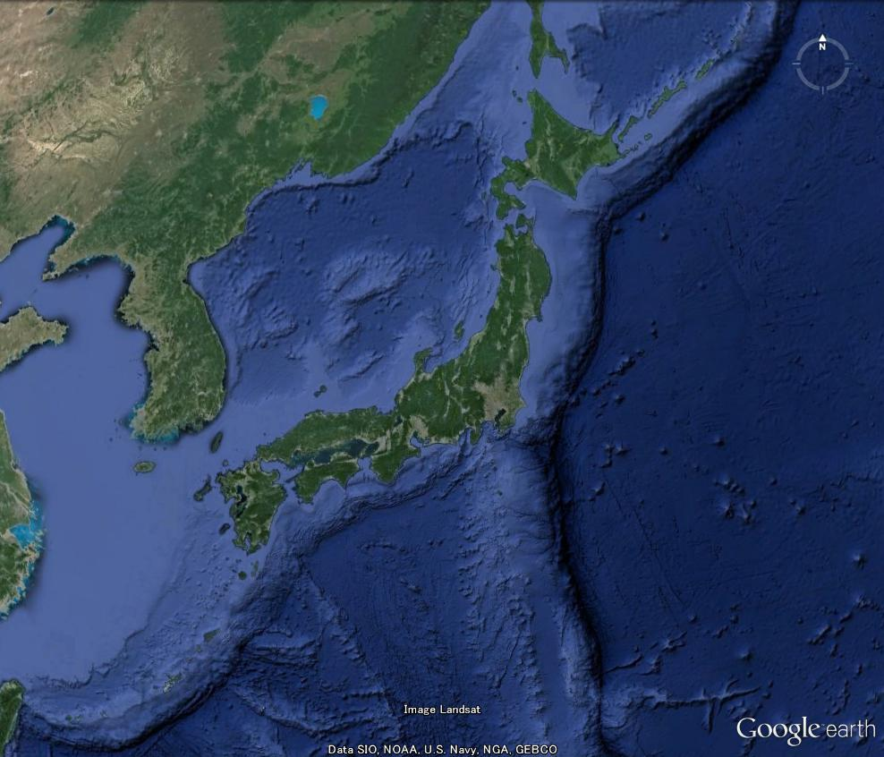
Characteristics and sources of Cs-137 detected at IMS radionuclide monitoring stations in Japan
Introduction
Horonobe TXL-3
(JPX81)
We are responsible for data analysis and management of IMS radionuclide monitoring stations as the NDC of Japan
There are two IMS radionuclide monitoring stations in Japan, at Takasaki for particles and noble gases and at Okinawa for particles
The detection frequency of Cs-137:
AS054
Takasaki Station
（RN38）
Mutsu TXL-2
(MUX88)
PS22
IS30
AS051
AS053
Takasaki (JPP38): high
originating mainly from the Fukushima Dai-ichi
Nuclear Power Plant Accident
Okinawa (JPP37) : occasionally, release source is unknown
An island in the Pacific Ocean with no nuclear facilities in the vicinity
Affected by long-range dispersion?
AS052
Okinawa Station
（RN37）
AS055
TXL: Transportable Xenon Laboratory
Place your QR Code here after removing this text box!
P2.4-547

Slide 3
Characteristics and sources of Cs-137 detected at IMS radionuclide monitoring stations in Japan
Objectives
focus on Cs-137 detection at Okinawa (RN37)
clarify the characteristics of the season and the pressure pattern of each detection
back-trajectory analysis using an atmospheric transport model will be conducted to estimate the release source of Cs-137, by comparing with the IMS data including the surrounding stations
Number of days Cs-137 was detected at RN37
 | Jan | Feb | Mar | Apr | May | Jun | Jul | Aug | Sep | Oct | Nov | Dec | Total
2012 |  |  |  | 1 |  |  |  |  |  |  |  |  | 1
2013 |  |  |  |  |  |  |  |  | 1 |  |  |  | 1
2014
2015
2016
2017 |  |  |  | 1 |  |  | 5 |  |  | 1 |  | 3 | 10
2018 | 1 | 2 |  | 8 |  | 1 | 1 | 1 |  |  |  |  | 14
2019 |  |  |  |  | 2 |  |  |  |  |  |  |  | 2
2020 |  |  |  | 7 | 5 |  |  |  | 1 | 1 | 1 | 2 | 17
2021 | 1 | 3 |  | 2 |  | 1 |  |  |  |  |  |  | 7
Total | 2 | 5 | 0 | 19 | 7 | 2 | 6 | 1 | 2 | 2 | 1 | 5
Frequency of detection has increased since 2017
Highest frequency is in April, also frequently detected from December to May
Need to confirm detection in July-August
Place your QR Code here after removing this text box!
P2.4-547

Slide 4
Characteristics and sources of Cs-137 detected at IMS radionuclide monitoring stations in Japan
Methods/Data
For all days when Cs-137 was detected in JPP37:
Check the weather map
Check if Cs-137 was detected at stations other than JPP37
Back-tracking for 5 days from the day Cs-137 was detected
Simulation conditions of the back-tracking:
Model：HYSPLIT (NOAA)
Input Meteorological data：GDAS 1.0°
Validation data: IDC RRR
Tracer : Cs-137
Release rate and duration: 1 Bq/hour for 24 hours
Period of analysis：2012 – 2021
Number of the tracer particles：100,000
Vertical diffusion：Kanthar/Clayson
Horizontal diffusion：determined as ratio of the vertical diffusion
Place your QR Code here after removing this text box!
P2.4-547

Slide 5
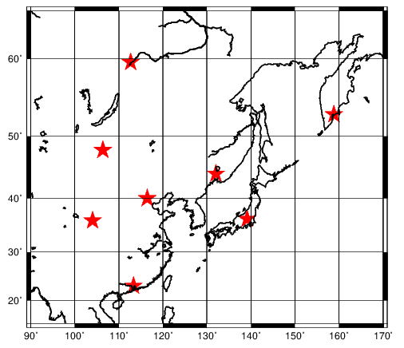
Characteristics and sources of Cs-137 detected at IMS radionuclide monitoring stations in Japan
Results
(1) Percentage (%) of detections at nearby stations within 5 days prior to the date of detection of Cs-137 at JPP37
 | Dec.-Feb. | Mar.- May | Jun.-Aug. | Sep.-Nov
CNP20 | 75.0 | 57.7 | 11.1 | 40.0
CNP21 | 16.7 | 46.2 | 11.1 | 0.0
CNP22 | 8.3 | 30.8 | 0.0 | 20.0
JPP38 | 41.7 | 65.4 | 88.9 | 60.0
MNP45 | 16.7 | 84.6 | 0.0 | 0.0
RUP56 | 8.3 | 30.8 | 11.1 | 0.0
RUP58 | 16.7 | 23.1 | 0.0 | 20.0
RUP60 | 16.7 | 15.4 | 11.1 | 0.0
RUP56
MNP45
RUP60
RUP58
CNP20
CNP21
JPP38
CNP22
JPP37
Place your QR Code here after removing this text box!
CNP20 makes a large contribution from December to May
MNP45 contributes significantly only from March to May
8 Yellow-sand observation days to western Japan out of 26 MAM detection days
P2.4-547

Slide 6
Characteristics and sources of Cs-137 detected at IMS radionuclide monitoring stations in Japan
Results
(2) Percentage of Cs-137 detection dates at nearby stations coinciding with the date the plume arrived by backtracking
 | DJF | MAM | JJA | SON
CNP20 | 75.0 | 50.0 | 0.0 | 50.0
CNP21 | 16.7 | 11.5 | 0.0 | 0.0
CNP22 | 0.0 | 7.7 | 0.0 | 0.0
JPP38 | 0.0 | 3.8 | 0.0 | 33.3
MNP45 | 16.7 | 57.7 | 0.0 | 0.0
RUP56 | 0.0 | 0.0 | 0.0 | 0.0
RUP58 | 0.0 | 7.7 | 0.0 | 0.0
RUP60 | 0.0 | 0.0 | 0.0 | 0.0
RUP56
MNP45
RUP60
RUP58
CNP20
CNP21
JPP38
CNP22
JPP37
Place your QR Code here after removing this text box!
Backtracking results show that in most cases from December to May, the radioactive plume reached northern China (CNP20) to near Mongolia (MNP45) or the continental interior
There were no stations where the plume reached during the summer season
P2.4-547

Slide 7
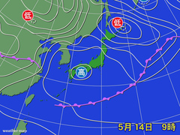
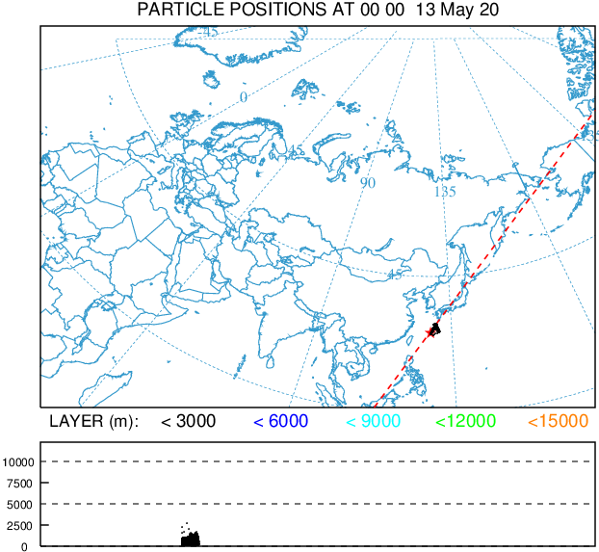
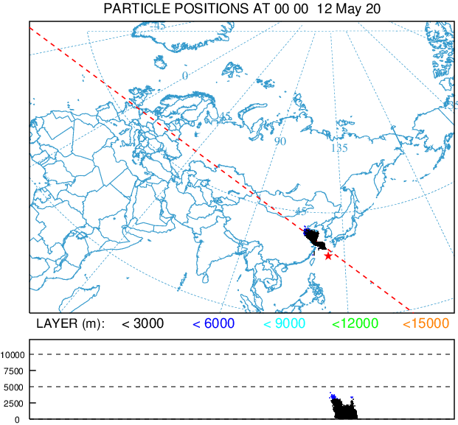
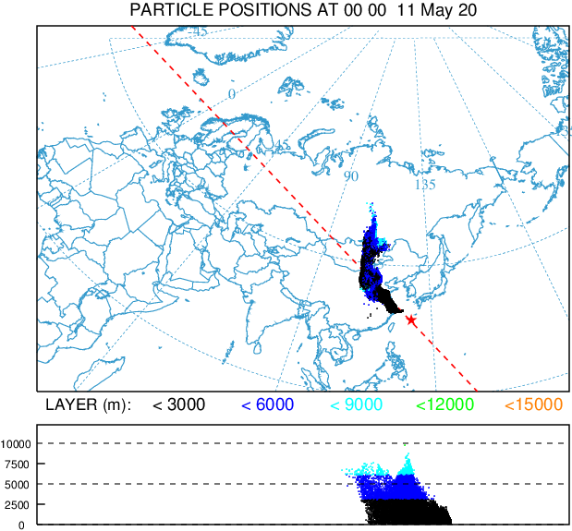
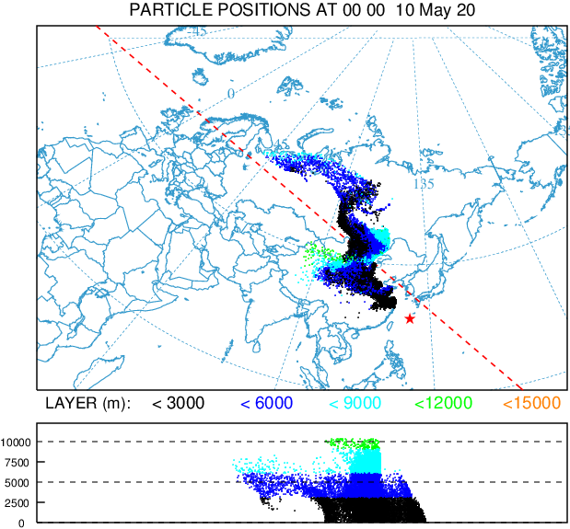
Characteristics and sources of Cs-137 detected at IMS radionuclide monitoring stations in Japan
(3) Typical example when Cs-137 was detected in spring at JPP37:
14 May 2020
Results
 | CN20 |  | CN21 |  | JP37 |  | MN45
 | Sim. | Obs. | Sim. | Obs. | Sim. | Obs. | Sim. | Obs.
14 May | 0 |  | 0 |  | 0.38925 | 3.69 | 0
13 May | 0 | 11.66 | 0 |  | 0.02919 |  | 0
12 May | 0.00037 | 16.90 | 0 |  | 0 |  | 0 | 2.97
11 May | 0.0003 | 14.47 | 3.4E-06 |  | 0 |  | 0.00206
10 May | 3.4E-05 | 1.93 | 1.4E-05 |  | 0 |  | 0.00268
L
L
H
0:00UTC 14 May
from ‘Kishojin’
https://kishojin.weathermap.jp/diary.php?ym=202004
Possible release source: Mongolia – inland China (Yellow sand?)
Place your QR Code here after removing this text box!
24h
48h
72h
96h
P2.4-547

Slide 8
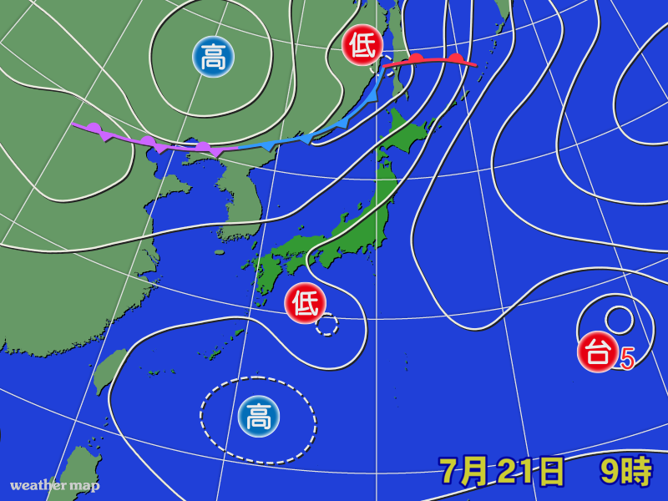
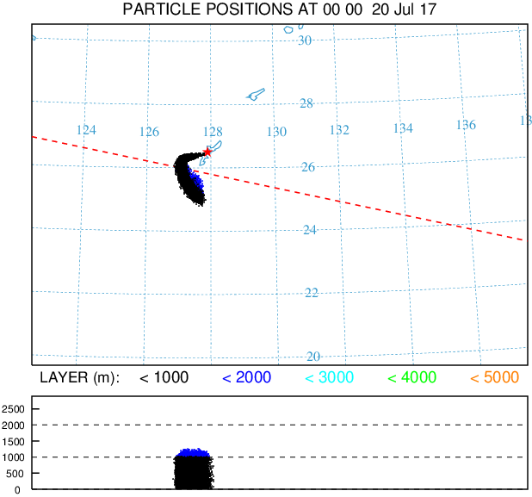
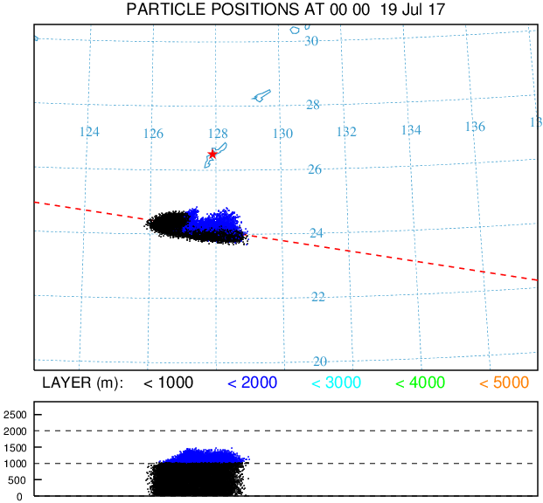
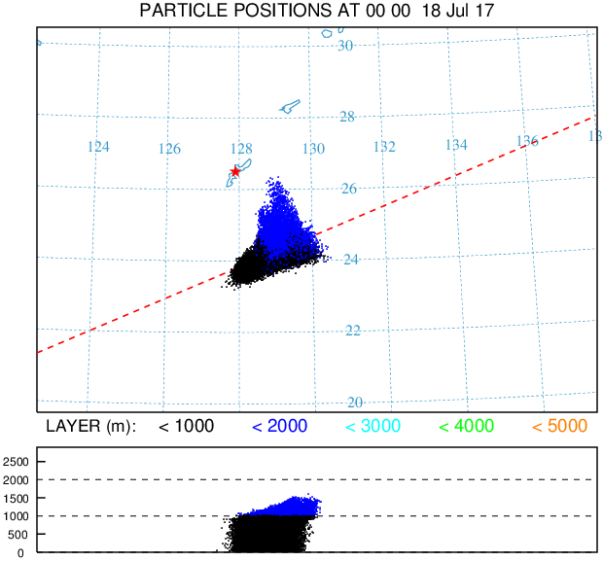
Characteristics and sources of Cs-137 detected at IMS radionuclide monitoring stations in Japan
Results
(4) Typical example when Cs-137 was detected in summer at JPP37:
21 July 2017
H
L
 | JP37 |  | JPP38
 | Sim. | Obs. | Sim. | Obs.
21 Jul | 0 | 3.68 | 0
20 Jul | 0 |  | 0
19 Jul | 0 |  | 0
18 Jul | 0 |  | 0 | 4.30
17 Jul | 0 |  | 0
L
L
H
0:00UTC 21 July
Possible release source:???
from ‘Kishojin’
https://kishojin.weathermap.jp/diary.php?ym=201707
Spectrum analysis results
Peak energy: 660.94keV
Reference energy: 661.66keV
FWHM= 2.49 (1.66) keV
: Possibility of false positives detection
Place your QR Code here after removing this text box!
P2.4-547

Slide 9
Characteristics and sources of Cs-137 detected at IMS radionuclide monitoring stations in Japan
Conclusion
JPP37 is an island in the Pacific Ocean where Cs-137 is sometimes detected despite the fact that there are no nuclear facilities on the island or nearby
Season of detection is mostly from December to May
High correlation with CNP20 throughout that period and with MNP45 from March to May => possibly related to the Yellow-sand phenomenon
Backtracking calculations show that plume migration to CNP20 and MNP45 is relatively well reproduced
Possible release areas are Mongolia - inland China
The typical meteorological pattern in spring that Cs-137 detection in Okinawa is a high-pressure system is overhanging from the continent
Possible release areas of cases detected in summer is unknown
Place your QR Code here after removing this text box!
P2.4-547

