Slide 1
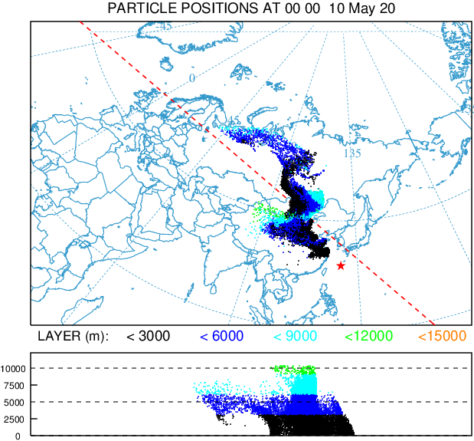
Characteristics and sources of Cs-137 detected at IMS radionuclide monitoring stations in Japan
Akiko Furuno, Yutaka Tomita, Toshiyuki Kurihara, Yoichi Yamamoto, Ryuta Ohmori, Yuya Minakawa
Japan Atomic Energy Agency
P2.4-547
【Characteristics of Cs-137 detection at JPP37 (Okinawa) from 2012 to 2021】
Percentage (%) of detections at nearby stations within 5 days prior to the date of detection of Cs-137 at JPP37
Typical example when Cs-137 was detected in spring at JPP37: 14 May 2020
 | Dec.-Feb. | Mar.- May | Jun.-Aug. | Sep.-Nov
CNP20 | 75.0 | 57.7 | 11.1 | 40.0
CNP21 | 16.7 | 46.2 | 11.1 | 0.0
CNP22 | 8.3 | 30.8 | 0.0 | 20.0
JPP38 | 41.7 | 65.4 | 88.9 | 60.0
MNP45 | 16.7 | 84.6 | 0.0 | 0.0
RUP56 | 8.3 | 30.8 | 11.1 | 0.0
RUP58 | 16.7 | 23.1 | 0.0 | 20.0
RUP60 | 16.7 | 15.4 | 11.1 | 0.0
Possible release source: Mongolia – inland China (Yellow sand?)
Cs-137 detection at JPP37 is mostly from December to May and is high correlation with CNP20.
It is also highly associated with MNP45 from March to May and may be related to Yellow-sand phenomenon.

