Slide 1
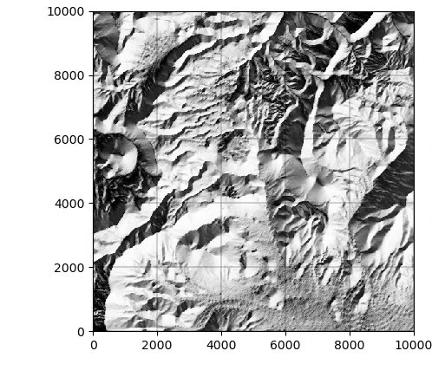
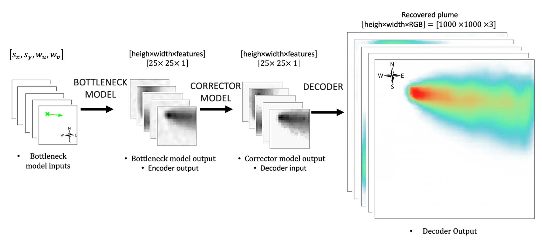
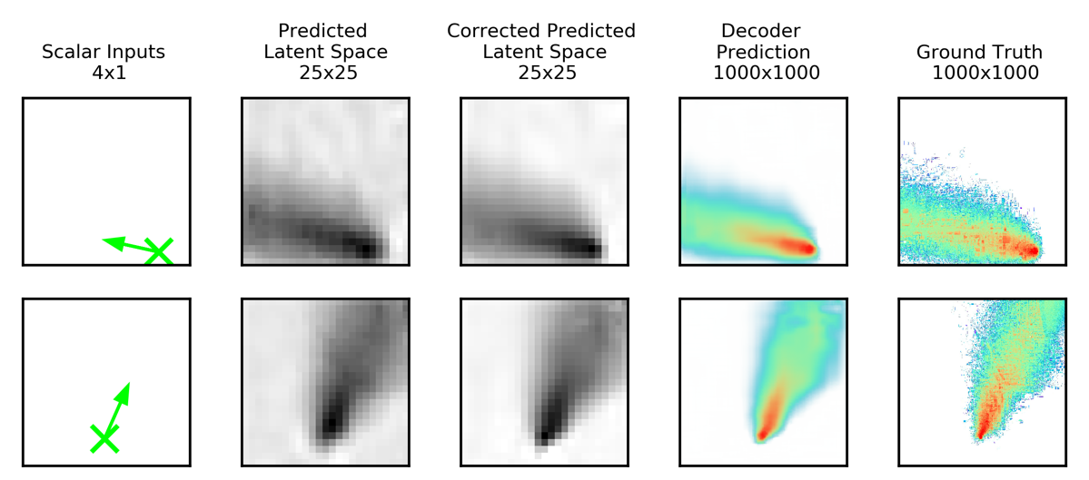
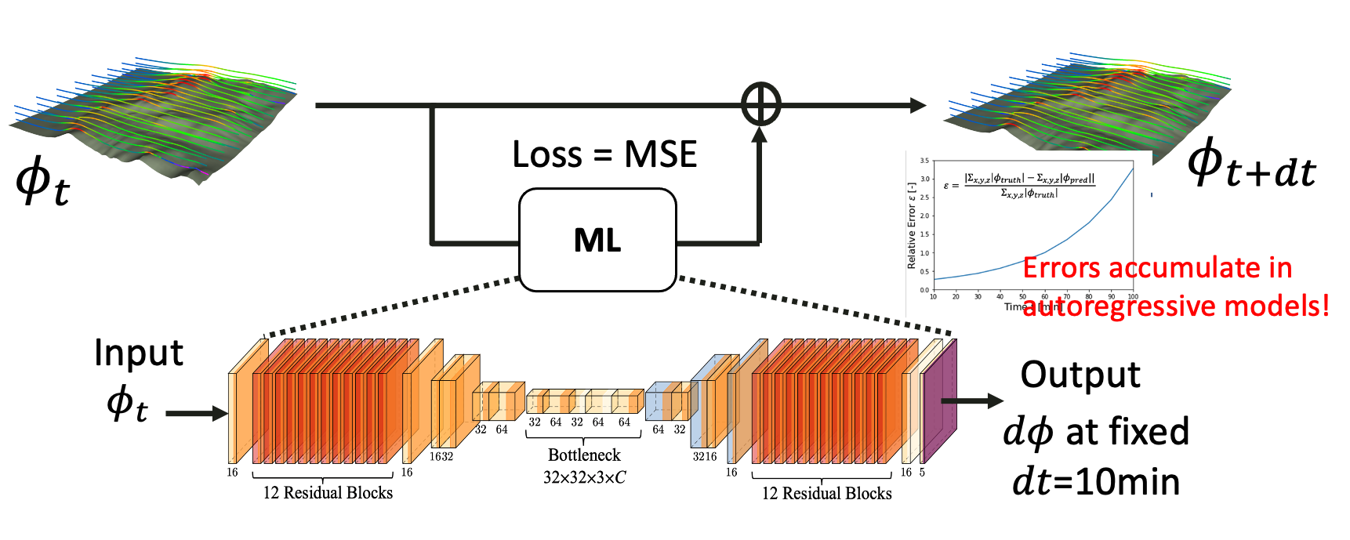
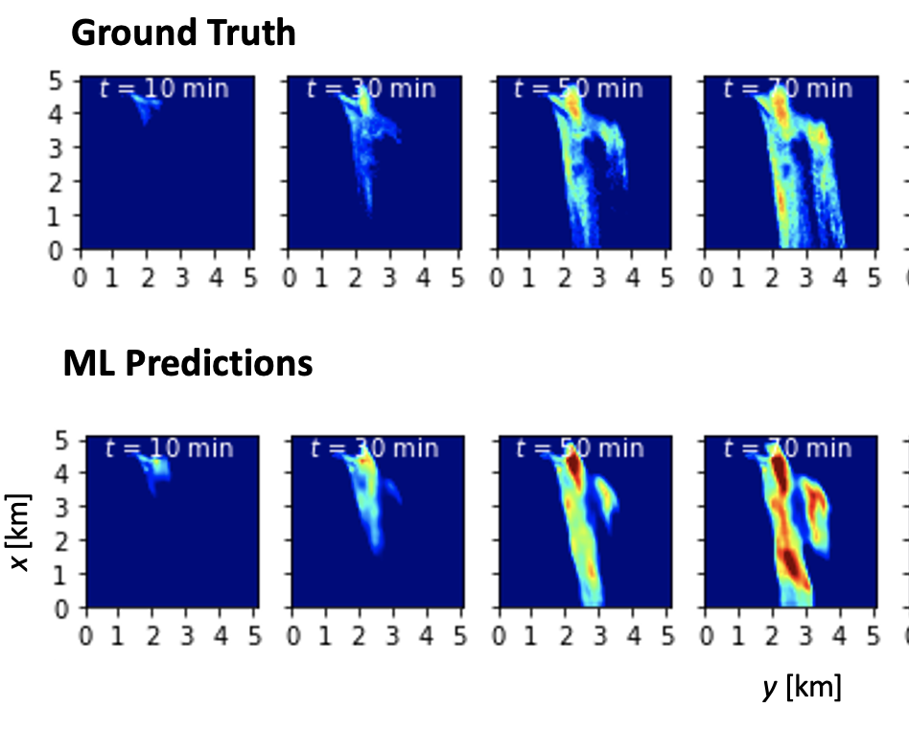
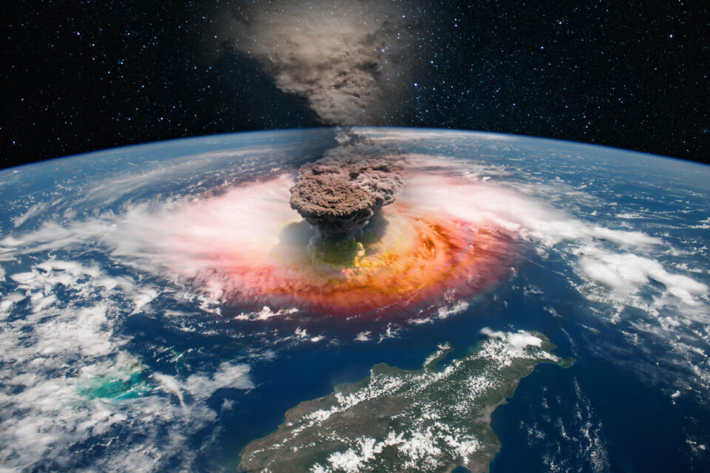
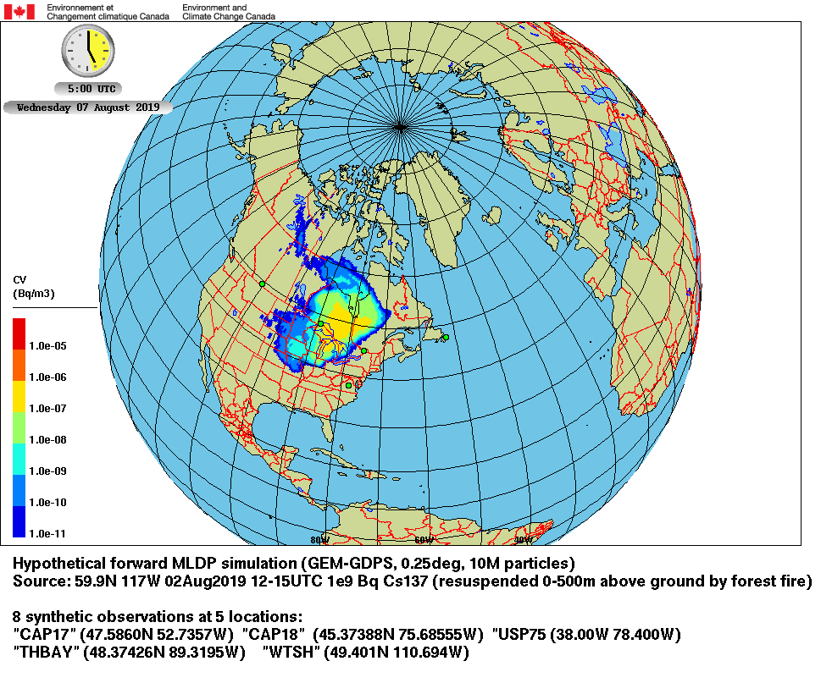
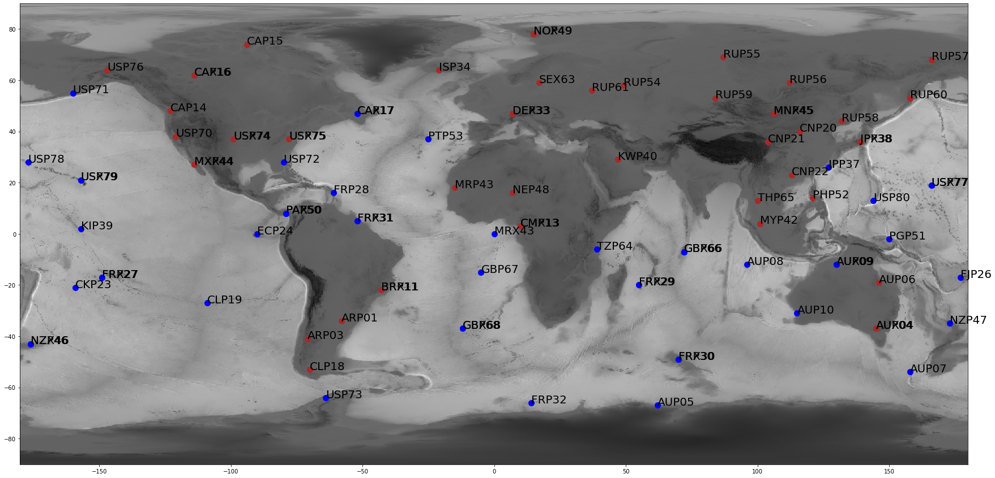
Leveraging Local Scale Deep Autoencoder-based Models to Characterize Early Times of Global Atmospheric Transport
Fernández-Godino, M. G.¹, Lucas, D. D. ¹, Chung, W. T.², Glascoe, L. G. ¹, and Myers, S. C. ¹
¹ Lawrence Livermore National Laboratory, ² Stanford University
P2.4-154
Wind speed direction fixed
Fernández-Godino et al., 2023
Deep convolutional neural network-based autoencoders are used to exploit relationships in wind-driven spatial patterns (DATASET 1).
The encoder compresses the dimensionality to 0.02% of the original size, reducing the data dimension.
The full predictive model demonstrates an error of 8%, a figure of merit in space of 94%, and a precision-recall area under the curve of 0.93.
LOCAL SCALE MODEL ~ 10¹km
$$y(m)$$
x
Release location
variable
x
$$x(m)$$
Two completely different spatial patterns after 90 minutes of continue release
initial conditions
Chung et al., 2022
De Meutter & Hoffman, 2020
GLOBAL SCALE MODELS ~ 10⁴ km
3-D CNN Autoencoder from Chung et al. 2022 is used.
Data from 100 Aeolus simulations split 80:10:10 (DATASET 2).
Trained on 4 Nvidia V100 GPUs for 50 epochs (36 hrs).
No physics-informed modifications yet.
Reasonable scalar position predictions, but quantitative predictions need improvement.
Next steps: optimal $dt$, improved ML architectures, optimal model size.
https://lexica.art/aperture
Fernández-Godino et al. 2022
Notes:
In this talk, we explore the latest developments in data science and machine learning for atmospheric and geosciences. We begin by discussing the advantages of using local models to predict global behavior. We see that small perturbations in source location can result in very different plumes, and local models provide detailed information on regional gas release dispersion.
We discuss the use of deep autoencoder-based algorithms to learn local scale physics by observing images. Instead of training models using physical quantities, we use images, or pixel information. We present a three-dimensional temporal Unet CNN Autoencoder-based model. The models capture plume location accurately, but we are working in improving it performance on predicting magnitudes. We identify next steps for improvement, including finding the optimal time step, using better machine learning architectures, optimizing the model size and super-resolution.

