Slide 1
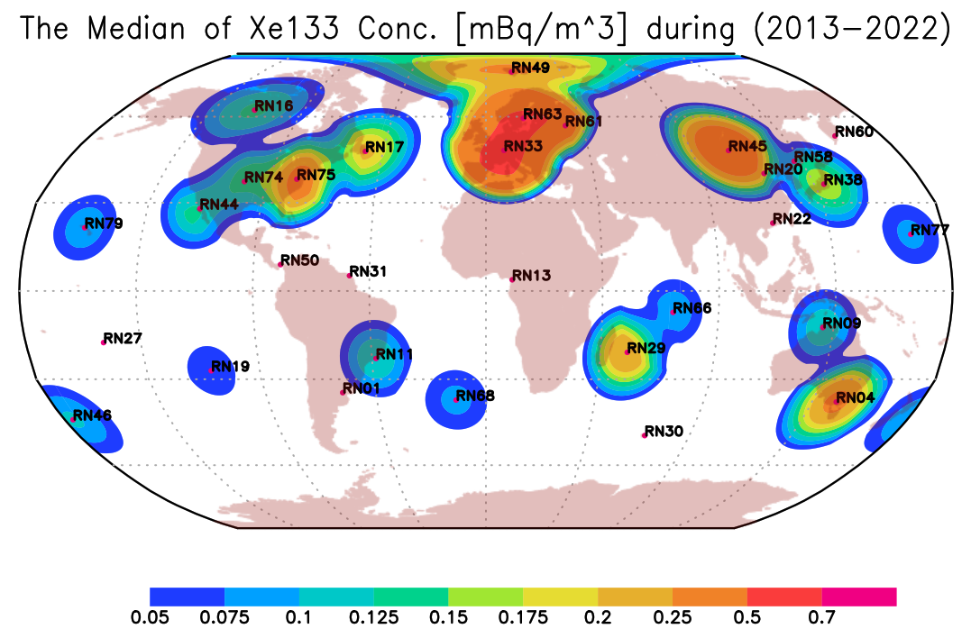
CTBT-relevant Xenon Isotopes Global Background in Ten Years (2013-2022)
Mohammed Elbahrawy and Sayed Mekhaimer
National Data Center, National Research Institute of Astronomy and Geophysics, Cairo, Egypt
P2.4-358
IMS noble gas stations are a unique network to measure and understand global radioxenon background.
All the data collected by the International Monitoring System (IMS) during 2013 and 2022 were used to study the changes in the global background of radioxenon.
The data were analyzed and the ratio between different Xenon isotopes were calculated.
The geographical distribution of radioxenon concentration is in consistence with the distribution of nuclear facilities (NPP, and MIPF).

