Slide 1
CTBT-relevant Xenon Isotopes Global Background in Ten Years (2013-2022)
Mohammed Elbahrawy and Sayed Mekhaimer
National Data Center, National Research Institute of Astronomy and Geophysics, Cairo, Egypt
Measurements of radioxenon isotopes are essential for the IMS as required for the CTBT. IMS measures continuously the four Xenon isotopes of interest for CTBT verification: Xe-131m, Xe-133m, Xe-133 and Xe-135.
Analyzing the global distribution of the Xe-133 isotope depending on data measured by the IMS noble gas stations. The ratios between different Xe isotopes were calculated for all the available stations.
Xe isotopes were measured frequently from 2013 to 2022.
Almost 40% of the measured samples have at least one Xe isotope detection.
The global geographical distribution of Xe-133 concentrations is consistent with the distribution of nuclear facilities.
Please do not use this space, a QR code will be automatically overlayed
Disclaimer: The views expressed on this poster are those of the authors and not necessarily reﬂect the ofﬁcial opinion of the National Data Center, National Research Institute for Astronomy and Geophysics.
P2.4-358

Slide 2
Abstract and Introduction
CTBT-relevant Xenon Isotopes Global Background in Ten Years (2013-2022)
Abstract
Monitoring radionuclide concentrations is an important component of the Comprehensive Nuclear Test Ban Treaty (CTBT) verification regime and can provide direct evidence of the nuclear nature of an explosion. Whereas, in the case of underground nuclear testing, the radioxenon isotopes have the highest probability of escaping into the atmosphere. Four of the xenon isotopes are of interest for CTBT verification; 131mXe, 133mXe, 133Xe, and 135Xe. The current international monitoring system (IMS) design foresees 40 radioxenon stations around the world to provide a 90 % detectability of a 1 kt nuclear explosion within 14 days. In 2010, the first radioxenon station was integrated into the IMS. At the end of 2022, 26 systems are already certified and 5 additional were installed and already in operation. This work provides a systematic study of the CTBT-relevant xenon isotopes' global background in ten years (2013-2022) using all the available stations. The geographical distribution and the ratios between different Xe isotopes were analyzed.
Radioxenon isotopes are the most likely isotopes to be released into the atmosphere from an underground nuclear explosion.
In a nuclear explosion, the four isotopes; 131mXe, 133mXe, 133Xe, and 135Xe are produced in sufficient quantities and have half‐live times long enough to allow an appreciable amount to travel and reach IMS radioxenon stations.
The ratio between different Xenon isotopes, 135 Xe, 133 Xe, 133m Xe, 131m Xe, is critical in determining the origin of the radioxenon.
Please do not use this space, a QR code will be automatically overlayed
P2.4-358

Slide 3
Studying global Xenon background.
IMS noble gas stations are a unique network to measure and understand global Xenon background.
Studying the development of the activity and the geographical distribution of the Xe isotopes on data collected by the international monitoring system (IMS) from 2013 to 2022.
Calculating and analyzing the ratios between different Xe isotopes.
Compare the Xe isotopic to the separation line between the nuclear explosion regime and civil regime according to Kalinowski graph.
Please do not use this space, a QR code will be automatically overlayed
P2.4-358

Slide 4
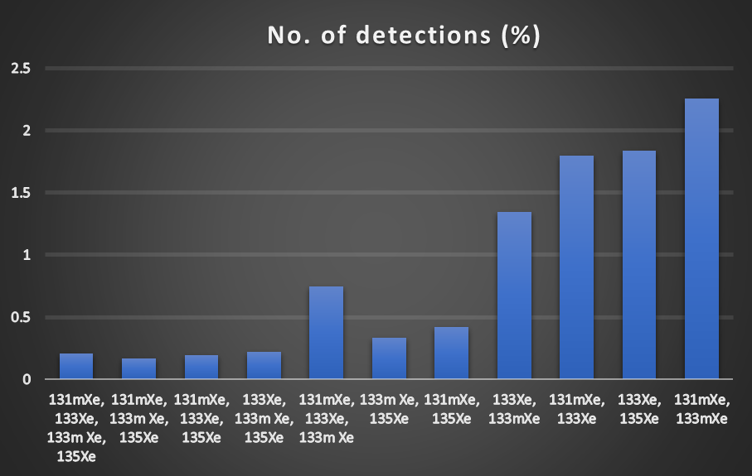
Xenon isotopes measurements (2013-2022)
IMS: Xe isotopes were measured frequently from 2013 to 2022
Total Number of samples: 137600
Total Number of samples with at least one Xe isotope: 54186
No. of Xe isotopes | Xe isotopes | No. of detections
Four | 131mXe, 133Xe, 133m Xe, 135Xe | 283
Three | 131mXe, 133m Xe, 135Xe | 232
Three | 131mXe, 133Xe, 135Xe | 272
Three | 133Xe, 133m Xe, 135Xe | 303
Three | 131mXe, 133Xe, 133m Xe | 1032
Two | 133m Xe, 135Xe | 457
Two | 131mXe, 135Xe | 583
Two | 133Xe, 133mXe | 1855
Two | 131mXe, 133Xe | 2474
Two | 133Xe, 135Xe | 2532
Two | 131mXe, 133mXe | 3107
2 isotopes
3 isotopes
4 isotopes
Please do not use this space, a QR code will be automatically overlayed
P2.4-358

Slide 5
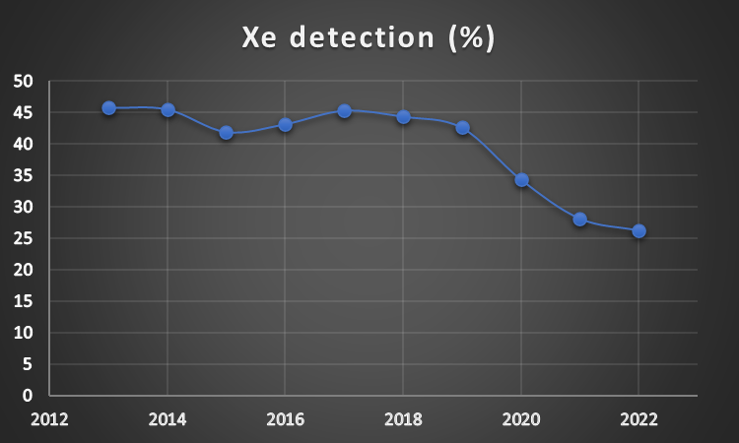
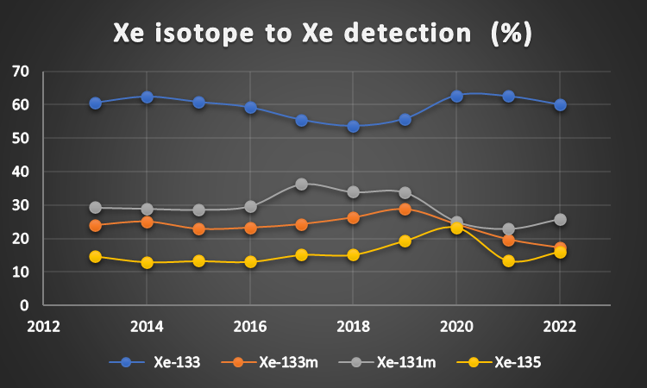
Xenon isotopes measurements (2013-2022)
Year | Sample with Detections | Number of Detections |  |  |  | Total Number of Samples
Year |  | Xe-133 | Xe-133m | Xe-131m | Xe-135
2013 | 4809 | 2914 | 1156 | 1410 | 711 | 10494
2014 | 5430 | 3389 | 1363 | 1574 | 708 | 11912
2015 | 5561 | 3383 | 1275 | 1595 | 743 | 13245
2016 | 6263 | 3709 | 1457 | 1863 | 822 | 14484
2017 | 6449 | 3578 | 1570 | 2341 | 977 | 14212
2018 | 6322 | 3392 | 1666 | 2148 | 962 | 14227
2019 | 6171 | 3446 | 1780 | 2089 | 1195 | 14461
2020 | 5005 | 3143 | 1216 | 1257 | 1164 | 14533
2021 | 4081 | 2553 | 806 | 937 | 550 | 14466
2022 | 4095 | 2459 | 706 | 1062 | 659 | 15566
Total | 54186 | 31966 | 12995 | 16276 | 8491 | 137600
IMS: Xe isotopes were measured frequently from 2013 to 2022
Almost 40% of the measured samples have at least one Xe isotope detection.
Please do not use this space, a QR code will be automatically overlayed
P2.4-358

Slide 6
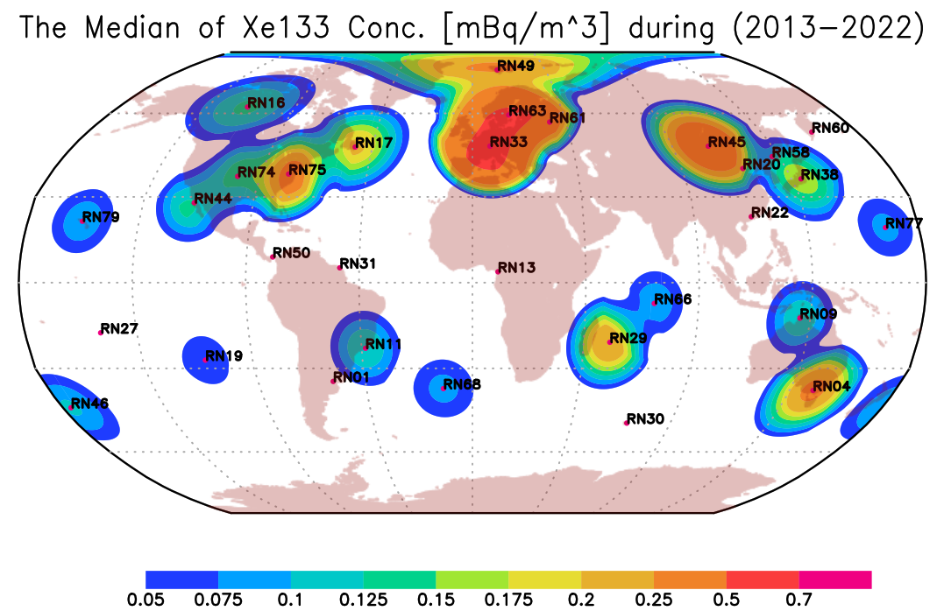
Xenon isotopes measurements (2013-2022)
Xe-133 concentration (2013 – 2022)
The geographical distribution of the median value of Xe-133 concentration is in consistent with the distribution of nuclear facilities.
Please do not use this space, a QR code will be automatically overlayed
P2.4-358

Slide 7
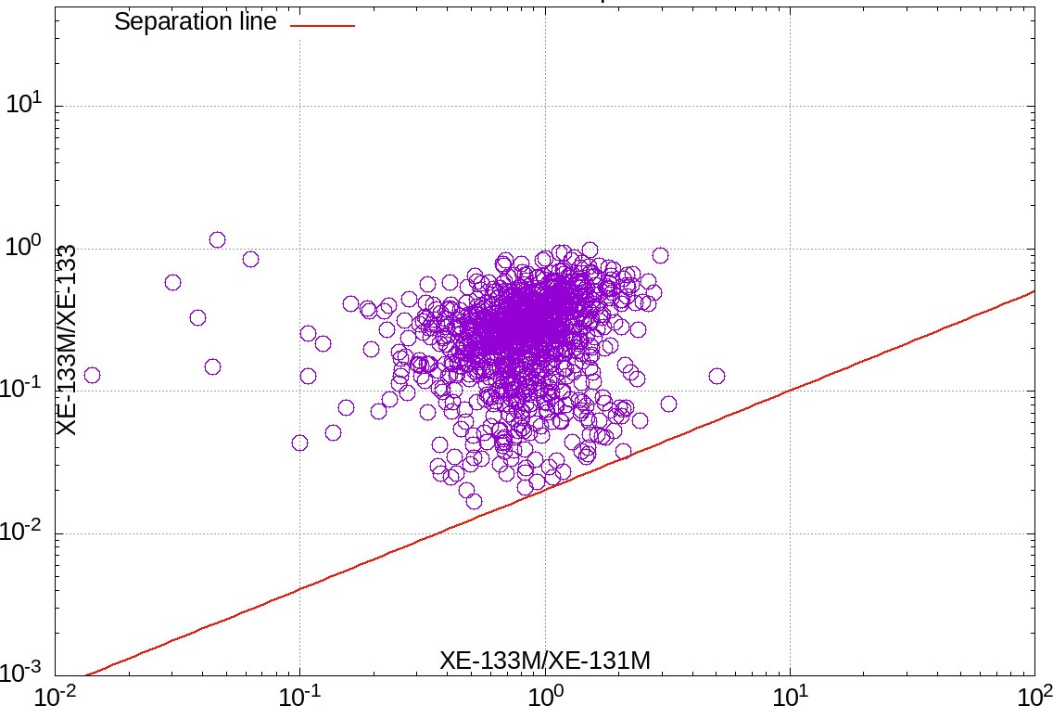
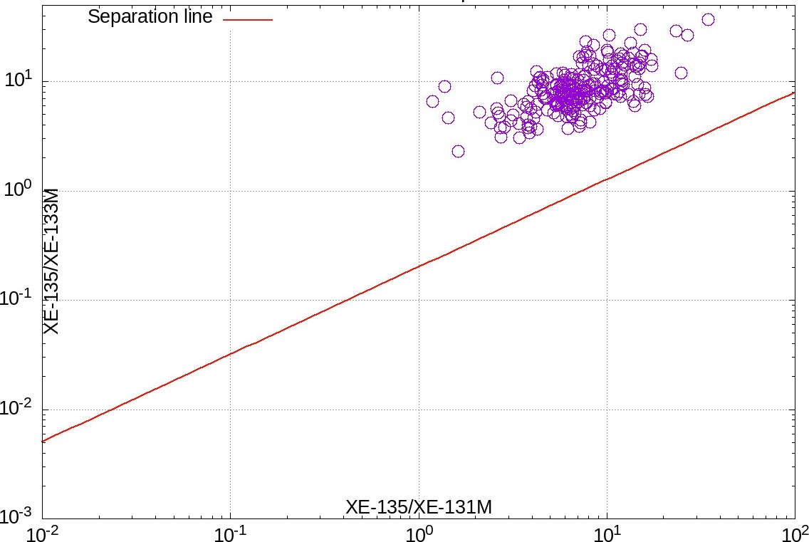
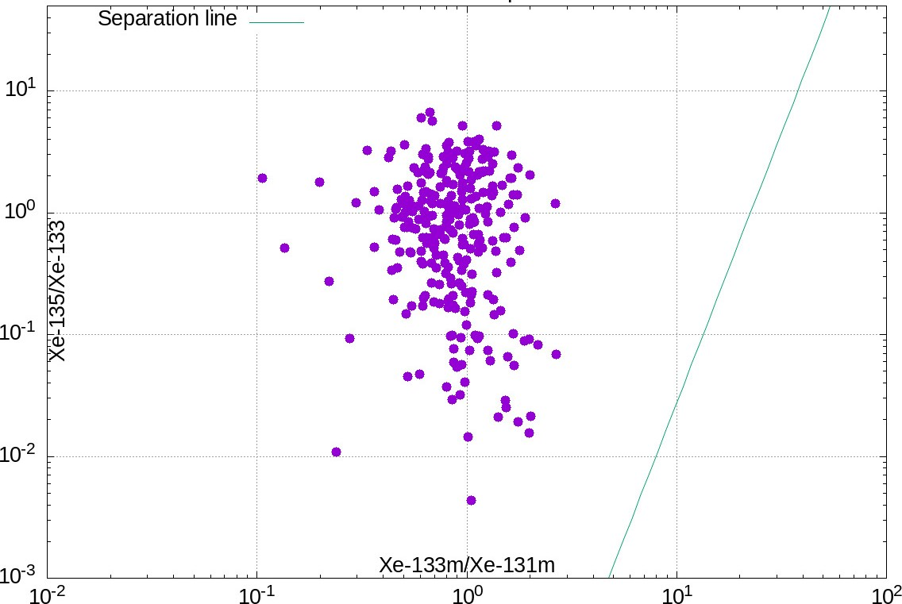
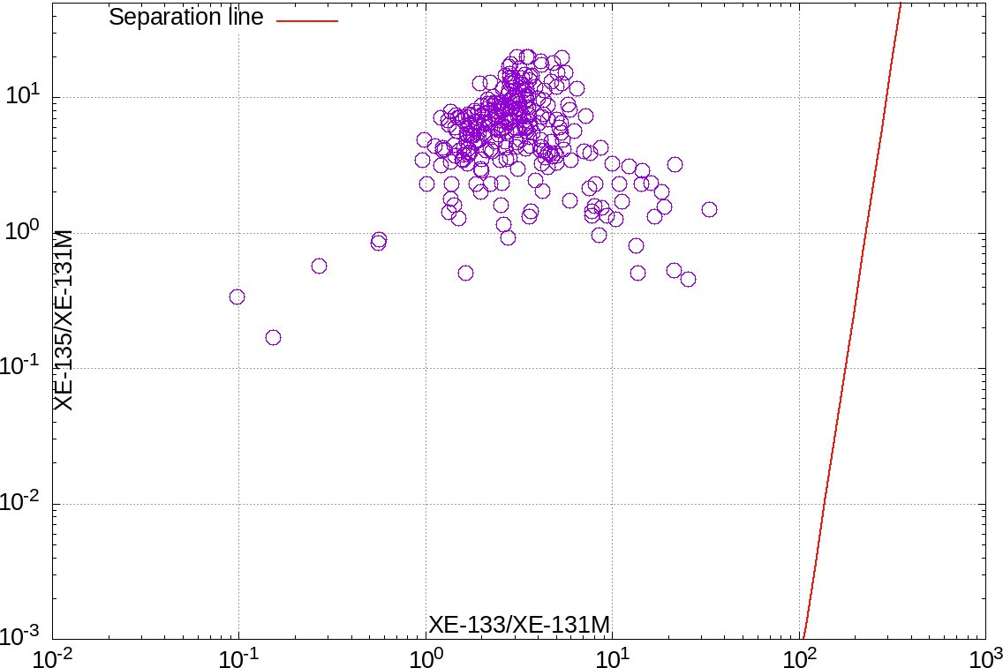
Xenon isotopic ratio
Xenon isotopic ratios are calculated and the separation line between the nuclear explosion regime and civil regime is drawn according to Kalinowski^{1,2}.
Please do not use this space, a QR code will be automatically overlayed
P2.4-358

Slide 8
Conclusion
The global distribution of the Xe isotopes depending on data measured by the IMS noble gas stations from 2013 to 2022 was studied.
Almost 40% of the measured samples have at least one Xe isotope detection.
Almost all of the radioxenon detections in the IMS come from industrial nuclear facilities.
The geographical distribution of the median value of Xe-133 concentration is consistent with the distribution of nuclear facilities (NPP, and MIPF).
The ratios between different Xe isotopes were analyzed, drawn and compared to the separation line between the nuclear explosion regime and civil regime. No alarm events were found in the analyzed data.
Please do not use this space, a QR code will be automatically overlayed
P2.4-358

Slide 9
References
M. B. Kalinowski and C. Pistner. Isotopic signature of atmospheric xenon released from light water reactors. Journal of Environmental Radioactivity, 88 (3): 215-235, 2006.
M. B. Kalinowski and et al. Discrimination of Nuclear Explosions against Civilian Sources Based on Atmospheric Xenon Isotopic Activity Ratios. Pure and Applied Geophysics, 167, (4-5):517–539, 2010.
Please do not use this space, a QR code will be automatically overlayed
P2.4-358

